Slide 1
UN/LOCODE on Confluence
UN/LOCODE Secretariat
June, 2016

Slide 2
In this presentation
UN/CEAFCT Confluence Overview
UN/LOCODE Space Design
UN/LOCODE Space Access Control Policy
Q & A

Slide 3
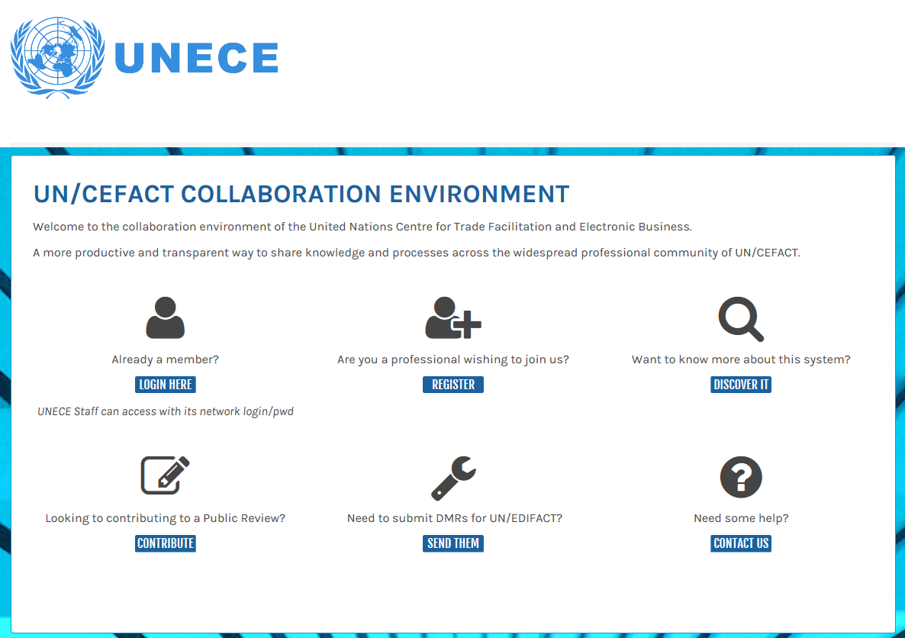
UN/CEFACT Confluence Overview
http: //www2.unece.org/cefact

Slide 4
UN/CEFACT Confluence Overview
How to access?
Not-yet-registered-as-a-UN/CEFACT-expert
Already-a-UN/CEFACT-expert-but-not-yet-register-in-Confluence
Already-registered

Slide 5
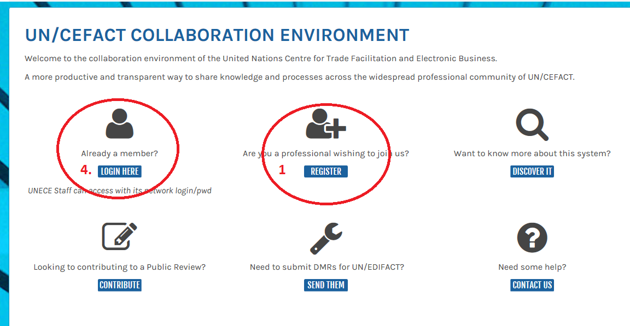
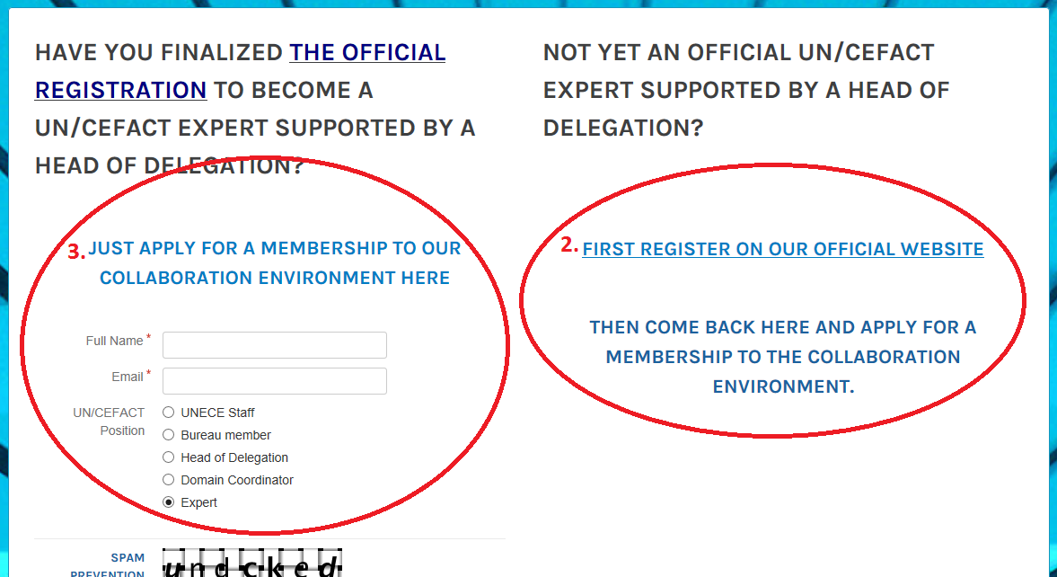
UN/CEFACT Confluence Overview
Click ‘REGISTER’ to open registration page
Click ‘FIRST REGISTER ON OUR OFFICIAL WEBSITE’ to fill in ‘UN/CEFACT Participant Registration Form’ for HoD’s approval
Fill in fields under ‘JUST APPLY FOR A MEMBERSHIP TO OUR COLLABORATION ENVIRONMENT HERE’ and then click the button ‘Submit’
Click ‘LOGIN HERE’

Slide 6





UN/CEFACT Confluence Overview
Not-yet-registered-as-a-UN/CEFACT-expert | Already-a-UN/CEFACT-expert-but-not-yet-register-in-Confluence | Already-registered

Slide 7
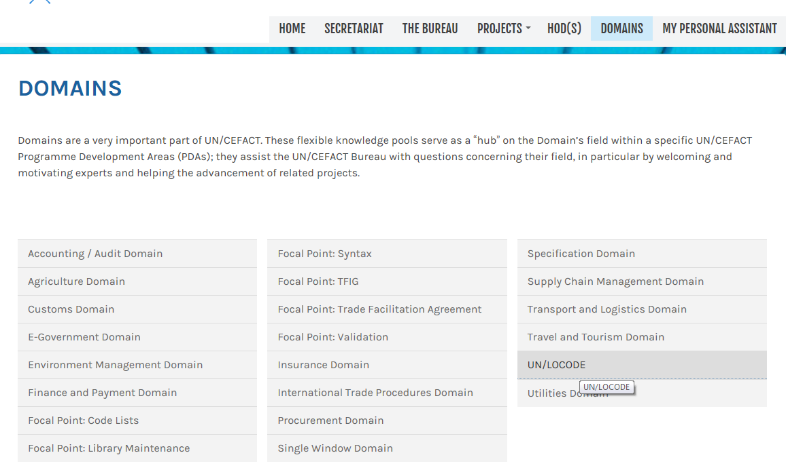
UN/CEFACT Confluence Overview

Slide 8
UN/LOCODE Space Design
UN/LOCODE Knowledge Sharing Space
Focal Point Network ?
Maintenance Group
User Community
Training Materials
Technical Guide
Training Presentation
Study Case
Activities
Feasibility Study
…
Meeting Minutes
Decisions
Document Repository
Conference report
List of Participants
Recommendation
Children Coding System Repository
Forum

Slide 9

UN/LOCODE Space Access Control
Feasibility study
The secretariat | Lead Editors | Editors
Full | Edit | Read, Comment

Slide 10

Q & A

Slide 11


