Slide 1
TFWA Support to NTFC
NTFC Maturity Model: Building sustainable consultation and coordination platforms
06 Oct. 2020

Slide 2
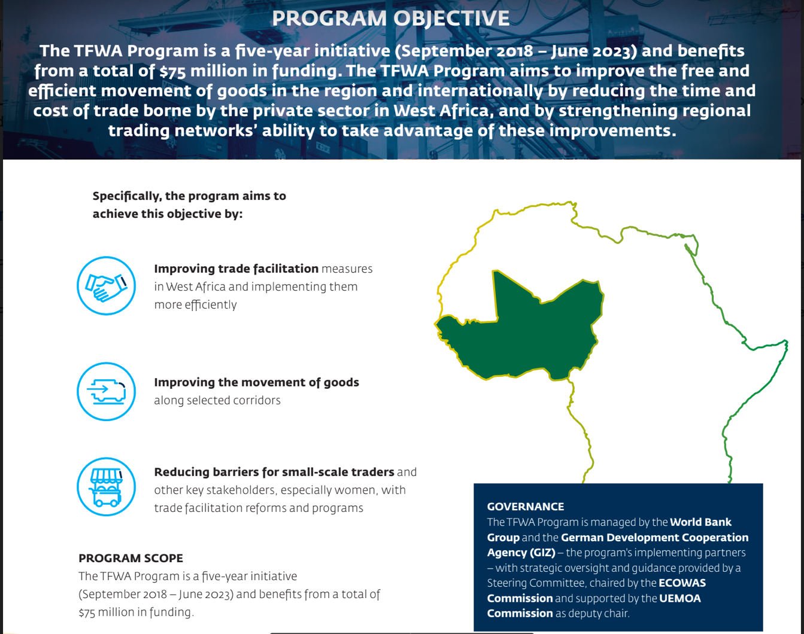


Slide 3
TFWA NTFC Maturity Model
Practical approach to build the NTFCs’ level of capacity
LEVEL 1
LEVEL 2
LEVEL 3
LEVEL 4

Slide 4
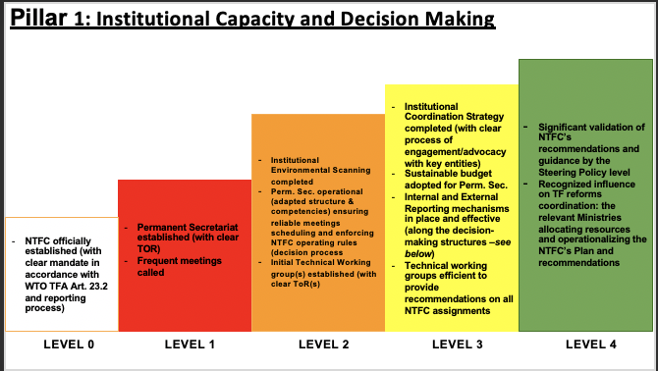
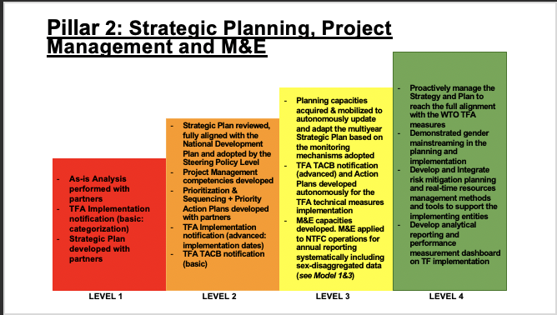
3 ENABLING PILLARS
Sequencing Sustainability
Institutional Capacity and Decision Making
Strategic Planning, Project Management and M&E
Consultation and Inclusiveness
The ability to operationalize an efficient institutional framework to advocate relevant technical recommendations and effectively influence the government reform agenda related to cross-border trade.
The ability to plan, monitor and evaluate the execution and implementation of sustainable TF measures ensuring strategic alignment and operational coherence through a result-based approach.
The ability to integrate inclusive participatory processes to the TF policy-making to guarantee institutional efficiency and accountability

Slide 5
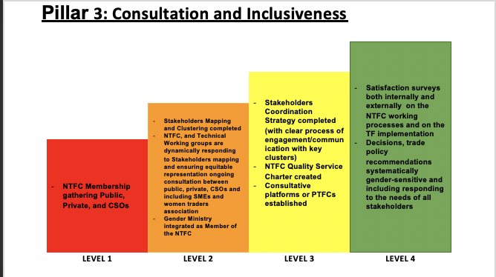
3 ENABLING PILLARS
Competencies
Sequencing Sustainability
Outcomes
KPIs
Institutional Capacity and Decision Making
Strategic Planning, Project Management and M&E
Consultation and Inclusiveness
The ability to operationalize an efficient institutional framework to advocate relevant technical recommendations and effectively influence the government reform agenda related to cross-border trade.
The ability to plan, monitor and evaluate the execution and implementation of sustainable TF measures ensuring strategic alignment and operational coherence through a result-based approach.
The ability to integrate inclusive participatory processes to the TF policy-making to guarantee institutional efficiency and accountability

Slide 6
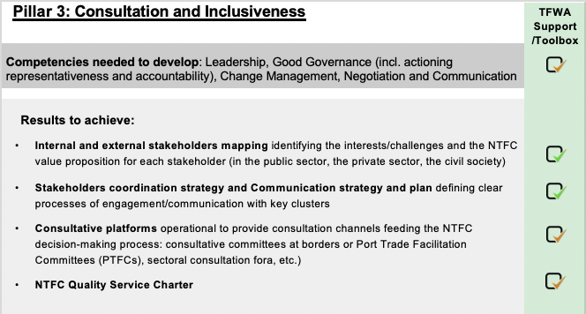
COMPETENCY FRAMEWORK & TFWA TOOLBOX
Integrated process with Institutional Framework and Decision-making Pillar

Slide 7
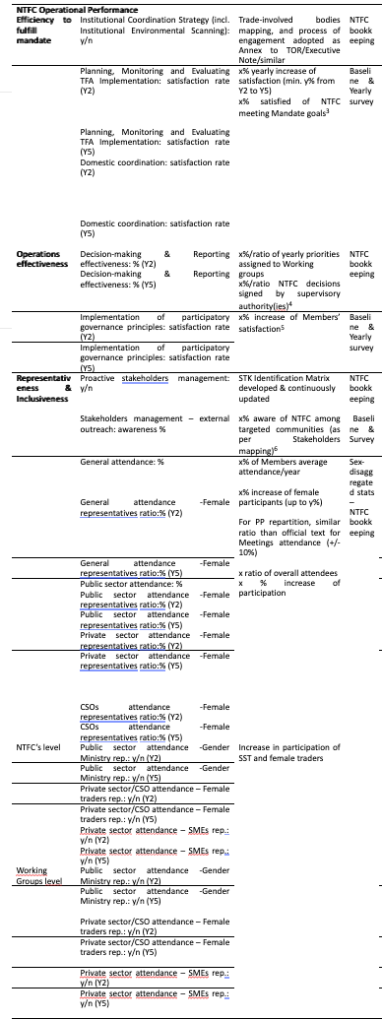
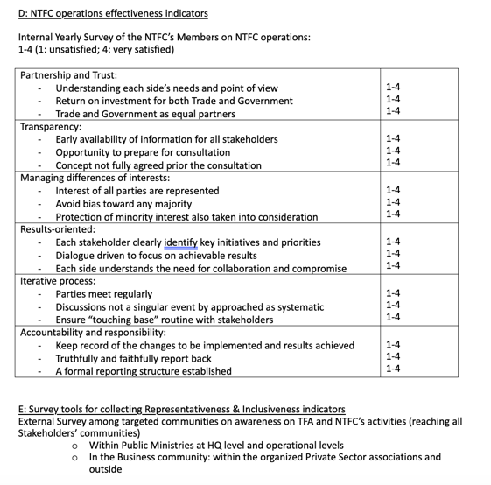
Measuring Consultation & inclusiveness
Maturity M&E Toolbox
Measurement in practice
  NTFC M&E Working Group
  Indicators & Progression rate
  Survey / Assessment tools
M&E Workshop & WG ToR
Indicators set
360° Surveys

Slide 8
Implementing Consultation & inclusiveness
Partnership and Trust: Understanding each side’s needs and point of view Return on investment for both Trade and Government Trade and Government as equal partners
Transparency: Early availability of information for all stakeholders Opportunity to prepare for consultation Concept not fully agreed prior the consultation
Managing differences of interests: Interest of all parties are represented Avoid bias toward any majority Protection of minority interest also taken into consideration
Results-oriented: Each stakeholder clearly identify key initiatives and priorities Dialogue driven to focus on achievable results Each side understands the need for collaboration and compromise
Iterative process: Parties meet regularly Discussions not a singular event by approached as systematic Ensure “touching base” routine with stakeholders
Accountability and responsibility: Keep record of the changes to be implemented and results achieved Truthfully and faithfully report back A formal reporting structure established
Competency Framework
Competency Dictionary
Learning Paths
  Per Profiles
  Per Maturity Levels
Training Catalogue and Repository

Slide 9
Foundational elements
Regional coherence
Sustainability of reforms
Accountability & inclusiveness
Regional integration
RTFC
Customized Support to all 15 NTFCs
ECOWAS – UEMOA Strategy –Mechanisms – Repository – Online platform
Local relays
Complementary approach
Support to PS structuring efforts
Advocacy competencies for SSCBTs
Gender mainstreaming

Slide 10
Many thanks

