Slide 1
6 October 2020
The National Committee on Trade Facilitation (NCTF) of Norway
Norwegian Customs, Norway

Slide 2
Legal basis for the Norwegian NCTF
The Act on Customs Duties and Movement of Goods (Customs Act) Section 12-16
Regulations to the Act on Customs Duties and Movement of Goods (Customs Regulations):
  Section 12-16-1 Consultations between border agencies and the business community

Slide 3
Delegated powers
From the Parliament to
  Ministry of Foreign Affairs and
  Ministry of Finance
Mandate settled on ministerial level
Implementation of Article 23.2 of the TFA is delegated to the Norwegian Customs:
The Committee is chaired by the Norwegian Customs
The Norwegian Customs also perform the Secretariat function

Slide 4
Structure
The Norwegian NCTF meets two times per year, preferably a short time before the WTO meetings.
NCTF acts as the general coordinating body for TF issues.
Working groups (sub-groups):
Continuation of former, separately operated, groups e.g.
  Development of new customs procedures
  IT communication (declarations)
New groups are formed to take care of specific issues, e.g.
  Revision of the customs legislation
  Rules of origin: Regional FTAs and GSP issues

Slide 5
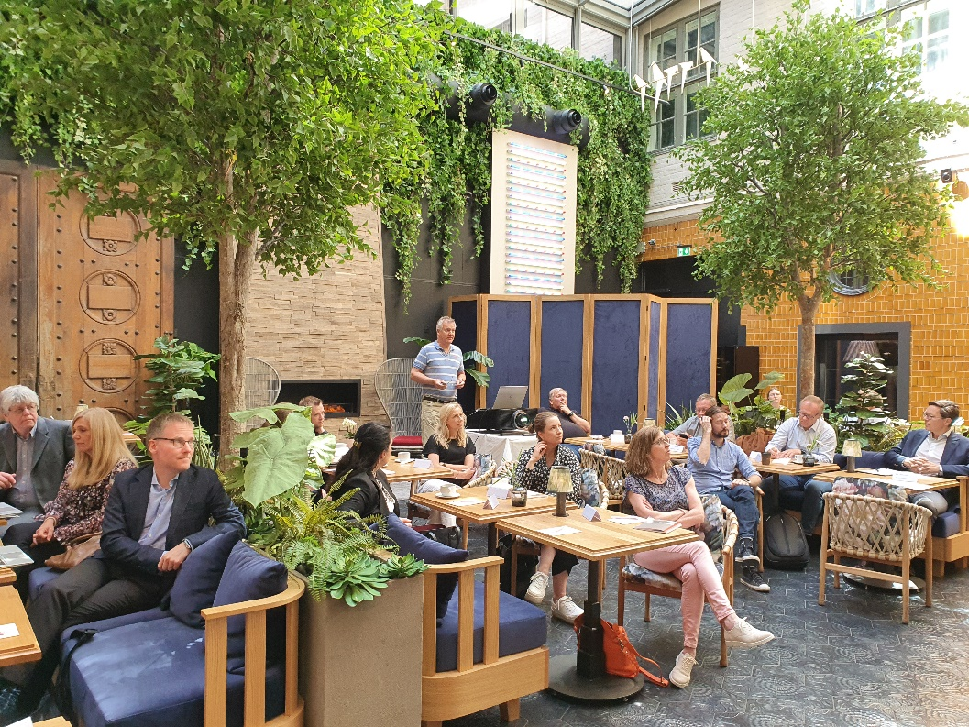
Governmental participants
Broad participation from relevant ministries:
Ministry of Foreign affairs
Ministry of Finance
Ministry of Trade, Industry and Fisheries
Ministry of Agriculture and Food
Ministry of Justice and Public Security
Ministry of Transport
Ministry of Culture
Ministry of Health and Care Services
and their agencies, e.g.:
Statistics Norway
Innovation Norway
Norwegian Agriculture Agency
Norwegian Food Safety Authority
Norwegian Medicines Agency
Norwegian Police Service
Norwegian National Security Authority

Slide 6
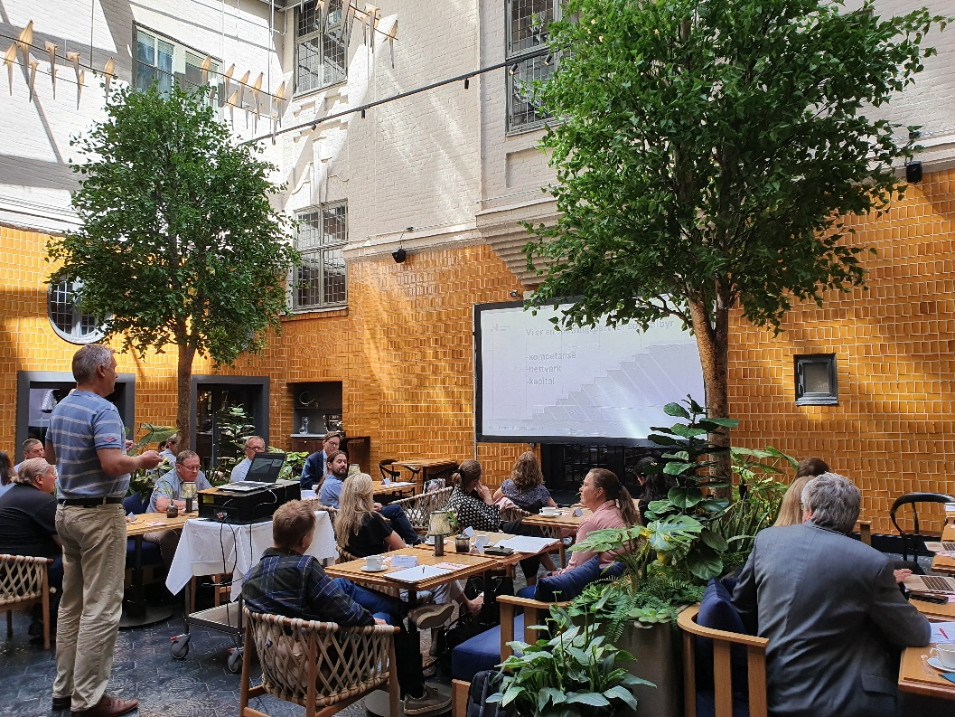
Business participants
Representative Business Organisations:
The Confederation of Norwegian Enterprise and affiliated organizations
The Enterprise Federation of Norway (Virke)
Logistics and Transport Companies Association
Norwegian Industry Association
Norwegian Seafood Federation
Norwegian Truckowners Association
Norwegian Shipowners Association
Chambers of Commerce
Norstella – Network for trade, industry, transport and service
Norwegian Association of SMEs
Companies with special challenges, e.g.
  Norwegian Postal Service
  Large importers/exporters with their own customs department

Slide 7
Major elements in the mandate
Surveillance of the coordination and implementation of TFA in Norway:
“Shall” obligations, as well as
“Endeavour” obligations etc.
Removal of unnecessary obstacles to the flow of goods by importation, exportation or transit
Assessment of Norwegian Exporters’ offensive interests
Support cooperation and development in international fora
WTO, WCO, OECD, ICAO, IMO, UNECE
Regional FTAs
Identify needs in developing countries for technical assistance to implement TF measures

Slide 8
Some issues addressed in the NCTF
Improve the dialogue between business and border agencies
Reorganization of Norwegian Customs
Development of a system for immediate clearance of goods at the border
Improve routines for post, courier dispatchments etc. with many consignees
Simplify document checks for repetitive situations (ref. risk management)
Improve statistical information for means of transport
Use ANPR (Automatic Number Plate Recognition) to allow for goods to pass through unmanned border crossings in remote areas
Tools and services for supporting Norwegian exporters
Impact of «brexit» for operators

Slide 9
Challenges
Acceptance of the NCTF as the main channel for the dialogue between business and government
Defining and structuring issues in the right fora and formats
Some agencies and business structures have specific or limited interests in the NCTF, which nevertheless may be important
  E.g. SMEs, postal or rail services, traders in medicines etc.
Engaging the most relevant representatives to address a large variation of needs and interests

Slide 10
Experiences
Useful tool for networking
Useful forum for sharing information on important issues, e.g. organizational and legal development
Some issues that would not have been raised elsewhere are discussed in the committee
Knowledge concerning developments in international trade is updated for all parties

Slide 11
Thank you for your attention!
Visit us at www.toll.no/en/corporate

