Slide 1

UN-CEFACT 35th Forum
Webinar: Engaging private sector in National Trade Facilitation Bodies
What works and what does not work?
Poul Hansen
Chief, Trade Facilitation
UNCTAD
6 October 2020

Slide 2
WTO TFA Art. 23.2
Each Member shall establish and/or maintain a national committee on trade facilitation or designate an existing mechanism to facilitate both domestic coordination and implementation of provisions of this Agreement.
WTO TFA Art. 2
Art.2.1. Each Member shall, to the extent practicable and in a manner consistent with its domestic law and legal system, provide opportunities and an appropriate time period to traders and other interested parties to comment on the proposed introduction or amendment of laws and regulations of general application
Art. 2.2. Each Member shall, as appropriate, provide for regular consultations between its border agencies and traders or other stakeholders located within its territory..

Slide 3

What does the private sector want from trade facilitation?
Reform
Predictability
Reduced cost
Facilitated connectivity
Have a say
Results

Slide 4






How to achieve trade facilitation reform?
Trade facilitation approaches
Transparency
Simplification
Standardization
Harmonization
Key principles for implementation
Modernization
Collaboration between
public and private sectors

Slide 5
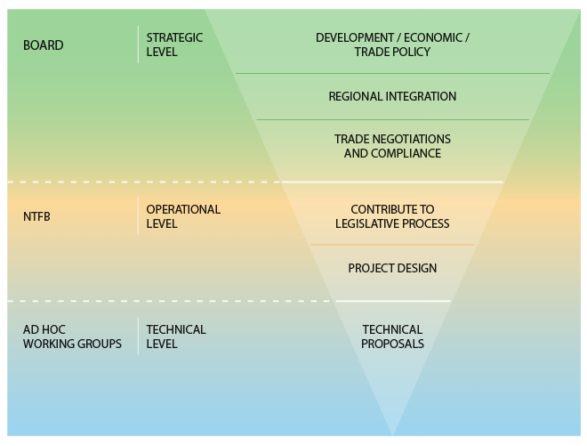
NTFC, structure and organization
Political leadership and champion
Private sector involvement
Joint chair
Structure and committee alignment
Sustainable secretariat
Private sector contribution and commitment, all levels
Result oriented, work plans etc.
Consultation, validation

Slide 6

Private sector in NTFC, how to engage?
Speak a with unified voice, be organized
Cover all areas of the private sector, represent sub-sectors views
Focus on policy and process issues, not individual cases
Be ambitious, but realistic
Be constructive and engaged, provide solutions, don’t only complain
Select representatives that are respected, assertive, collaborative and knowledgeable
Provide facts and data, not hearsay
Adopt a Public-Private-Partnership approach, support the NTFC Secretariat,
Sustain participation and support
Make use of resources and good practices from the international business sector
?

Slide 7

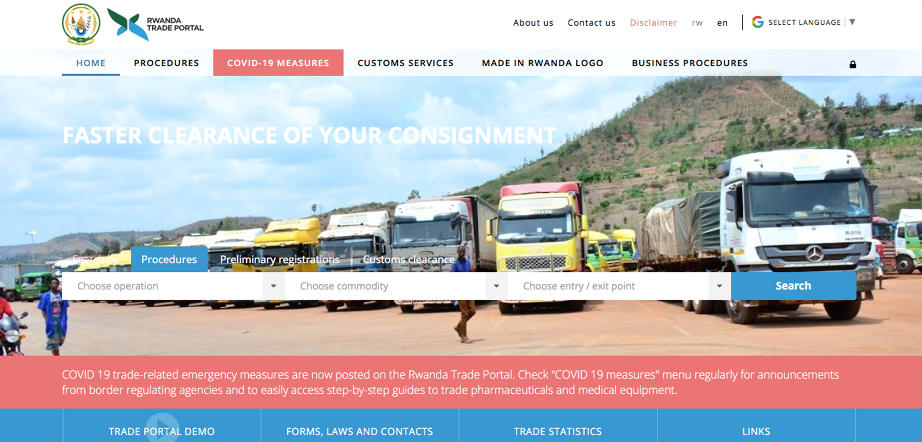

UNCTAD support for NTFC
http://unctad.org/tfcommittees
http://tradeportal.eregulations.org
https://asycuda.org/en/

Slide 8
Thank you for your attention
https://unctad.org/en/Pages/DTL/TTL/Trade-Facilitation.asp
Poul.Hansen@unctad.org

