Slide 1
Welcome to SMDG
Michael Schröder
Hapag-Lloyd AG, Hamburg
michael.schroeder@hlag.com

Slide 2
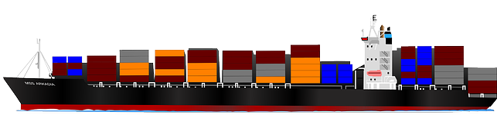
SMDG is a non-profit foundation, run by and on behalf of companies and organizations working in the maritime industry, like container terminals, ocean carriers and related companies and organizations
SMDG develops, maintains and promotes
the use of EDI messages for the maritime industry

Slide 3
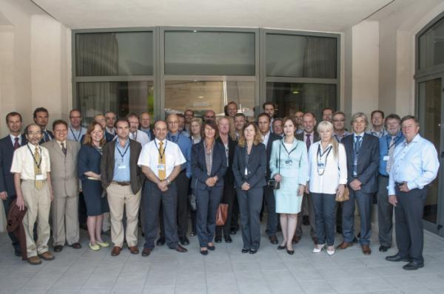
66th SMDG Meeting in Malta
The SMDG plenary meetings are held twice yearly in April and October.
Interim meetings are held by the working groups via conference calls.

Slide 4
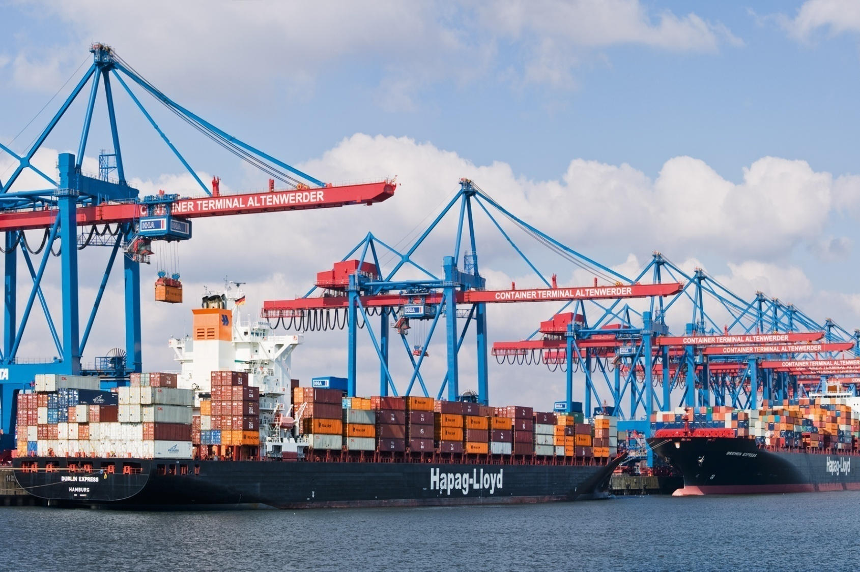
SMDG stakeholders
Terminal Operator
Vessel Operator
Container Operators
+ Software Providers +

Slide 5


Since 1987 SMDG develops and promotes UN/EDIFACT EDI-messages for the Maritime Industry and is an official Pan European User Group, recognised by the UN/CEFACT body
Message structures essential to the use of electronic commerce in the transport sector have been agreed and approved by the relevant United Nations and local authorities, have been implemented by various communities around the world over the past 20+ years.
SMDG documentation can be downloaded by any interested party free-of-charge from the SMDG website: www.smdg.org

Slide 6
SMDG is responsible for the development of the following UN/EDIFACT messages
BAPLIE | Bayplan Message - position of containers on a ship
MOVINS | Move Instruction Message (for Stowage)
TANSTA | Tank Status Message
TPFREP | Terminal Performance Report
VESDEP | Vessel Departure Message
COPRAR | Container Discharge and Loading List
COARRI | Container Discharge and Loading Confirmation
CODECO | Container Delivery Confirmation (Gate Moves)
COPARN | Container Pre-Announcement and Release Notice
COPINO | Container Pick-Up Notification
COREOR | Container Release Order
INVOIC | Freight Cost and other Charges (e.g. invoice from a terminal)
IFTSAI | Vessel Schedule
IFTSTA | Status Message
IFTMBF | Booking Firm (only for DG Bookings between shipping lines)
SHPDAT | Ship Technical Data Message (under construction)
VERMAS | Verified Gross Mass (new in 2015)

Slide 7
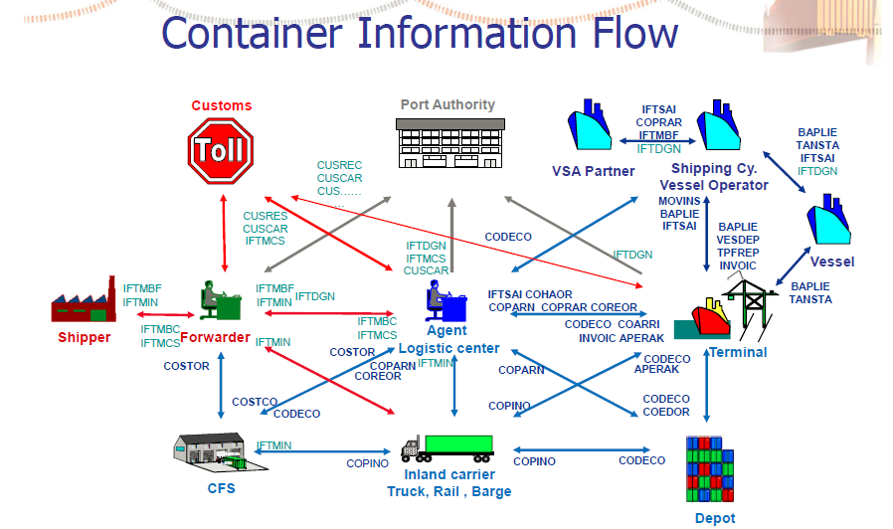

Slide 8
SHIPPER = CUSTOMER
CARRIER
= CONTR. OPERATOR
= PARTNER LINE
VESSEL OPERATOR
Typical use of messages from booking to loading
TERMINAL
Not in SMDG scope
Transport
Order
Booking
Confirmation
Documentation B/L
Container
Tracing
Container
Tracing
IFTSTA
VESSEL
IFTSTA
IFTMBC
provide Doc
IFTMBF
IFTMIN
Booking
Shipping
Instruction
Container
Tracking
Load Order
Summary
Container
Tracking
CODECO
COARRI
Container stuffed
Vessel Arrival
Container
Tracking
Container
Tracking
Booking
Load Order
Summary
Ship Planning
CODECO
COARRI
COPARN
COPARN
COPRAR
COPRAR
MOVINS
Pre-Advice
Pre-Advice
Gate-In
Full
Gate-In
Full
Load List
Stowage Plan
Load
Full
Load
Full
Container arrives at Gate
BAPLIE
Provisional Stowage Plan
In SMDG scope

Slide 9
The way to standardisation
Start
Submit official DMRs to
UN/CEFACT Secretary
Prepare draft DMRs for the message structure and codes/qualifiers
Propose to SMDG Plenary
Assessed by Methodology & Technology PDA
EDIFACT: Syntax Focal Point
ebXML: Library Maintenance Focal Point
Rejected
Assessed by SMDG
Added into the UNTDID
Not added into the UNTDID
Approved
Approved
Rejected
Propose to T&L Domain Group
Rejected
Assessed by T&L Domain Group
Approved
End

Slide 10
Recent standardisation projects
BAPLIE 3.0
Major redesign for the “flagship message” incorporating all the open requirements of the past 15 years.
VGM and VERMAS
Upgrade the BAPLIE and all Coxxxx Container Messages (old and new versions) for VGM reporting . In addition develop a completely new message type VERMAS.
IFTSAI Vessel Schedule
Enhancements for reporting from Barge operator to terminal
IFTMBF for exchange of DG bookings between shipping lines
SMDG has assumed responsibility for this special variant of the IFTMBF and published the MIG on our website

Slide 11

Next projects in the pipeline
Message Validation Portal
Offer an online tool for validation of an Edifact message with immediate
error report. Service development in cooperatoin with Gefeg.
MOVINS (Stowage Move Instruction)
Major redesign, in line with BAPLIE 3.0 - MOVINS and BAPLIE go hand in hand in the stowage planning process
TANSTA (Tank Status Message)
Redesign is required by shipping lines and software vendors.
TPFREP (Terminal Performance Report)
Long wish list from the carriers awaiting development of version 4.1
“Noon Report”
Discuss an electronic transmission format. Each vessel sends a daily noon report to its vessel operator, giving details about speed, course, fuel consumption, ETA adjustment etc. Currently sent in individual formats.

Slide 12
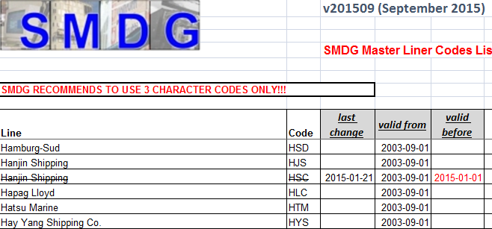
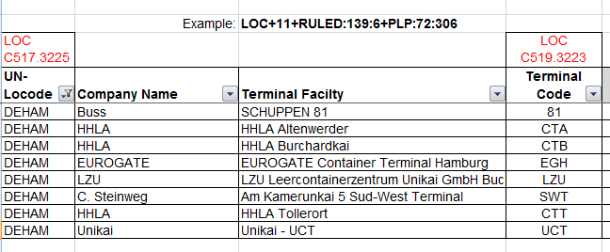
SMDG Code lists
The code lists are maintained and published by the SMDG and are widely recognized
Master Liner codes =
vessel operator codes
Terminal codes =
more detailed level than port locode
Smaller code lists developed along with BAPLIE 3 e.g. Handling Codes

Slide 13
SMDG Recommendations
The recommendations for standardization requirements that are not otherwise covered are widely recognized:
Tier numbering = How to define stow positions for vessels with more than 9 tiers on deck
that are not covered by ISO9711
Containers with non-ISO ID = How to handle a container number without alpha-prefix

Slide 14





Liaison with standardisation and other organisations
UN/CEFACT
Good cooperation in many standardisation initiatives
PROTECT publishes the IFTDGN, WASDIS and BERMAN messages
UNECE
UN-Locode directory
ANSI X.12
could be more intense
ISO9711 stow position
and ISO6346 container size/type. Cooperation could be closer
Future validation portal
INTTRA would development MIGs for IFTMBF and IFTMIN enhanced for VGM reporting
PCS
Various PCS using our messages

Slide 15



SMDG Office Holders
Simon Spoormaker
SMDG Chairman
Gerry Endenburg
Copas
Secretary General
Contact us at www.smdg.org
or come to our meetings!

