Slide 1
VERMAS Work Session
UN/CEFACT 27th Forum
“Mini-Conference on electronic maritime safety regulatory information exchange standards”
26th April 2016, Geneva
Michael Schröder
Hapag-Lloyd AG, Hamburg, Germany
michael.schroeder@hlag.com

Slide 2
VGM / VERMAS
In this presentation
New SOLAS amendment and IMO guidelines
Business requirements – Shipper, Forwarder, Carrier, Terminal
Existing Edifact messages
New VERMAS message: Use cases
New message: Final structure, data elements
Time line – Next steps

Slide 3

VGM / VERMAS
What is SOLAS?
The SOLAS Convention (Safety of Life at Sea) is maintained by the IMO (International Maritime Organization) as a UN agency.
It is an UN international treaty concerning the safety of merchant ships.
SOLAS has been in place for many decades and is well known at carriers, terminals and ports.
The SOLAS Convention has been ratified by 162 contracting states. SOLAS represents 99% of the tonnage of the global merchant fleet.
It applies to ships flying the flag of a SOLAS country.
The SOLAS Convention is Binding International Law.
The SOLAS amendment requires in chapter VI, part A, regulation 2 that packed containers’ gross mass are verified prior to stowage aboard ship.
With the VGM Verified Gross Mass regulation, SOLAS for the first time reaches
out to the shipper of a container. Effective date is 1st July 2016.

Slide 4
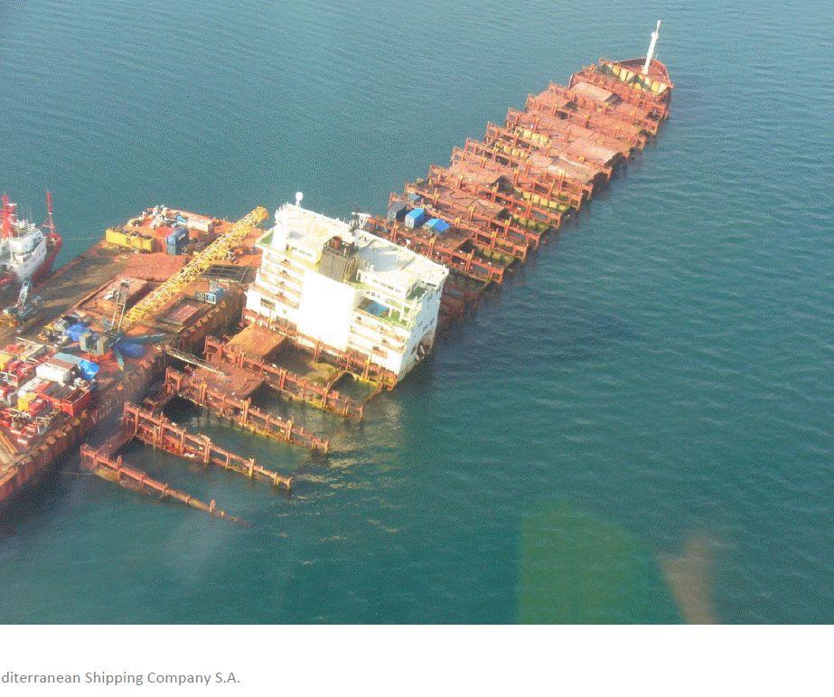
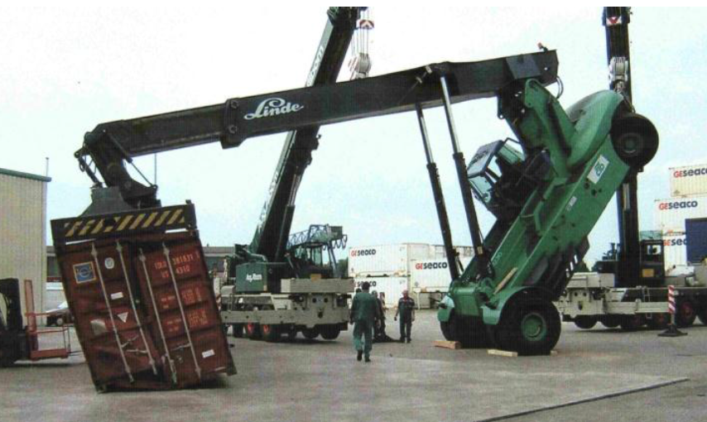
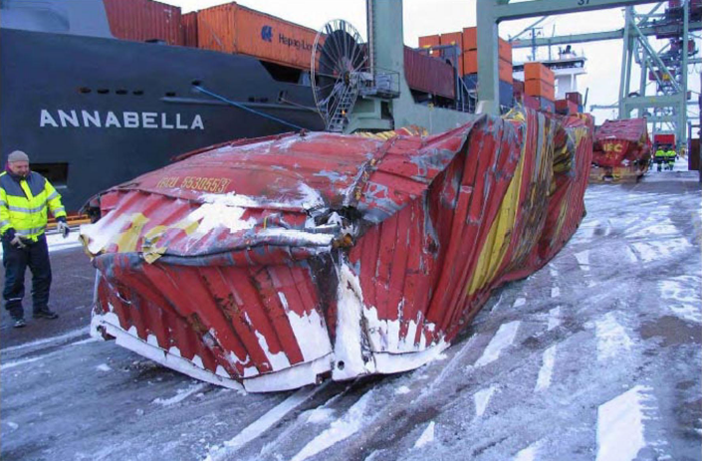
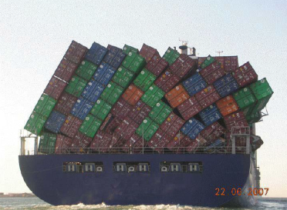
VGM / VERMAS
Why is the new SOLAS regulation needed?
For many containers, too many, the actual gross weight is higher than the declared gross weight. The problems resulting from mis-declared container weights include the following:
Damage to ships and terminal equipment
Stability risks for ships
Risk of personal injury to seafarers and shoreside workers
Collapsed container stacks
Containers lost overboard (both those overweight and containers that were not overweight)
MSC NAPOLI in 2007

Slide 5
VGM / VERMAS
Why is the new SOLAS regulation needed? Example MSC NAPOLI in 2007
A major incident at sea caused by many overweight containers.
This was the actual starting point for discussing stricter rules on container weight declaration.

Slide 6
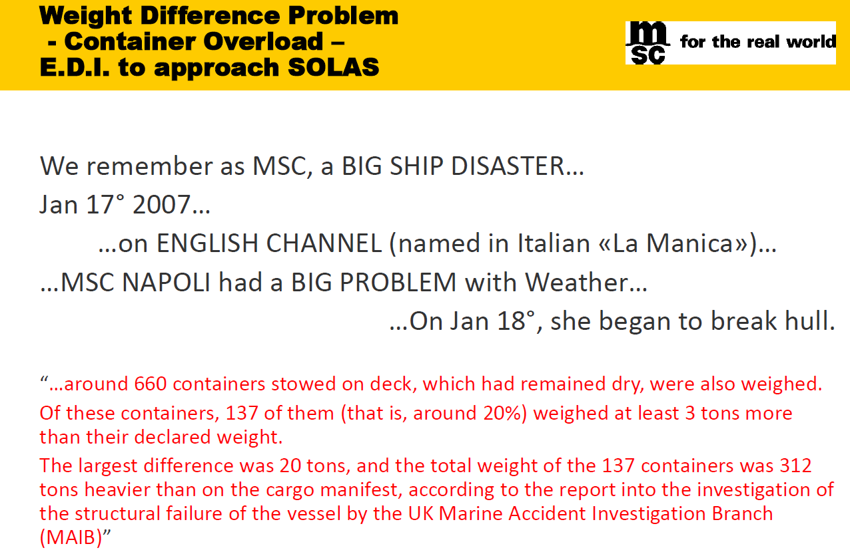
VGM / VERMAS
Why is the new SOLAS regulation needed? Example MSC NAPOLI in 2007

Slide 7
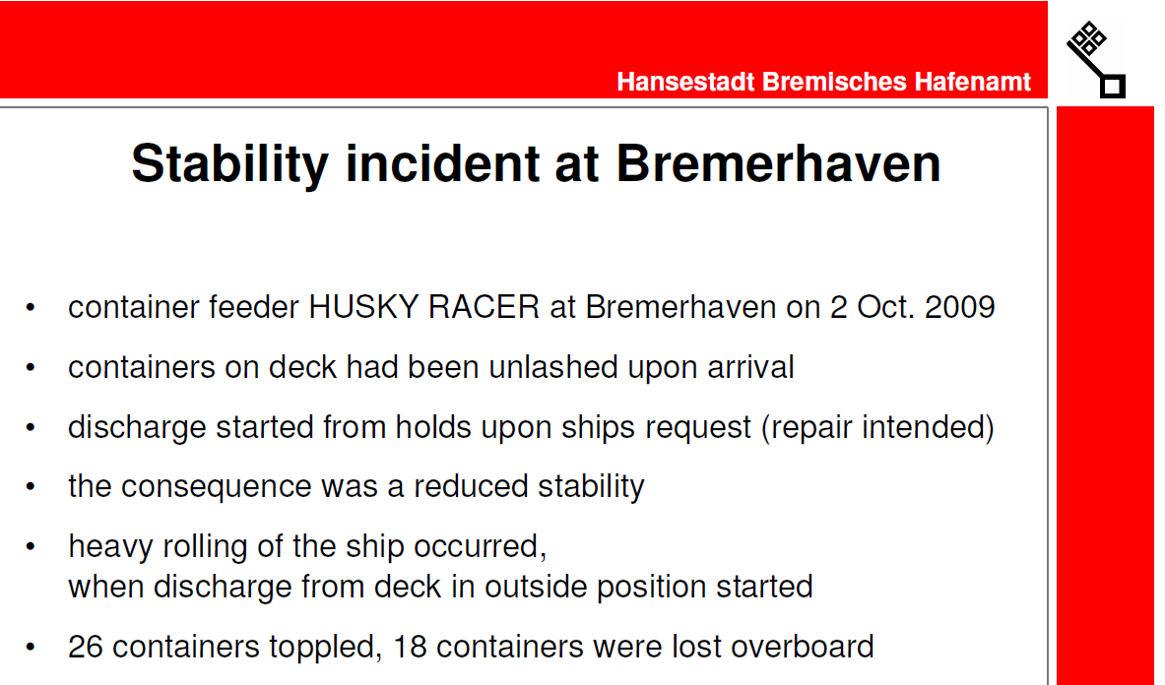
VGM / VERMAS
Why is the new SOLAS regulation needed? Example HUSKY RACER

Slide 8
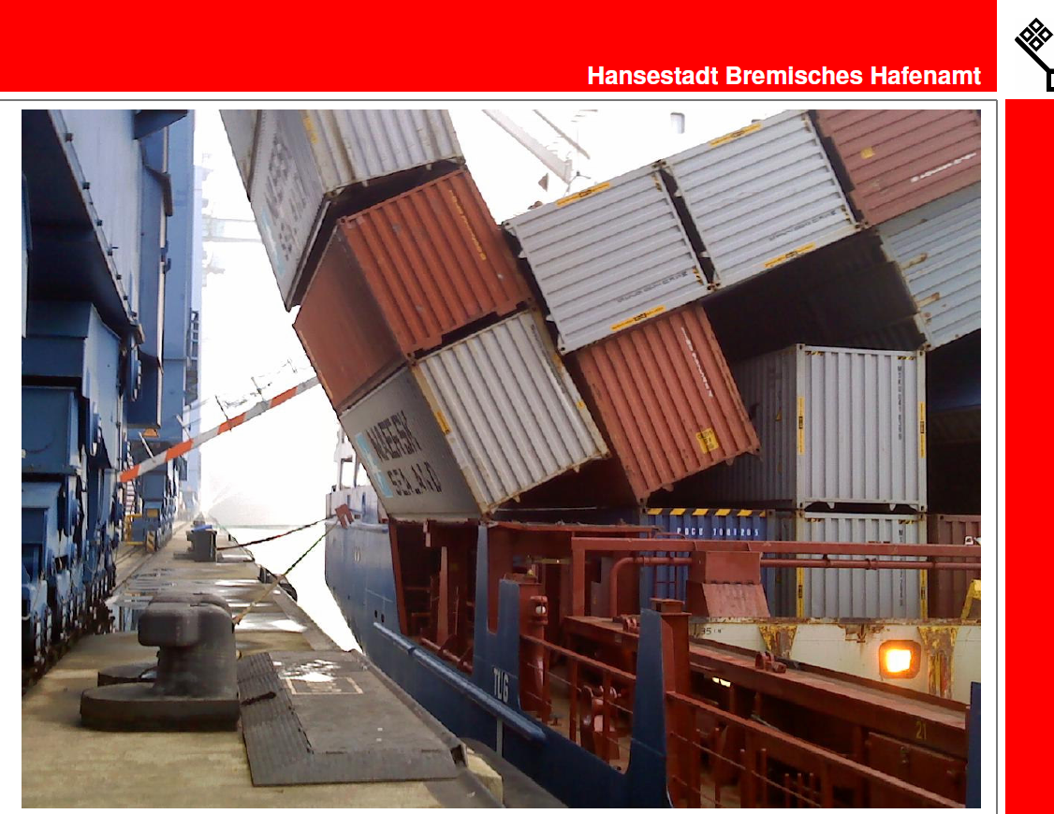
VGM / VERMAS
Why is the new SOLAS regulation needed? Example HUSKY RACER

Slide 9
VGM / VERMAS
Why is the new SOLAS regulation needed? Example single overweight container
Smaller incidents with overweight containers happen too often in daily port operations work around the world.
Each incident puts human life at danger and disrupts the supply chain.

Slide 10

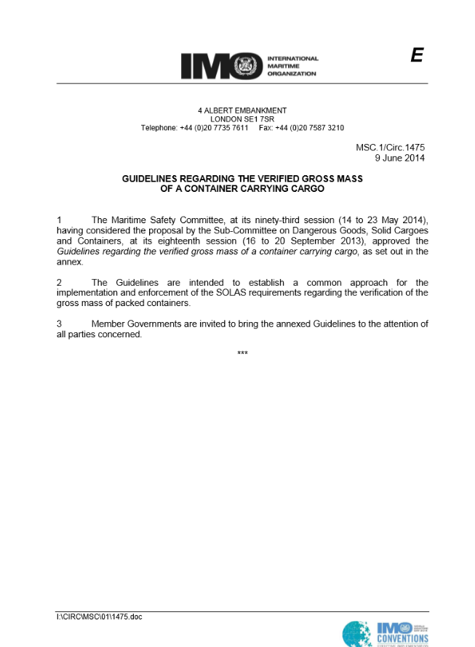
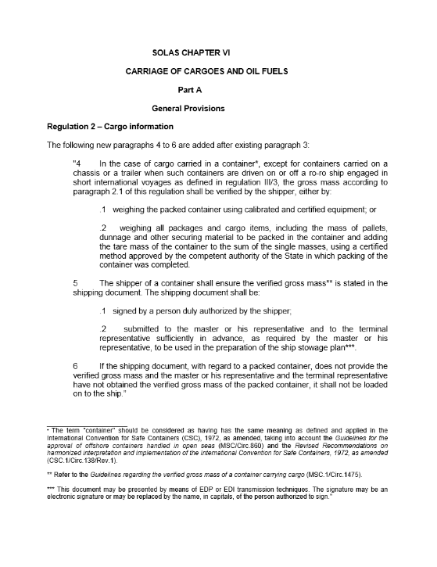
VGM / VERMAS
Is the SOLAS VGM regulation valid without National Legislation?
The SOLAS Convention is Binding International Law
in each of the 162 signatory states, even
without national legislation.
The VGM reporting requirements are clearly described
in the IMO guidelines MSC.1/Circ.1475 and must be followed.
The typical flow is: Shipper ➔ Carrier ➔ Terminal.
Carrier and Terminal have a joint responsibility to ensure
that a container without VGM is not loaded.
A national legislation would clarify the following items:
  How can the shipper become certified for method 2?
  Which is the competent authority for that certification?
  Which weight tolerance is allowed by the authority in case of re-weighing?
  What happens in case of violation?
The legislation will not clarify the time or deadline when the VGM must be reported. This has to be an operational agreement with the carrier.
Additional information can be found on:
http://www.worldshipping.org/industry-issues/safety/cargo-weight

Slide 11
VGM / VERMAS
Requirements and consequences of the IMO Guidelines on VGM
The Shipper on the ocean carrier’s B/L is responsible for providing a Verified Gross Mass (VGM) for each full container.
He may decide between two methods: 1) to weigh the packed container or 2) to add the weight of all cargo items plus the weight of the packing material plus the tare weight of the container.
The VGM can only be determined for a completely packed container.
The shipper may delegate the actual procedure of obtaining the VGM to a 3rd party, for example a forwarder or a weighing facility. This does not release the shipper from his responsibility according to 1 above.
The carrier and the terminal have a joint responsibility to ensure that a packed container is not loaded on a SOLAS ocean vessel if there is no VGM available.
The vessel command must not accept a packed container on board until they have been informed about its VGM.
The VGM is part of shipping documents. Besides the weight itself, the name of the person duly authorized by the Shipper must be transmitted to the carrier.
A container status may change from “VGM not available” to “VGM available”.
An existing VGM may be revised by means of EDI messages.
EDI messages must be able to distinguish “VGM” and “gross mass without verification”.
The typical reporting chains is: Shipper ➔ Carrier ➔ Terminal ➔ Vessel
but different variants are possible.

Slide 12
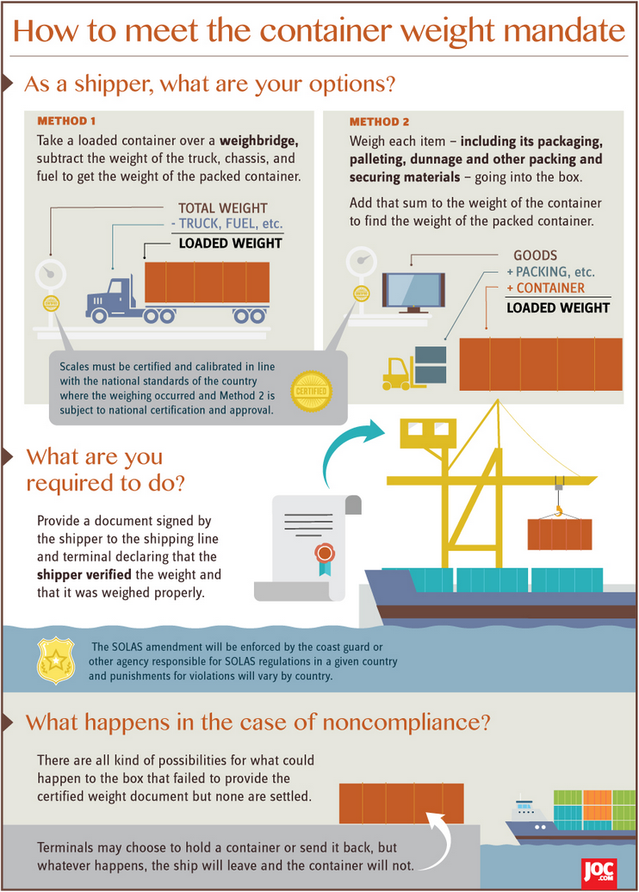
VGM / VERMAS
What is required from the Shipper?
The requirements are laid down in the IMO guidelines . They become effective on 1st July 2016
The Shipper is responsible for providing a Verified Gross Mass (VGM) for each full container.
He may decide between two methods: 1) to weigh the packed container or 2) to add the weight of all cargo items plus the weight of the packing material plus the tare weight of the container.
The VGM is part of shipping documents. In a paper world, it would be signed by a person duly authorized by the Shipper. In our electronic world it is sufficient to transmit the full name of the authorized person in capital letters
replacing the signature.
The VGM document must be provided to the carrier and to the terminal in time to be used for the ship stowage planning.
No VGM – No Load.
© JOC.com
page 8

Slide 13
VGM / VERMAS
Who will report the VGM to the carrier?
The happy flow
The real world
The shipper on the ocean carrier’s bill of lading is the responsible party to provide the VGM to the carrier. He can delegate the actual reporting, but he has to ensure that the process works.
A person duly authorized by the shipper must sign the (electronic) document. This person can belong to another company than the shipper, for example to a forwarder or a weighing station.
The carrier will accept the VGM from a 3rd party if they are authorized by the shipper. The carrier cannot check that authorization chain.
The 3rd party must report at minimum 1) The name of the Shipper on whose behalf they are acting, 2) Their own identity, 3) The full name of the authorized person, 4) The carrier’s booking number, 5) The container number and the VGM.
(please reconfirm with your carrier)
Forwarder
NVO
“Shipper”
Booking
Party
BCO
Warehouse
Carrier
Trucker
Sub-
contractor
Portals
Terminal

Slide 14

VGM / VERMAS
What will the carrier do with the VGM?
The carrier will assign the VGM to the correct booking and capture it in his IT system.
He will use it for the stowage planning.
The carrier will forward the VGM to the terminal.
The carrier cannot and will not check or verify the VGM. He has no policing function.
The VGM will normally not be printed on the B/L.
The VGM will not be forwarded to customs or any other authorities.
No such requirement is known so far.
In case of a Port State Control or in case of a possible incident, the carrier might be asked by authorities to reveal the responsible party to the competent authorities.

Slide 15
VGM / VERMAS
SHIPPER
CARRIER
Typical message flow Shipper - Carrier
The booking (IFTMBF) is too early. The container is not yet stuffed.
The Shipping Instructions (IFTMIN) often come too late, sometimes even after vessel departure.
And the VGM is more time critical than the Shipping Instructions!
➔ Therefore the new Edifact message VERMAS: Small and simple, only for VGM transmission.
Too early
Too late
VGM
Cut-Off
Transport
Order
Booking
Confirmation
Determine VGM
VGM
Confirmation
Documentation B/L
IFTMBC
APERAK
provide Doc
Container stuffed
Container Gate-In
Vessel Arrival
IFTMBF
VERMAS
IFTMIN
Booking
Container
VGM
Shipping
Instruction
TERMINAL
Notes:
Drawing illustrates a standard message exchange flow between Shipper and Carrier.
Main focus on VERMAS.

Slide 16
CARRIER
VESSEL OPERATOR
VGM / VERMAS
VGM: Terminal EDI communication (EDIFACT messages)
TERMINAL
Typical message flow Carrier – Terminal - Vessel
VESSEL
Booking
VGM received
before Gate-in
VGM received
after Gate-in
Container
Tracking
Container
VGM
Load Order
Summary
Container
Tracking
CODECO
VERMAS
BAPLIE shows cntrs from
all partners
COARRI
Container stuffed
Ship Planning
Container arrives at Gate
Load Order
Summary
Vessel Operations
BAPLIE
COPARN
COPARN
VERMAS
COPRAR
COPRAR
COPRAR
Pre-Advice
w/o VGM
Pre-Advice
with VGM
VGM advice
Gate-In
Full
Weigh bridge
Load Lists
from each partner line
Stowage Plan
Load
Full
If terminal weighs
BAPLIE
Stowage Plan
EDI message with VGM

Slide 17

VGM / VERMAS
What is the VERMAS message ?
The VERMAS is a new developed UN/EDIFACT message. It is especially designed for the
purpose of VGM transmission.
It is an offer to the trade, usage is facultative.
It can be used by any party in the transport chain if desired: By a shipper, a carrier, a terminal, a weighing station etc.
It‘s a very small and simple message format, only for the data needed for the VGM.
It has been developed by the SMDG. The VERMAS 0.4 Message Implementation Guide can be downloaded free from the SMDG website www.smdg.org
After approval by UN/CEFACT, the VERMAS message will be published on the official UN/EDIFACT Repository in June 2016.
The VERMAS message enables
the transmission of the VGM

Slide 18
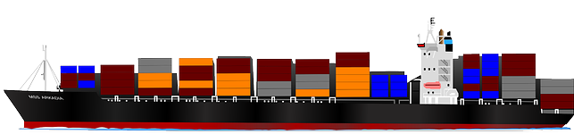
Who is the SMDG?
SMDG is a non-profit foundation, run by and on behalf of companies and organizations working in the maritime industry, like container terminals and ocean carriers
www.smdg.org
SMDG develops, maintains and publishes EDI messages
for the maritime industry since 1987.
SMDG is recognized by the UN/CEFACT.

Slide 19
Process diagram standards development SMDG – UN/CEFACT
Start
Submit official DMRs to
UN/CEFACT Secretary
Prepare draft DMRs for the message structure and codes/qualifiers
Propose to SMDG Plenary
Assessed by Methodology & Technology PDA
EDIFACT: Syntax Focal Point
ebXML: Library Maintenance Focal Point
Rejected
Assessed by SMDG
Added into the UNTDID
Not added into the UNTDID
Approved
Approved
Rejected
Propose to T&L Domain Group
Rejected
Assessed by T&L Domain Group
Approved
End

Slide 20
new Edifact Message
VERMAS – Verification of Mass
VERMAS in the Process Chain
IFTMBF, IFTMIN
or VERMAS
COPARN, COPRAR
or VERMAS
Only BAPLIE
Shipper
Carrier
Terminal
Vessel Master
IFTSTA
or VERMAS
CODECO
or VERMAS
VERMAS
VERMAS
Weighing station

Slide 21
new Edifact Message
VERMAS – Verification of Mass
SMDG Activities in the VGM context
The structure of following messages is being enhanced by the SMDG in order to enable VGM reporting.
New versions have been published on www.smdg.org
Message | Activity | Purpose | Sender-Receiver
BAPLIE | Enhanced | Stowage Plan | Carrier <> Terminal
MOVINS | No change | Move Instructions | Carrier > Terminal
COPARN | Enhanced | Pre-arrival notice | Carrier > Terminal
COPRAR | Enhanced | Load List | Carrier > Terminal
CODECO | Enhanced | Gate-In confirmation | Terminal > Carrier
COARRI | Enhanced | Load/Discharge | Terminal > Carrier
VERMAS | New development | VGM Reporting | Between various parties in the transport chain

Slide 22
new Edifact Message
VERMAS – Verification of Mass
Scope of the new message VERMAS
To transmit the verified gross mass (the weight) and all details of the related weighing certificate for a packed container including the name of the authorized person.
It is a legal requirement that all parties along the transport chain are informed about the Verified Gross Mass of the container:
Shipper, Carrier, Vessel Operator, Terminal and the vessel itself.
VERMAS
Different process steps
Unlike other EDIFACT messages, the VERMAS is not dedicated to a certain process step in the transport chain. It can be used by different parties at different times in the process chain.
Not to use as an order
The VERMAS purpose is only to report a weight that was determined earlier. It will not be used to order a service such as weighing a container. For the purpose of ordering services, for example the COHAOR should be used.

Slide 23
new Edifact Message
VERMAS – Verification of Mass
Why a completely new message?
1. New processes
There are new process steps that are not covered by existing message types. For example reporting from a weighing station to the shipper, or the weight from the terminal to the carrier or from the carrier to the shipper.
2. Different timing for weight transmission in current messages
In many cases the existing messages are sent at a different time than the VGM is known or is required. The existing messages are sent too early or too late for transmission of the VGM.
3. One new message easier than changing many existing messages
Shippers, carriers and terminals need to change a large number of message versions on a fixed deadline. Many of them find it easier to implement one new message for this special purpose of VGM reporting than upgrading many existing message versions and test simultaneously with many EDI partners.
4. Message identification determines the purpose
The receiver can detect the purpose (VGM update) from the message identification VERMAS. He does not have to go into the message to detect the function.

Slide 24
new Edifact Message
VERMAS – Verification of Mass
Use cases for the new message
Just examples – detailed list in the MIG
 | Sender | Receiver | Purpose
1 | Shipper or Forwarder | Carrier (Shipping Line) | If the shipping instructions are sent too early, when the VGM is not yet known. If the shipping instructions are sent too late, when the container is already at the terminal. ➔ In these cases the timing of existing messages is not suitable.
2 | Carrier | Terminal | In cases where COPARN and COPRAR are not suitable for the terminal.
3 | Weighing station | Shipper | If the shipper ordered the weighing service. ➔ New process, not covered by existing messages.
4 | Weighing station | Carrier | If the shipper has authorized the weighing station to transmit directly. ➔ New process, not covered by existing messages.
5 | Terminal | Shipper or Carrier | If the terminal weighed the container upon arrival and determined a new VGM. ➔ New process, not covered by existing messages.

Slide 25
new Edifact Message
VERMAS – Verification of Mass
Sender and Receiver of the new message
Sender
The party who has knowledge about the verified gross mass. This can be for example:
a) The shipper who has stuffed the container and verified the gross weight.
b) The operator of a weighing facility who has determined the VGM for the packed container.
c) The vessel operator or the terminal who forwards the VGM to another party in the transport chain.
Receiver
The party who requires the verified gross mass. This can be for example:
a) The party who has ordered the service of weighing the packed container.
b) The forwarder, or the carrier, or the terminal
The VERMAS message is an offer to the maritime industry .
Its usage is optional and is left to agreements between the trading partners.
They may also decide to use the enhanced versions of IFTMIN, COPRAR, CODECO etc for VGM transmission

Slide 26
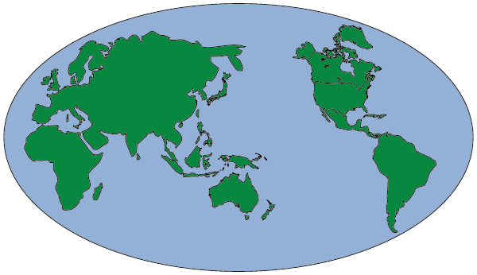
new Edifact Message
VERMAS – Verification of Mass
Who supports the development and implementation of the VERMAS?
As per status of April 2016, it appears that the VERMAS will become the world standard
for transmission of VGM. Parties that are preparing to implement the VERMAS include:
All shipping lines that are participating in the SMDG
Most of the shippers and forwarders will send the VERMAS
Many container terminals prepare to receive the VERMAS
Big portals like INTTRA or DAKOSY will receive and send the VERMAS
Stationary and mobile weighing facilities will send the VERMAS
In addition the WSC World Shipping Council supports and promotes the VERMAS as the electronic medium to transmit the VGM and thus enable the SOLAS implementation.
The shippers, booking portals and weighing facilities are not members of the SMDG but they welcome the new message to cover the legal requirements.

Slide 27
new Edifact Message
VERMAS – Verification of Mass
Content of the VERMAS message – in a nutshell
Mandatory for VGM to the carrier:
The unique container ID (e.g. HLXU1234567) and ISO size/type.
The Verified Gross Mass in kilogram or lbs.
The identity of the message sender
The identity of the Shipper (SOLAS responsible party)
The name of the authorized person in capital letters, as electronic equivalent of the signature.
Optional:
All details that a paper certificate would show: date and place of weighing, the weighing
company, method used (1 or 2 according to SOLAS), reference number etc.
Reference to a particular transport order or purchase order, by means of booking number, B/L number, port of loading, port of discharge, vessel name, voyage number etc.
Related transport parties: Shipper, carrier, terminal, weighing facility etc.
Seal number

Slide 28
new Edifact Message
VERMAS – Verification of Mass
UNH
M 1
BGM
M 1
DTM
C 1
UNT
M 1
0
SG1 C9
SG2 C9
SG4 C 99999
1
RFF
M 1
NAD
M 1
EQD
M 1
2
DTM
C 1
SG3 C9
RFF
C 9
LOC
C 9
SEL
C 9
SG5 C9
SG6 C9
SG7 C9
CTA
M 1
MEA
M 1
TDT
M 1
DOC
M 1
3
COM
C 9
DTM
C 9
RFF
C 9
DTM
C 9
SG8 C9
NAD
M 1
4
SG9 C9
CTA
M 1
SG2/SG3
Message
Sender
5
COM
C 9

Slide 29
new Edifact Message
VERMAS – Verification of Mass
SG4
EQD – Container ID and Sizetype
RFF - Booking No OR Bill of Lading OR Shipper‘s reference
LOC – POL OR POD OR Final Destination etc.
SEL – Seal number
SG5 MEA – Verified Gross Mass and Unit
DTM - Date of Verification or Weighing
SG6 – Vessel Names / Voyage Numbers for this cntr.
0
1
2
SG7
DOC – Method of verification and Certificate ID/reference
DTM – Dates referring to the weighing document,
e.g. issue date of the weighing certificate
3
SG8/SG9
NAD – Party that has verified the weight and issued the
certificate.
CTA, COM
- Name of the Responsible Person, belonging to
that party.
– Contact information
4
5

Slide 30
Electronic VGM transmission
Example VERMAS message
Example VERMAS message from a shipper to a carrier (shipper sends the message)
UNB+UNOC:3+SUBMITTER_ID+RECEIVER+160601:1430+100'
UNH+80+VERMAS:D:16A:UN'
BGM++8394887+9'
DTM+137:201606011430:203'
EQD+CN+HLCU1260179+22GP+1'
RFF+BN:90300221‘
SEL+XYZ12345+SH
MEA+AAE+VGM+KGM:13300'
DTM+798:201607010830:203'
NAD+SPC+800372::86++RESPONSIBLE PARTY NAME+STREET AND NUMBER+PARIS++75007+FR'
CTA+RP+:VICTOR HUGO'
COM+309 229 8828:TE'
UNT+9+100’
Sender / Receiver
Message name
EDI Reference
Date of sending
Container and Size Type
Booking number
Seal number
VGM (Gross weight)
Date of weighing
Responsible party (SOLAS Shipper)
name and address
Authorized Person name („signature“)
Authorized Person phone number
Message trailer

Slide 31
MIG versus Message Structure
We need to differentiate two levels:
The UN/CEFACT approves and publishes the Message Structure only.
The message structure consists of segments, groups, optionalities, cardinalities etc. All this is already reflected in the current MIG on the SMDG website.
The SMDG publishes a Message Implementation Guide (MIG).
The MIG contains much more details than the message structure: Explanations to the usage of segments and qualifiers, example message for use cases etc.

Slide 32
new Edifact Message
VERMAS – Verification of Mass
VERMAS Timeline
1.4.2015 SMDG Meeting in Malmoe | Agreement to pursue the development of a new message
1.7.2015 T&L Group interim meeting in Paris | T&L Group within UN/CEFACT agrees and supports the development of a new Edifact message for VGM
21.9.2015 | DMRs for new codes submitted to UN/CEFACT for D.15B
30.9.2015 SMDG meeting in Malta | Proposal for VERMAS message was approved
4.11.2015 UN/CEFACT Forum Marseille | General approval for VERMAS message structure
6.11.2015 | SMDG publishes first VERMAS MIG as version 0.4
11.2.2016 | UN/CEFACT project proposal supported by 3 national HoD
26.2.2016 | SMDG provides VERMAS Boiler Plate for D.16A to UN/CEFACT
8.3.2016 | SMDG provides the BRS for the VERMAS message
20.4.2016 SMDG Meeting in Copenhagen | Prepare for next VERMAS MIG version 1.0
25. - 29.4.2016 UN/CEFACT Forum in Geneva | Final VERMAS approval by UN/CEFACT
May / June 2016 | UN/CEFACT publishes VERMAS in D.16A directory
now

Slide 33

Electronic VGM transmission
We all share the same goal:
Shipper
We want
to load
the cargo !
Carrier
Terminal

Slide 34
Electronic VGM transmission
Backup
Which data is required for VGM transmission? Page 1/2
The VERMAS message can transmit mandatory and optional data elements. Depending on who is the sender of the message, the requirements are different.
From a shipper to a carrier:
Reference | Data elements | Remarks | Mandatory/optional
Message sender |  |  | mandatory
Shipper | Company name and address. Identification by Tax number, EORI number etc. is possible if agreed | Responsible party for VGM as per SOLAS | mandatory
Authorized Person | Person authorized by the shipper to sign the VGM document | Full name in capital letters, contact details (mail, tel.) | Full name mandatory, contact details recommended
Transport Order Reference | Carrier‘s booking number or B/L number |  | Highly recommended to avoid delays
Container number |  |  | mandatory
VGM | Verified gross mass of the container incl. unit of measurement | KGM | mandatory

Slide 35
Electronic VGM transmission
Backup
Which data is required for VGM transmission? Page 2/2
Reference | Data elements | Remarks | Mandatory/optional
Date+Time of weighing | Date + Time when the container was weighed or the weight was determined |  | Recommended
Place of weighing | Location where the container was weighed or the weight was determined. | At minimum the country of weight determination should be transmitted. | Recommended
Seal number |  |  | Optional
Method of weight determination | SM1 or SM2 | SOLAS method 1 or 2 | Optional
Weight certificate | Unique reference for a weight certificate | E.g. for a weighing slip | Optional

