Slide 1
  A new way to facilitate eBusiness communication
  A breakthrough in how electronic communication will be carried out in the future
Rolf Wessel SCRDM Project Lead
Gerhard Heemskerk SCRDM Lead Editor
The Substance behind ZUGFeRD
ZUGFeRD Developers Days, 24-25 November 2016

Slide 2
The Substance behind the ZUGFeRD CII
a Semantic Model
Named as
The Supply Chain Reference Data Model (SCRDM)
Being
The first Reference Data Model
of
UN/CEFACT
(United Nations Centre for Trade facilitation and E- Business)
ZUGFeRD Developers Days, 24-25 November 2016

Slide 3
  A new way to facilitate eBusiness communication
Harmonization
Standardization
Simplification
Reducing the dependency on traditional documents as the means of driving the supply chain by removal of redundancy and adoption of process-driven collaborative workflows and shared trade data
ZUGFeRD Developers Days, 24-25 November 2016

Slide 4
The benefits
Reduction of administrative burden
A trusted Reference Data Model
Standardized business data exchange structures
Integrated international code lists
Enhanced interoperability of data
A future proof semantic model (syntax neutral)
Links to UN Key Layouts, UN/EDIFACT support migration
Easy to find artefacts, searching in subset “10% of total”
...and more
ZUGFeRD Developers Days, 24-25 November 2016

Slide 5
The SCRDM project
Project Leader: Rolf Wessel
Lead Editor : Gerhard Heemskerk
Editing team : Andreas Pelekies, Hisanao Sugamata, Ian Watt, Karina Duvinger, Mary Kay Blantz, Natascha Rossner, Sue Probert,
Colin Laughlan, Ulrike Linde, Noppadon Vannaprapa, Chaloemchai
Start : August 2015
End : January 2017
Purpose : Development of a semantic model for the Supply Chain
: Semantic links
: Guidelines
Deliverables : Sematic Model, subset of UN/CEFACT CCL for the Supply Chain
: Semantics links
: Guidelines
  Related Projects : Cross Industry Invoice Extension of technical artefacts (CII)
  : Procedures for Reference Data Model & Associated Artefacts Publication Proj.
  : Multi Modal Transport Reference Data Model (MMT)
ZUGFeRD Developers Days, 24-25 November 2016

Slide 6
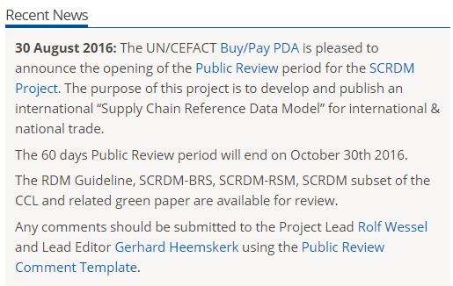
Project Status
Public Review period ended on 30th October 2016
ZUGFeRD Developers Days, 24-25 November 2016

Slide 7
Work for the coming month
Processing SCRDM Public Review comments
Adding additional semantic links (BN/TDED/UN-EDIFACT)
Preparing publication SCRDM (BRS/RSM/Guidelines)
Publication CII BRS/RSM documents (CII Project)
ZUGFeRD Developers Days, 24-25 November 2016

Slide 8
Work we handed over to related projects
“Procedures for publication Reference Data Models”:
  Project: Reference Data Models & Publication project
“Transition plan for process driven schemas”
  Project: Extension of Cross Industry Invoice technical artefacts
“How to use code lists etc.”
  Project : Code Management (waiting for approval)
ZUGFeRD Developers Days, 24-25 November 2016

Slide 9
Project Timeline
30 August 2016 –
30 October 2016
1 November 2016 -
1 January 2017
1 January 2017
Soon after
ODP 4
Public Review Supply Chain Reference Data Model
Process Comments
ODP 5
Project Exit
ODP 6
Publication
ZUGFeRD Developers Days, 24-25 November 2016

Slide 10
UN/CEFACT Reference Data Models
Reference Data Model (e.g. SCRDM)
  a subset of the UN/CEFACT Core Component Library
  a rich collection of business artefacts
  from which standard business data exchange
  structures (messages) can be derived/created.
The evolution:
  creation of standard business data exchange structures (subsets) from a ‘Master Structure’.
  Levels of contextual restrictions: the CCL (library), the Master Structure and/or the business data exchange structure (such as CII message).
ZUGFeRD Developers Days, 24-25 November 2016

Slide 11
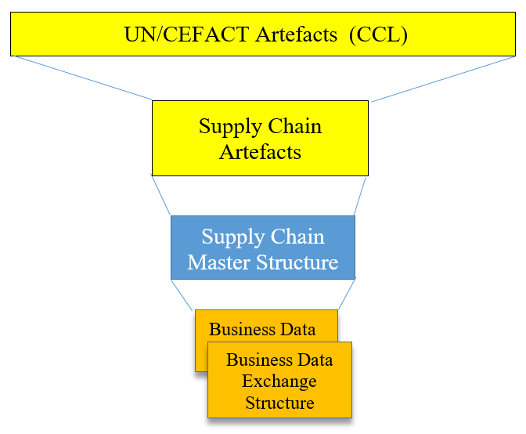
How the Supply Chain Reference Data Model works..
All artefacts
Layer 1: Restrictions
Subset of all artefacts
Layer 2: Restrictions
Master Data Exchange Structure
Layer 3: Restrictions
Derived data exchange structure(s)
e.g. Invoice, query..
ZUGFeRD Developers Days, 24-25 November 2016

Slide 12
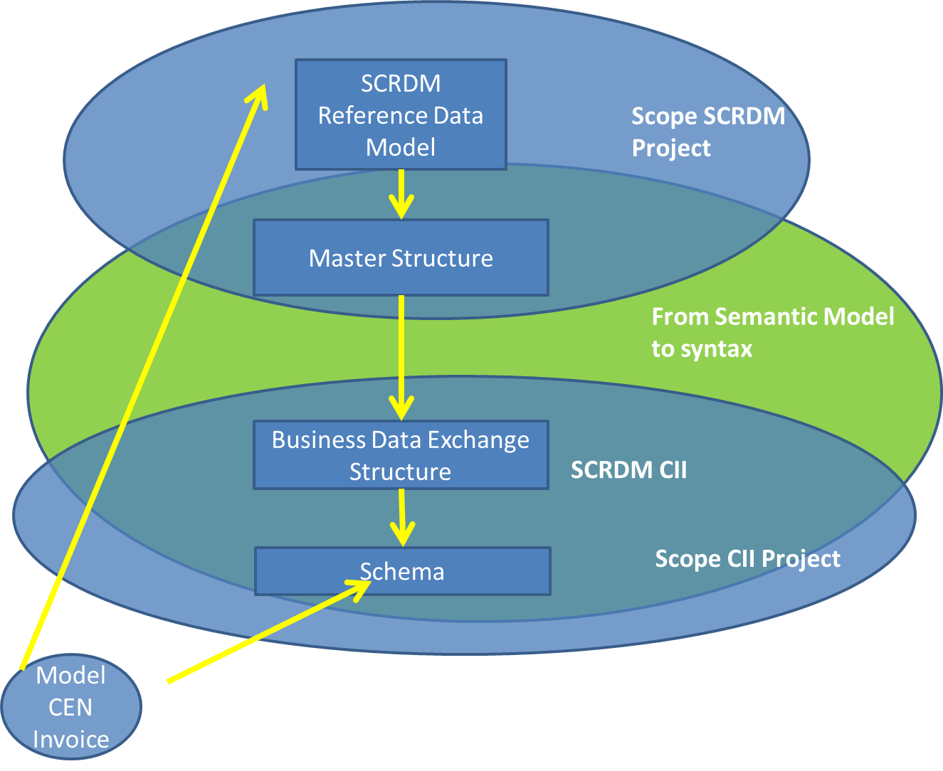
First SCRDM delivery: UN/CEFACT CII
Cross Industry Invoice
ZUGFeRD Developers Days, 24-25 November 2016

Slide 13
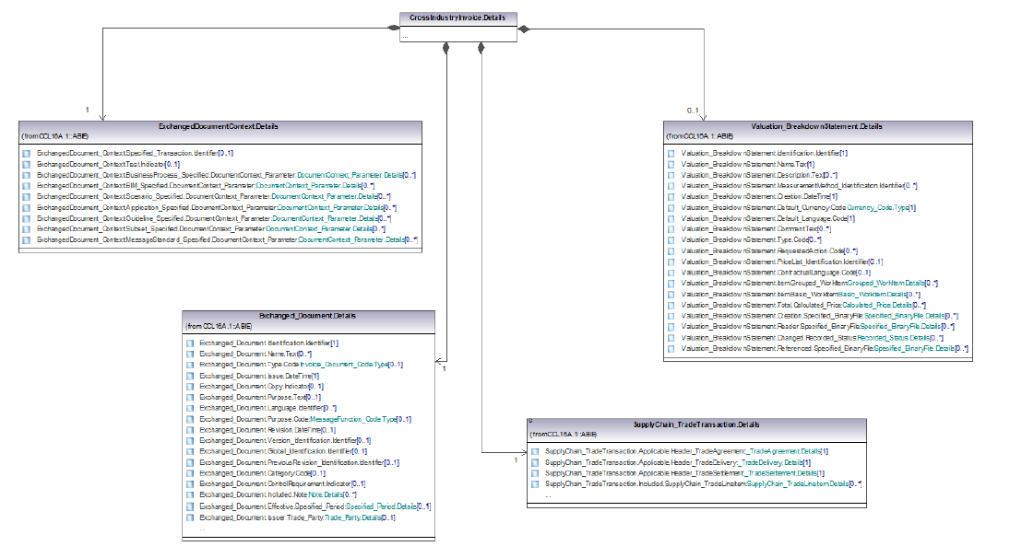
Cross Industry Invoice
Geographical Focus: Global
950 Artefacts available in CII
ZUGFeRD Developers Days, 24-25 November 2016

Slide 14
SCRDM Deliverables
Semantic model (SCRDM)
  The Supply Chain artefacts “subset of the CCL”
  Semantic links to TDED. UN/EDIFACT, UN Layout Keys
Guidelines generic
  Executive summary for the Reference Data Model
  How to use, update and create a reference data model
  How to create syntax neutral data exchange structures (messages)
High level SCRDM-BRS (Business Requirements Specification)
  Processes in the Supply Chain, Transport, Finance, Government
  Actors and scenarios
High level SCRDM-RSM (Requirements Specification Mapping)
  Mapping of common party roles
  Mapping of common locations
  Mapping of common business entities
ZUGFeRD Developers Days, 24-25 November 2016

Slide 15


Reference Data Model Guideline
Steps for using
Steps for updating
Steps for creating
Mini Conference, Bangkok, 27 September 2016

Slide 16
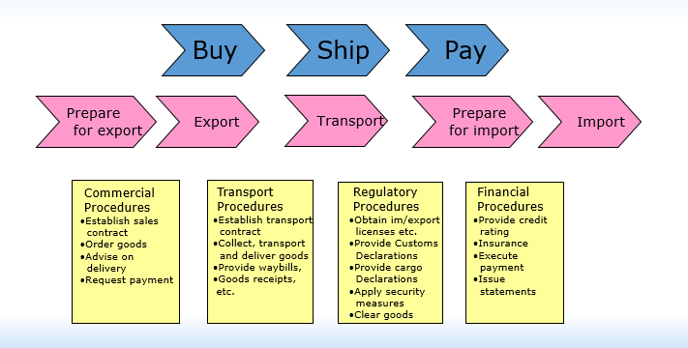
High-level BRSs (Business Requirements Specifications)
SCRDM and MMT (transport & logistics)
ZUGFeRD Developers Days, 24-25 November 2016

Slide 17
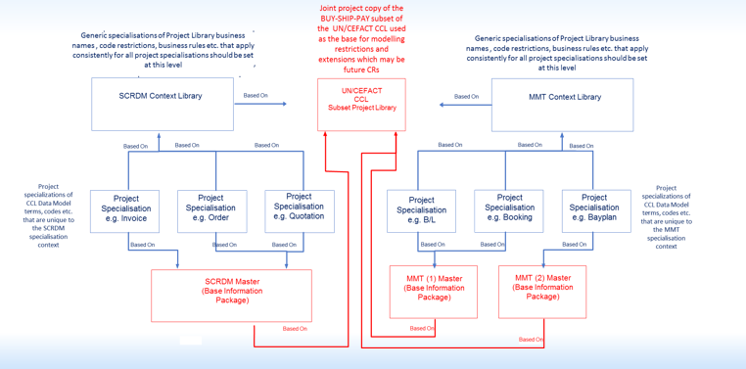
Two projects sharing the same common subset of the library
SCRDM
MMT
ZUGFeRD Developers Days, 24-25 November 2016
17

Slide 18
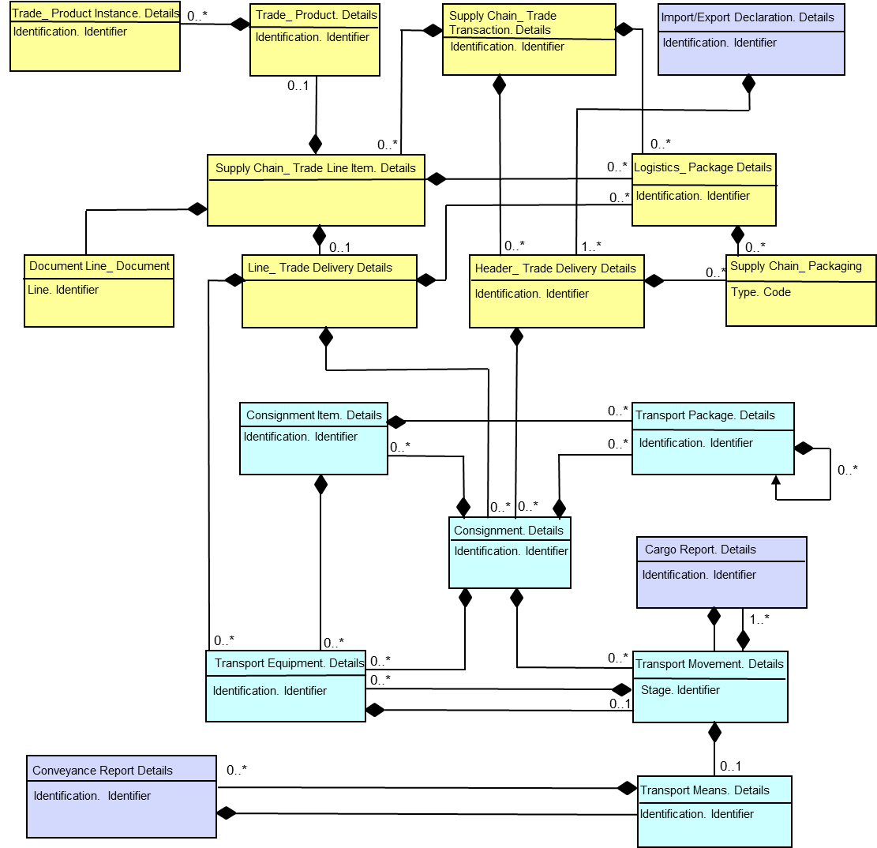
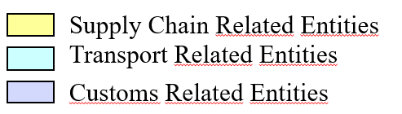
High-level RSM (Requirement Mapping Specification)
SCRDM
ZUGFeRD Developers Days, 24-25 November 2016

Slide 19
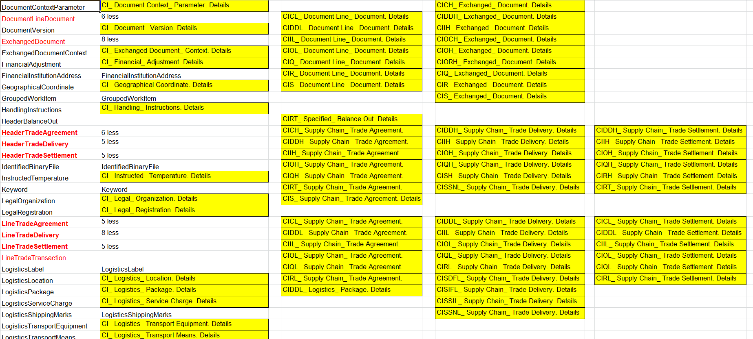
Back to Main
The evolution: process driven artefacts
ABIES : 123
ABIES : 200
-77
SCRDM: Process approach
Before: Document centric approach
ZUGFeRD Developers Days, 24-25 November 2016

Slide 20
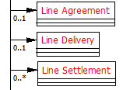
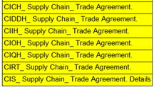
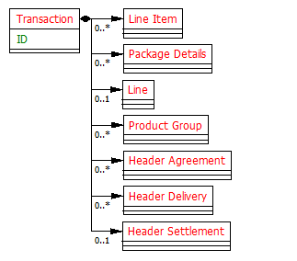
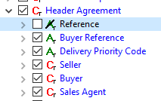
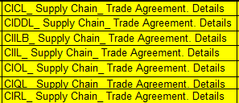
Using a master, deriving messages
Master Structure
Layer 2: Restictions
................
Header
Data Exchange Layer 3
Layer 3: Restriction
................
Rationalized
Derived
Line
Restrictions:
SCRDM CCL, Master Structure and/or Data Exchange layer
ZUGFeRD Developers Days, 24-25 November 2016

Slide 21
Rationalization results...
40% less business information artefacts needed to build the same number of messages.
- 17 new artefacts (ABIEs), 1% of total library (CCL)
- 1400 SCRDM artefacts out of 11.500 of total library
- 950 Cross Industry Invoice artefacts out of 1400 SCRDM
- Easily maintainable
- Easier to implement
ZUGFeRD Developers Days, 24-25 November 2016

Slide 22
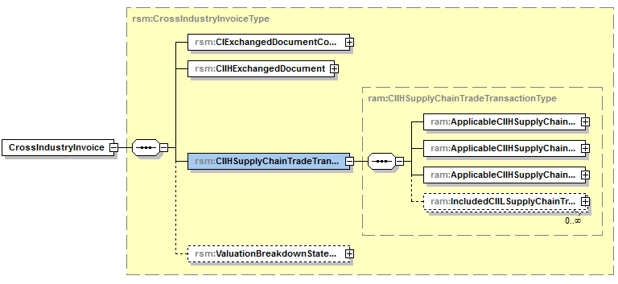
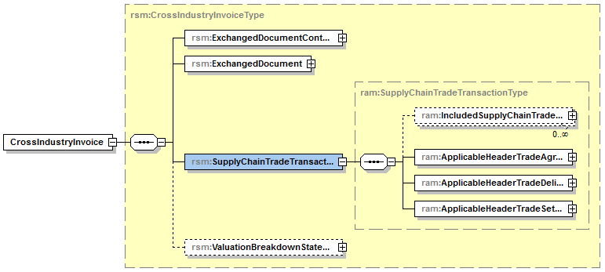

SCRDM CII schema: only used artefacts
CII Schema non restricted RABIE
CII
CII Schema restricted RABIE
SCRDM CII
ZUGFeRD Developers Days, 24-25 November 2016

Slide 23
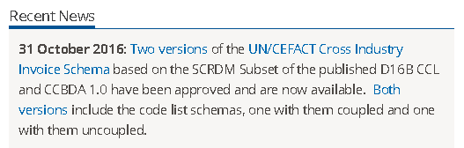
Other improvements: SCRDM CII coupled/uncoupled codes lists
From 16B: two CII schema’s versions:
Uncoupled (new)
Coupled
ZUGFeRD Developers Days, 24-25 November 2016

Slide 24
Schema with uncoupled codes lists
Still compliant to the standard UN/CEFACT published schema even when codes are changing.
Maximum flexibility in configuring and updating code lists without changing the standard UN/CEFACT schemas.
You can extend or restrict the codes in the code list so that the corresponding type refers to the modified code list schema.
ZUGFeRD Developers Days, 24-25 November 2016

Slide 25
Schema with coupled code lists
All trading partners have to validate against the same codes, this enhances interoperability.
UN/CEFACT code lists are standardized and widely used, also used by other standards.
A validadtion of codes in a schema instance in 1 step.
ZUGFeRD Developers Days, 24-25 November 2016

Slide 26
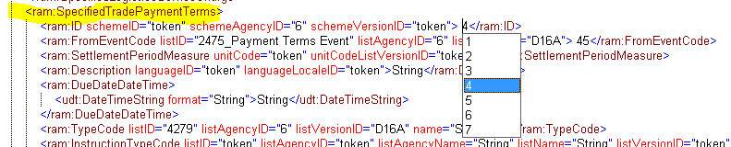
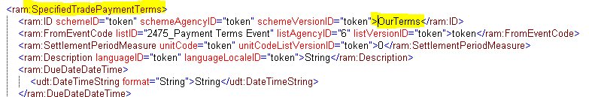
D16B SCRDM (Subset) CII instances
1. Coupled Code List schema Modules
2. Uncoupled Code List schema Modules
ZUGFeRD Developers Days, 24-25 November 2016

Slide 27
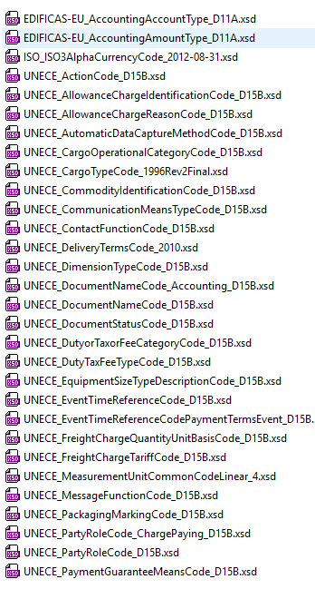
SCRDM CII: only used code lists
CII Document Centric Schema
CII
imported schema modules
128
CII Process Driven Schema
SCRDM CII
Imported schema modules*
50
ZUGFeRD Developers Days, 24-25 November 2016

Slide 28
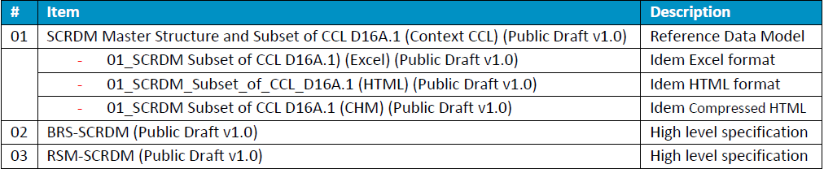
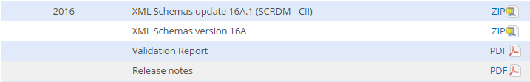
Deliverables SCRDM/CII
Publication set of SCRDM (soon on the official UN/CEFACT website)
Publication Cross Industry Invoice Schema (already published)
CII BRS/RSM will be published soon
ZUGFeRD Developers Days, 24-25 November 2016
28

Slide 29




How it is published: SCRDM/CII artefacts
Supply Chain
Reference Data Model
(SCRDM)
Available in different
formats
Supply Chain
Cross Industry Invoice (CII)
compressed
ZUGFeRD Developers Days, 24-25 November 2016
29

Slide 30
Next messages..relatively easy to create: all artefacts are in place
SCRDM is an easy to use and maintainable semantic framework
  From which messages can be derived
    Using a common master structure structure
      From which we can easily produce schemas (XML syntax)
ZUGFeRD Developers Days, 24-25 November 2016

Slide 31
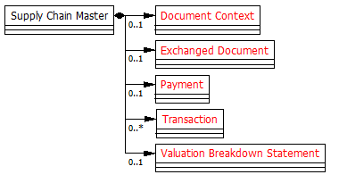
Deriving the other CI messages from the same master structure
ZUGFeRD Developers Days, 24-25 November 2016

Slide 32
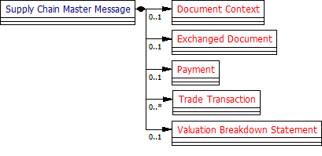
Easy click off, easy change occurrence
1:1
1:1
Quotation
1:1
Order
1:1
1:1
1:1
1:1
1:1
1:1
Invoice
1:1
Remittance Advice
1:1
1:1
1:1
1:1
1:1
1:1
1:1
0:1
ZUGFeRD Developers Days, 24-25 November 2016
32

Slide 33
Messages in scope....
Business Requirements
Business Requirements
Business Requirements
Process
Cataloguing
Process
Quotation
Process
Ordering
1
Catalogue
2
Quotation Proposal
6
Order
3
Quotation Prop. Resp
7
Order Response
4
Quotation Request
8
Order Change
5
Quotation Req.. Resp.
Business Requirements
Business Requirements
Business Requirements
Process
Delivery
Process
Scheduling
Process
Remittance
9
Despatch advice
10
Demand Forecast
15
Remittance Advice
11
Demand Forec. Resp.
12
Inventory Forecast
13
Supply Instruction
14
Supply Notification
ZUGFeRD Developers Days, 24-25 November 2016
33

Slide 34
Who will decide taking next steps?
Project Proposal sent to the Bureau for approval on November 16th 2016
Covering schemas for the following processes:
- Cataloguing, Quotation, Ordering, Delivering,
Remittance advice
Developments depend on the support of
UN/CEFACT Heads of Delegations (HoDs)
ZUGFeRD Developers Days, 24-25 November 2016
34

Slide 35
Thank you for your attention!
For further information:
- Project Leader : Rolf Wessel
E-mail : r.wessel@seeburger.de
- Lead Editor : Gerhard Heemskerk
E-mail : gerhard.heemskerk@kpnmail.nl
ZUGFeRD Developers Days, 24-25 November 2016

