Slide 1
SCRDM project
Purpose & Team
Status
7-April-2016

Slide 2
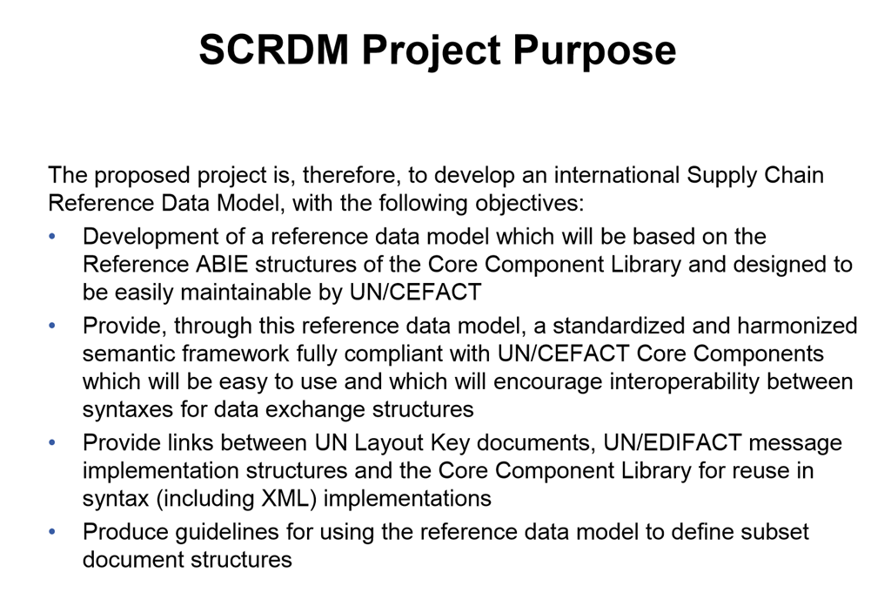
Notes:
The purpose of the SCRDM project is creating reference data model.
Because it’s eay to use, it will encourage interoperability between different data models.
The reference data model contains semantic links to EDIFACT and the Trade Data Element Directory (the ‘old’ world).
It’s the basis for creating documents.
The project is NOT about creating documents and schemas. That’s will be following projects (but they can be created fast, due to our work done till now).

Slide 3
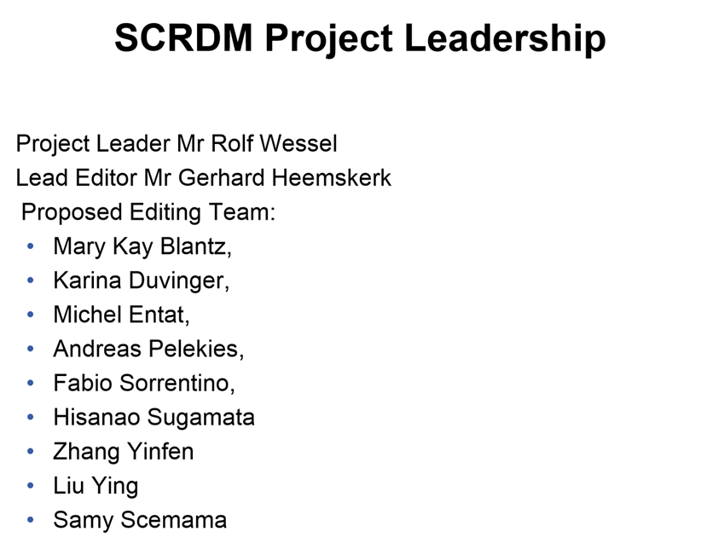
Notes:
This is our team.
The team consist of people from;
The harmonization team
Supply Chain Domain
And others.

Slide 4
Status of SCRDM project
Deliverables
Planning
Notes:
And now the status of the project.
What’s the status of the deliverables?
And what’s the planning, when do we finish the project?

Slide 5
1. Deliverables (a)
Back to main
The deliverables from the project will be:
A structured reference data model based on
the latest release of the CCL (15B)
1. Internal Review DRAFT SCRDM CCL started
- Survey started 1 April show
- A Master Message Structure show
- Semantically 100% equal to CCL 15B + CCBDA show
- PoC CCBDA Cross Industry Invoice show
Notes:
We finished the DRAFT SCRDM CCL and made it available for internal review.
We created a master message structure from which all needed Supply chain messages can be created.
The DRAFT SCRDM CCL is 100% semantically equal to the 15B CCL, but a far easy to use CCL.
The proof of concept of the Cross Industry Invoice showed that it works.

Slide 6
1. Deliverables (b/c)
b) Semantics links with UN/EDIFACT messaging and the TDED to support
increased interoperability between data exchange structures
- EDIFACT Code lists as qDT’s show
- UNTDED - UN Trade Data Element Directory – show
- Business names show
c) Guidelines to produce exchange syntax neutral message structures based
on the UN/CEFACT CCBDA v1.0
- Guideline how to built SCRDM business documents show
- High level BRS SCRDM (Business Requirements Specification) show
- High level RSM SCRDM (Requirement Mapping Specification) show
Notes:
Another deliverable is semantic links with EDIFACT and the Trade Data Element Directory.
We will work on adding recommended code list to the CCL.
The library maintenance people will work on adding TDED’s.
We have added buiness names for all informations object.

Slide 7
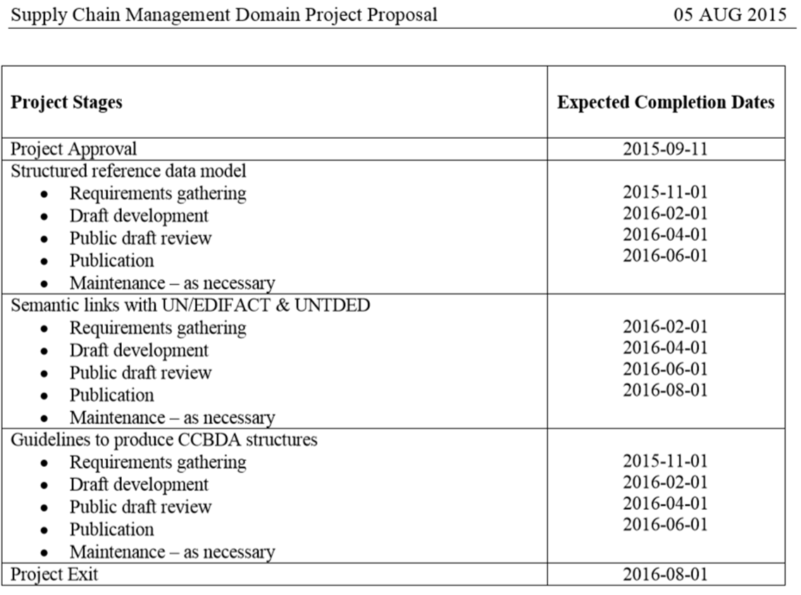
2. Planning
Back to main
See UN/CEFACT Confluence status
Internal review till 17 april
Public review till 1 july ?
Active
Active
Expected 2 months delay
Notes:
As I said earlier, we started the internal review of the DRAFT SCRDM CLL.
I expect after processing the results we can start the public review half of May.
The other sections are still active.
Overall I expect an delay of 2 month, mainly caused by the Proof of Concept.

Slide 8
Thank you for your attention!

Slide 9
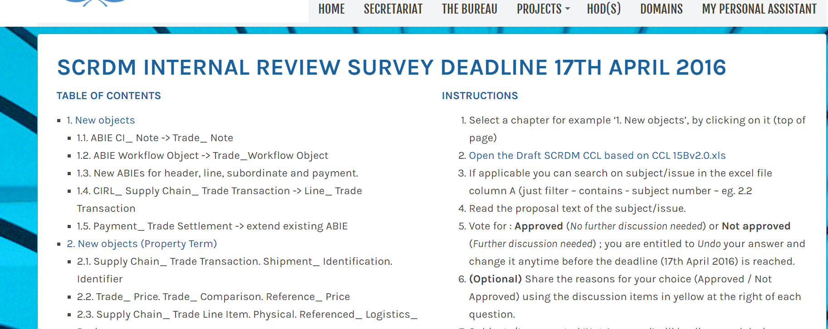
Back to Main
Issues
Excel Draft SCRDM CCL
Notes:
During building the SCRDM CCL, I had to solve some issues. Before solving them we invited team members and un/cefact experts to take part in this survey.
The issues numbers mentioned in the survey can be found in the SCRDM CCL spreadsheet (click link).

Slide 10
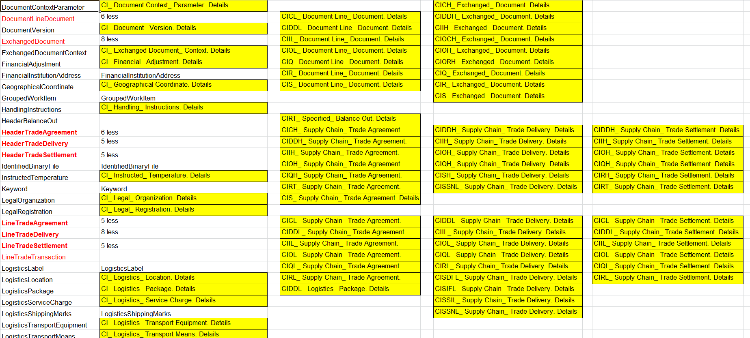
Supply Chain
Supply Chain
ABIEs
123
ABIES
200
Back to Main
77
CCL 15B
+ CCBDA
SCRDM
Reference BIE ☺
Restrictions per document on library level ☹
Notes:
This picture shows the meaning of CCBDA.
Restrictions for messages will not be done in the library it self but during message assembly.
The message BIE wil not change when it is used in another message/document.
Therefore our SCRDM reference BIE’s uses only 123 ABIEs.
During applying CCBDA we can create 100% semantically equal messages.

Slide 11
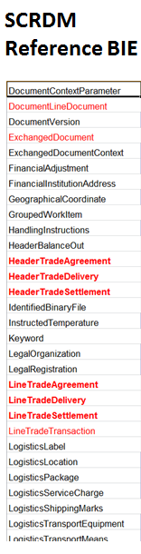
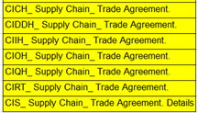
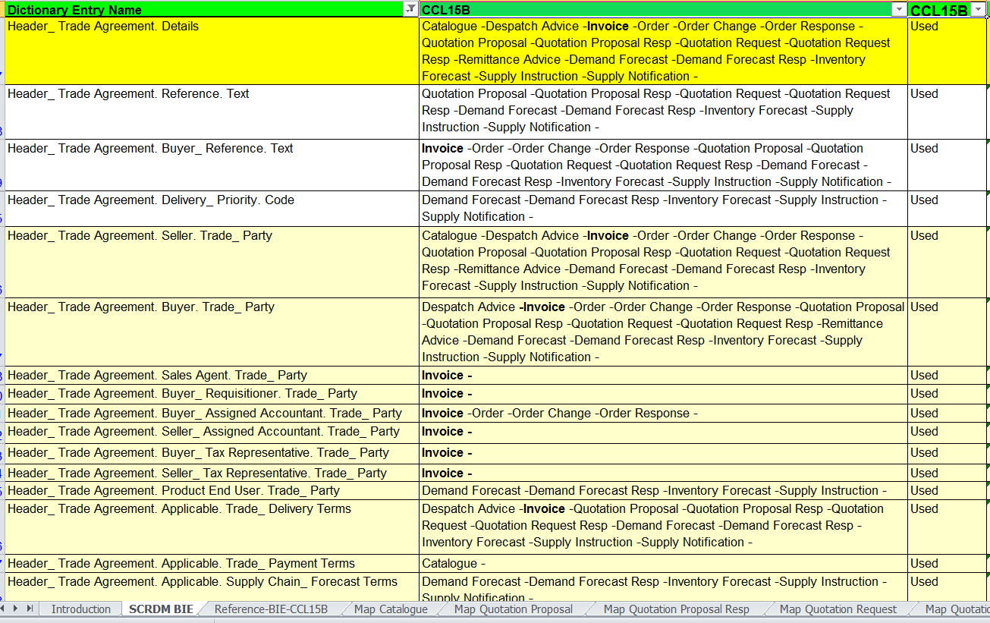
Back to main
CCBDA
(business document assembly)
106
Exists
17
new
Previous
Notes:
The same ABIE used for different message. Instead of document related ABIEs.

Slide 12
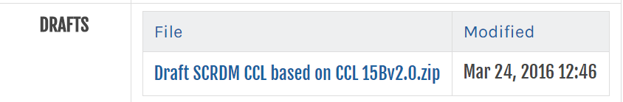
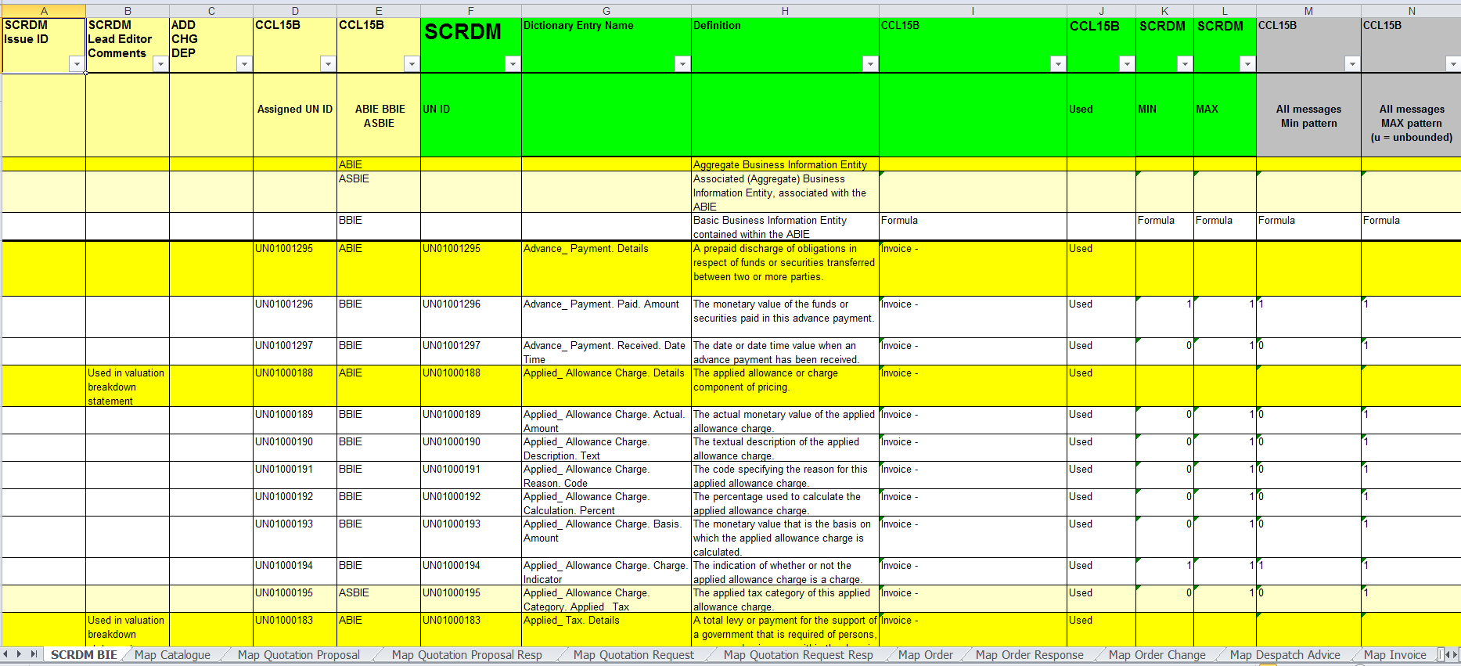
Back to Main
Notes:
This spreadsheet can be dowloaded from the CEFACT website.
In column A issues numbers, as mentioned in the survey, are listes.
Any needed additions or changes compared to CCL 15B, are marked in column C.
The same has been done on message level (click on map invoice).

Slide 13
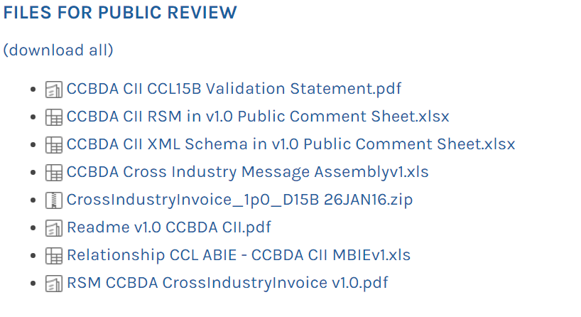
CCTS 2.01 & CCBDA 1.0 & NDR 2.1 ARTEFACTS PUBLICATION PUBLIC REVIEW
Back to (a) or (b/c)
SCRDM CCL
CCBDA CII
Schema
PoC CCBDA CII / CEN diagram
Notes:
The proof of concept is a good example of the concept of a reference data model and applying CCBDA, working towards schemas’.

Slide 14
Back to main
Proof of Concept
CCBDA CII
SCRDM
Reference Data Model
Standard
Business Document
Master structure
Profiling ABIE‘s
Document
PoC CCBDA CII
Schema
Message schema
Model
CEN
Invoice
Previous
Notes:
The same picture.

Slide 15
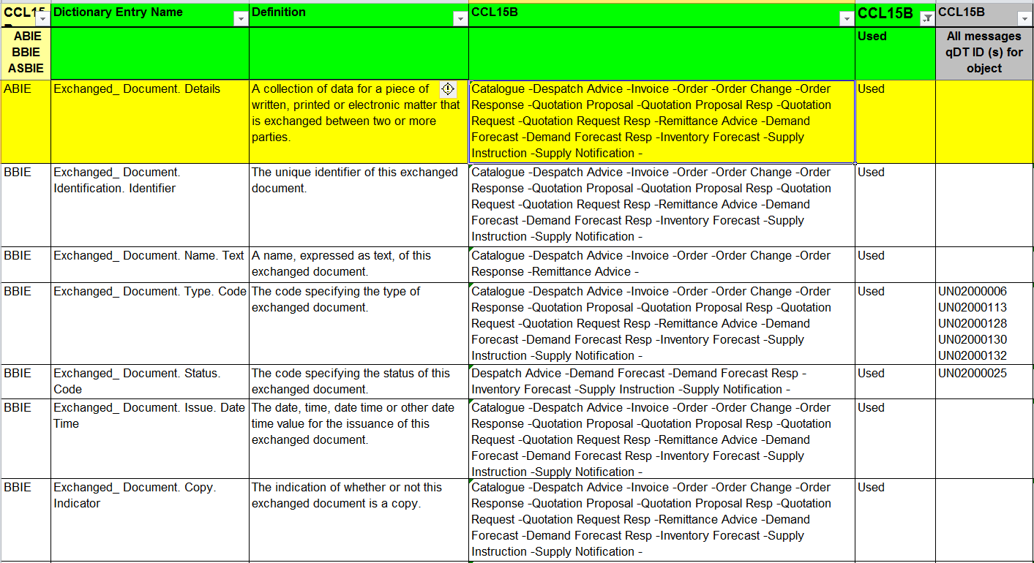
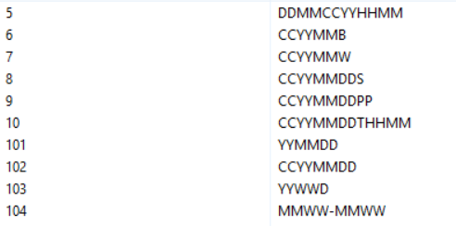
Recommended Code Lists
Such as
Document_ Type Code, Invoice_ Document_Type Code*
Back to Main
Edifact link; UN02000153 Formatted Date Time
Notes:
As you can see here, in different documents restricted code lists have been used.
This is at the moment only the case for the information object Document Type Code.
We still have to figure out how we will restrict them in a CCBDA context.

Slide 16
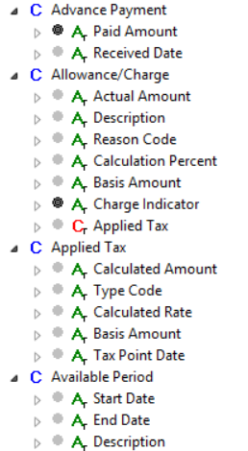
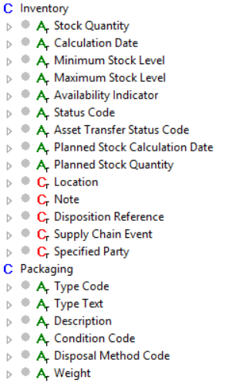
All objects have now a Business Name
Back to Main
Notes:
Representation of business names is supports the link between data and business requirements.

Slide 17
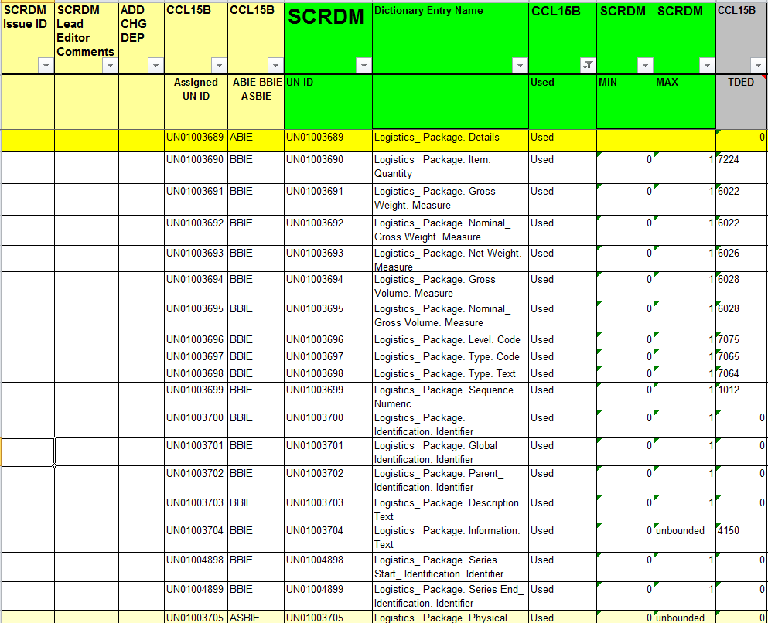
TDED: 31% of objects more will be added
Back to Main
Notes:
A you can see some of the trade date element tags are equal to the data element tag used in EDIFACT.

Slide 18
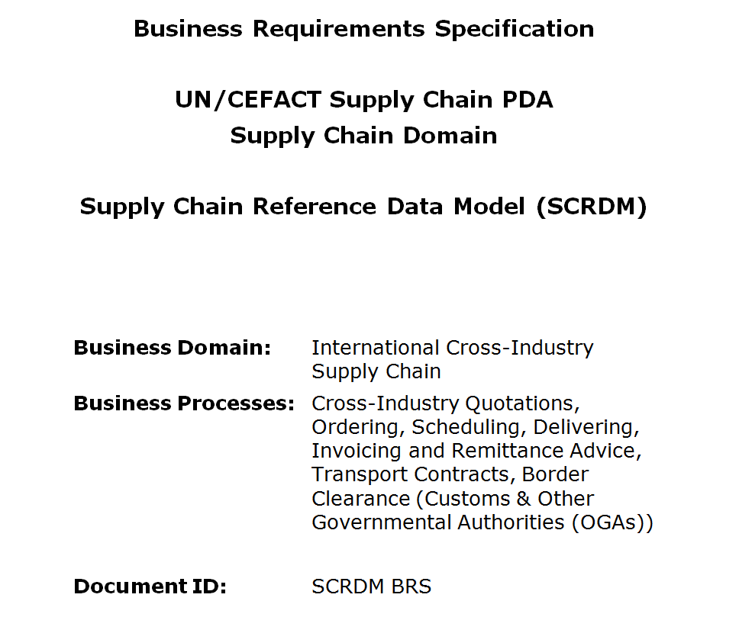
BRS SCRDM
Back to Main
Date: January 2016
Relationship with MMT (Multi Modal Transport) Reference Model included
Notes:
We have made a concept SCRDM Business Requirements document.
This document describes also the relationship with the other reference data model of MMT.

Slide 19
Relationships between the highest-level Business Information Entities of the
CCTS SCRDM and MMT Reference Data Models.
Back to main
Previous
Notes:
This diagram show relationsships between the different reference data models of MMT and WCO.

Slide 20
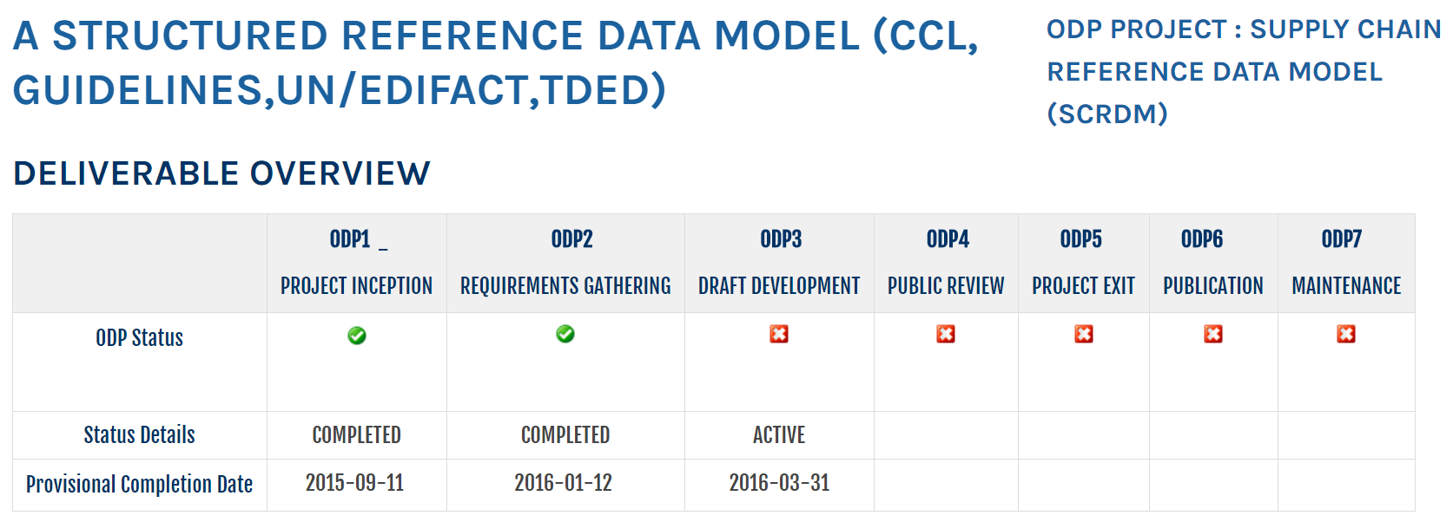
UN/CEFACT Confluence page
Back to main
Back to Planning
Notes:
On the confluence page you can see the actual status of the SCRDM project.

Slide 21
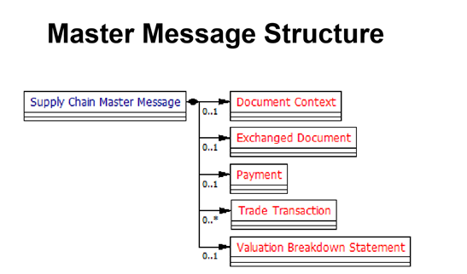
Back to main
• Buy-Ship Pay Context
• Reuses just 123 (just over 10%) Reference ABIEs from Core Component Library
• Same set of ABIEs as MMT reuses!
Show more
Notes:
We created a standard message (or document) structure from which documents can be created.

Slide 22
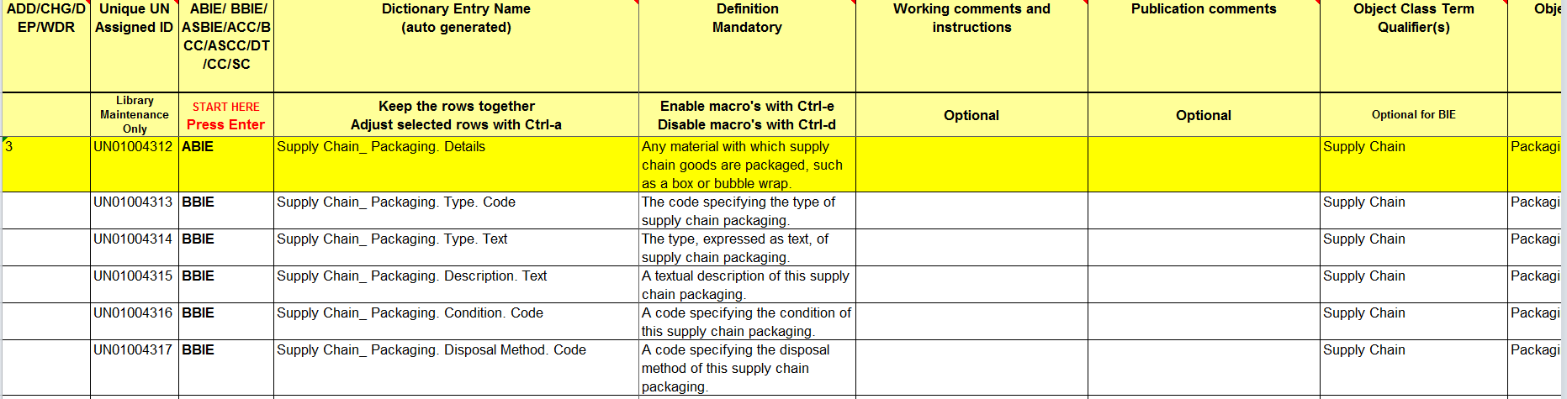
Publication of Data Model
Back to main
Subset of traditional Excel, HTML. Word documents…
Previous page
Notes:
It’s still a question how to publih the reference data model.
Should it be published as a subset of the CCL in an Excel file, or a linked HTML, or in word documents or a combination of all.

Slide 23
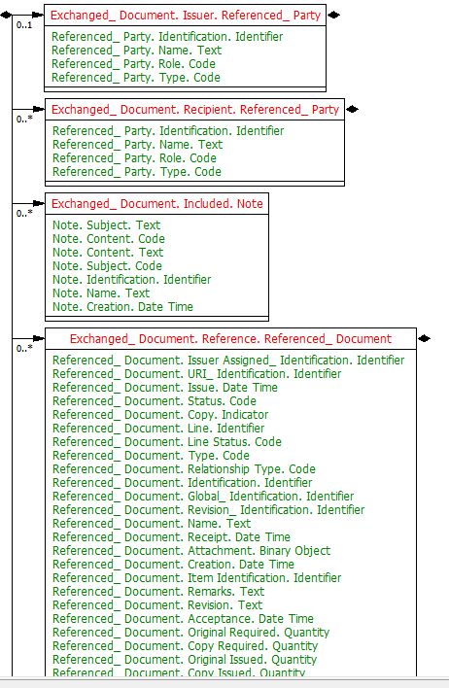
High level RSM
Back to main
• Buy-Ship Pay Context
• Reuses just 123 (just over 10%) Reference ABIEs from Core Component Library
• Same set of ABIEs as MMT reuses!
Form of publication is still open
Notes:
A grahpical representation of the reference data model is requested by team members.

Slide 24
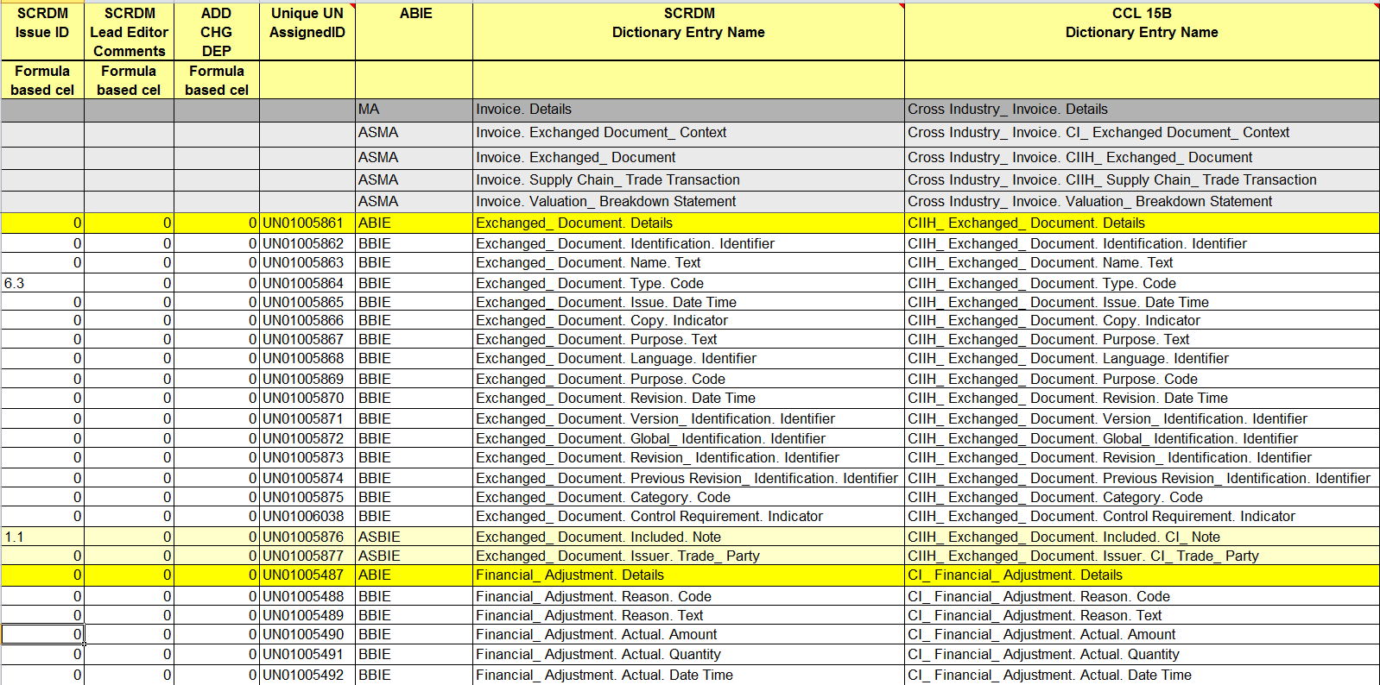
Map Invoice
SCRDM <–> 15B
Back to main
Notes:
You can also se.e the mapping between SCRDM and 15B objects

Slide 25
SCRDM CII – CCL15B synchronizing
Occurrence difference = from common to CCDBA, changed manually
Attribute usage difference = Schema production issue
Not in 15B = from common to CCDBA, changed manually
Not in SCRDM = CCL was still in progress
Wrong order of appearance = Will be issue in SCRDM
Some duplicate ABIEs = Will be gone (identified/Specified Binary File etc).
Notes:
The order of appearance of ellements is still an issue.
Should new elements in a message BIE be placed at the end (not mandatory to do so in 5B)
Some ABIE’s might be dropped because they are semantically equal.

Slide 26
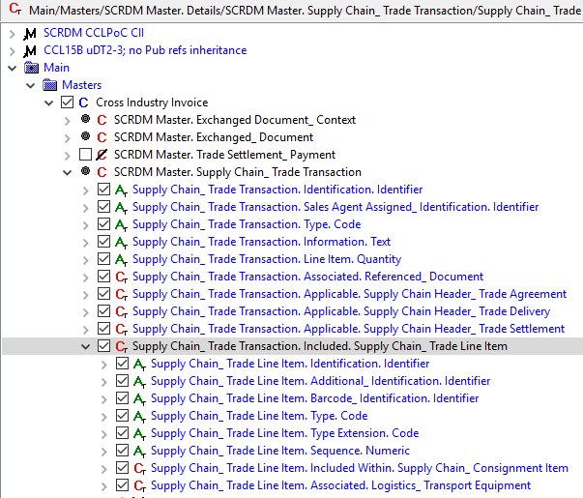
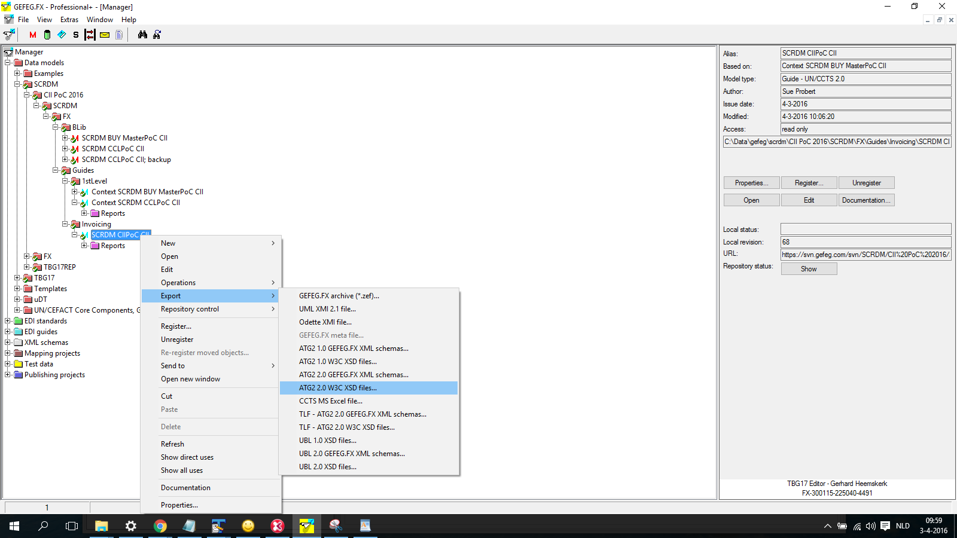
Our tool, CCBDA Poc CII
Back to main
Previous

