Slide 1

Netherlands Food and Consumer Product Safety Authority
(NVWA)
Alexander Moret
E-Certification Specialist
UNCEFACT April 2016
Notes:
1

Slide 2


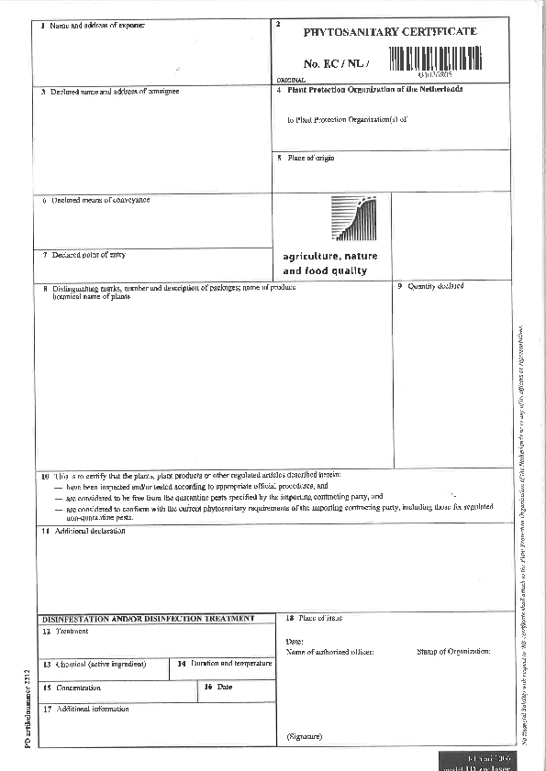

Slide 3
Contents
What is electronic certification
What is not electronic certification
Benefits of electronic certificates
How does it work?

Slide 4
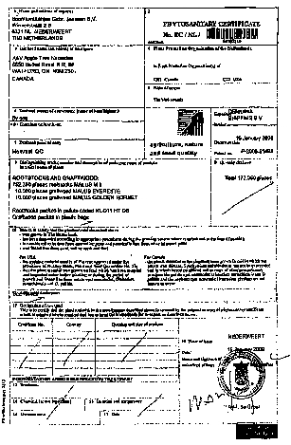

Electronic certificate
An electronic SPS certificate is the electronic equivalent of a paper SPS certificate, containing the same information and giving the same guarantee

Slide 5
1. What is electronic certification
Certification data
Transmitted electronically
Security
Authenticity
From government to government

Slide 6
Health certificate
Exporter
Certificate
Authority exporting country
Certificate
Notification of interception
Pre arrival notice
Importer
Certificate
Authority importing country
Document control
Electronic
Movement Document
Identity check & Health check

Slide 7
SPS certificate
Exporter
Certificate number
Authority exporting country
Certificate number
Electronic certificate
Result of import inspection
Pre arrival notice
Importer
Certificate number
Authority importing country
Document control
Electronic
Health Movement Document
Identity check & Health check

Slide 8
2. What is NOT considered electronic certification
Text processing or other electronic generation of paper forms
Transfer of electronic version of a paper certificate (e.g. pdf)
National electronic system to facilitate certification

Slide 9
3. Benefits of electronic certification
Enter data only once
Re-use of data (single window)
(In the End) No paper anymore
Less fraude
Less mistakes
Easier and faster replacement
BUT: global harmonisation needed

Slide 10
4. How does it work?
XML language, communication between computer systems
All certificate elements in the XML message
Secure transmission between NPPOs

Slide 11
XML message
<SPSExchangedDocument>
<Name>Phytosanitary Certificate</ Name>
<ID>KEPHIS/677636/2010</ID>
<IssuerSPSParty>
<Name>Kenya Plant Health Inspectorate Service (KEPHIS)</Name>
<TypeCode>National Plant Protection Organisation</TypeCode>
</IssuerSPSParty>
<RecipientSPSParty>
<Name>Ministry of Economic Affairs, Agriculture and Innovation</Name>
<TypeCode>Ministry</TypeCode>
</RecipientSPSParty>
<RecipientSPSParty>
<Name>Food and Consumer Product Safety Authority (VWA)</Name>
<TypeCode>National Plant Protection Organisation</TypeCode>
</RecipientSPSParty>
<Description>Cut flowers</Description>
<CommonName>Rose</CommonName>
<ScientificName>Rosa spp.</ScientificName>
<NetWeightMeasure unitCode="NA">109,460</NetWeightMeasure>
<ApplicableSPSClassification>
<SystemName>Commodity Class of the product</SystemName>
<ClassName>120: Other living plants: Cutflower and branches with foliage</ClassName>
</ApplicableSPSClassification>
<ApplicableSPSClassification>
<SystemName>Intended end use of the product</SystemName>
<ClassName>Consumption</ClassName>

Slide 12
<Name>Phytosanitary certificate<Name>
<ID>EC/NL/04026805<ID>
<IssueDateTime>2011-07-20<IssueDate Time>
<IssuerSPSparty>
<Name>Plant Protection Organization
of the Netherlands<Name>
<RecipientSPSparty>
<Name>APHIS<Name>
<Description>Cut flowers<Description>
<ScientificName>Rosa spp.<ScientificName>

Slide 13

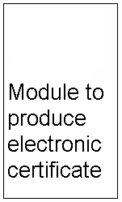




Exchange mechanism
Electronic certificates issued in Exporting country
13

Slide 14



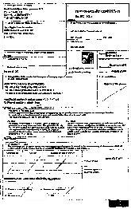
Electronic certificates received in Importing country

Slide 15
Scenario’s : what can you do with e-cert data
1. Print the E-cert data and compare with the data in the Paper certificate
Minimal Change to IT & Procedures
Reduction to fraude
Extra work

Slide 16
Scenario’s : what can you do with e-cert data
2. Use the E-cert data in the Import System to support the Import Process
Medior Change to IT & Procedures
Reduction to fraude
More efficient (all data is available to all inspectors and earlier in the proces)
Better risk analysis

Slide 17
Scenario’s : what can you do with e-cert data
3. Process the E-cert data in the Import System to perform automatic checks and risk analysis
Maximum Change to IT & Procedures
Reduction to fraude
More efficient (Inspections can be partly done automatically )
Better risk analysis

Slide 18
Scenario’s : what can you do with e-cert data
4. Use the E-cert data in the Import System as an legal alternative for paper (paperless)
Maximum Change to IT & Procedures, additional change of law
Best protection against fraude
Most efficient (Authenticity check automatically, Inspections can be partly done automatically )
Additional security required (Digital Evidence)

Slide 19
Ⅱ. Business Process
Status Transition
Import Inspection – Permitted States for Transition
Initial
By SOAP Client of Import Agency
Acknowledged
Approved
By Import Inspector
Accepted
Replaced
Rejected
Detained
ToBe Replaced
Withdrawn
Request Replacement
Replacement
Authorised
Revoked

Slide 20
Questions ?
Lex Moret
A.J.Moret@DICTU.nl

