Slide 1







Slide 2

Who am I
Head of IT strategy and Architecture
Represent Sweden in DTLF
National expert in EMS group

Slide 3



Slide 4
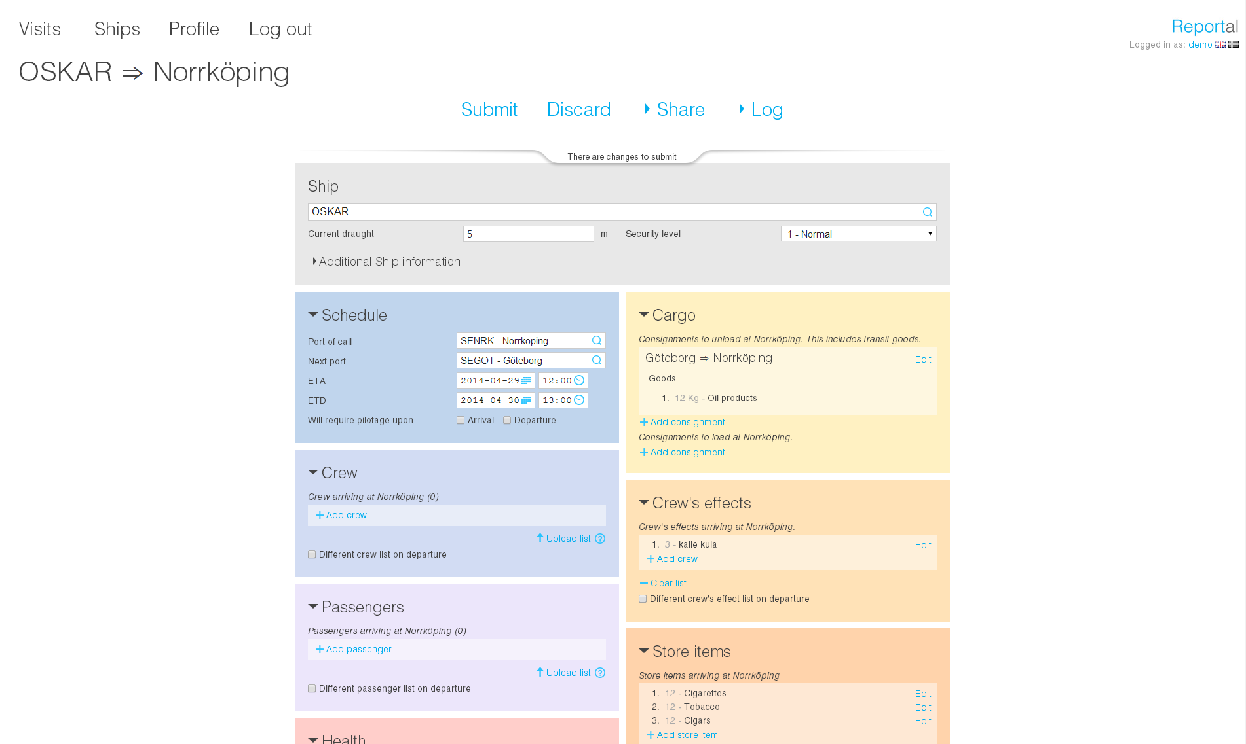

Slide 5
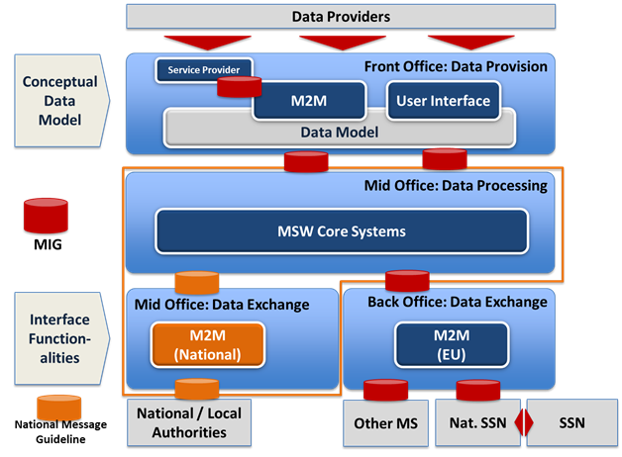
Logical Architecture
Notes:
Nämn att vi har implementerat ett sk single automated system where the authorities has a integration with the MSW

Slide 6
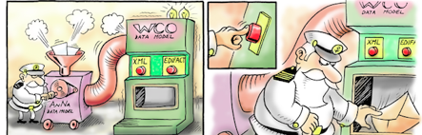
The datamodel mapped to declaration types
MAI The messages comes in 2 flavors
NOA
NOD
PAX
HAZ
…………….

Slide 7

Current status
Production since 1/10 2015 (including port of gothenburg via PCS)
Coast guard joined as of March 2016
Customs join first of June 2016
Expand the MSW with Pilot ordering this autum
Expand the MSW with payment of fareway dues this autum
Notes:
Nämn det som Lance tog upp med privata aktörer, vi har det inne i vårt MSW.

Slide 8

THANK YOU!

