Slide 1
eManifest – European MSW
Meeting with WCO, UN/CEFACT, ISO
Philippe Duchesne / Senior project officer
Unit C.2 Vessel & Port Reporting

Slide 2
EMSW background
European Maritime Single Window Prototype
Objective
Support EU Member States in setting up at national level a maritime single window according to EU Directive 2010/65/EU
Involvement of EU Member States
Expert Group lead by EU Commission and EMSA
Applies EU National Single windows guidelines
Development lead by EMSA with support of group of participating countries
Data format derived from ISO 28005 standards for XML-based electronic port clearance
Harmonised data structure for all participating countries
2

Slide 3
Formalities
FAL forms and conventions
FAL 1: General Declaration
FAL 2: Cargo Declaration
FAL 3: Ship’s Stores Declaration
FAL 4: Crew’s Effects Declaration
FAL 5: Crew List
FAL 6: Passenger List
FAL 7: Dangerous Goods
Maritime Declaration of Health
Formalities from legal acts of the EU
72h PSC pre-arrival
Pre-arrival,
Actual arrival and departure
Border checks on persons
Dangerous or polluting goods
Waste and residues
Ship pre-arrival security information
Formalities from national legislations
Waste delivery receipt
Bunkers on board
Certificates
3

Slide 4
eManifest - Objectives
Phase 1 - 2016
  A harmonised eManifest encompassing cargo formalities required by both maritime and customs authorities
  Reduce the administrative burden of the shipping industry by applying the reporting once principle
  Test processes which will increase the efficiency of the maritime transport
  17 Member States interested in participating in project
  WSC, ECSA, ECASPBA, ESPO, FEPORT, IPSCA are consulted
Implemented and tested with the European Maritime Single Window Prototype

Slide 5
eManifest - Scope
Additional customs formalities related to arrival notifications
  Arrival Notification,
  Presentation Notification,
  Declaration for Temporary Storage,
  Transit by sea (simplified transit)
  Proof of Union (PoU) status:
    MRN obtained from a proof of union system, or
    Customs Good Manifest (CGM)

Slide 6
EMSW Configuration
Only one prototype will be developed but accessible by different Member States who can configure it in accordance with national requirements
  One harmonised data model for all MS
  Individual data elements can be deactivated per country
6

Slide 7
Message sequence
Information is reported in Notification messages, to
  Request port clearance to enter or leave the port
  Fulfil customs formalities
  Report the actual arrival or departure of the ship
Two types of Notifications
  Arrival, Departure
EMSW returns a technical Receipt message
Communication of authorities’ decisions and feedback through Acknowledgment messages
  Port clearance, customs feedback

Slide 8
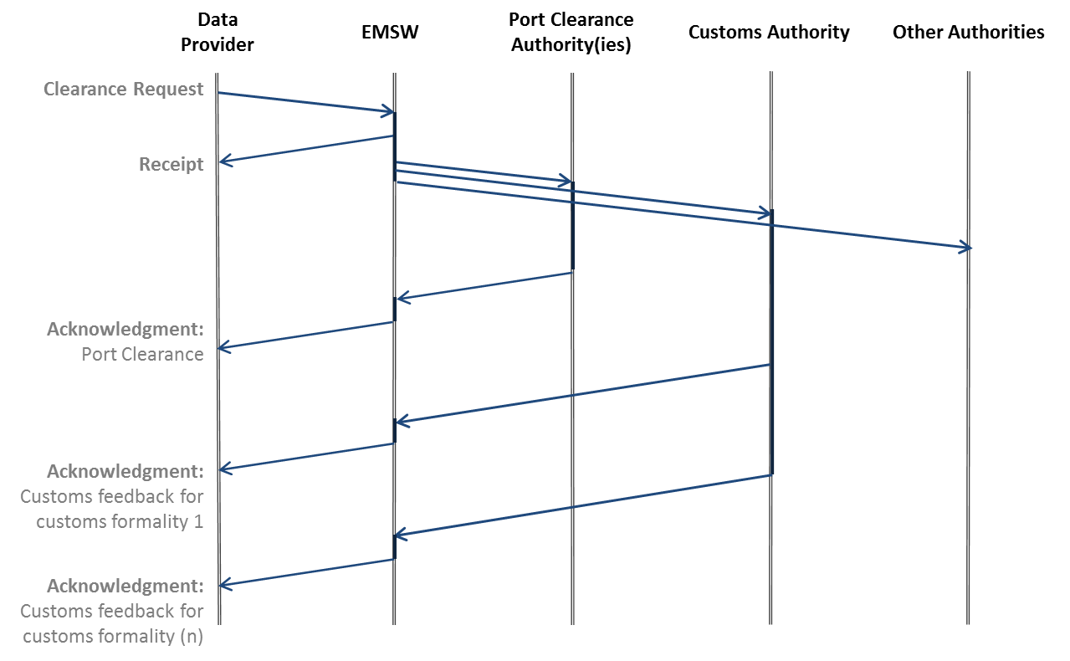
Message sequence

Slide 9
Data mapping
Reporting once principle
  All supported formalities mapped into one unique set of data elements
  Data Mapping-eManifest-20160307.xlsx

Slide 10
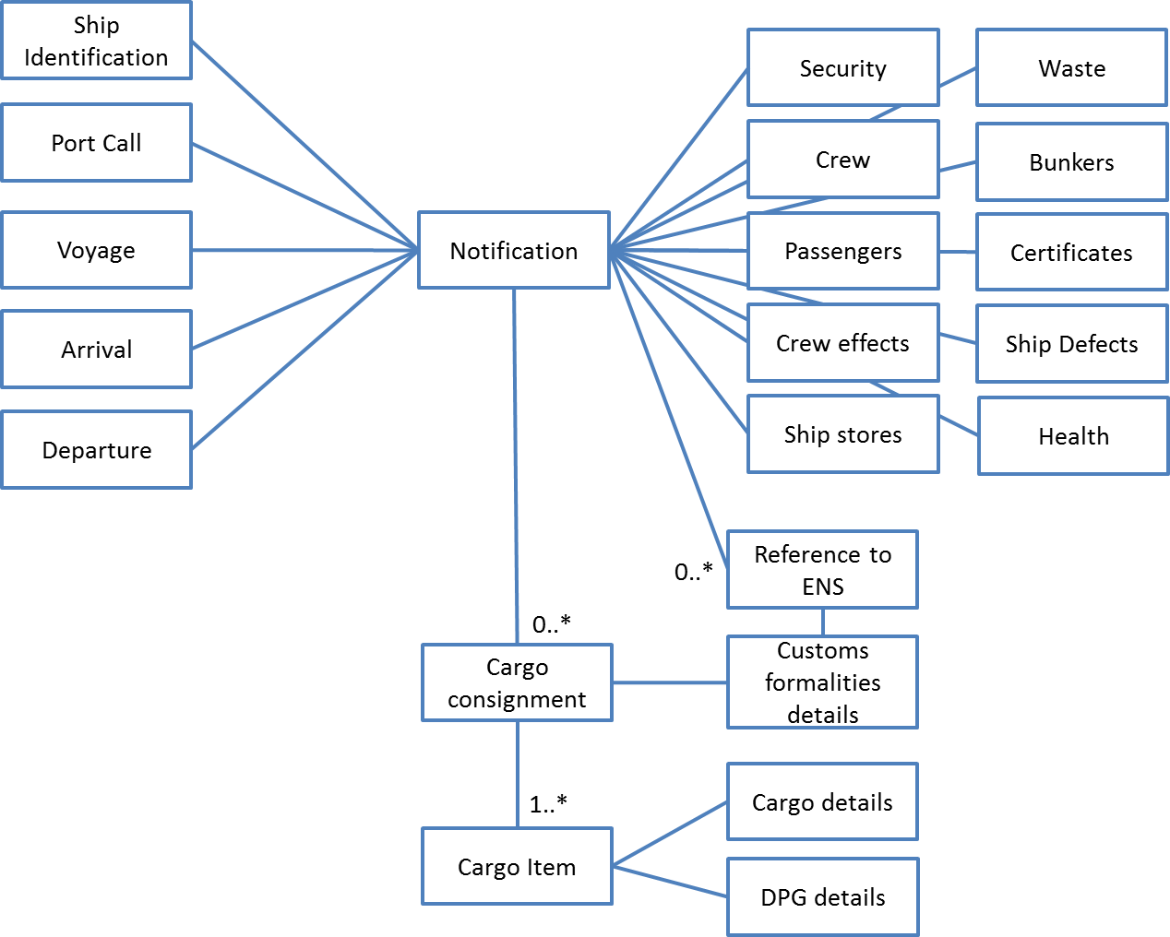
Data structure

Slide 11
Messages standards
Project phase 1
  XML format derived from ISO 28005
Future developments
  EDI/EDIFACT requested by user community
  WCO data model

Slide 12
www.emsa.europa.eu/nsw.html

