Slide 1
EPIX integration
May 2020

Slide 2
Agenda
Background
Business processes
Components
Exchange of information

Slide 3
Background
MOU signed between UNCTAD and its ASYCUDA programme and the CITES Secretariat in 2010
Signing of a project with the CITES Secretariat in December 2018 to develop the eCITES@asycuda BaseSolution
Signing of a project with the Sri Lanka Department of Wildlife Conservation (DWC) in April 2019 to deploy the eCITES@asycuda in Sri Lanka

Slide 4
Business process
Automated permit request and issuance
Electronic payments of fees
Electronic information exchange and workflow between government agencies
Implementation of modern risk management methods
Exchange of trusted and up-to-date permit information between authorities in the exporting and importing country
Automated generation of data for annual trade reports and other relevant reports
Notes:
- Automated permit request and issuance including electronic requests of permits by traders, scheduling of inspections, recording of inspection results and issuance of permits to simplify procedures, reduce transaction time and make best use of the resources of the management authority
- Electronic payments of fees to increase revenue and reduce opportunities for corruption
- Electronic information exchange and workflow between government agencies, in particular between the Management Authority and Customs to strengthen controls
- Implementation of modern risk management methods based on past compliance of traders which may lead to preferential treatment of compliant traders
- Exchange of trusted and up-to-date permit information between authorities in the exporting and importing country
Automated generation of data for annual trade reports and other relevant reports

Slide 5
Components
ePERMIT
Request and issuance of ePermits (paper and electronic)
Management and storage of CITES trade data for CITES annual reporting
Inspection/risk assessments
Payments
eCONTROL
Permit information exchange with Customs
Risk management and validation at export
Single Window integration
eREPORT
Automated exchange of national permit data from country to CITES Secretariat and UNEP WCMC EPIX to generate statistics and CITES reporting
eEXCHANGE
Exchange of national permit data between countries
Cross-border traceability of CITES permits

Slide 6
eCITES base solution components
Single Sign-on
Profile Management
Dashboard
Mobile Compatible
User Management
Easy Navigation
Accounting module
CITES Information Management
E-Documents and Operations
Reference Tables
Reporting tool
Restful application
Notes:
The system comprises all relevant CITES information (including CITES Appendix or national Annexes etc)
This information will be used by the Trader/Applicant when filling-in the Application/Request for CITES permit.
As result, the applications submitted to MA are accurate.
- Facility to adopt stricter domestic measures and include some non-CITES species

Slide 7
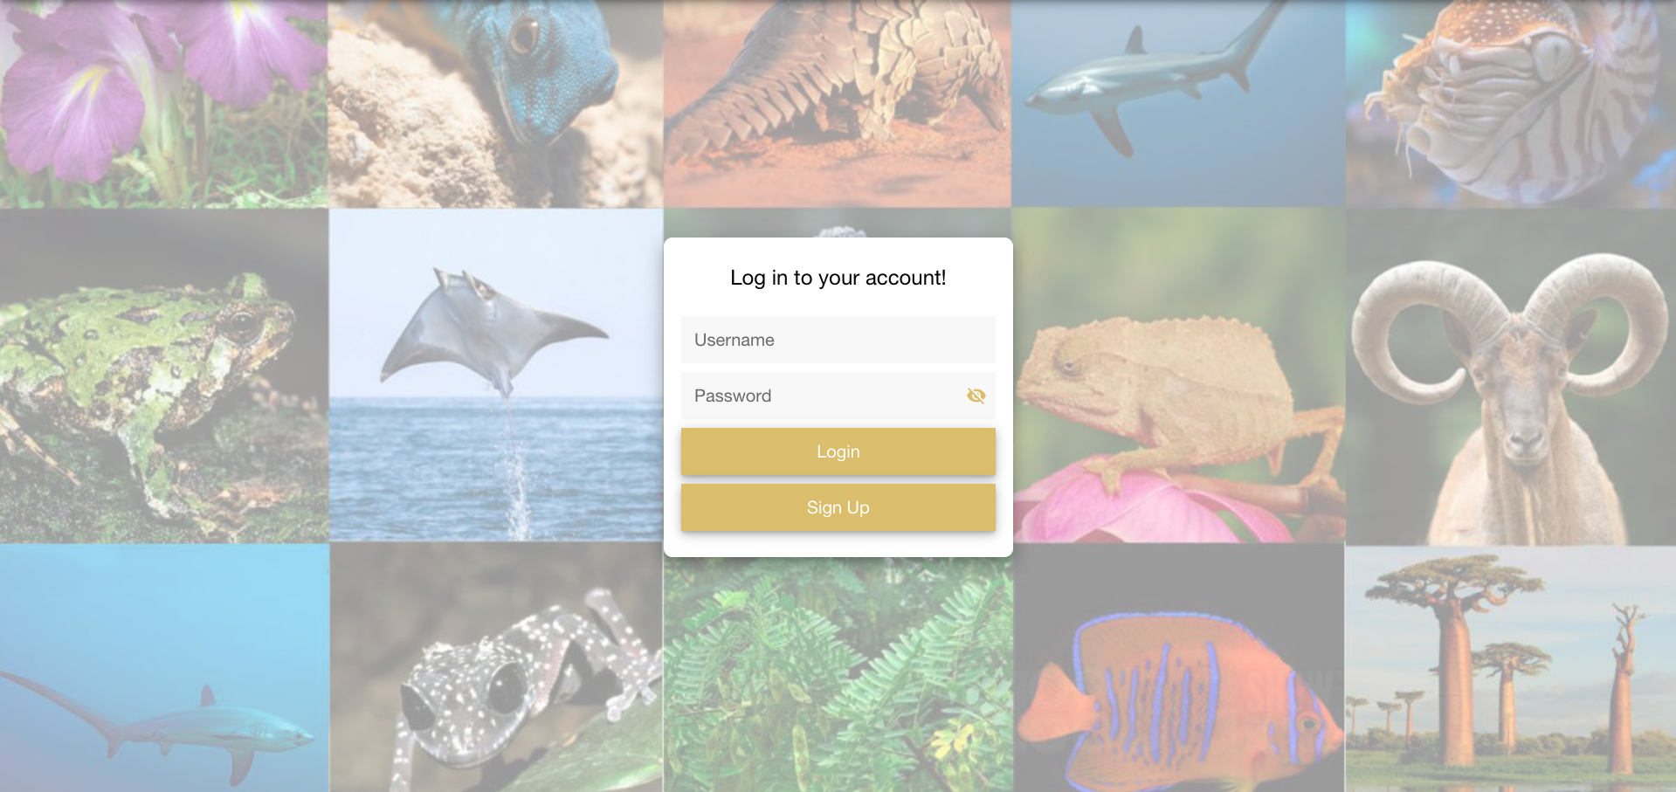
Login

Slide 8
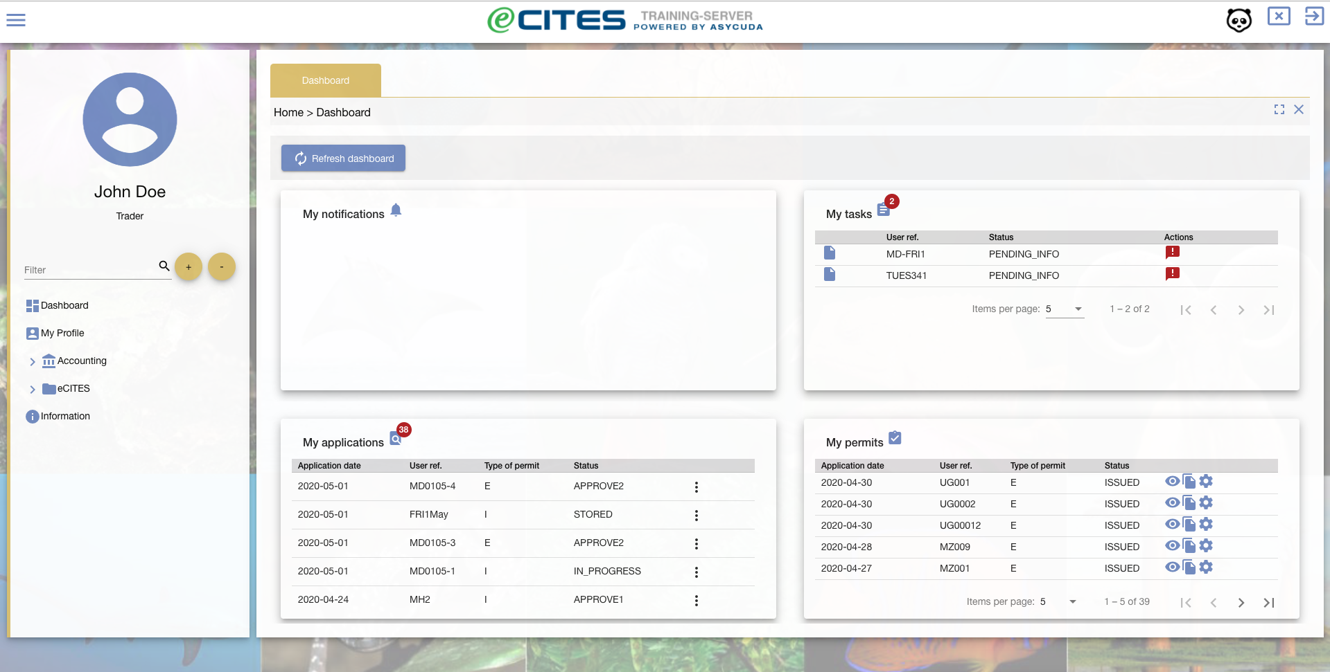
Dashboard

Slide 9
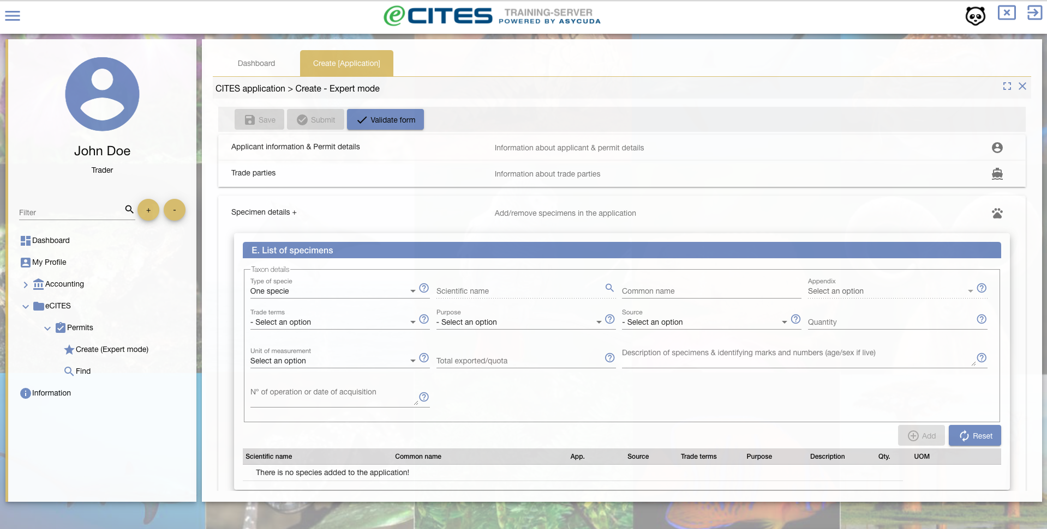
Permit creation form

Slide 10
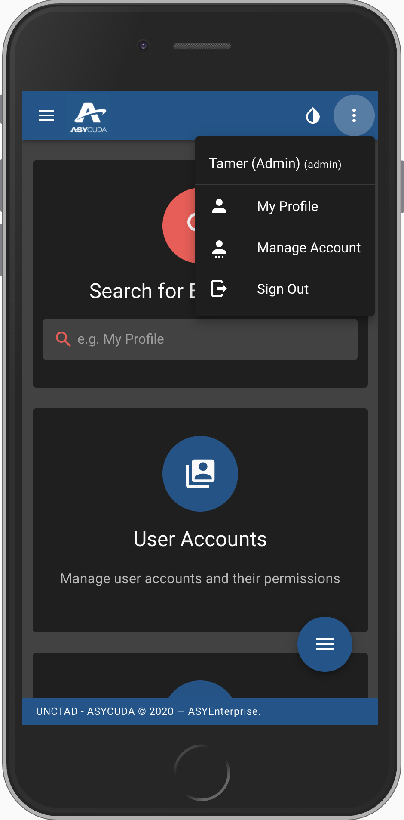
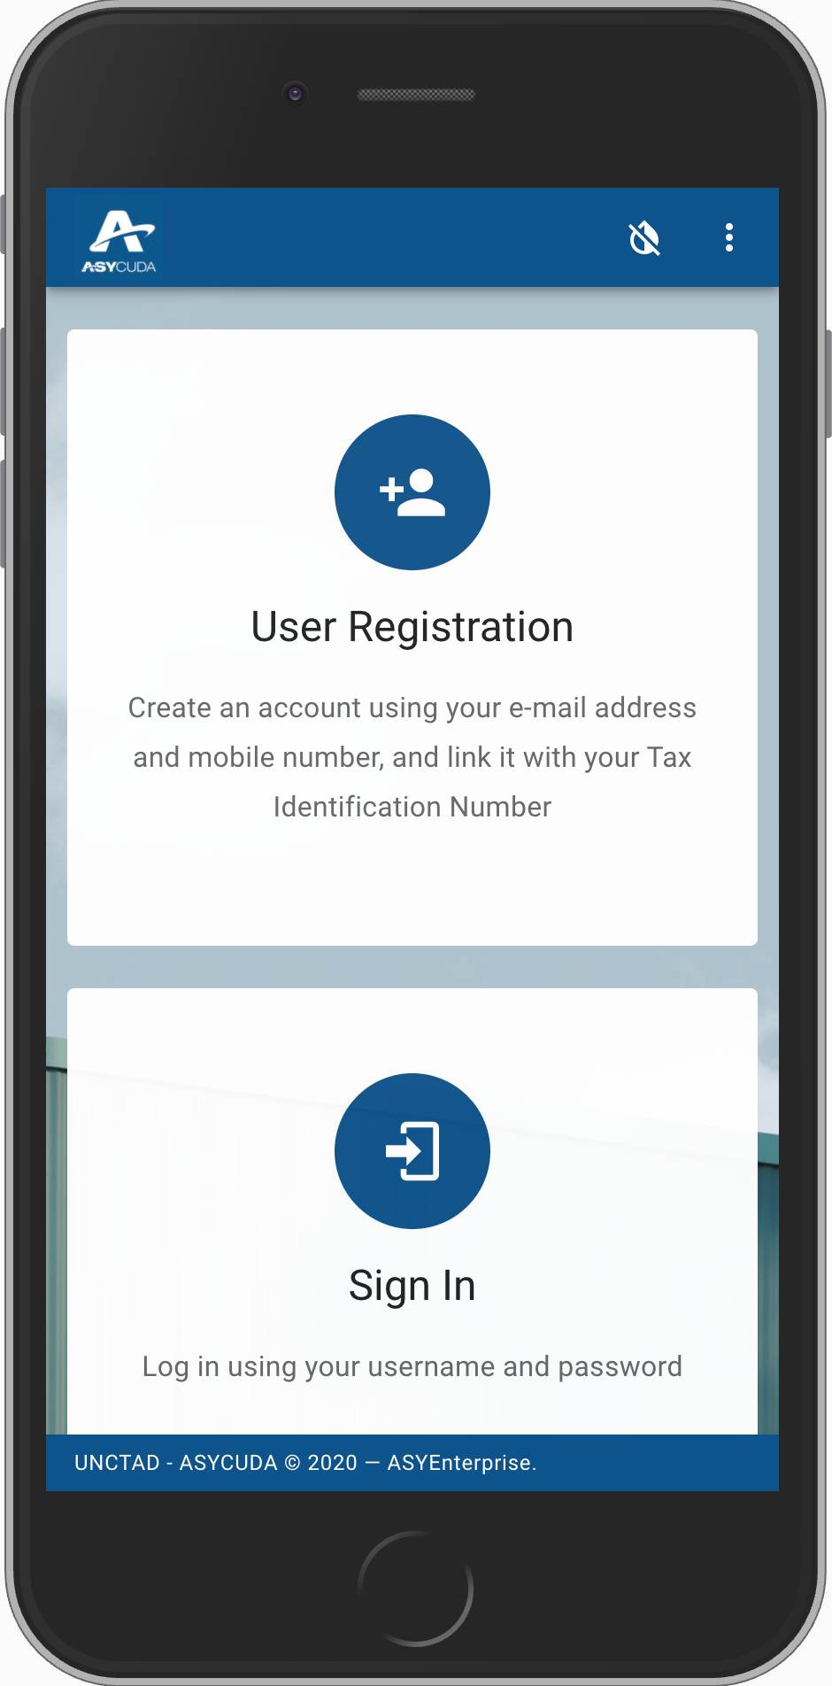
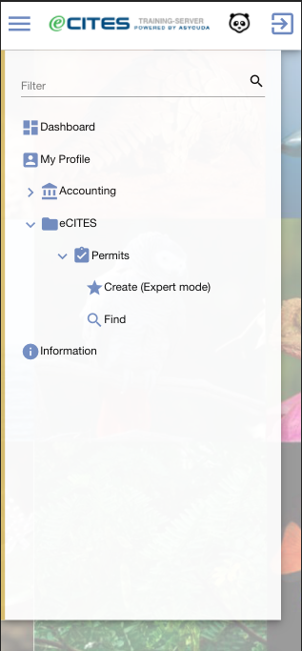
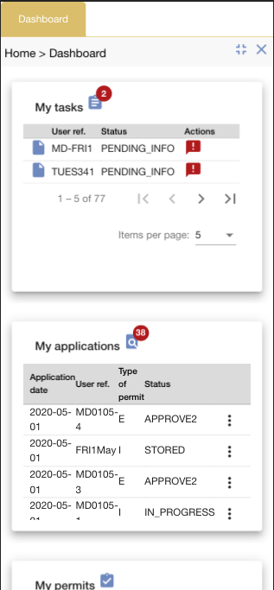
Works on Mobiles, Tables of any screen size

Slide 11
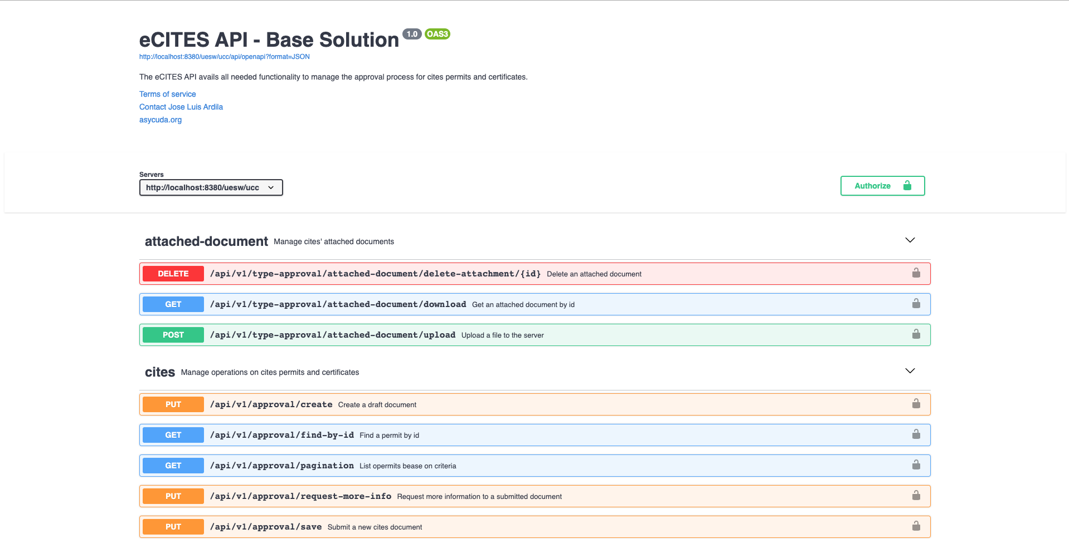
Automatic API Docs Builder

Slide 12
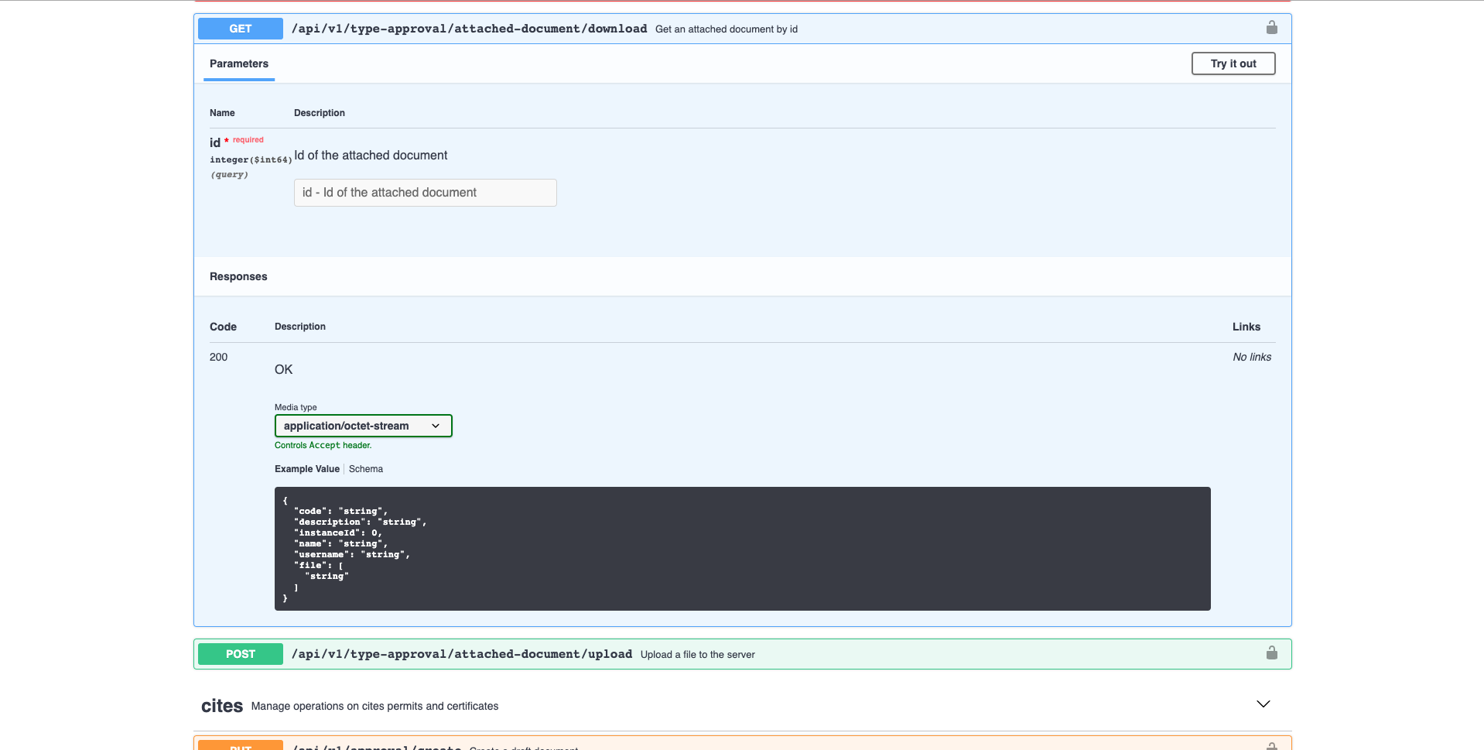
API Testing

Slide 13
Thank you

