Slide 1

A global partnership to facilitate
safe trade
Simon Padilla, STDF Secretariat
UNECE/UNESCAP Task Force and Electronic Exchange of CITES permits
16 July 2020

Slide 2
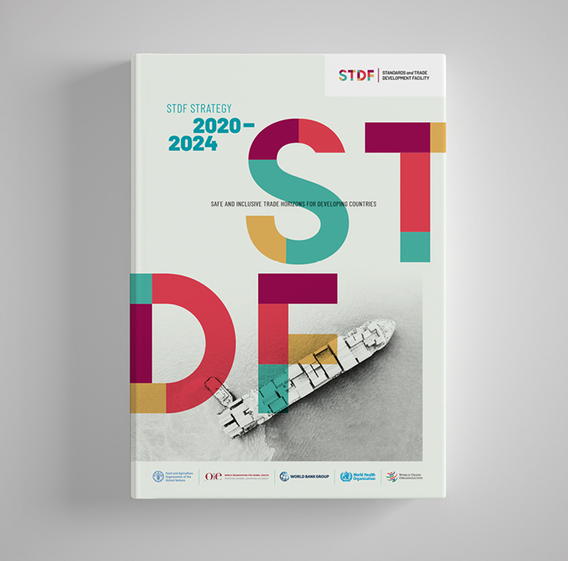
STDF Strategy, 2020-2024
Building on STDF's track record
Further developing the partnership to expand reach and resources
"The STDF is responding to the needs of developing countries in its focus on building SPS capacities to enable and unlock trade."
“The STDF and the STDF Secretariat have delivered outputs and results beyond what might be expected given their budget and resources." External Evaluation, 2019

Slide 3

STDF’s theory of change

Slide 4

Knowledge work
Good practice on latest
SPS solutions
Public-private partnerships
Facilitating safe trade
Electronic SPS certification
Good regulatory practice
Prioritizing SPS investments

Slide 5

Trade Facilitation Agreement (TFA)
Entered into force on 22 February 2017
Applies to all relevant border agencies (including SPS)
Goal: Expedite movement, release & clearance of goods

Slide 6

Electronic SPS certification
How electronic SPS certification can contribute significantly to facilitating safe trade
STDF seminars and projects:
  STDF seminar on SPS e-Cert, Geneva, June 2016 www.standardsfacility.org/SPS-eCert
  Transitioning from paper-based to automated SPS systems, Geneva, July 2017: www.standardsfacility.org/A4T_Review_2017
  ePhyto (FAO/IPPC, WBG, WCO, CITES, CFIA, USDA, private sector) - www.standardsfacility.org/PG-504
  eVet based on Single Window (OIE/FAO/WB) - www.standardsfacility.org/PG-609
E-cert

Slide 7

Electronic SPS certification
STDF e-Cert Advisory Committee (ECAC)
Share information on initiatives related to SPS e-Cert and to facilitate linkages and synergies between these initiatives to maximize outputs and reduce
www.standardsfacility.org/sps-ecac

Slide 8
The ePhyto Solution
In the beginning
Point-to-point transmission
Point-to-point exchange is when ePhyto exchange occurs directly between an exporting country and an importing country.
In each case, the country needs to establish separate bilateral arrangements with each country to facilitate exchange.
High costs for establishing separate connections (@$120K per connection) and significant annual costs ($20K-100K) for maintaining separate connections with each partner country

Slide 9
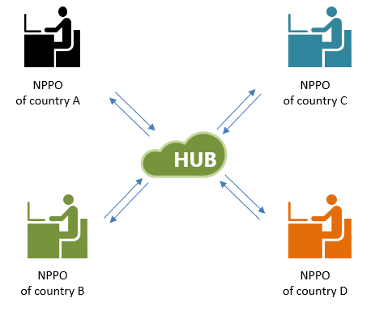
The ePhyto Solution
ePhyto: Globally harmonized system to exchange electronic phyto certificates
Improved security and reduced potential for fraudulent certificates
Efficiencies in the arrival and clearance of plants and plant products
Reduce need for bilateral agreements
See more: standardsfacility.org/PG-504
"The STDF work on electronic certification and the ePhyto project offered the impetus for the World Bank and IPPC Secretariat to deepen their collaboration on SPS capacity
building and trade facilitation.“ Bill Gain, World Bank Group

Slide 10
The ePhyto Solution

Slide 11
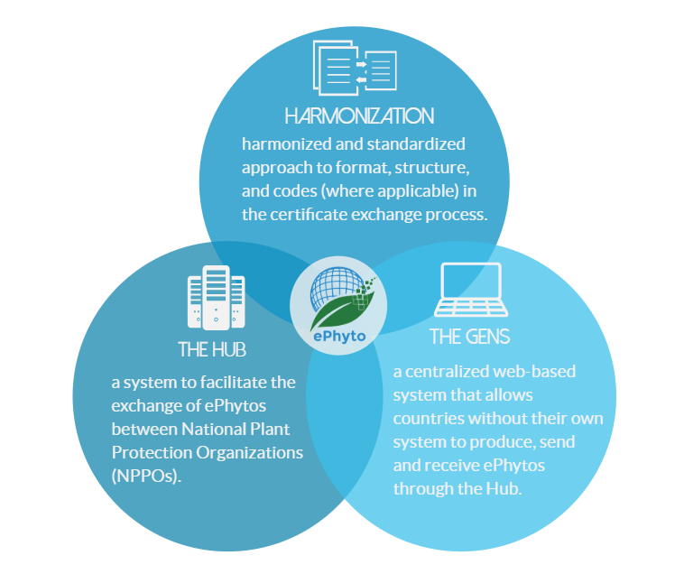
The ePhyto Solution
What is the ePhyto Solution
The ePhyto Solution is a system managed by the International Plant Protection Convention (IPPC), and designed, developed and hosted by the United Nations International computing Centre (UNICC).
The ePhyto Solution is funded by the STDF and Donor Countries.
The system has 3 core components: Harmonization, the Hub and the Generic ePhyto National System

Slide 12
The ePhyto Solution

Slide 13
The ePhyto Solution

Slide 14
The ePhyto Solution

Slide 15
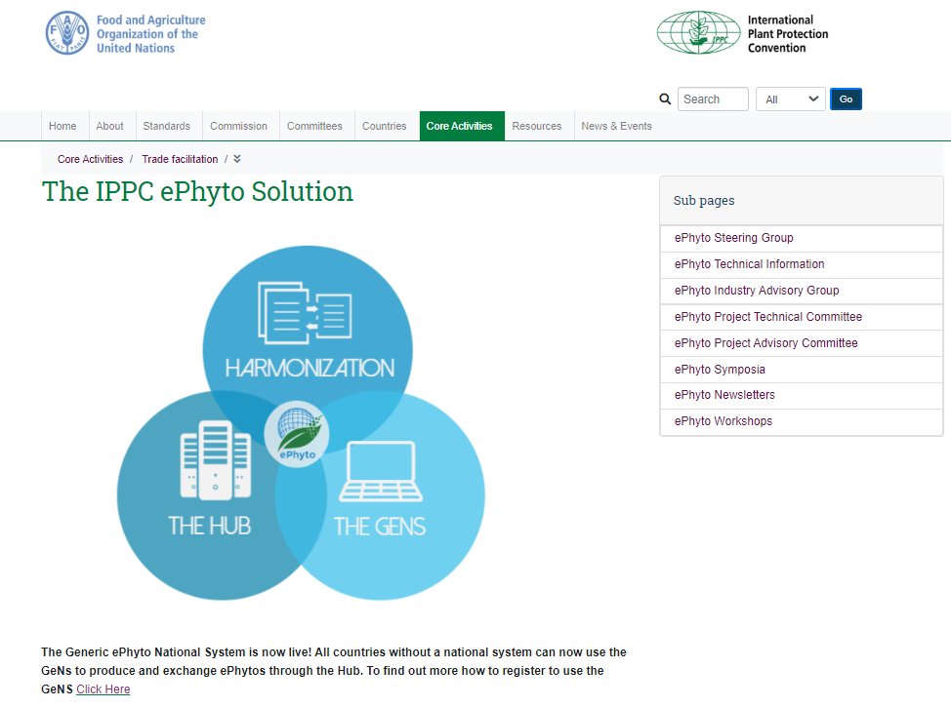

The ePhyto Solution
Recent highlights
The IPPC ePhyto Solution website:
https://www.ippc.int/en/ephyto/
The IPPC ePhyto Solution training platform:
https://www.ephytoexchange.org
ePhyto numbers:
80+ countries connected to the ePhyto Hub
40+ countries exchanging ePhytos
11,000+ ePhytos exchanged per month
Connection with EU TRACES system established
Particularly relevant COVID-19 crisis

Slide 16

Electronic SPS certification
Facilitating eVet certification based on SWs
Taking stock of how veterinary authorities are using e-certification
Learning from other relevant work and experiences
Developing recommendations and a plan to move forward
See more: standardsfacility.org/PG-609

Slide 17
Electronic SPS certification

Slide 18


Electronic SPS certification
Cherry on the cake?
e-Cert is effective when countries already have effective paper-based SPS certification systems, including functioning institutions and adequate legislation
e-Cert does not solve systematic failures in national SPS import / export control systems
Avoid risk that automation delivers the cherry, without the cake!
Source: M. Pikart, UNECE, STDF Seminar on e-cert, 2016

Slide 19


To know more about the STDF
STDFSecretariat@wto.org
Simon.Padilla@wto.org

