Slide 1

Guidelines and specifications for Electronic Permit Information eXchange (EPIX) of CITES permits and certificates
Markus Pikart
UNECE Trade Division
- Trade Facilitation Section -
Markus.Pikart@un.org
UNECE
June 2020

Slide 2
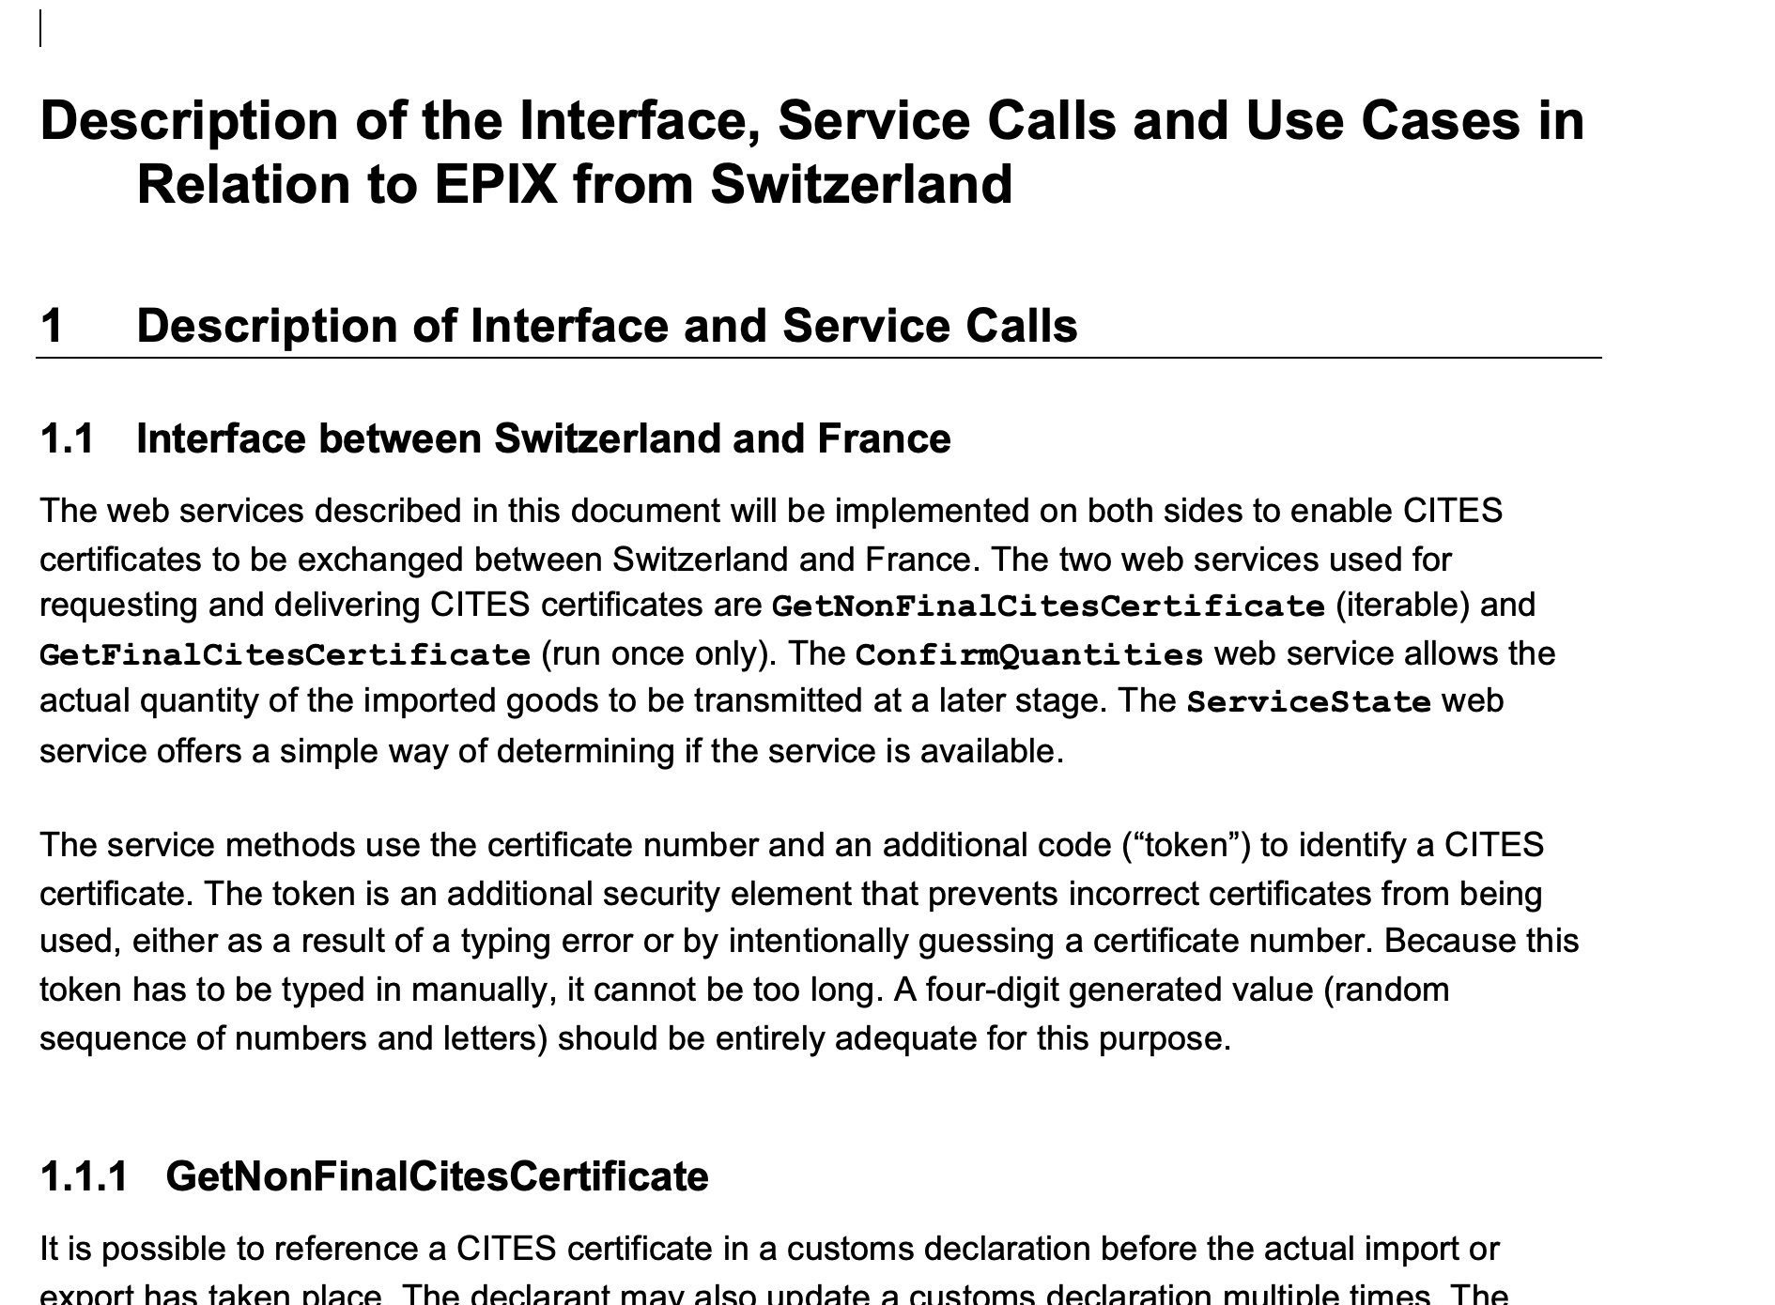
Once approved you will have access to the task force Website

Slide 3
All current EPIX pilots are based on the Swiss documentation
We need to abstract from the Swiss system and create a documentation for EPIX standards that is independent from the Swiss system
We need to find a controlled and independent maintenance process

Slide 4
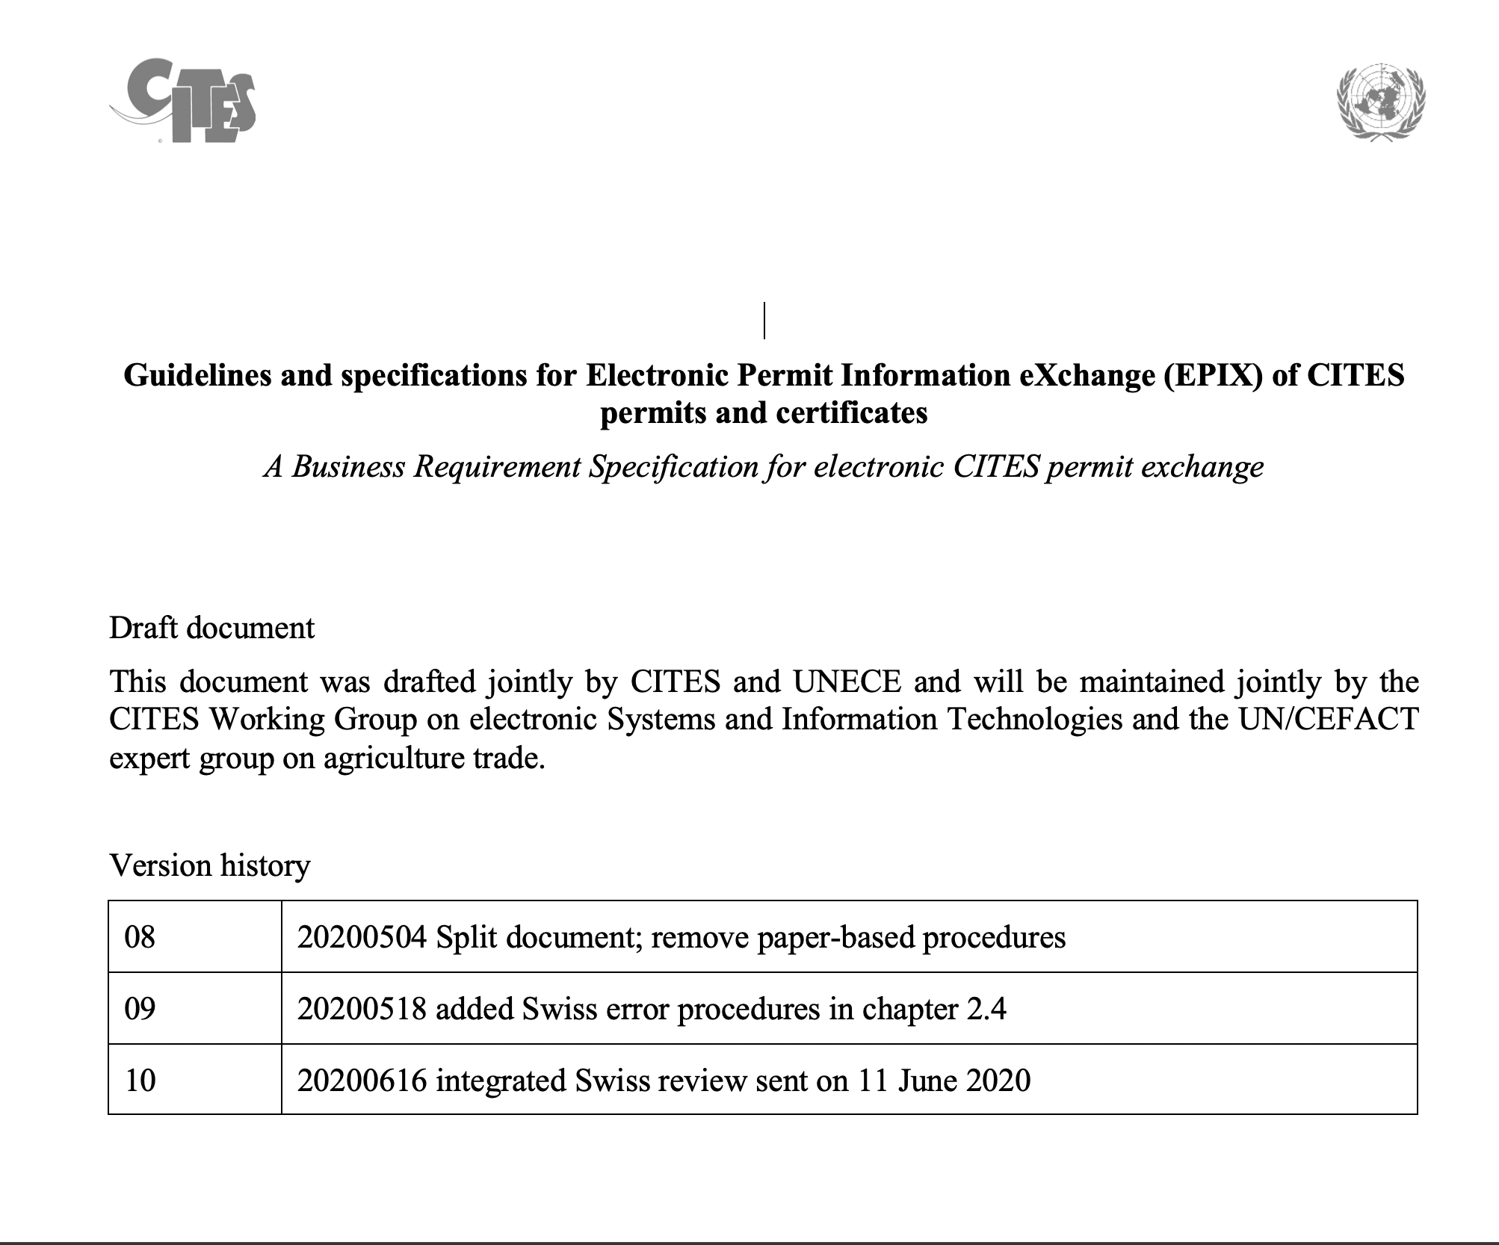

Slide 5
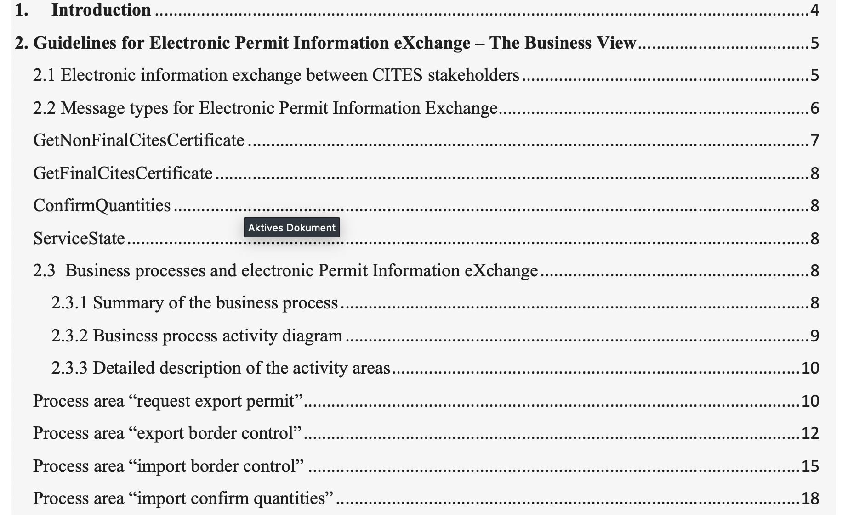

Slide 6
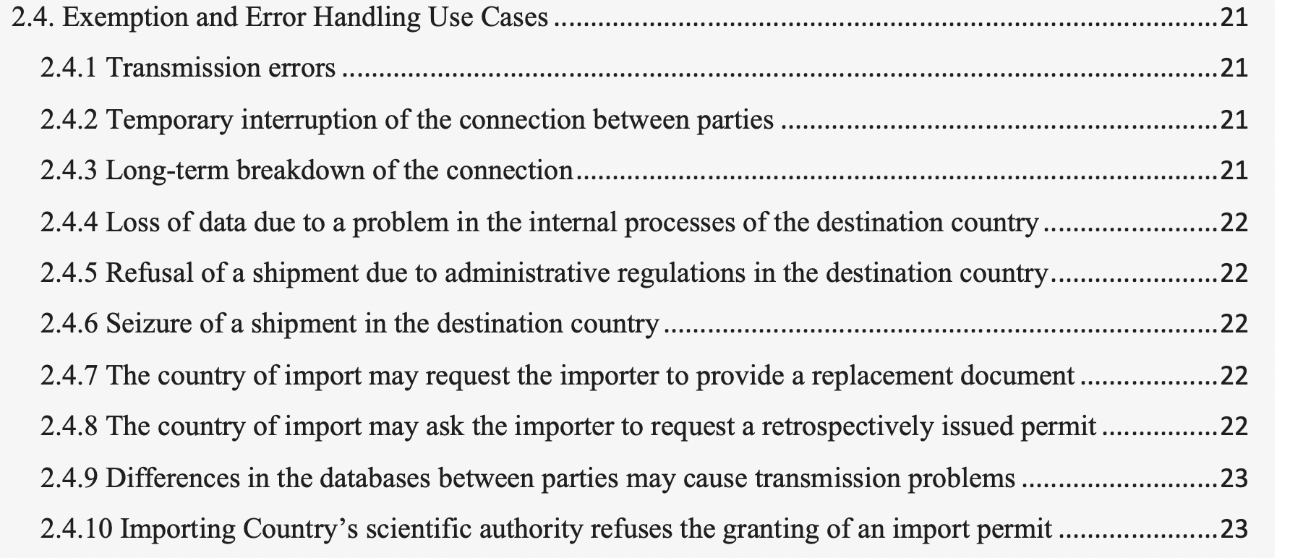

Slide 7
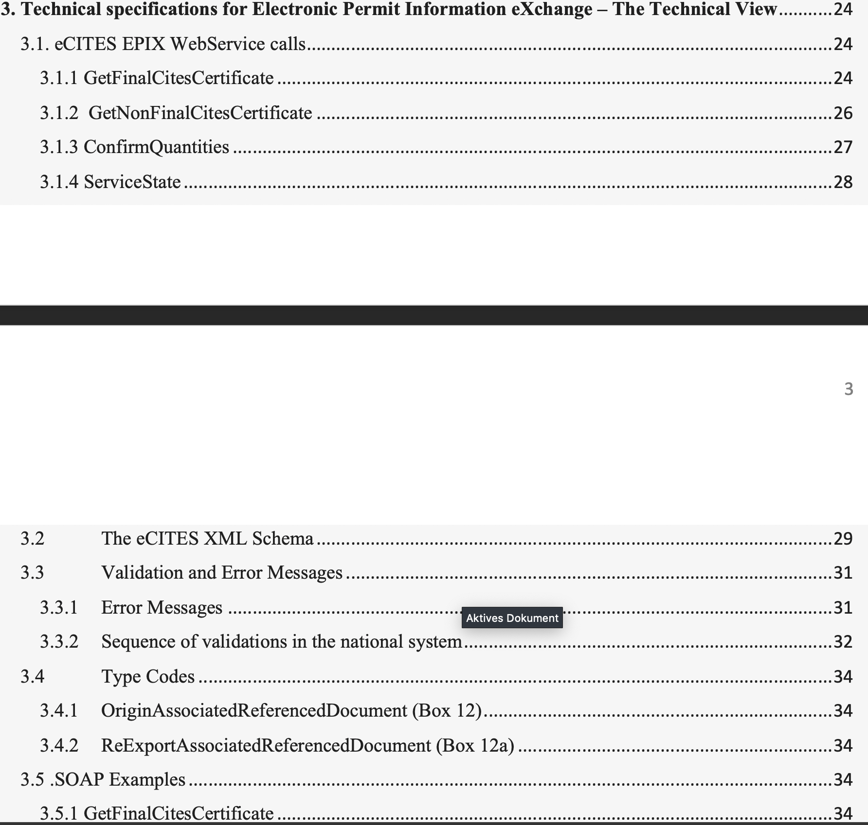

Slide 8
Guidelines and specifications for Electronic Permit Information eXchange (EPIX) of CITES permits and certificates
New documentation is 100 % compatible to the documentation of the Swiss system
New EPIX implementations should be based on this documentation
Documentaiiton should be updated to take into accpunt new experiences
We suggest to review the document in this group and present it to
  CITES WG on electronic systems and information technologies
  CEFACT Agriculture Working Group

Slide 9
Thank you!

