Slide 1
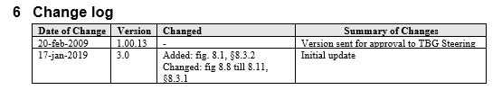
Initial update BRS
- a starting point -

Slide 2
Delivery Process – Adding Receiving Advice
Scope of the despatch and
receive process diagram
Positioning diagram in Buy-Ship-Pay
Entity Life Cycle diagram
Business Process Activity Diagram
Business Collaboration Protocol
- Activity Diagram
The Business Collaboration diagram
Business Information View
Despatch And Receive Of Goods
Delivery Process
Business Transaction Use Case Diagram
Correct Despatch Advise
Business Transaction Use
Case Diagram Advise Despatch
Business Transaction Use Case Description
Correct Despatch Advise
Business Transaction Use Case
Description Advise Despatch
Activity Diagram Correct Despatch Advice
Business Transaction Use Case Diagram
Advise Receipt
Activity Diagram Advise Despatch
Activity Diagram Advise of Receipt of Goods
Business Entity Class Diagram – Trade Delivery
Business Transaction Use Case Description Advise Receipt
Business Entity Class Diagram – Trade Product
Business Entity Class Diagram – Despatch Advice
Business Entity Class Diagram – Receiving Advice
Business Document – Despatch Advice
Business Document – Receiving Advice

Slide 3

Receiving Advice almost a mirror image of Despatch Advice?
Despatch
Advice
Receiving
Advice
Dealing with
quantities differences
and
other discrepancies
Published
As
doc centric
&
SCRDM CCBDA version

Slide 4
Bringing in Receiving Process Related Entities
Goods Receipt Physical State Code
Received Quantity
Goods Receipt Physical State Description
Rejected Quantity
Goods Ownership Change Date
Returned Quantity
SCRDM
Receiving Process
Related
Destroyed Quantity
Actual Receipt Event
Quantity Variation Reason Code
Actual Unloading Event
Quantity Discrepancy Nature Code
Handling Event
Product Additional ID
Material Returns Document
Disposal Party

Slide 5
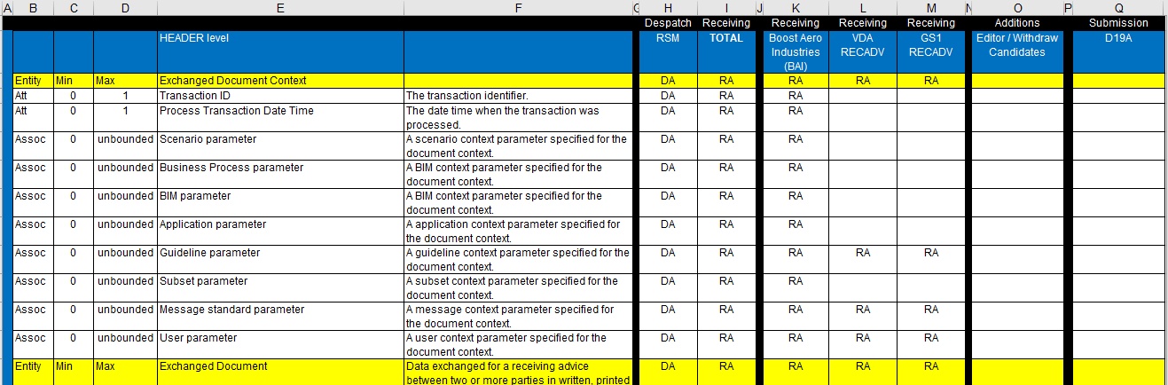
Based on requirements Receiving Advices
(UN/CEFACT, BAI, VDA, GS1)
Requirements
Gathering
(checking)

Slide 6
Fig. 8.1. Added diagram from UN/CEFACT
ISCM proces model

Slide 7
Fig. 8.8
Updated diagram Despatch Advice

Slide 8
Fig. 8.9
Added diagram Receiving Advice

Slide 9
Fig. 8.10
Updated diagram
Product

Slide 10
Fig. 8.11
Updated
Diagram
Trade Delivery

Slide 11
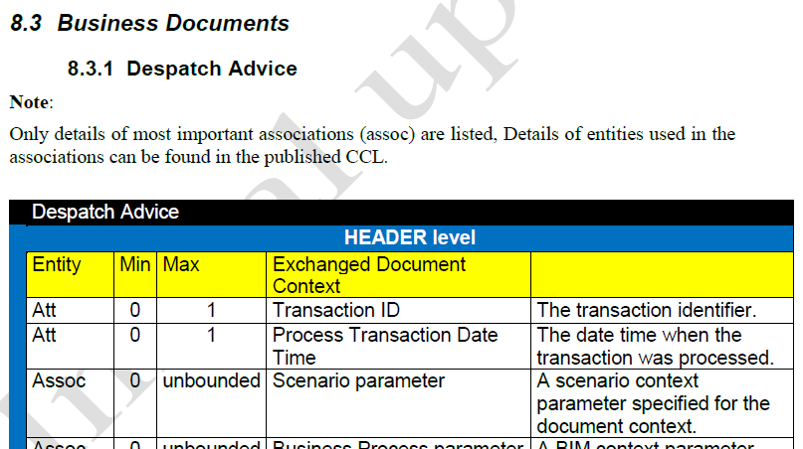
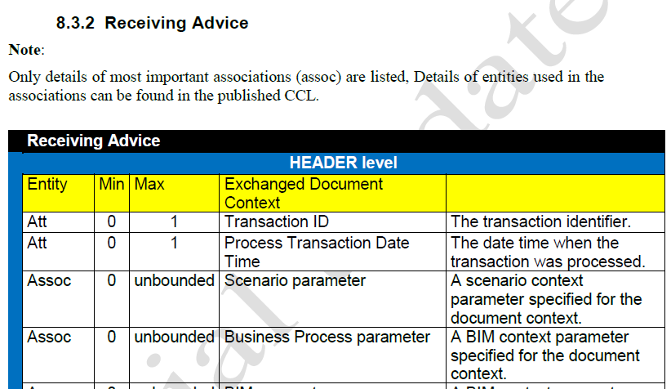
Paragraph 8.3.1
Updated
Despatch Advice
Message table
Paragraph 8.3.2
Added
Receiving Advice
Message table

