Slide 1
REVISED
CROSS INDUSTRY DELIVERY PROJECT
Rolf Wessel, Project Lead
Gerhard Heemskerk, Project Lead Editor
UN/CEFACT Forum 4th April 2019

Slide 2
Agenda, forum 4th april 2019
Short introduction of the project 9.00 – 09.15
BRS update 9.15 – 10.30
MA Despatch & Receiving Advice 11.00 – 12.30

Slide 3
PROJECT PURPOSE & Scope
PROJECT PURPOSE
- Receive Process – adding Cross Industry Receiving Advice
PROJECT SCOPE
- to exchange information concerning despatching & receiving of goods
missing requirement list
EXIT CRITERIA
1 - Completed revised BRS Public review and logs
2 - Completed CCBDA message structures
3 - CCs & BIEs integrated into the CCL
4 - Completed XML Schemas

Slide 4
BRS update
Process:
The business process description already includes the receiving process. Added text about automated invoice and scenarios using despatch (DA) and receiving advice (RA).
BIEs:
Actual mapped BIEs (DA) forms the basis of updated requirements lists.
Receiving Advice business document requirement list added.
Updates of recent 10 years processed in the requirement lists.
Diagrams:
Updated Message structure
Updated Product
Updated Trade Delivery

Slide 5
Updating Requirement lists of Business Documents
Actual mapped BIEs previous BRS (DA) is the basis
Requirement list of RA is almost equal DA (mirror)
Requirement list of RA contains specific BIEs
Despatch
Advice
Receiving
Advice
BIEs copied to Receiving Advice
CCL BIEs updates
Shared DA updates
Requirement gathering
Requirement gathering

Slide 6
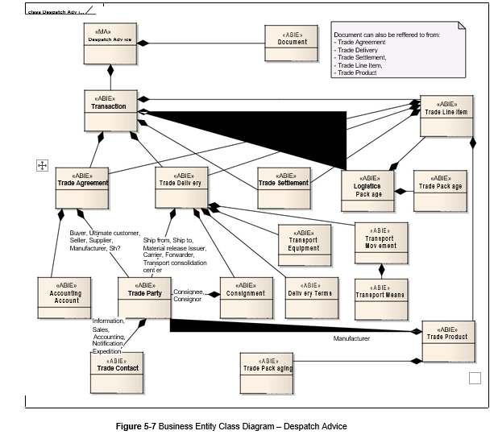
Update figure 5-7
- one model for both despatch & receiving advice, more detailed on logistics package
OLD
NEW

Slide 7
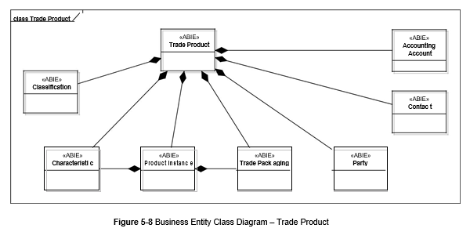
Update figure 5-8
- all associations covered. Accounting Account removed (never existed in product)
OLD
NEW

Slide 8
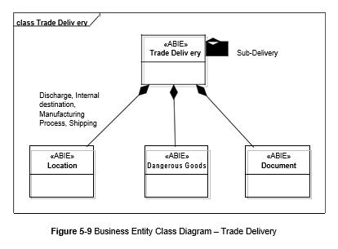
Update figure 5.9
- all associations covered.
OLD
NEW

Slide 9
Added diagram
(from un/cefact iscm.eap

Slide 10
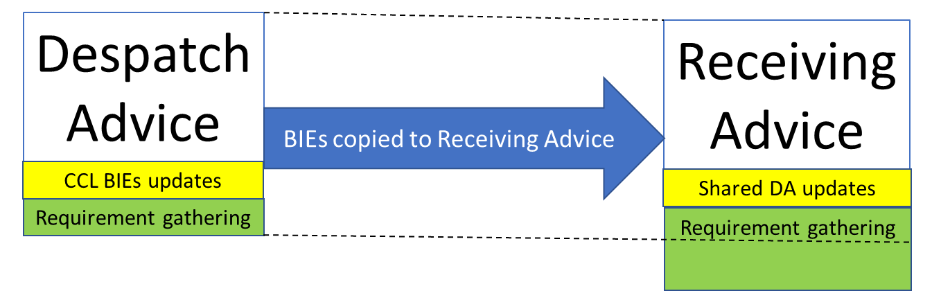
Concept Business document assemblies
(requirement gathering)
Initial contribution: BAI, GS1, VDA and UN/CEFACT Despatch Advice (DA) message
What’s in DA more or less RA.
DA Green → before not in DA
RA Green → decided to adopt in RA
DA/RA Blue → extra wanted by BAI
DA/RA Orange → Discuss
DA/RA Red → Dismissed
Schemas: Only CCBDA (SCRDM) based

Slide 11
Summary on business document assemblies
Most of actual mapped DA BIEs will be in RA
Most of additional BAI BIEs in RSM RA will not be adopted, only BAI mapped ones
More indicators used, such as Over Delivery Allowed, Partial Delivery Allowed
More references to link documents
Information added about:
  physical state of goods
  inventory, such as available and customer Inventory
  parties, such as disposal and inventory manager
  Goods Ownership Change Date
  Received-/Rejected-/Returned-/Destroyed Quantity
  Actual Receipt Event /Actual Unloading Event
  Consignee Internal Destination Location
  Ultimate Customer Assigned ID
  Degree Of Product Change
  Goods Receipt Note
  Dangerous goods

