Slide 1
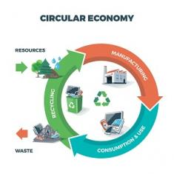
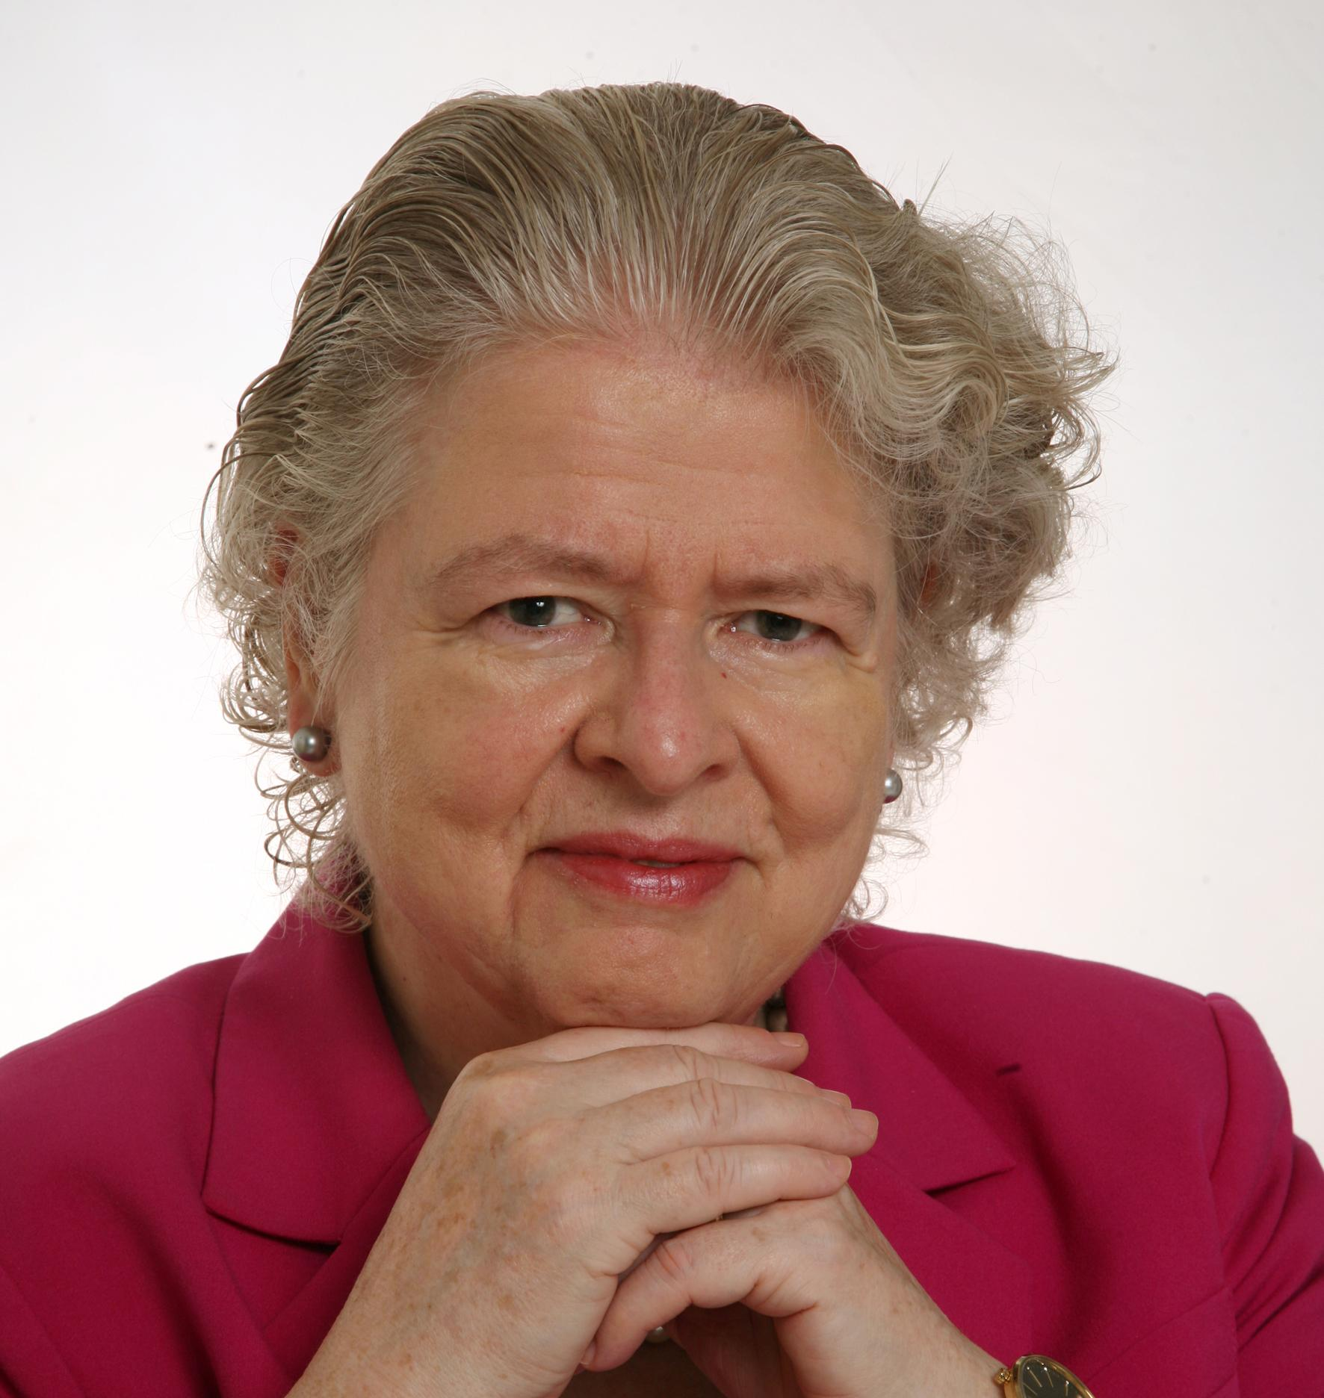
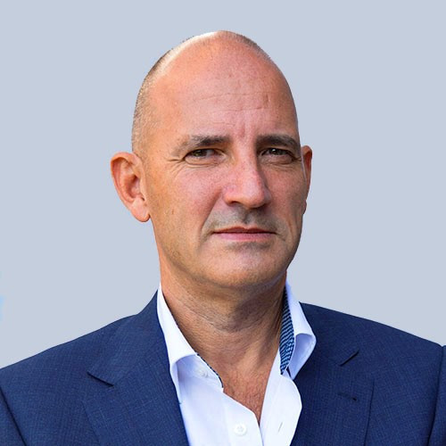
Product Circularity Data Project
Working meeting
1 September 2023
Virginia Martos-Cram, UN/CEFACT Project Lead
Gerhard Heemskerk, UN/CEFACT Editor

Slide 2
Item | AGENDA 1 September 2023 Working Meeting
1 | Opening remarks and meeting overview Virginia Martos-Cram, UN/CEFACT Project Lead
2 | Brief overview results last call Gerhard/Virginia
3 | Finishing touch to longlist (second session) Gerhard/Virginia
4 | Any other business and next meeting Virginia

Slide 3

Reminder - Project milestones?
ODP Stage (open Development Process) | Working Period | Maximum Duration
Requirements gathering | 01.2023 to 05.2023 | 4 months
Draft development | 05.2023 to 09.2023 | 4 months
Public Draft Review | 09.2023 to 11.2023 | 2 months
Publication | 11.2023 to 02.2024 | 3 months
Project exit | 02.2024 to 05.2024 | 3 months

Slide 4
Product Circularity Data Project
Working meeting
1 September 2023
2. Brief overview / results last call
Gerhard Heemskerk
Virginia Martos-Cram

Slide 5
Results last call: attributes becoming predefined values in a code list

Slide 6
Results last call moved elsewhere and dismissed
Moved elsewhere
Dismissed

Slide 7
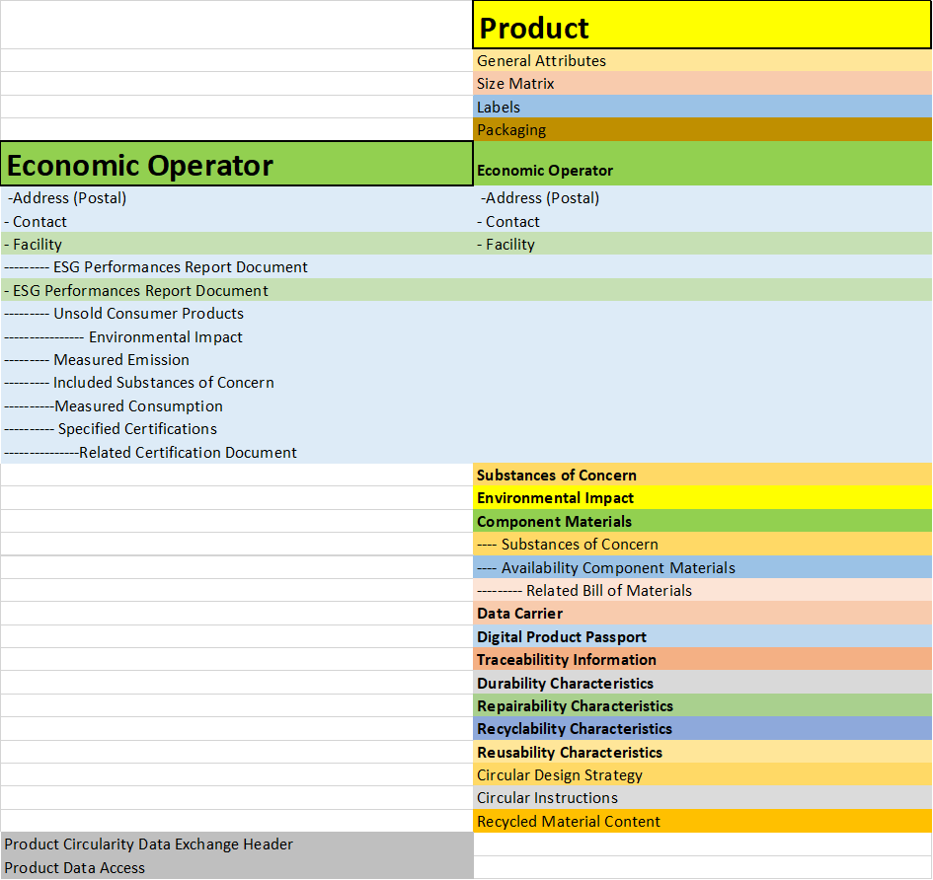
Entities overview
ESG performances on economic operator and facility level
Substances of Concern on product, component and emission (incl waste) level.
Certification details on the level of economic operator and the product.
Unsold consumer products entity for both discarded and destroyed aspects.
Waste disposal delivery total measure (renamed, is waste from unsold consumer products)
Certification references documents: inspection results, test results, conformity declaration, test protocol conditions, chemical safety assessment instead of attributes.
Circular design strategies and circular instructions will become predefined code values with in code list.
Authorized representative ID on both economic operator level and product level.

Slide 8
Product Circularity Data Project
Working meeting
1 September 2023
2. Finishing touch to longlist (second session)
Gerhard Heemskerk
Virginia Martos-Cram

Slide 9
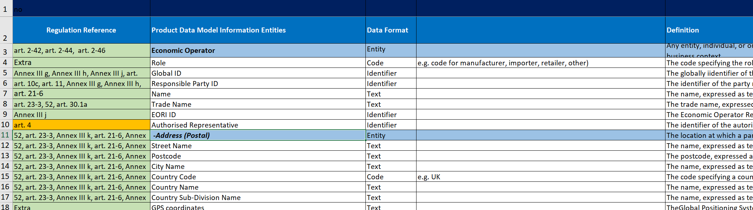
2nd finishing touch longlist
Colour left side:
Green row has been done,
White row is to do
Orange row is slightly changed

Slide 10
Product Circularity Data Project
Working meeting
1 September
4. Any other business and next meeting
Looking forward to your contributions at our next meetings!
Friday September 8, 2023 15.00-17.00 (update of BRS - process)
Friday September 15, 2023 15.00-17.00 (update of BRS - data)
Friday September 22, 2023 15.00-17.00 (Public Review draft Go/No)

