Slide 1
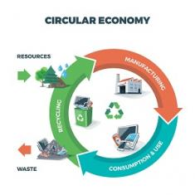

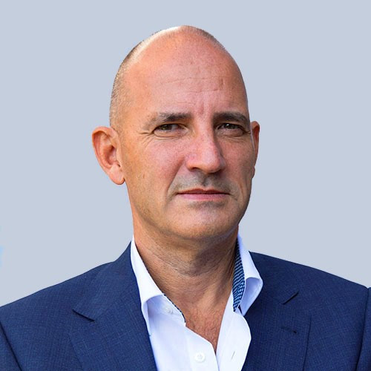
Product Circularity Data Project
Working meeting
25 August 2023
Virginia Martos-Cram, UN/CEFACT Project Lead
Gerhard Heemskerk, UN/CEFACT Editor

Slide 2
Item | AGENDA 25 August 2023 Working Meeting
1 | Opening remarks and meeting overview Virginia Martos-Cram, UN/CEFACT Project Lead
2 | Brief overview results last call Gerhard/Virginia
3 | Finishing touch to longlist (first session) Gerhard/Virginia
4 | Any other business and next meeting Virginia

Slide 3

Reminder - Project milestones?
ODP Stage (open Development Process) | Working Period | Maximum Duration
Requirements gathering | 01.2023 to 05.2023 | 4 months
Draft development | 05.2023 to 09.2023 | 4 months
Public Draft Review | 09.2023 to 11.2023 | 2 months
Publication | 11.2023 to 02.2024 | 3 months
Project exit | 02.2024 to 05.2024 | 3 months

Slide 4
Product Circularity Data Project
Working meeting
25 August 2023
2. Brief overview / results last call
Gerhard Heemskerk
Virginia Martos-Cram

Slide 5
Results last call
Finishing touch requested and processed
205 Emissions to air, water, soil | Add at least type and volume
226 Sustainability Report | Add Due Diligence Report too?
227 Third Party Supply Chain Assurances | Move to certification details.
224/225/238 EU Conformity Declaration | Make class generic, without EU.
245 Washing & Drying Energy Consumption | Look at other washing related data
247 Washing/Drying GHG Emissions | Look at other washing related data
254 Warranty Period | Remains in list (for luxury products)
Dismissed attributes
214 Conditions for use | Not relevant for textiles.
215 User Warnings | Not relevant for textiles.
223 Common Specifications | Not relevant for textiles.
231 Symbol for garment sorting (quality) | Not relevant for textiles.
232 Meaning of symbol | Not relevant for textiles.
240 Manufacturing date | Not relevant for textiles.
252 Access to or Use Hardware Needed | Not relevant for textiles.
253 Access to or Use Software Needed | Not relevant for textiles.
255 Recovered Material Content | Not relevant for textiles.
256 Product Life Impact on Climate Change | Not relevant for textiles.
218 Sustainability of Substances Concentration Limit | Not relevant for textiles.
230 Production Process Verified by Authorised Representative | Moved to certification details: object and Auth. Repr. attributes

Slide 6
Results last call
Not clear attributes
219 Alternative Sustainable Substances | Unclear. Jan Merckx should clarify. Was dismissed by Jan Merckx.
235 Delivery Discarded Products | Unclear. Jan Merckx should clarify.
236 Authorised Representative ID | Unclear. Jan Merckx should clarify.
257 Carbon footprint per value chain stage | Unclear. Jan Merckx should clarify. How are stages in a value chain defined so as to be comparable? The carbon footprint of the textile product as share of total Textile Carbon Footprint. Was dismissed by Jan Merckx.
96 Sustainable Certified Minimum Weight Measure | Unclear. Jan Merckx should clarify.

Slide 7
Suggestions made
Clean up the longlist
- group data logically
- make small naming adjustments
- add missing definitions
- use code lists (supports comparability)
- check static/dynamic characteristic of attributes
- use generic approach where possible

Slide 8
Product Circularity Data Project
Working meeting
25 August 2023
2. Finishing touch to longlist (first session)
Gerhard Heemskerk
Virginia Martos-Cram

Slide 9
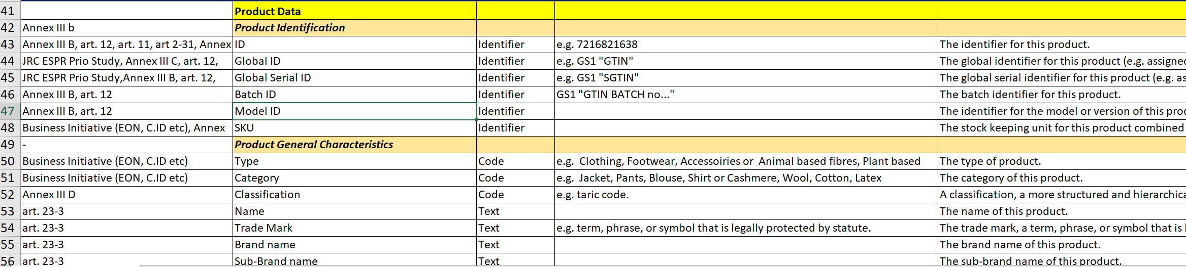
Clean up of the long list
85 attributes dismissed
45 attributes moved or put on economic operator/meta data level
+/- 125 Product level attributes

Slide 10
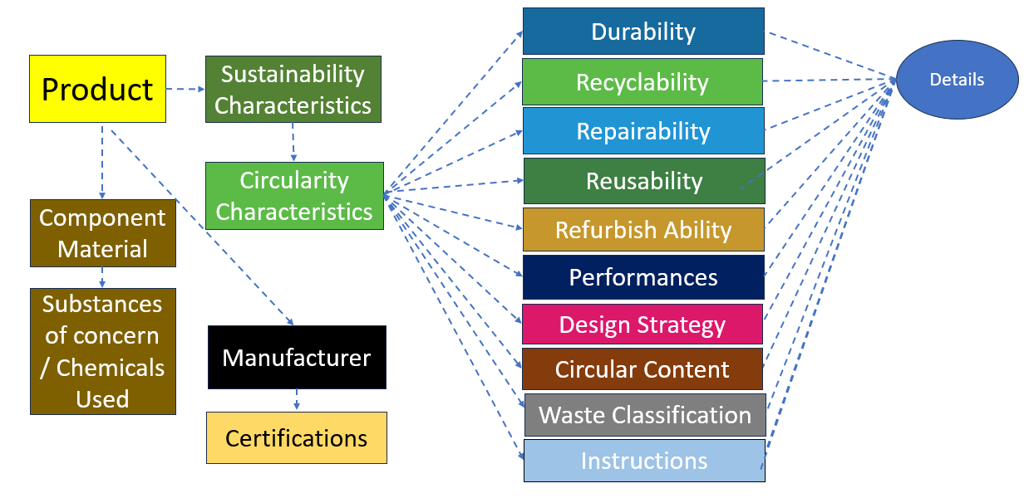
Conceptual product data model

Slide 11
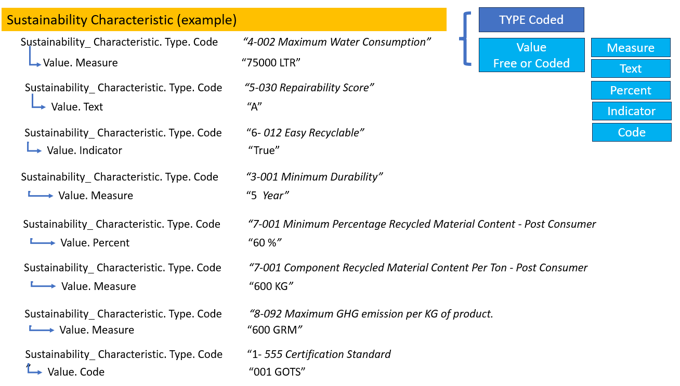
Example of a generic approach

Slide 12
Using code lists (supporting comparability) Data in green are related to circularity/DPP data
Economic Operator Role | Size Code | Verified Subject Code | Environmental Impact Category Code
Country Code | Material Type | Assurance Level Code | Data Access Method Code
Product Type Code | Material Category Code | Declaration Subject Code | Data Access Party Role Type Code
Product Code | SoC Type | Emission Type | Data Access Rights Code
Product Classification Code | SoC Category Code | Emission Source Code | Ease of Re-Use Waste Score/Index
Country of Origin Code | Label Type Code | Consumption Type Code
Species Code | Label Content Type Code | Consumption Purpuse Code
Consumer Gender Code | DPP Product Level Code | Circular Design Type Code
Grade Code | Data Carrier Type Code | Sustainable Sensitivity Score Code
Pattern Code | Data Carrier Material Tyoe Code | Repairability Score Code
Water Characteristic Code | Data Carrier Layout Type Code | Recyclability Score Code
Production Process Code | Data carrier Position Type Code | Disassembility Score Code
Product Status Code | Data Carrier Data Standard Type Code | Disassembling Skills Level Code
Finishing Treatment Code | Measurement Unit Code | Reuseability Purpose Code

Slide 13
Product Circularity Data Project
Working meeting
25 August 2023
4. Any other business and next meeting
Looking forward to your contributions at our next meetings!
Friday September 1, 2023 15.00-17.00 (2nd finishing touch to list)
Friday September 8, 2023 15.00-17.00 (update of BRS - process)
Friday September 15, 2023 15.00-17.00 (update of BRS - data)
Friday September 22, 2023 15.00-17.00 (Public Review draft Go/No)

