Slide 1
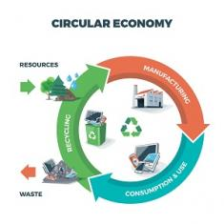
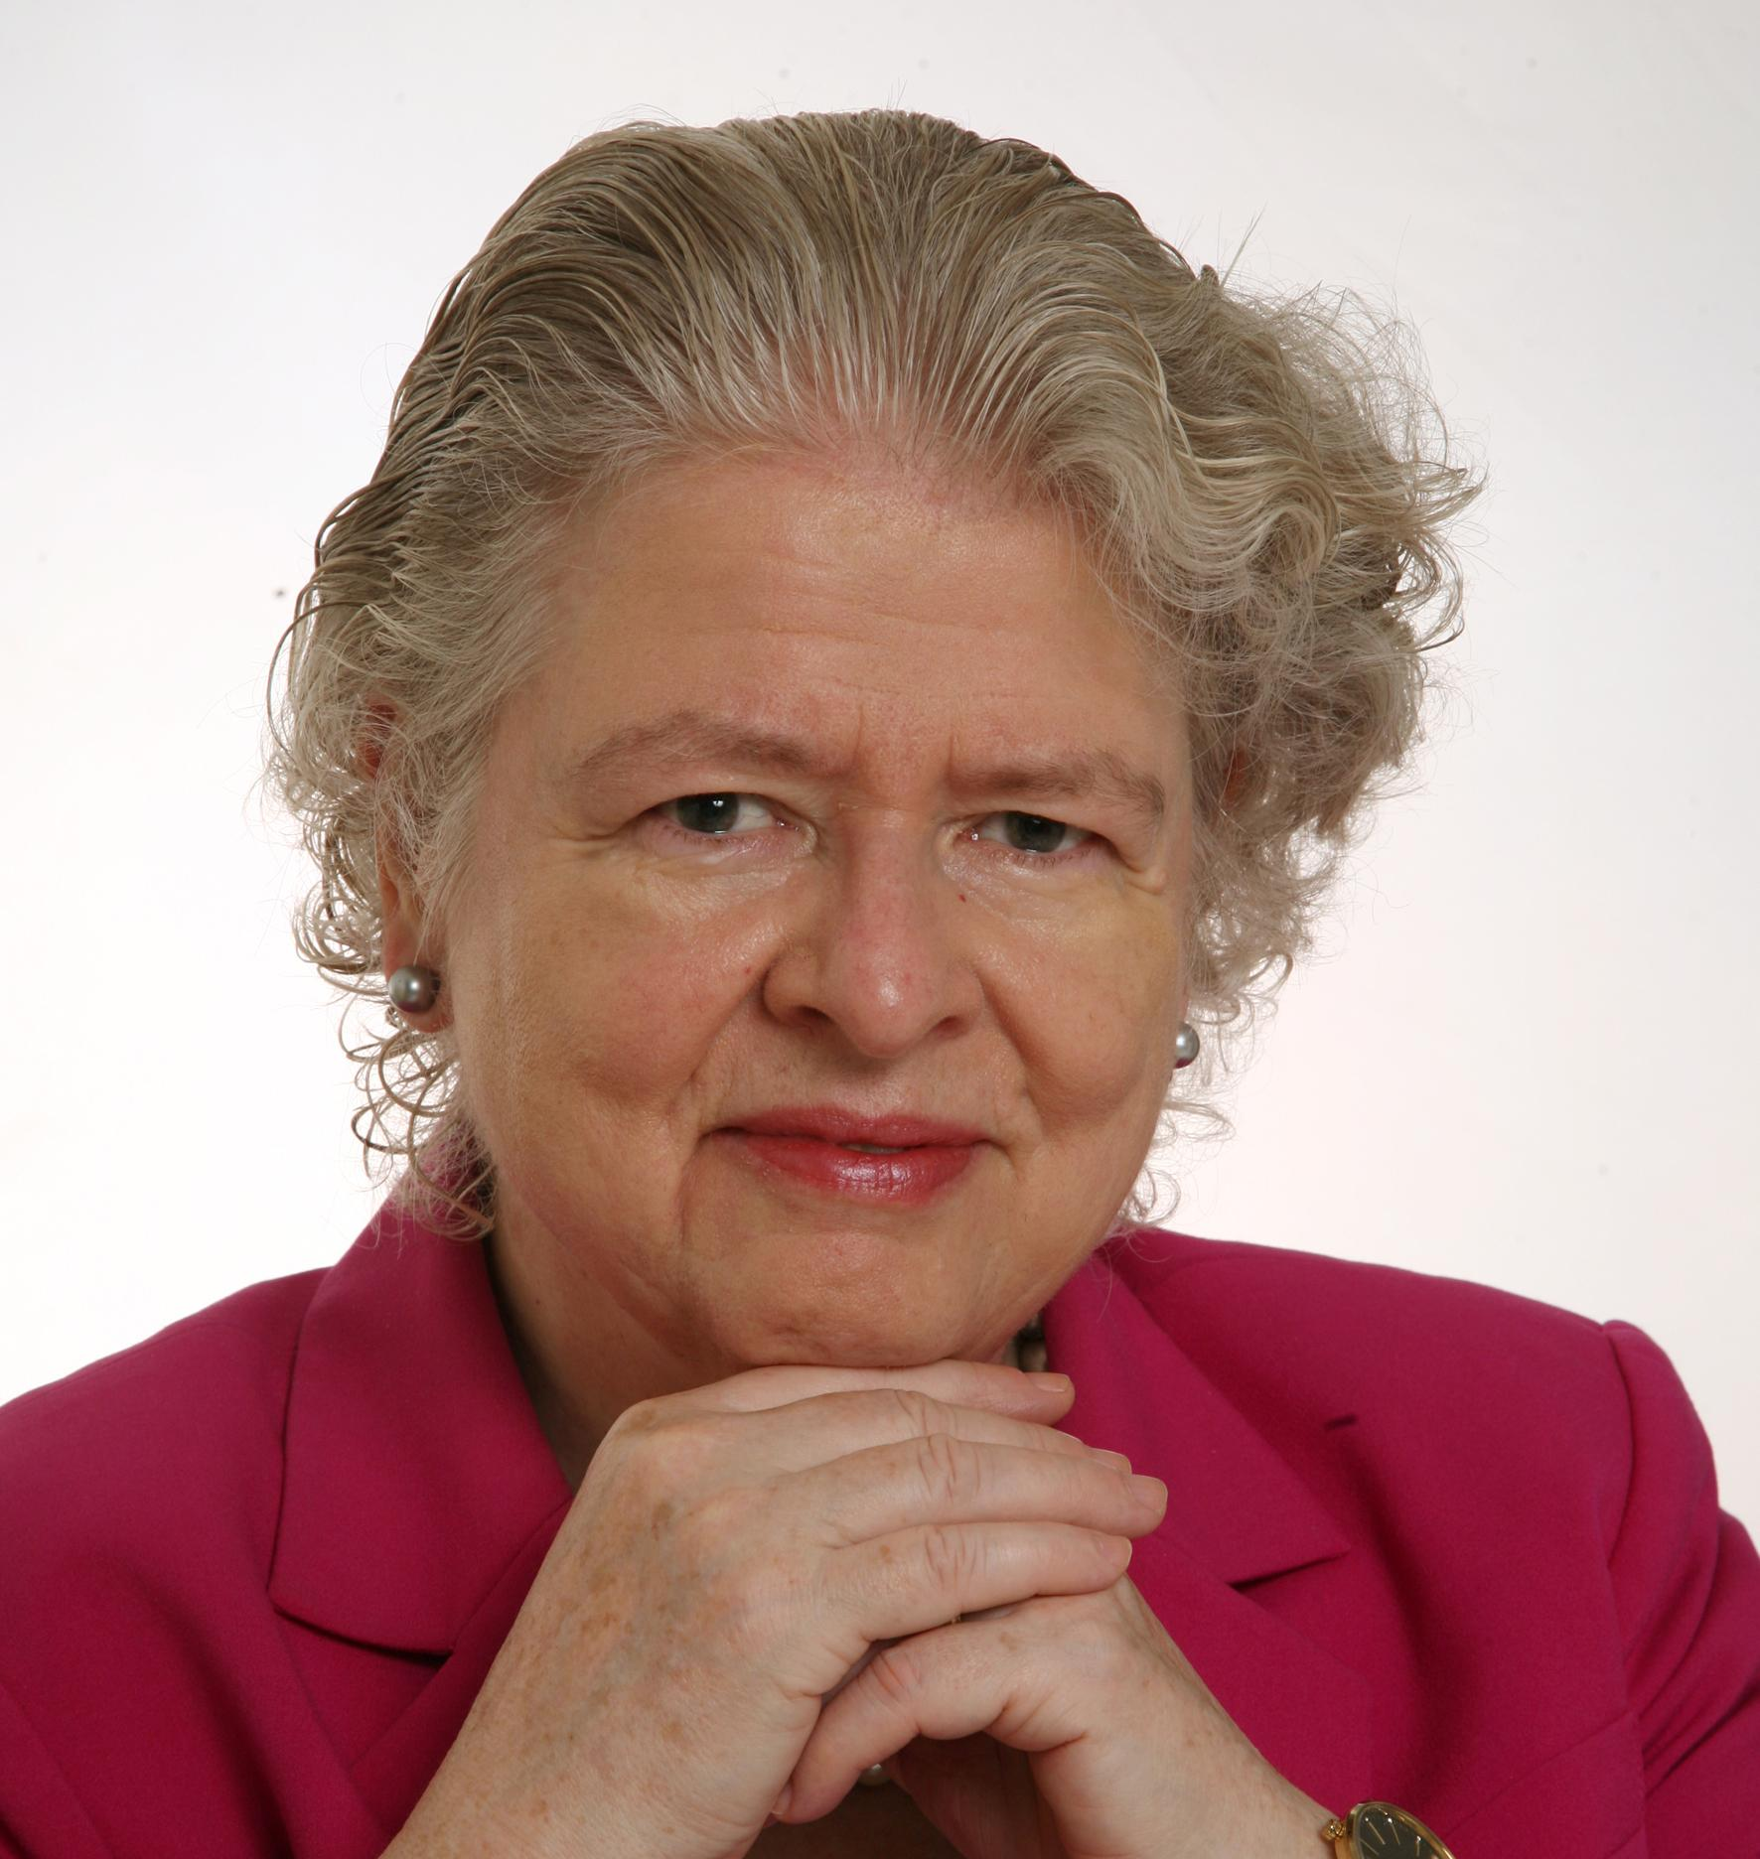
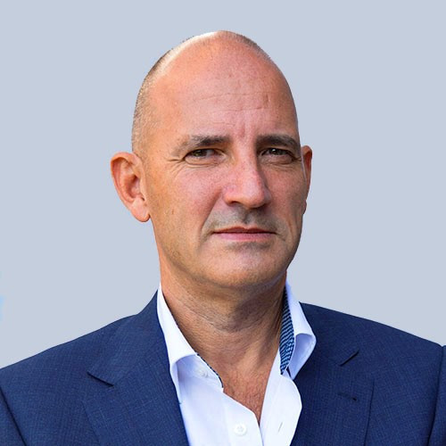
Product Circularity Data Project
Working meeting
18 August 2023
Virginia Martos-Cram, UN/CEFACT Project Lead
Gerhard Heemskerk, UN/CEFACT Editor

Slide 2
Item | AGENDA 18 August 2023 Working Meeting
1 | Opening remarks and meeting overview Virginia Martos-Cram, UN/CEFACT Project Lead
2 | Brief overview results previous call Gerhard/Virginia
3 | Continue review of BRS product circularity data long list Gerhard/Virginia
4 | Any other business and next meeting Virginia

Slide 3
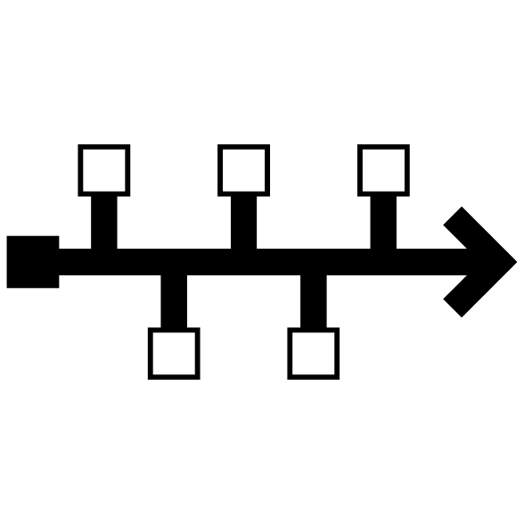
Reminder - Project milestones?
ODP Stage (open Development Process) | Working Period | Maximum Duration
Requirements gathering | 01.2023 to 05.2023 | 4 months
Draft development | 05.2023 to 09.2023 | 4 months
Public Draft Review | 09.2023 to 11.2023 | 2 months
Publication | 11.2023 to 02.2024 | 3 months
Project exit | 02.2024 to 05.2024 | 3 months

Slide 4
Product Circularity Data Project
Working meeting
18 August 2023
2. Brief overview / results previous call
Gerhard Heemskerk
Virginia Martos-Cram

Slide 5
Results previous call
Below attributes from row 99-207 grouped | Result
Performances attributes | Generic approach for consumptions/impacts, designed for, and periods
Instructions attributes | Duplicates and combined ones made separate.
Product composition attributes | Clarification about the use of sunstances of concern and chemicals used
Circular content attributes | Generic apporach on how to used, specify circular contnet of product/ material
Design strategies attributes | Grouping different types of design strategies under one umbrella
Circular products/materials availability attributes | Suggesting to add the availabity of rewearable products next to other types
Grouping of products/materials/waste attributes | Clarification on the use of type, category and classification
Attributes dismissed or not (after the call) | Final check by Jan Merckx, as co-hear of CIRPASS Textiles group
Updated figure showing high level product structure | Performances, design strategy, circular content, waste classification, instructions, substances added
Chat answers | See minutes: bramd/trade name, emissions, commodities code, certified chain, dye stuff, infrared sorting, disposal instructions manufacturers, water consumption by other types of fibres, innovative designs, score card for disassembling.

Slide 6
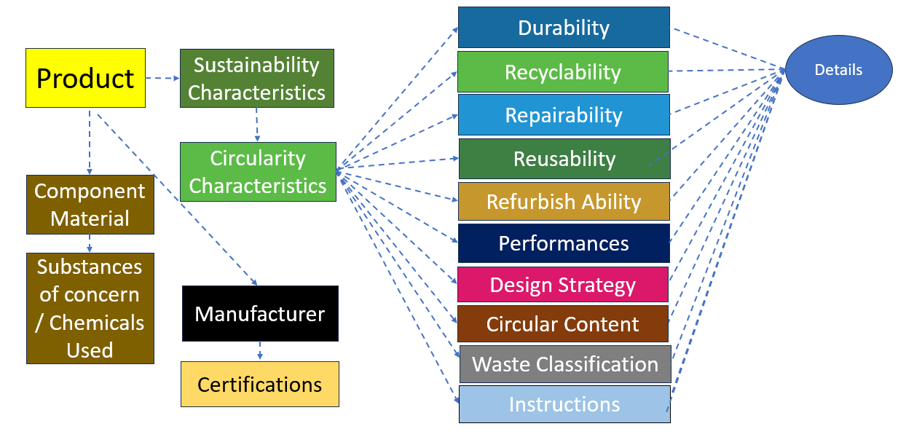
Conceptual product data model

Slide 7
Product Circularity Data Project
Working meeting
18 August 2023
2. Continue review (last 52 rows !)
Gerhard Heemskerk
Virginia Martos-Cram

Slide 8
Product Circularity Data Project
Working meeting
18 August 2023
4. Any other business and next meeting
Looking forward to your contributions at our next meetings!
Friday August 25, 2023 15.00-17.00 (finishing touch list)
Friday September 1, 2023 15.00-17.00 (finishing touch list)
Friday September 8, 2023 15.00-17.00 (start update BRS)

