Slide 1
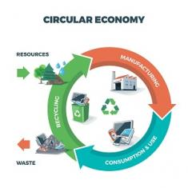


Product Circularity Data Project
Working meeting
21 July 2023
Virginia Martos-Cram, UN/CEFACT Project Lead
Gerhard Heemskerk, UN/CEFACT Editor

Slide 2
Item | AGENDA 21 July 2023 Working Meeting
1 | Opening remarks and meeting overview Virginia Martos-Cram, UN/CEFACT Project Lead
2 | What has been done & continue review list BRS circularity data longlist Gerhard/Virginia
3 | Comments on latest internal/external developments Jan
4 | Any other business and next meeting Virginia

Slide 3

Reminder - Project milestones?
ODP Stage (open Development Process) | Working Period | Maximum Duration
Requirements gathering | 01.2023 to 05.2023 | 4 months
Draft development | 05.2023 to 09.2023 | 4 months
Public Draft Review | 09.2023 to 11.2023 | 2 months
Publication | 11.2023 to 02.2024 | 3 months
Project exit | 02.2024 to 05.2024 | 3 months

Slide 4
Product Circularity Data Project
Working meeting
21 July 2023
2. What has been done & continue to review list
Gerhard Heemskerk, update
Virginia Martos-Cram, review

Slide 5
2.1. What has been done last 3 weeks
Textile Pass
21 July 23
Partly in BRS longlist
Look-a-like Battery Pass
BRS Longlist
7 July 2023
DPP
Initial alignment
Already fully in
BRS longlist
Our first attempt
Included
Joint Research Centre
Report: Ecodesign for Sustainable Products Regulation – prelimi-nary study on new product priorities.
ESPR Coverage
Checks
Regulation References
added
JRC
Battery Pass
Alignment for
horizonal data
Partly in BRS
longlist
Initiatives data
already fully in BRS longlist
e.g. EON, Circularity ID, PCDS
Something to be reuse?
Does business already cover ESPR?

Slide 6
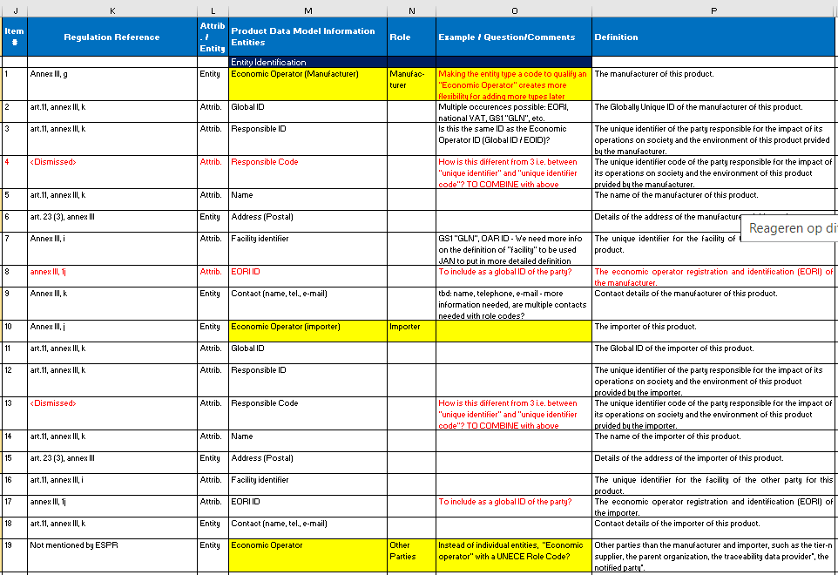
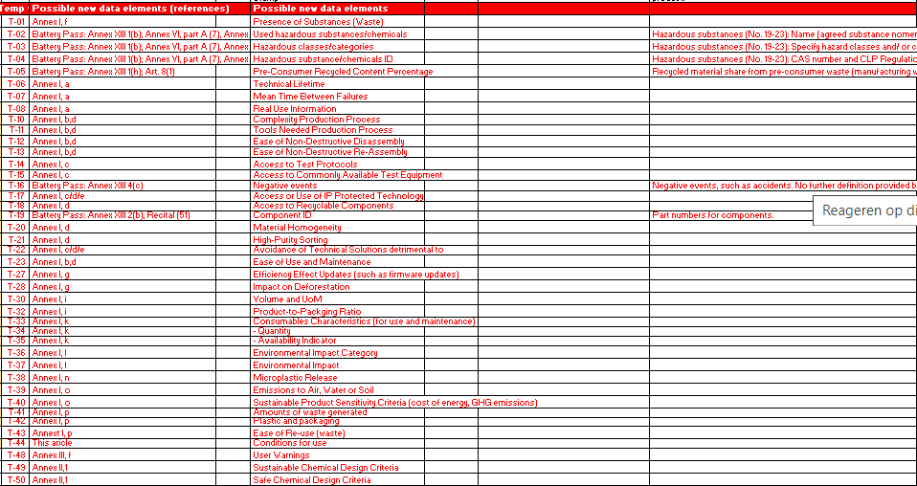
2. 2 Continue review of BRS longlist list
Initiatives data
(e.g. EON)
DPP
Already in
BRS longlist
BRS Longlist
7 July 2023
Textile Pass
Draft 21 July 23
Includes data from
JRC Prioritisation study
Partly in BRS longlist
Discussed thru row 37
JRC
Possibly to be added in
BRS longlist
Battery Pass
horizontal data partly in BRS longlist
Previous list
New data

Slide 7
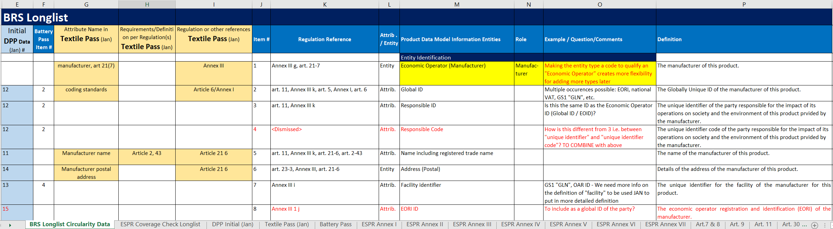
2.3 Continue review BRS Longlist
Mapping to initial DPP & Textile Pass List
BRS Longlist
BRS Longlist
sheet
ESPR Coverage
sheet
DPP Initial
Sheet
Textile Pass
sheet
Battery Pass
sheet
Annexes
sheets
Additional info
sheets

Slide 8
Product Circularity Data Project
Working meeting
21 July 2023
3. Comments on latest developments
Jan Merckx

Slide 9
3.1 Comments on latest developments
Of course there may be changes, but this will only imply the deletion or addition of some data attributes and we should not wait for the regulation.
The Delegated Act which will define the information to be provided will be released for textiles around 2025. However, the approach of taking the information requirements from the:
The ESPR requirements itself
  Product ID, Economic Operator ID, Manufacturer Location ID (Facility ID), Substances of Concern, (Carbon footprint?)
JRC Prioritisation study (which includes information for textiles)
  Requirements for durability, circularity and post consumer recycled content
The legal requirements (like fibre composition, etc.)
  should be similar to the actual linear process.
Business requirements taken from existing business initiatives for digital product circularity data.

Slide 10
Product Circularity Data Project
Working meeting
21 July 2023
4. Any other business and next meeting
Looking forward to your contributions at our next meeting!
Friday August 11, 2023 15.00-17.00

