Slide 1
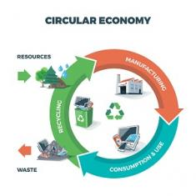


Product Circularity Data Project
Working meeting
09 June 2023
Virginia Martos-Cram, UN/CEFACT Project Lead
Gerhard Heemskerk, UN/CEFACT Editor

Slide 2
Item | AGENDA 09 June 2023 Working Meeting
1 | Opening remarks and meeting overview Virginia Martos-Cram, UN/CEFACT Project Lead
2 | Newcomer introductions and question time Virginia Martos-Cram, UN/CEFACT Project Lead
3 | Review of Contents of latest draft Gerhard
4 | Identification of outstanding work to be done and who should assist Note: In particular, we need more input about the specific data that different actors need Gerhard and Virginia
5 | Report on latest developments under the CIRPASS EU project Jan
6 | Any other business and next meeting Virginia

Slide 3
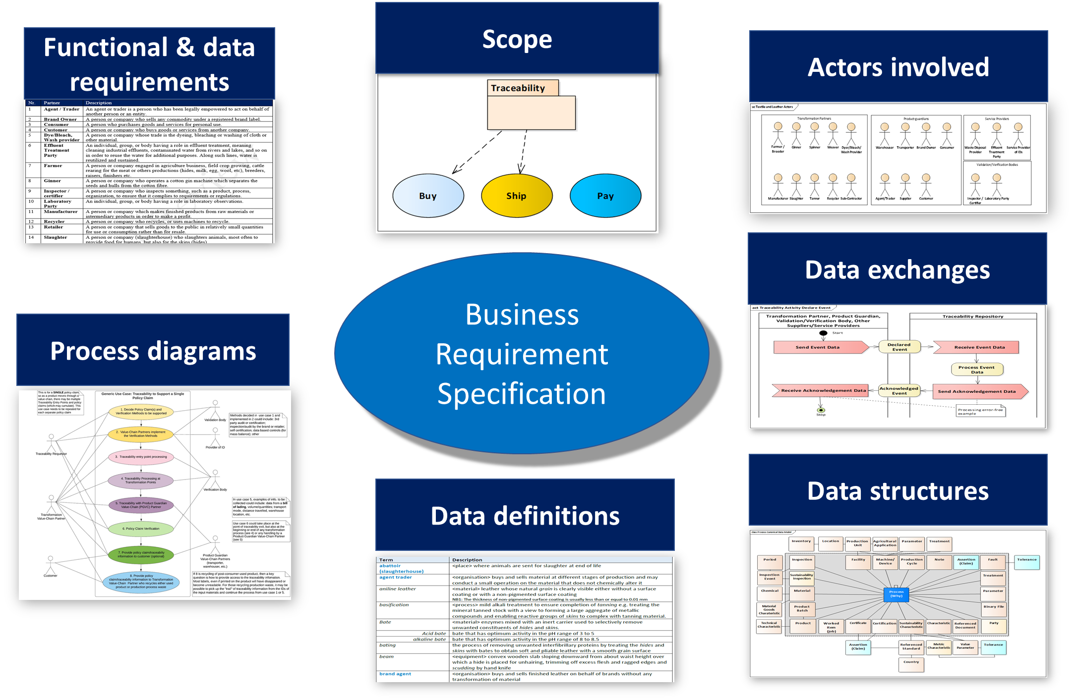
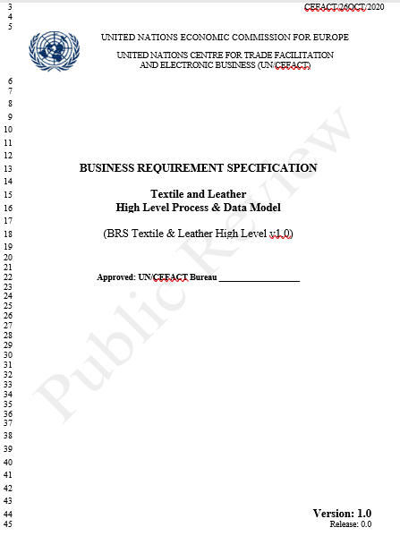
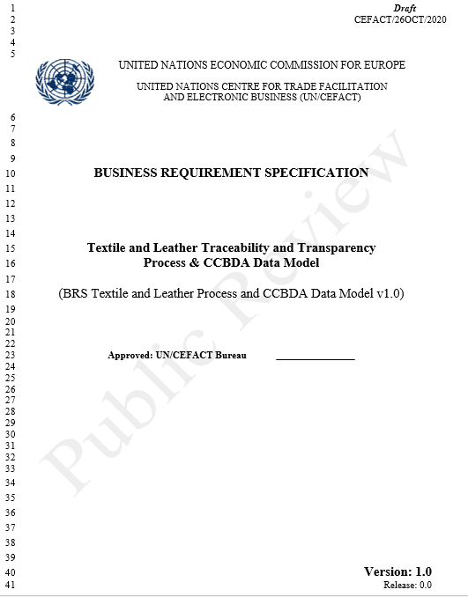
The draft will be included within the existing
Business Requirement Specification (BRS)
Value Chain
Processes & Data
Part 1
Use cases
Part 2

Slide 4
PROCESS: Circular Economy Business Domain View
Circular product data represents the digital identity of product and material data in such a way that it supports circular business models, including resale, rental, collections, sorting, and recycling.
What’s happening and who is involved?

Slide 5
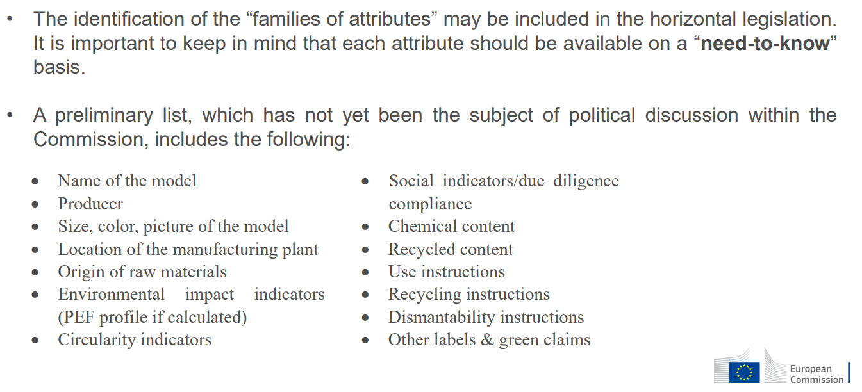

DATA: alignment of “Circular Product Data Model” with the European Digital Product Passport (ESPR & Acts)
European Union's Proposal for a Regulation on Ecodesign for Sustainable Products

Slide 6
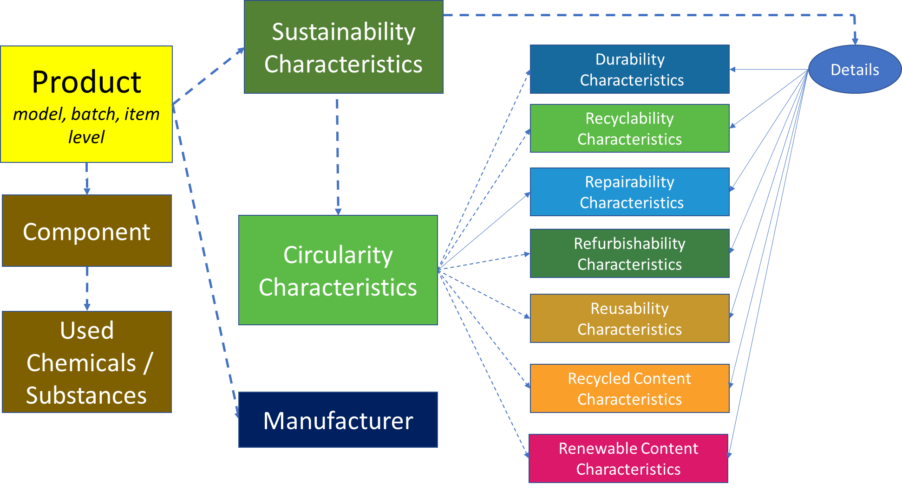
Shaping product data to become more circular
Should support:
Consumers
Policy makers & Regulators
Producers & Manufacturers Retailers & Platforms
Collectors & Sorters Recyclers &
Final disposal facilities Research and development organizations

Slide 7
Review of contents of latest draft (summary)
Changed “Refurbishing Centre” to “Refurbishment Centre / Refurbisher”.
Changed process name “Decomposing”to “Composting”.
Deleted “Biodegradation facility”, replaced by “Industrial Composting Facility”.
Changed “Decomposing” to “Composting”.
Added "Repair Provider” (such as repair shop) for “Repairing” process.
Added “Recycler”, “Waste Collector”, “Waste Collection Centre”, “Waste Aggregator”, “Waste Incineration Facility” for "Selling & Renting” process.
Added “Waste Aggregator” for ”Collection” process.
Added “Governmental Authority” for “Recycling” process.
Added “Industrial Composting Facility” for “Composting” process.
Changed: "Controlled Final Disposal” to “(Controlled) Final Disposal”
Added “Product Identity Platform” for “Recycling” process (collects product related data, PLC events).
Added “Designer” for “Textile & Leather Value Chain” processes.
Changed diagram sections “Recycling and (Controlled) Final Disposal” into separate sections.
Added “Trader” and “Agent” for “value chain processes”.
Aggregated waste by “Collection & Sorting” can either end-up in one of the “reusing processes” or become “final disposed waste”.
Changed text “flow directly back to value chain processes” to “Reusable waste, e.g. includes burning waste for energy by manufacturer”.
Added first draft for Conceptual Model for Product Circularity Data.

Slide 8
Considerations: to be part of the product data model
Transportation routes (emissions)
Production techniques/methods
Recycling options of products
Inventory data
Consumer feedback
Sorting possibilities/methods
Quality of recycled materials
Positioning a retailer as a role of a trader
Use of e-commerce platforms instead of online marketplace
Tier 1-n Supplier/Manufacturer instead of Tier-1 Supplier/Manufacturer

Slide 9
Identification of outstanding work to be done and who should assist
Terminology harmonization with ISO.
Identifying product data elements from battery alliance spreadsheet relevant for us.
Identifying product data elements from ESPR and acts yet to be included.
Identifying product data elements used or requested by different actors.
Updating existing BRS with extension for product circularity use case (include draft).
Aligning business (data) requirements identified by CIRPASS team for DPP.
Checking finally product data elements on usability for supporting the circular economy.
  For consumers, policy makers and regulators, producers, manufacturers, retailers, platforms, collectors, sorters, recyclers, final disposal facilities, research and development organizations.

