Slide 1
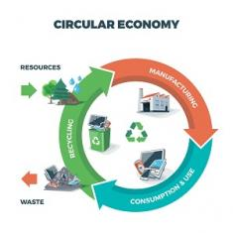

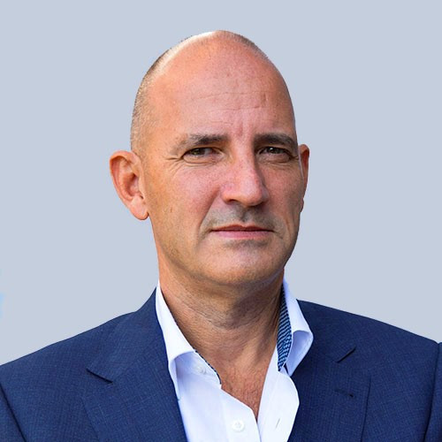
Product Circularity Data Project
Working meeting
28 April 2023
Virginia Martos-Cram, UN/CEFACT Project Lead
Gerhard Heemskerk, UN/CEFACT Editor

Slide 2
Item | AGENDA 28 April 2023 Working Meeting
1 | Opening remarks and meeting overview Virginia Martos-Cram, UN/CEFACT Project Lead
3 | European Union's Proposal for a Regulation on Ecodesign for Sustainable Products Articles 6 through 13 (pages 51-58) Virginia
4 | Changes since last draft Gerhard, Julie and Jan
5 | Any other business and next meeting Virginia

Slide 3
Product Circularity Data Project
Working meeting
28 April 2023
Discussion on
European Union's Proposal for a Regulation on Ecodesign for Sustainable Products
We will focus on Performance and Information Requirements as well as the Digital Product Passport and its implementation (Articles 6 through 13 on pages 51-58)
Questions to consider:
How can we align our work with this and other initiatives?
Are there inputs we might give to this and other initiatives based on our work?

Slide 4
Product Circularity Data Project
Working meeting
28 April 2023
Changes in the draft outputs
since the last meeting

Slide 5
Created sections
Textile & Leather Value Chain
Selling & Renting
Collecting & Sorting
Reusing
Recycling & Controlled Final Disposal
Could be divided

Slide 6
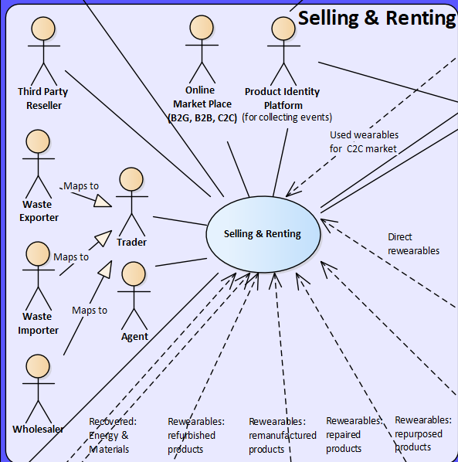



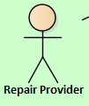

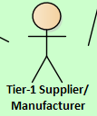
Changes draft 1: Selling & Renting
New
Involved are:
Third Party Reseller
Waste Exporter
Waste Importer
Wholesaler
Retailer
Agent
Brand
Consumer
Online Market Place
Product Identity Platform
Extension of selling & renting
Refurbishment Centre
Repair Provider
Tier-1 Supplier/Manufacturer
Third Party Manufacturer
Pre-cons.
New
Reusing
New
New

Slide 7
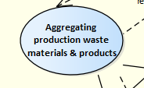
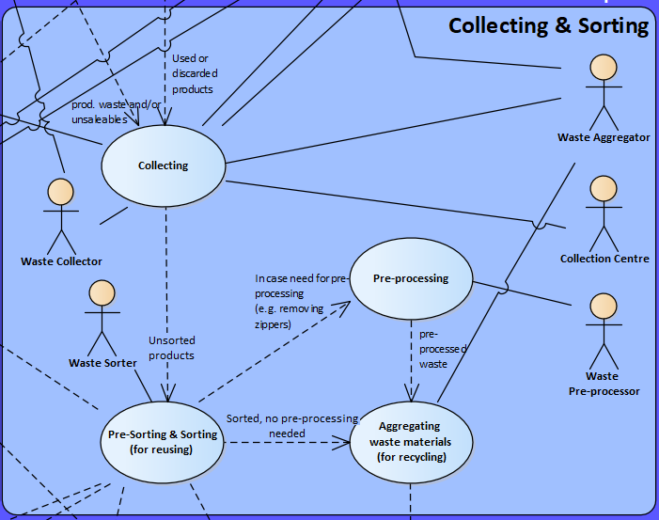
Changes draft 1: Collecting & Sorting
Also now involved in pre-consumption “Aggregating production waste”:
Waste Collector
Waste Aggregator
Waste Collector: A person or a company that is responsible for collecting and transporting waste materials from residential, commercial, and industrial areas to designated facilities for further processing or disposal.
Waste Aggregator: A company or organization that collects waste materials from multiple sources and aggregates them in a centralized location before transporting them to a processing or disposal facility. Waste aggregators typically operate at a larger scale than waste collectors, working across multiple municipalities or even regions to collect waste from a variety of sources.
also
precons.
also
precons.

Slide 8


New actors and their definitions
- Biodegradation facility | A place where organic materials, such as biodegradable textile waste, are broken down by microorganisms into simpler compounds.
Waste Importer | A company who makes - or on whose behalf a customs clearing agent or other authorized person makes - an import declaration. This may include a person or company who has possession of the waste or to whom the waste is consigned.
Waste Exporter | A company who makes, or on whose behalf the export declaration is made, and who is the owner of the waste.
- Wholesaler | A company that sells products or services, often in large quantities, to be retailed by others.
Should we make actor “Designer” more explicit then let it “be part of” the subcontractor?
Subcontractor | A person or company that signs a contract to perform part or all of the obligations of another’s contract (e.g. a designer).

Slide 9
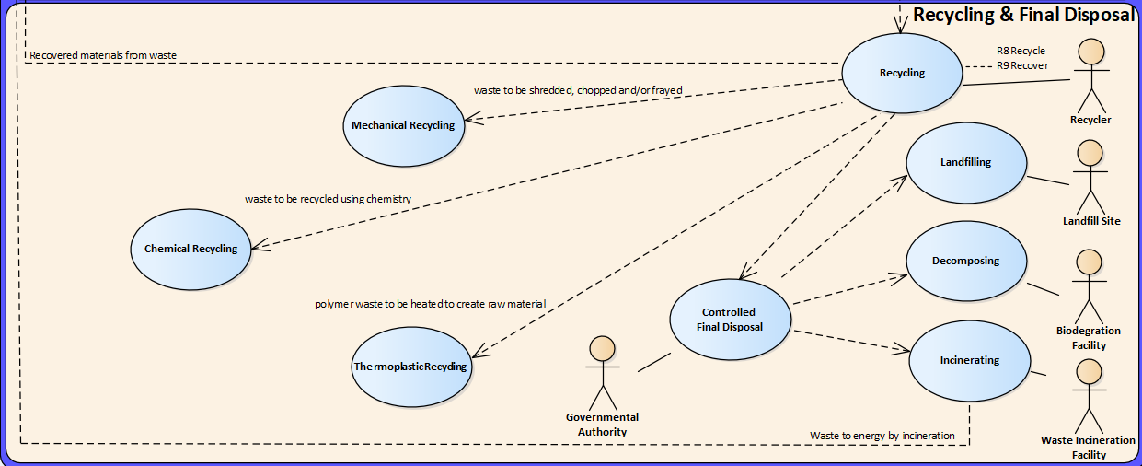
Changes draft 1: Elaborate diagram for Recycling and Controlled Final Disposal
Added to diagram
Added to diagram
Added to diagram
Added to diagram
New
Added to diagram
Added to diagram
New

Slide 10
New processes and their definitions
Incinerating | Incineration of waste is the process that involves the burning of solid, liquid, or gaseous waste materials at high temperatures to convert them into ash, gases, and heat. The primary purpose of incineration is to reduce the volume and weight of waste, as well as to dispose of hazardous or non-recyclable materials.
Landfilling | Landfilling is a method of waste disposal where solid waste is buried in a designated area of land. It involves depositing waste into a landfill site and compacting it to reduce the volume of the waste. The compacted waste is then covered with soil to prevent odors, litter, and the spread of disease, and to control pests.
Decomposing | The decomposing of textile materials refers to the breakdown or degradation of these materials into smaller components or elements, often through natural or artificial means.

Slide 11
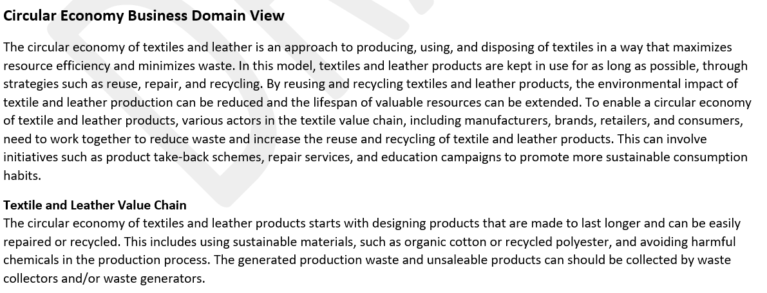
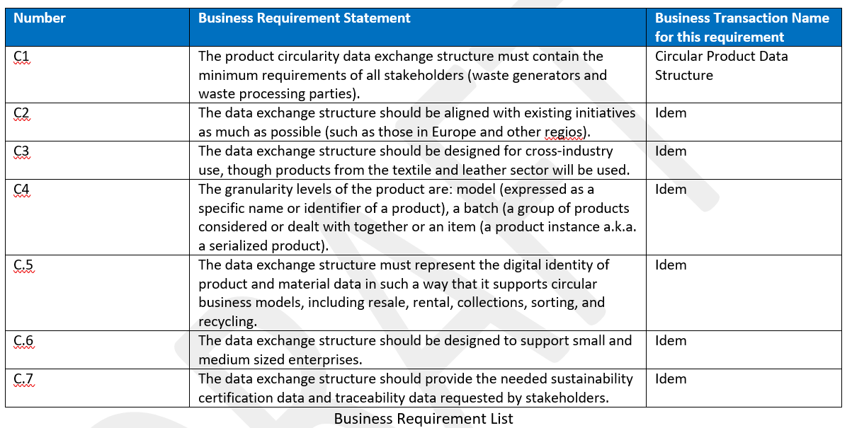
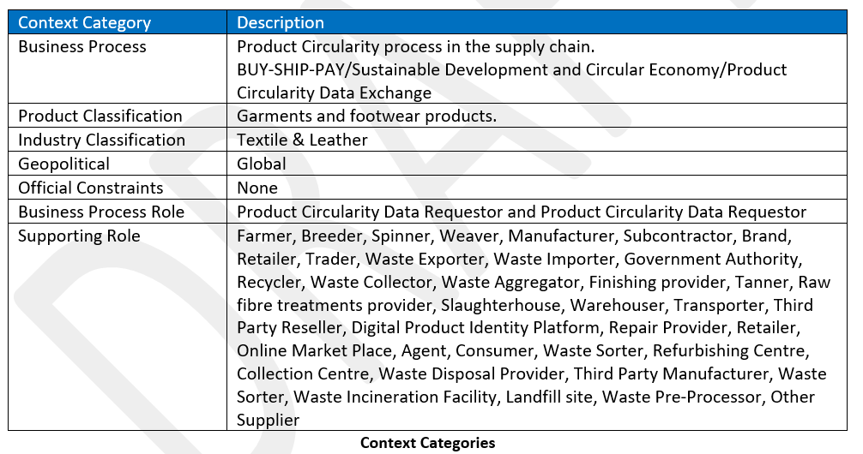
More that has been done
3
2
Business Domain View Description
5
1
Business Requirement List
4
Context Categories
Use Case diagram
Activity Diagram

Slide 12
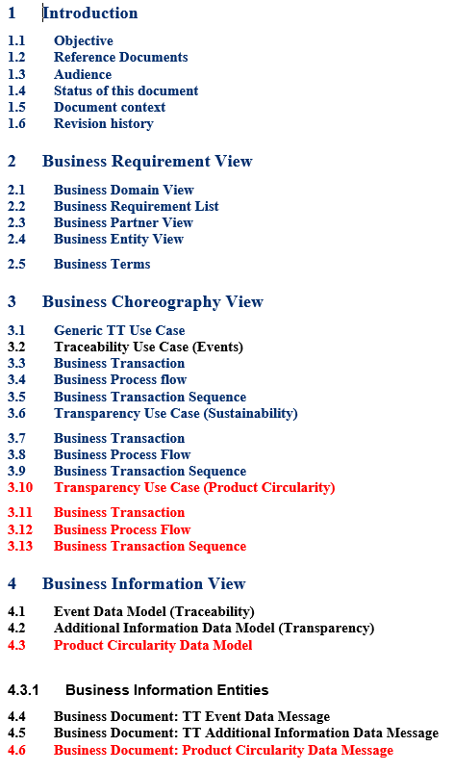
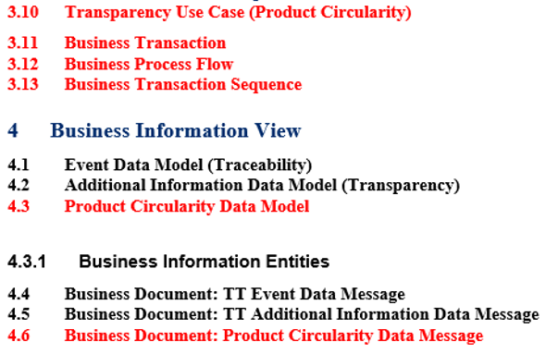
All will be merged at some point in time into existing BRS

Slide 13
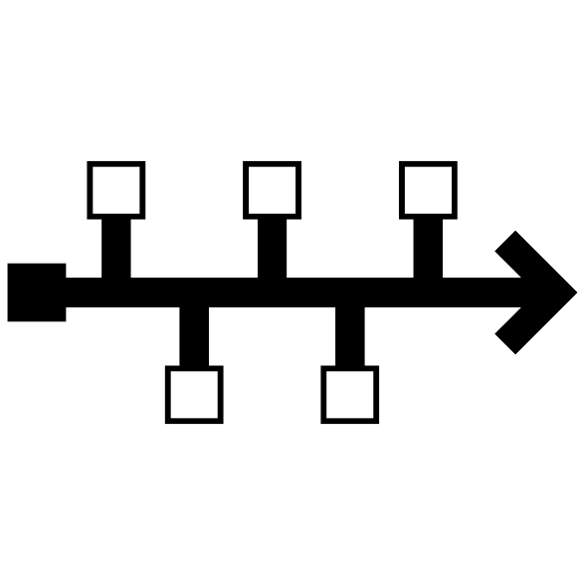
Reminder - Project milestones?
ODP Stage (open Development Process) | Working Period | Maximum Duration
Requirements gathering | 01.2023 to 05.2023 | 4 months
Draft development | 05.2023 to 09.2023 | 4 months
Public Draft Review | 09.2023 to 11.2023 | 2 months
Publication | 11.2023 to 02.2024 | 3 months
Project exit | 02.2024 to 05.2024 | 3 months

Slide 14
Product Circularity Data Project
Working meeting
28 April 2023
Looking forward to your contributions and presentations at our next meeting!
UN/CEFACT Forum Meeting Date:
Tuesday, 9th of May 2023

