Slide 1
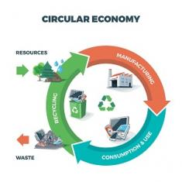
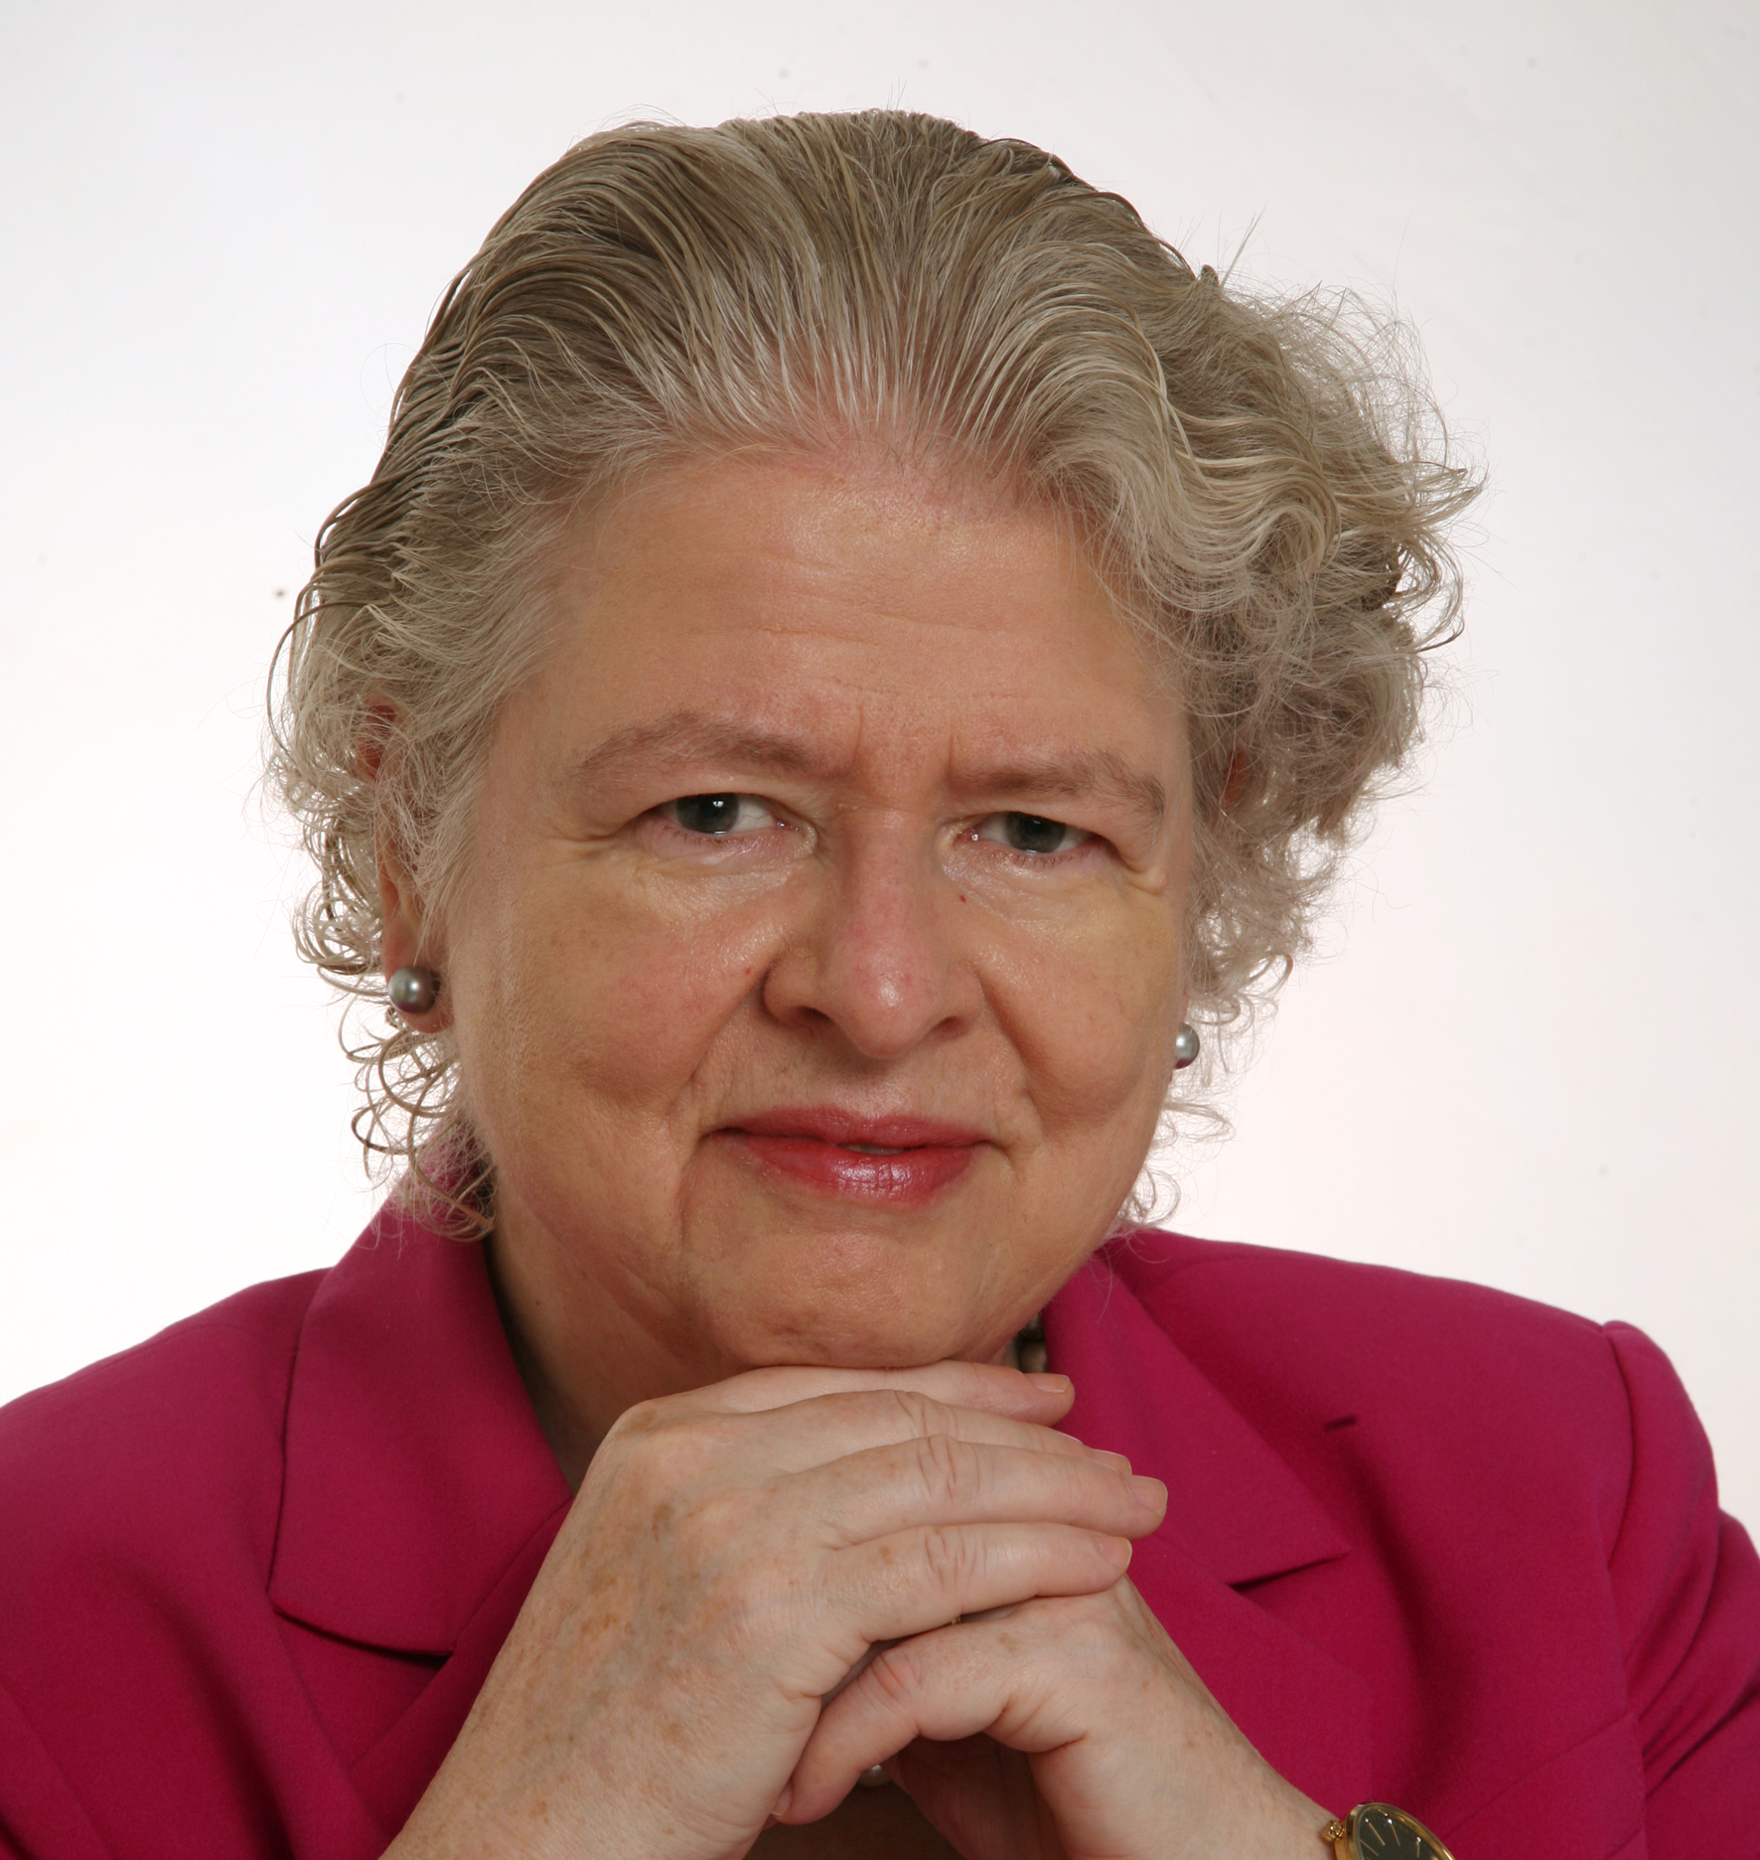
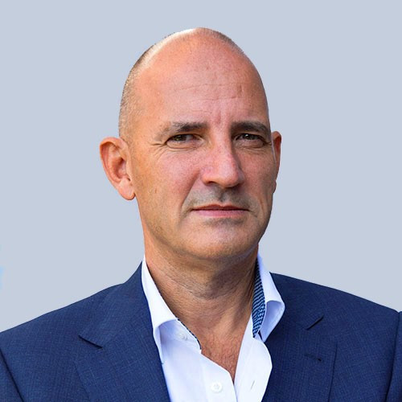
Product Circularity Data Project
Working meeting
14 April 2023
Virginia Martos-Cram, UN/CEFACT Project Lead
Gerhard Heemskerk, UN/CEFACT Editor

Slide 2
Item | AGENDA 14 April 2023 Working Meeting
1 | Opening remarks and meeting overview Virginia Martos-Cram, UN/CEFACT Project Lead
2 | What has been changed in the drafts Gerhard, Julie and Jan
3 | What needs to be done prior to the UN/CEFACT Forum (8-12 May) Gerhard
4 | Key challenges that still need to be overcome Gerhard, Julie and Jan Examples: Alignment with EU DPP and main ISO terms while not having either Ensuring a focus on serving the global circular economy, and not only individual region(s) Including more circularity aspects related to leather (in addition to textiles) Maintaining the right balance between business terms and listed data requirements Ensuring the right granularity of data (using code lists or precisely named data elements) Ensuring the right balance between the use case, the definitions of collaboration and data exchanged, and the domain view
5 | Any other business and next meeting Virginia

Slide 3
6. Any other Business & Next Meeting
Proposed Meeting Date: Friday, 28 April 2023 at 15:00 CET

Slide 4
Product Circularity Data Project
Working meeting
14 April 2023
Changes Log of the drafts

Slide 5
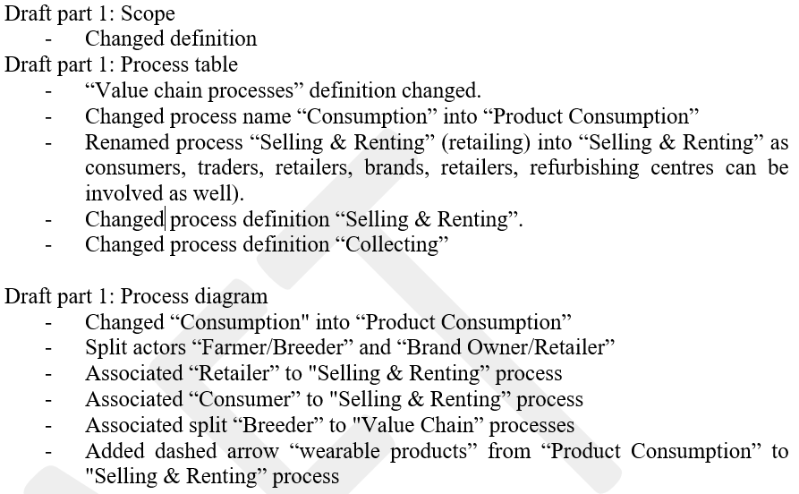
Changes draft 1: Processes

Slide 6
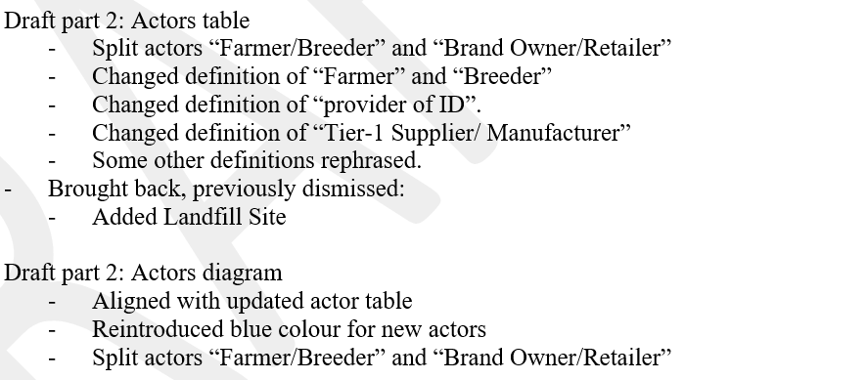
Changes draft 2: Actors

Slide 7
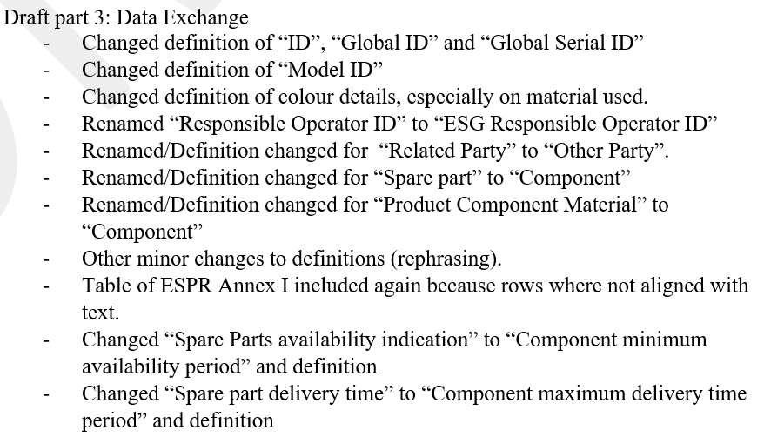
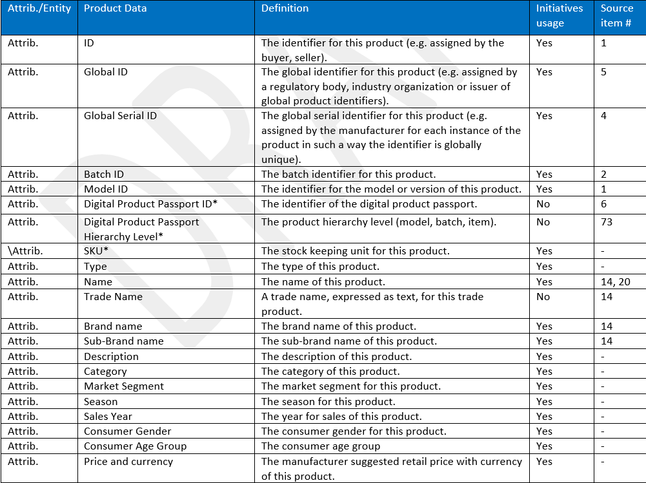
Changes Part 3: Data Exchange

Slide 8
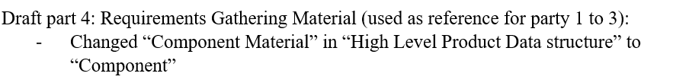
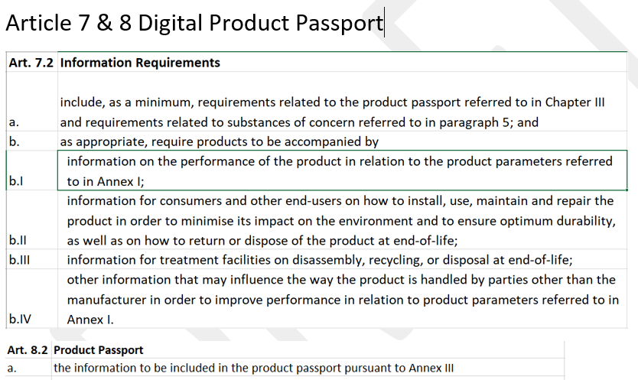
Changes part 4:

Slide 9
Product Circularity Data Project
Working meeting
14 April 2023
Discussion and Feedback

Slide 10
Part 1.
Circular Economy Processes
Part 2.
Circular Economy Actors
FEED-BACK?
Part 3.
Data Exchange
Identified Data
Part 4.
Harmonization with EU DPP & ISO

Slide 11
Product Circularity Data Project
Working meeting
14 April 2023
Challenges and work ahead

Slide 12
Challenges
Why?
Alignment with EU DPP → “In development”
Alignment with main ISO terms → “In development”
Serving the global circular economy → “Tendency to focus on regional matters (e.g. EU)”
Textile AND leather → “Tendency to focus on textiles only”
Business terms → “Tendency to use business terms, use generic possibly”
Data requirements → “Granularity of the data differs from actor to actor”
Code List with predefined values → “Harmonized code lists available? who will maintain them?”
Use case, collaboration, data exchange → “Tendency to focus on domain processes, belongs to BPA”.
Reuse and Recycle is circularity → “Tendency to focus recycling, though reuse is important”.
Stakeholders → “Tendency to forget govern. authorities & sales platforms actors”

Slide 13
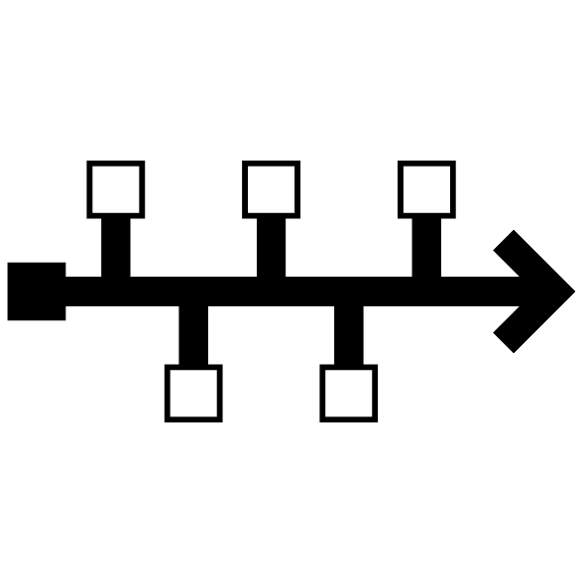
Reminder - Project milestones?
ODP Stage (open Development Process) | Working Period | Maximum Duration
Requirements gathering | 01.2023 to 05.2023 | 4 months
Draft development | 05.2023 to 09.2023 | 4 months
Public Draft Review | 09.2023 to 11.2023 | 2 months
Publication | 11.2023 to 02.2024 | 3 months
Project exit | 02.2024 to 05.2024 | 3 months

Slide 14
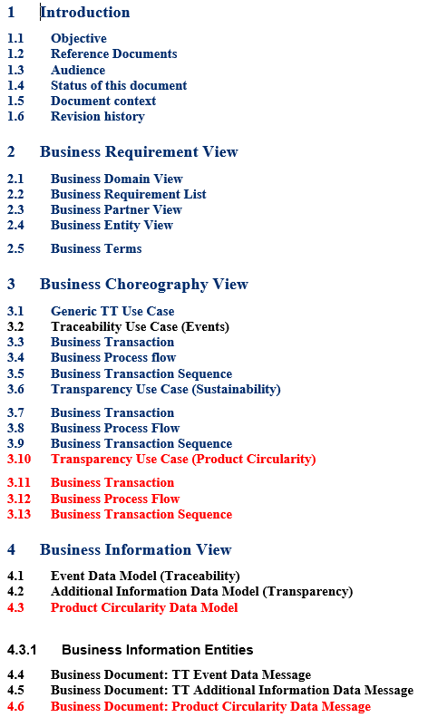
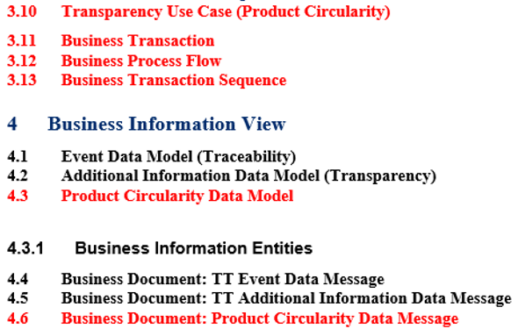
Next Step: Starting up updating the BRS part 2

Slide 15
But first finalysing data requirements of all actors
Scheduled:
next 3 weeks?
Identifying data requirements of actors involved in the circular economy of textile and leather
  What kind of data Iinformation category) do they need to perform at their utmost?
  Can they provide a priority to an information category?
  How granular the information categories should be?
  What type of identifiers are important to retrieve the necessary data?
Less important
  Mandatory of optional data (something done within implementation guidelines)
  Syntax of the data (XML, JSON)
  Security, Encryption, Privacy, Access rights as the product is about Product Circularity Data exchange.

Slide 16
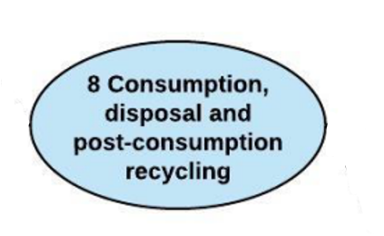
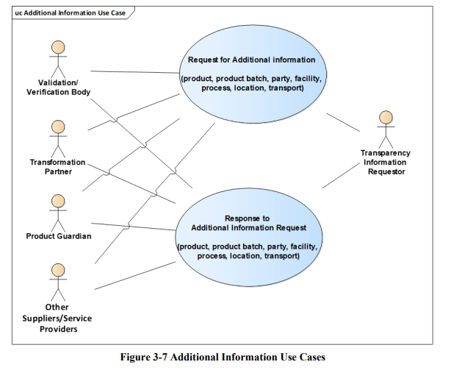
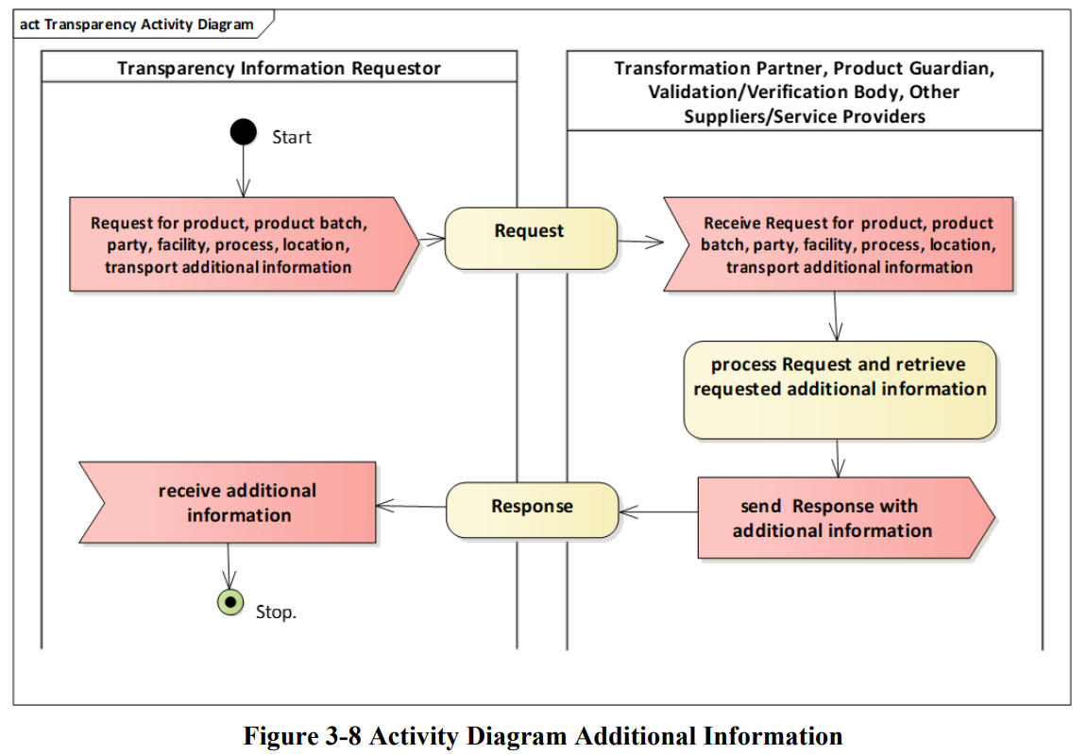
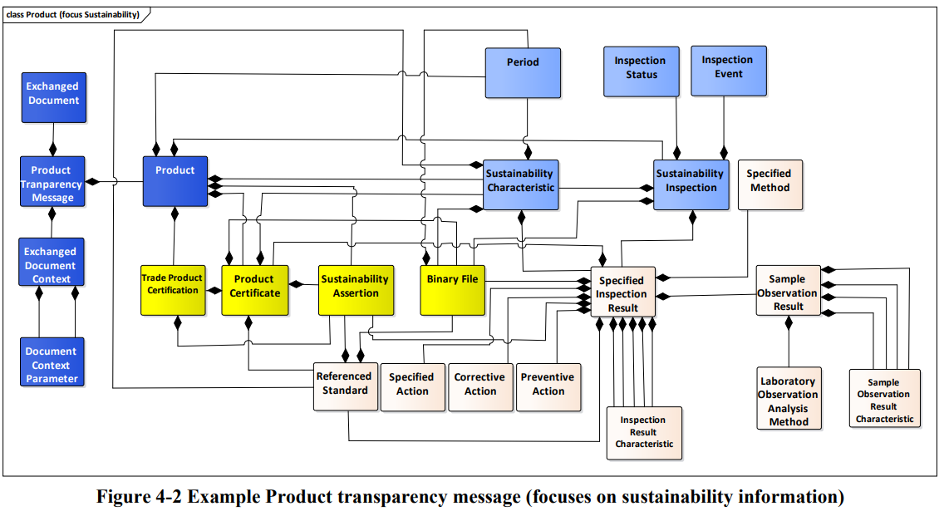
When finished, building use case
Scheduled:
Starts after the forum
From elaborated Domain Circular Economy Processes
Update Textile and Leather BRS part 2
Creating UMM (UNCEFACT Modeling Methodology) representation of the business requirements
Use Case for Data Exchange
Use Case Diagram Activity Diagram Class Diagram

Slide 17
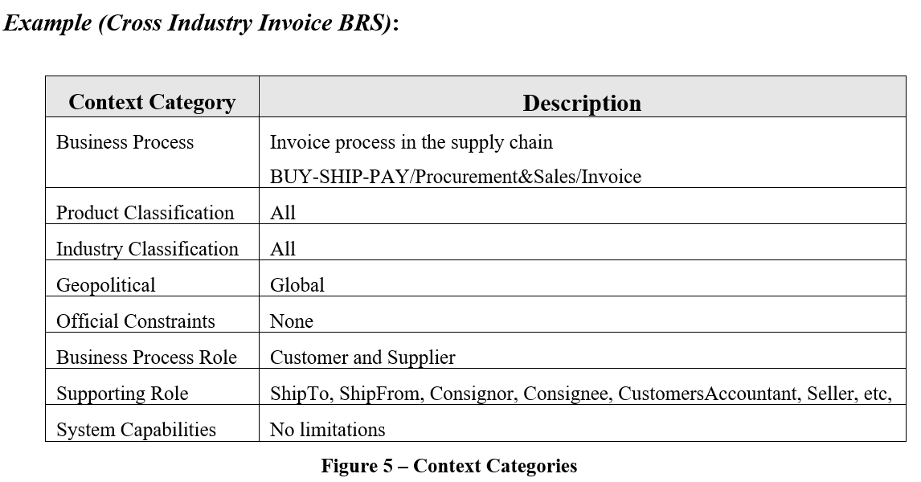
Some examples of work ahead
- Context
From BRS template
Scheduled:
next 3 weeks
The extent and limits of the business process within the business domain SHOULD be described. Identify where this project fits in to the wider business domain.

Slide 18
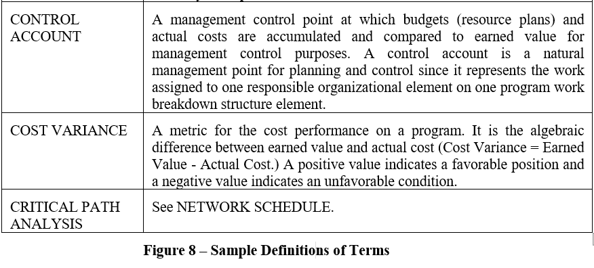
- Definitions of terms
From BRS template
Scheduled:
next 3 weeks

Slide 19
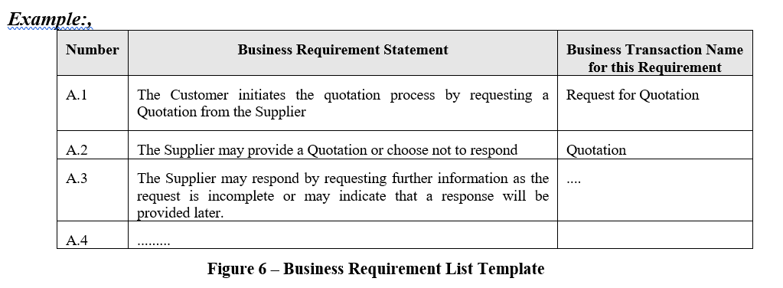
- Business Requirement List
From BRS template
Scheduled:
next 3 weeks

Slide 20
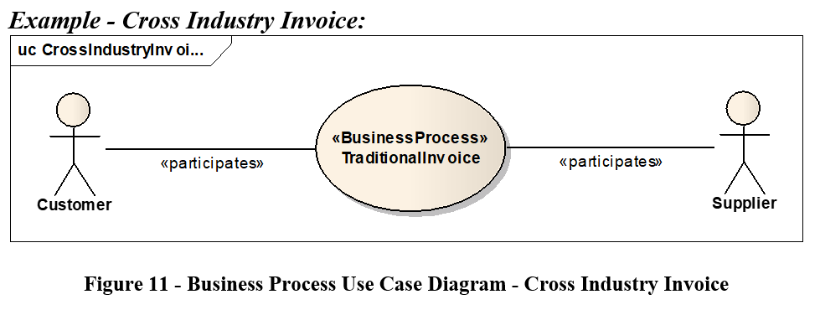
- Use Case
From BRS template
Scheduled:
Starts after the forum
<<BusinessProcess”
CircularProductData

Slide 21
- Activity Diagram
From BRS template
Scheduled:
Starts after the forum

Slide 22
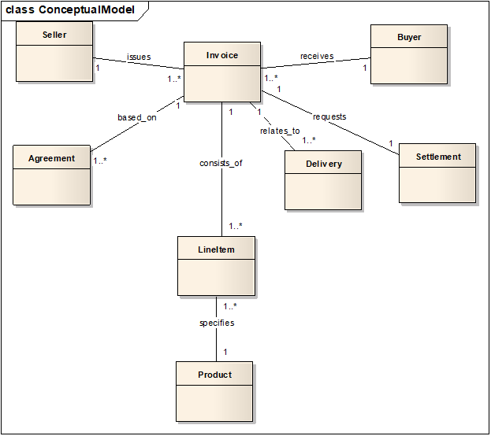
- Business Information View (high level)
From BRS template
Scheduled:
Next 3 weeks

Slide 23
- Business Information View (detailed)
From BRS template
Scheduled:
Starts after the forum

Slide 24
6. Any other Business & Next Meeting
Proposed Meeting Date: Tuesday, 9th of May 2023 at ?? CET

Slide 25
Product Circularity Data Project
Working meeting
14 April 2023
Looking forward to your contributions and presentations at our next meeting!
UN/CEFACT Forum Meeting Date:
Tuesday, 9th of May 2023 at ?? CET

