Slide 1
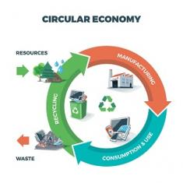

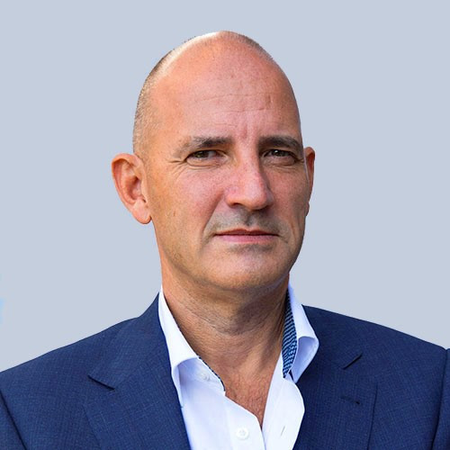
Product Circularity Data Project
Working meeting
31 March 2023
Virginia Martos-Cram, UN/CEFACT Project Lead
Gerhard Heemskerk, UN/CEFACT Editor

Slide 2
Item | AGENDA 31 March 2023 Working Meeting
1 | Opening remarks and meeting overview Virginia Martos-Cram, UN/CEFACT Project Lead
2 | Discussion on terms/definitions in general Virginia and Jan Looking for feedback on providing input to ISO and other related other work as well as how to reflect their work in ours - keeping in mind that users only have access to ISO terminology and definitions if they pay
3 | 1st Draft output : Updated processes Julie Looking for feedback on the diagram/definitions
4 | 2nd Draft output: Updated actors/definitions Gerhard and Gokul Looking for feedback on diagram/definitions
5 | 3rd Draft output: Updated input for data exchange Jan Especially interesting in comments on the sheet of DPP data.
6 | 4th Draft output: Updated alignment initiatives with data exchange input draft 3 Gerhard Looking to align practice with regulations and acts
7 | Any other business and next meeting Virginia

Slide 3
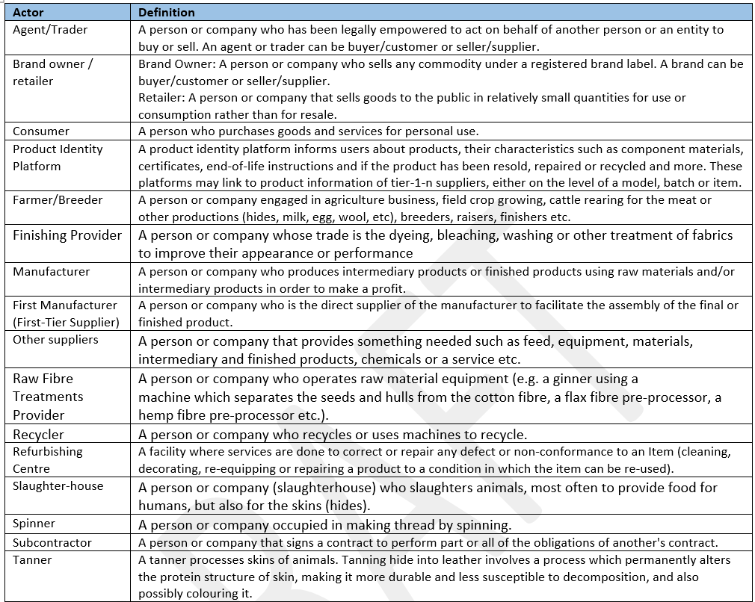
DRAFT 2: Harmonization
Actors with existing ones in UN/CEFACT BRS
Actors definitions
Blue added ones

Slide 4


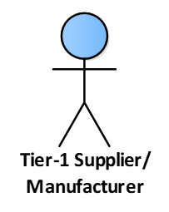
DRAFT 2: Harmonization
Identify possible missing actors
Input Gregory Mungal
Source: Institute for Integrated Quality Design (IQD), Johannes Kepler University Linz, Austria, Circular Business Model Typology
Adding per actor
  R-strategy and Product Design
Adding actor
  Repair Provider
  Retailer Service Point
Rename actor
  First Manufacturer → Tier-1 Supplier/Manufacturer
Actors offering repair services - A person or company that offers repair services for various products or equipment. A repair provider can diagnose the issue and repair the product to restore it to working condition.
A location within a retail store where customers can go to receive customer service, support, maintenance, upgrading or repairs for products that they have purchased from the store.
A tier 1 supplier is a company that directly provides products or services to an original equipment manufacturer (OEM) or a final product manufacturer.

Slide 5
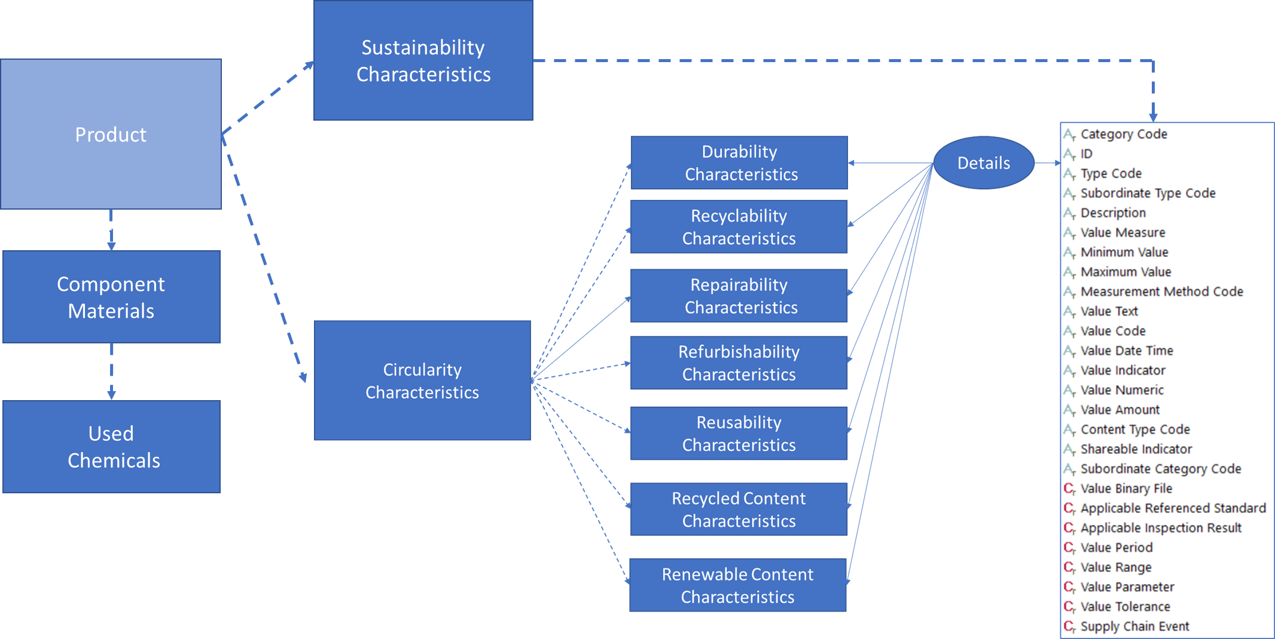
DRAFT 4: Harmonization
Identify related information groups and their characteristics

Slide 6
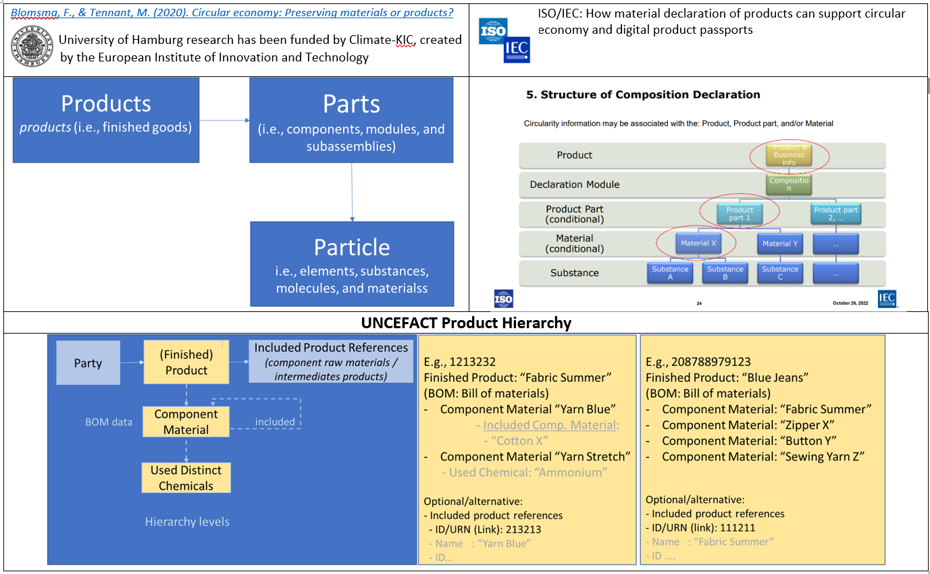
DRAFT 4: Harmonization
Product hierarchy

Slide 7
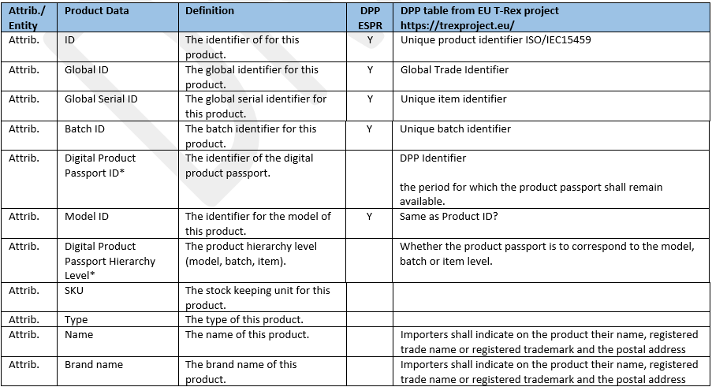
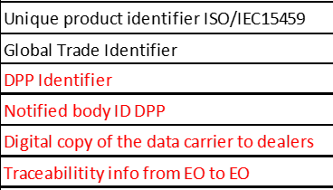
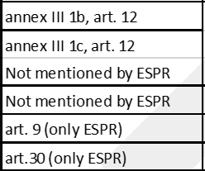
DRAFT 4: Harmonization
Combined Product Data – initiatives & Regulations
Related to list of information groups provided By Jan

Slide 8
6. Any other Business & Next Meeting
Proposed Meeting Date: Friday, 14 April 2023 at 15:00 CET

Slide 9

Reminder - Project milestones?
ODP Stage (open Development Process) | Working Period | Maximum Duration
Requirements gathering | 01.2023 to 05.2023 | 4 months
Draft development | 05.2023 to 09.2023 | 4 months
Public Draft Review | 09.2023 to 11.2023 | 2 months
Publication | 11.2023 to 02.2024 | 3 months
Project exit | 02.2024 to 05.2024 | 3 months

Slide 10
Product Circularity Data Project
Working meeting
31 March 2023
Looking forward to your contributions and presentations at our next meeting!

