Slide 1
Pipelines Data model PDES¹
Information transmitted progressively and potentially by multiple filers, so snippet data identifiers need to be defined
        WCO standards establish a ‘Unique Consignment Reference’ (UCR) to allow associations to be created
        PDES snippets use UCRs at three levels, linking master, house and trade data
        Key identifiers: transport means and transport equipment
¹ Developed within EU project SELIS https://www.selisproject.eu in a SELIS Task led by conex, and presented in UN/CEFACT 31st,32nd and 33rd Forums and in WCO, reflecting to the UN/CEFACT Data Pipeline Project, D. Roff
Notes:
Sue

Slide 2
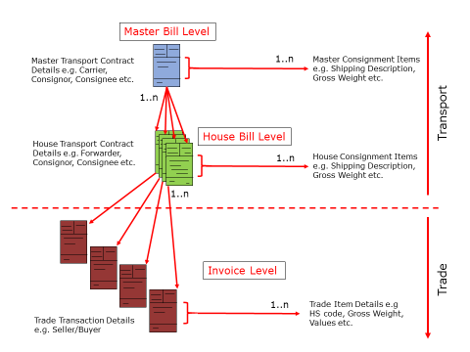
Pre-Entry Security Declarations – B2B Contract Levels
MUCR
Master level
HUCR
House level
TUCR
Trade level
Notes:
Sue

Slide 3
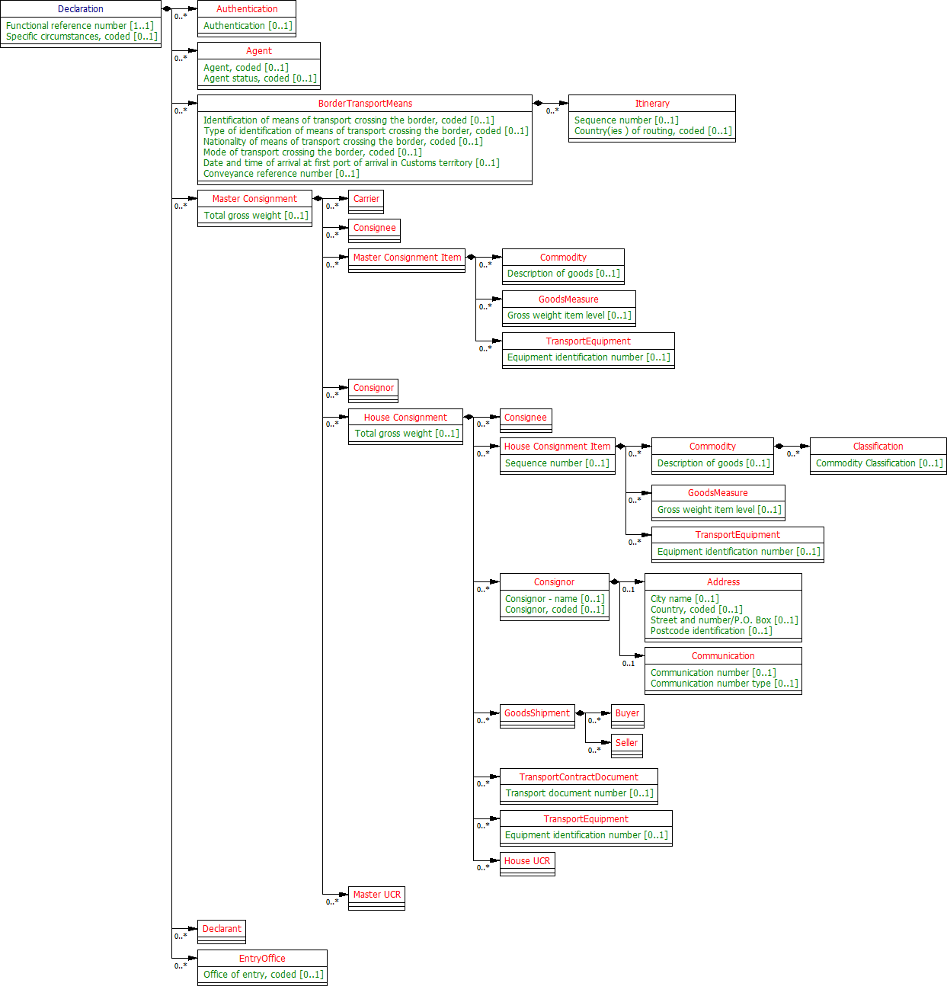
Pre-Entry Security Declarations – EUCDM (ICS2)
MUCR
Master level
TUCR
Trade level?
HUCR
House level
Notes:
Sue

Slide 4
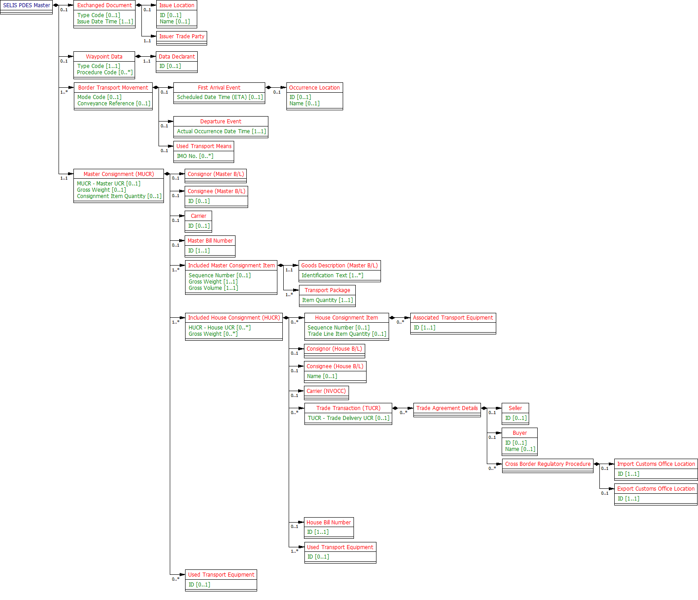
Pre-Entry Security Declarations – expressed in SELIS PDES
MUCR
Master level
HUCR
House level
TUCR
Trade level
Notes:
Sue

