Slide 1
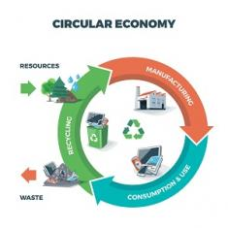

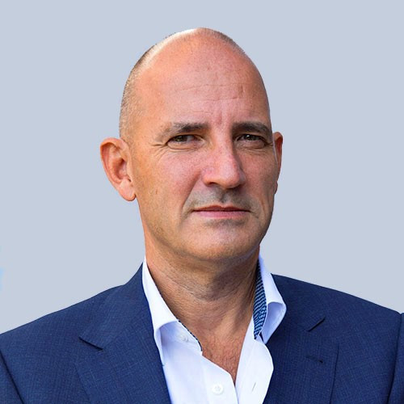
Product Circularity Data Project
Working meeting
3 March 2023
Virginia Martos-Cram, UN/CEFACT Project Lead
Gerhard Heemskerk, UN/CEFACT Editor

Slide 2
Item | AGENDA 3 Marchy 2023 Working Meeting
1 | Opening remarks and meeting overview Virginia Martos-Cram, UN/CEFACT Project Lead
2 | Scope and processes led by Julie Brown. Finalizing the scope statement and preparing a draft list of the circularity processes to be included within the scope together with their definitions”. Co-editors: Gokul and Gerhard.
3 | Actors with their descriptions or roles led by Gokul Alex Preparing a draft list of the actors in circularity processes together with descriptions of their roles. Co-editor: Gerhard Heemskerk
4 | Identify the information exchanged between actors led by Jan Merckx. A table for the process “Collection” showing per actor the needed data. Co-editor: Gerhard
5 | Harmonization led by Gerhard Heemskerk Harmonize the work on all 3 drafts (scopes and process; actors and data) by helping the work leaders to identify existing UN/CEFACT data and definitions, including existing initiatives. Co-editor: Isa Olalekan
6 | Any other business and next meeting

Slide 3
Product Circularity Data Project
3rd meeting
3 March 2023
ITEM 2: Presentation ON Scope and Process
Julie Brown, Leader Draft 1: Scope and Process
Used sources: Modeling and linking report – Accelarating Circularity
Accelarating workforce development in the U.S. Circular Textile Economy
EU Environment policies and the role of standards - EU
Five Circular Business Models - World Economic Forum
Four Cicular Business Models Fashion - Ellen Macarthur Foundation
Business Process Analysis for Sustainability and Circularity in Textile Value Chains
Business Process Analysis for Sustainability and Circularity in Leather Value Chains

Slide 4
Scope of the project
DRAFT
Circular product data
To exchange with
Scope of recycling
Circular Strategies
that represents the digital identity of product and material data in
such a way that it supports
Circular Business Models including:
Resale (Product use extension)
Rental (Product as a service)
Collection, Sorting, Recycling (Resource Recovery)
Especially brands want to be able to exchange product and material data from the first point of sale with:
Resellers
Sorters
Recyclers
they need a digital identity to scale systems for circular lifecycle management.
Post-Consumer Recycling
Pre-consumer Recycling:
“Waste materials from the manufacturing process”
Recover
Recycle Repurpose
Remanufacture Refurbish
Repair
Reuse
Reduce
Rethink
Refuse

Slide 5



Business models of a circulary economy
DRAFT
5 Circular Business Models
4 Circular Business Models for Fashion
5 Circular Business Models
(below models are mentioned in the project proposal but repair, remake are in scope too)
1. Circular inputs
1. Rental
1. Collection
Renewable, recycled, or highly recyclable inputs are used in production processes
This includes one-off rentals peer to peer by private owners, as well as large scale rental and subscription models by multi-brand platforms or individual brands.
Discarded items are “directed” via the process of “sorting” after having been “collected”.
2. Sharing economy concept
2. Resale
2. Sorting
How idle assets are used across a community
This includes peer-to-peer sale of second-hand items (online and offline), third-party marketplaces (online and offline), and own-brand re-commerce and take-back (online and offline)
Sorting means to arrange according to characteristics. This is especially meaningful in preparation for reusing and recycling.
3. Product as a service
Focus on performance, thus maximizing the usage factor and useful life.
3. Resale
4. Product use extension
3. Repair
Selling an item that has been previously sold and used
Products designed for repairability, upgradability, reusability, ease of disassembly, reconditioning, and recyclability.
This is the operation by which a faulty or broken product or component is returned back to a usable state.
4. Rental
Rental of item for occasions and celebrations e.g. Christmas.
4. Remaking
5. Recycling
5. Resource recovery
This is the operation by which a product is created from existing products or components. This operation can include disassembling, re-dyeing, and repurposing.
Collecting, sorting and processing products or materials that would otherwise be thrown away as trash and turning them into new products.
Recover embedded materials, energy, and resources from products at the end of use.

Slide 6
Definitions of circular strategies
DRAFT
Recycle: collecting and processing materials that would otherwise be thrown away as trash and turning them into new products, this includes waste-to-energy, bioremediation.
Recover: recovery of waste without any pre-processing.
Redistribute: redistribute pre- or post-consumer materials or products to different supply chain stages for longer-life products (using, and reusing materials).
Reduce: redesigning materials, products, and services to be less resource intensive, and recapturing resources by recycling to manufacture new materials and products.
Refurbish: fix, clean, or repair a product to a condition in which the item can be re-used.
Refuse: refusing to buy products pre- and post-consumer that cannot be recycled or reused or are not sustainable.
Remanufacture: rebuilding of a product to specifications of the original manufactured product using a combination of reused, repaired and new parts.
Repair: to put something damaged, broken, or not working correctly back into good condition or make it work again.
Repurpose: to give new use to something for a different purpose than the one for which it was originally intended.
Rethink: thinking and designing products so that their manufacturing process consumes fewer raw materials, extends their lifecycle, and generates less waste or recyclable waste.
Reuse: the practice of using a material over and over again in its current form (includes share, rental).

Slide 7
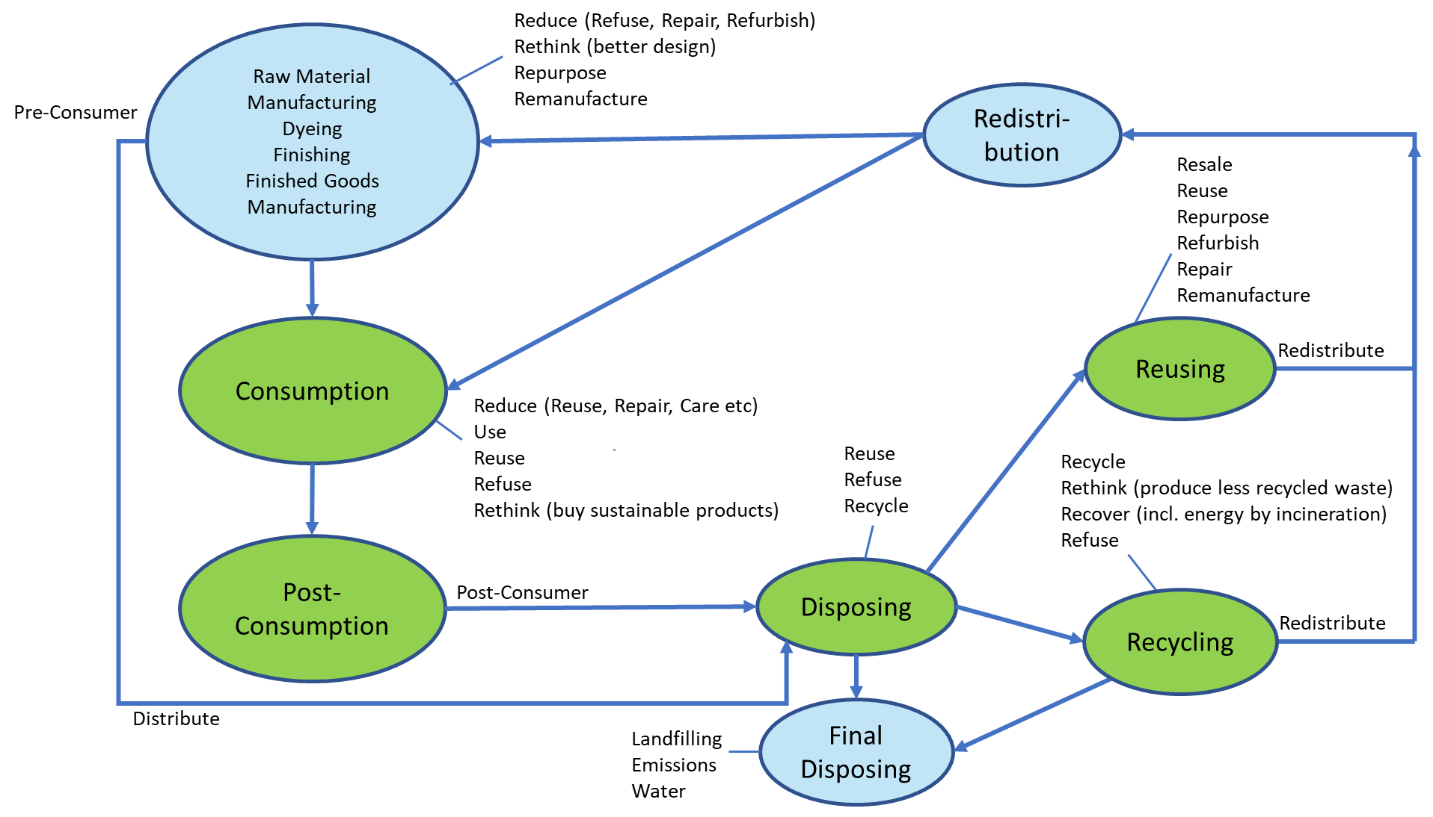
Extending process diagram supporting circular business models.
DRAFT

Slide 8
Reusing processes & actors
DRAFT
Reusing Processes | Definition | Actors involved
Collecting | The process of taking discarded textile out of circulation in order for it to be sorted and re-directed to the best circular-economy destination (reuse, recycling or final disposal). | Brand, Consumer, 3rd Party Reseller (e.g. digital platform)
Refurbishing | Fix, clean, or repair a product to a condition in which the item can be re-used. | Brand, Consumer, 3rd Party Reseller (e.g. digital platform), Repair Centre
Remanufacturing (including upcycling) | Transforming products into new products perceived to be of greater quality or value. | Brand, Consumer, 3rd Party Reseller (e.g. digital platform)
Reselling | Selling an item, on the market, that has been previously sold and used. | Brand, Consumer, 3rd Party Reseller (e.g. digital platform)

Slide 9
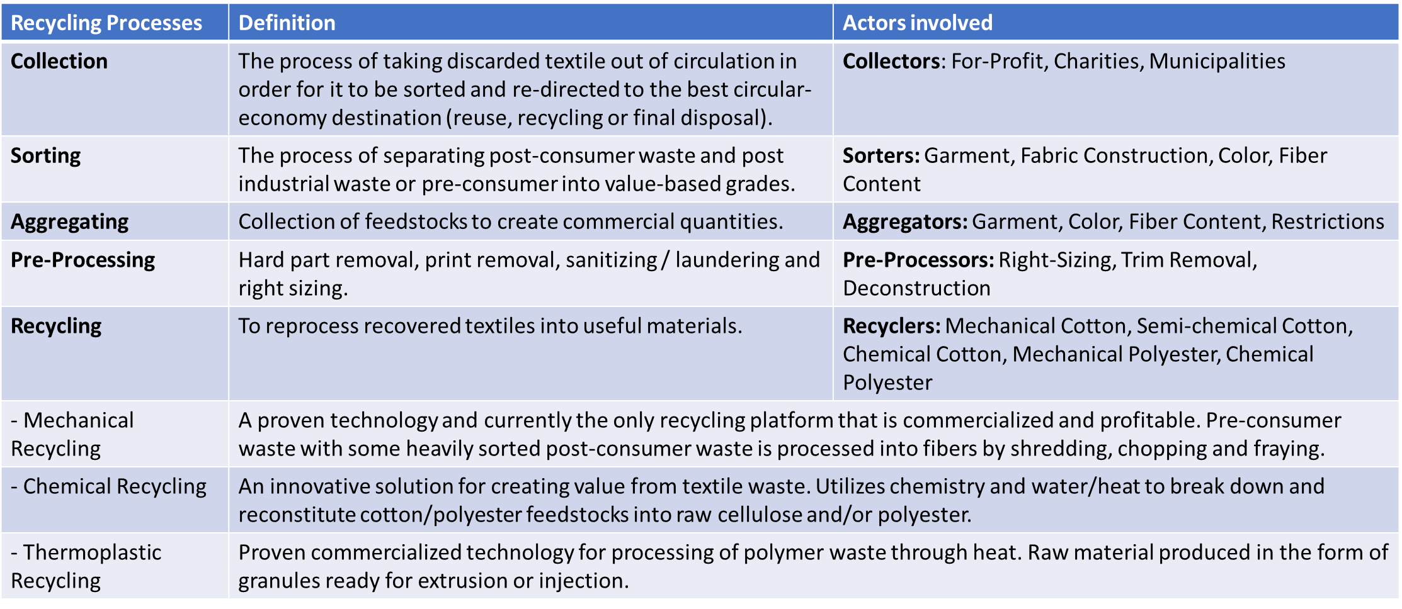
Recycling processes & actors
DRAFT

Slide 10
Product Circularity Data Project
3rd meeting
3 March 2023
ITEM 3: Presentation ON Actors with their descriptions/roles
Gokul Alex, Leader Draft 2: All actors in cicular economy for textile and leather
Used sources: European Recycling Platform
Business Process Analysis for Sustainability and Circularity in Textile Value Chains
Business Process Analysis for Sustainability and Circularity in Leather Value Chains

Slide 11
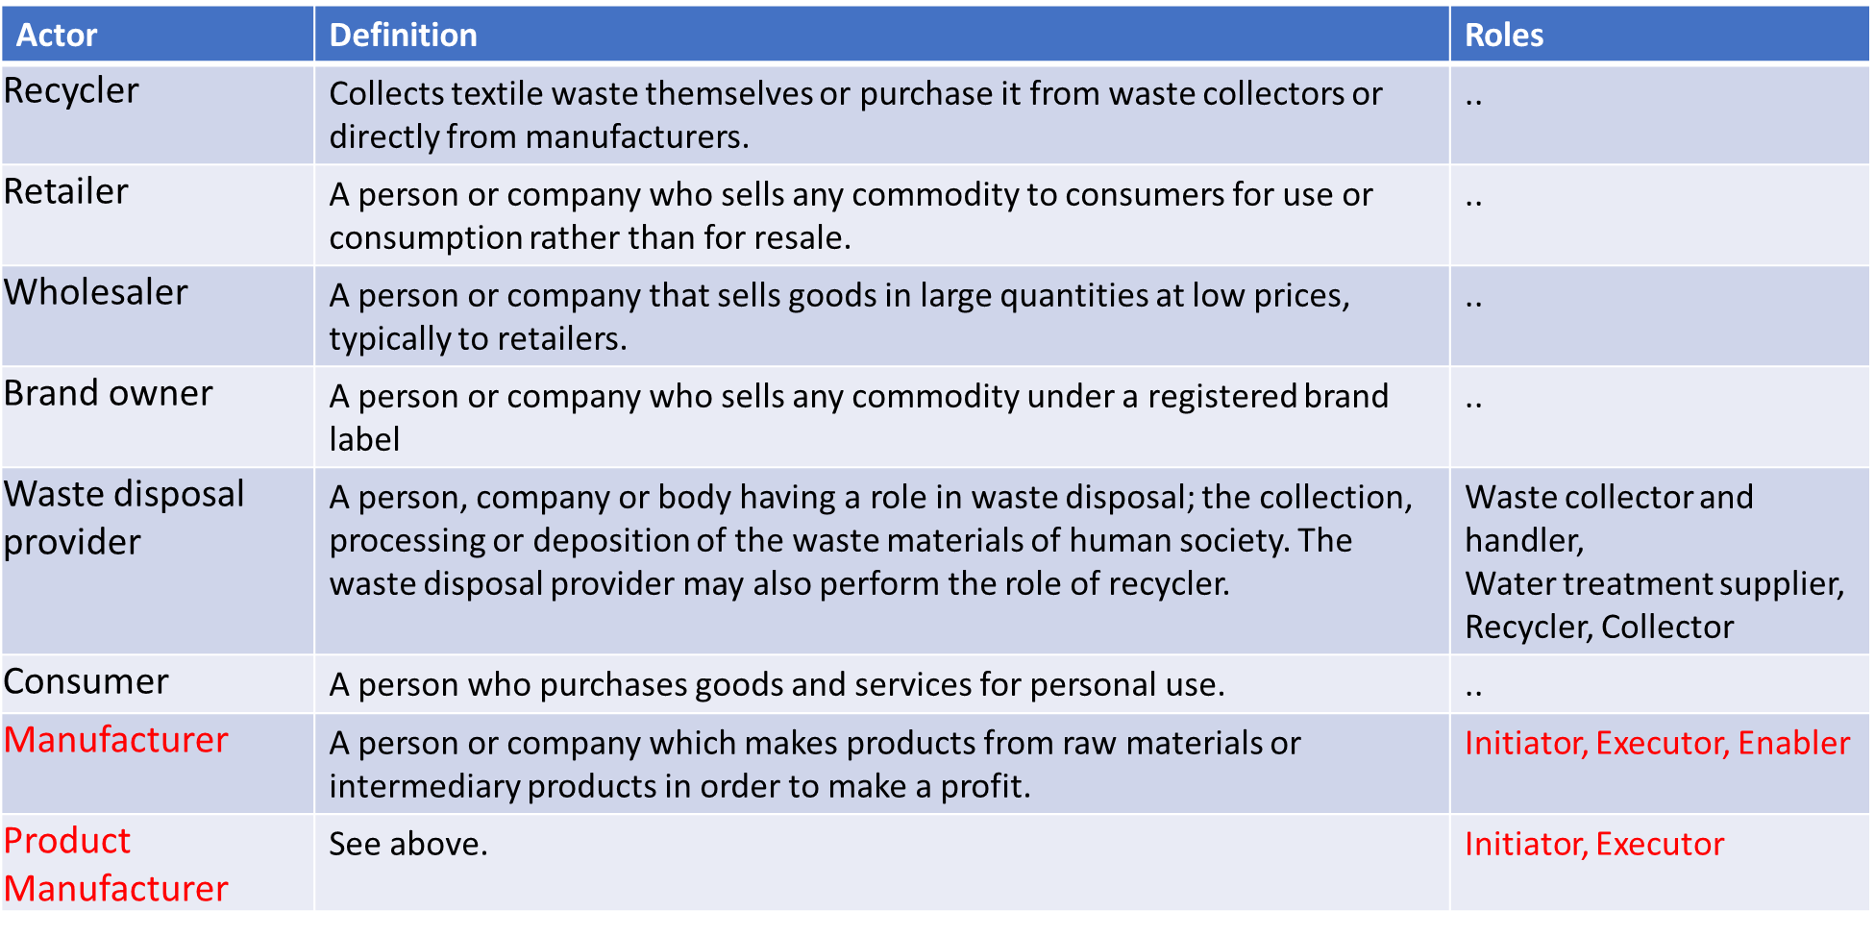
Circular Economy: Actors/Definitions/Roles
DRAFT

Slide 12
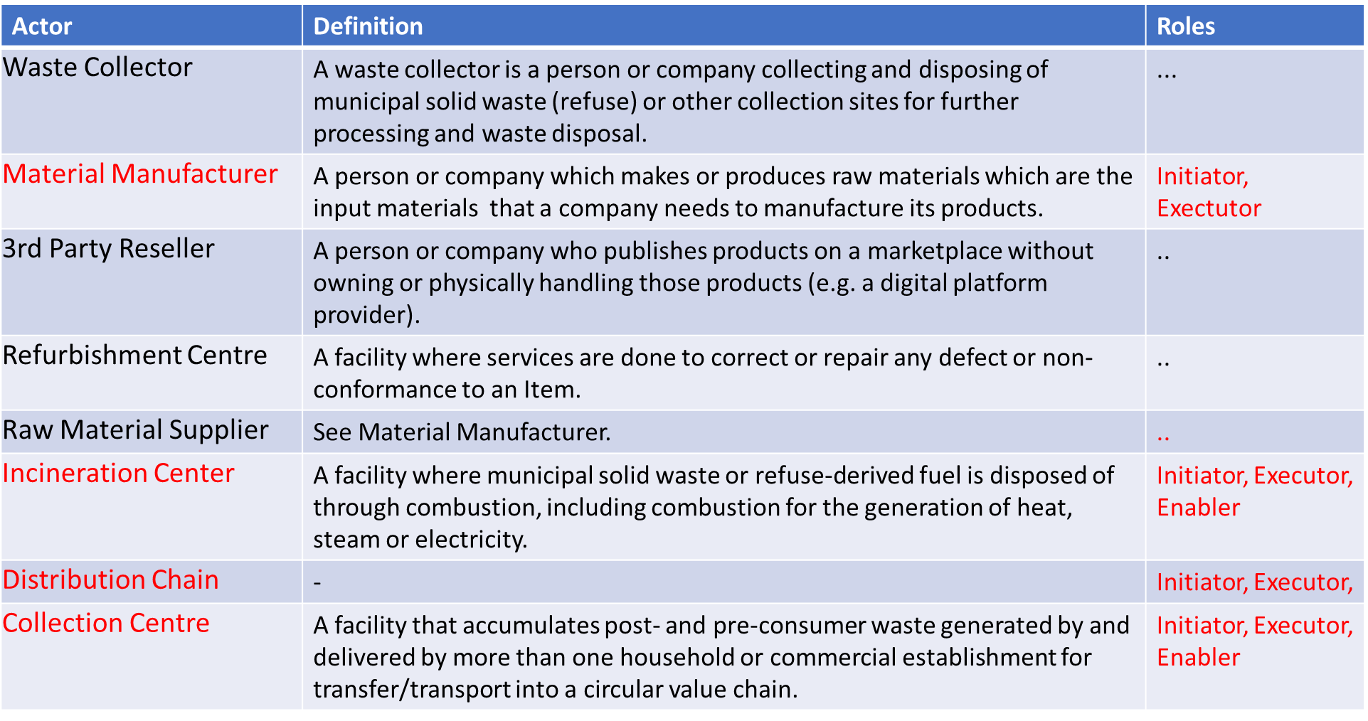
Circular Economy: Actors/Definitions/Roles
DRAFT

Slide 13
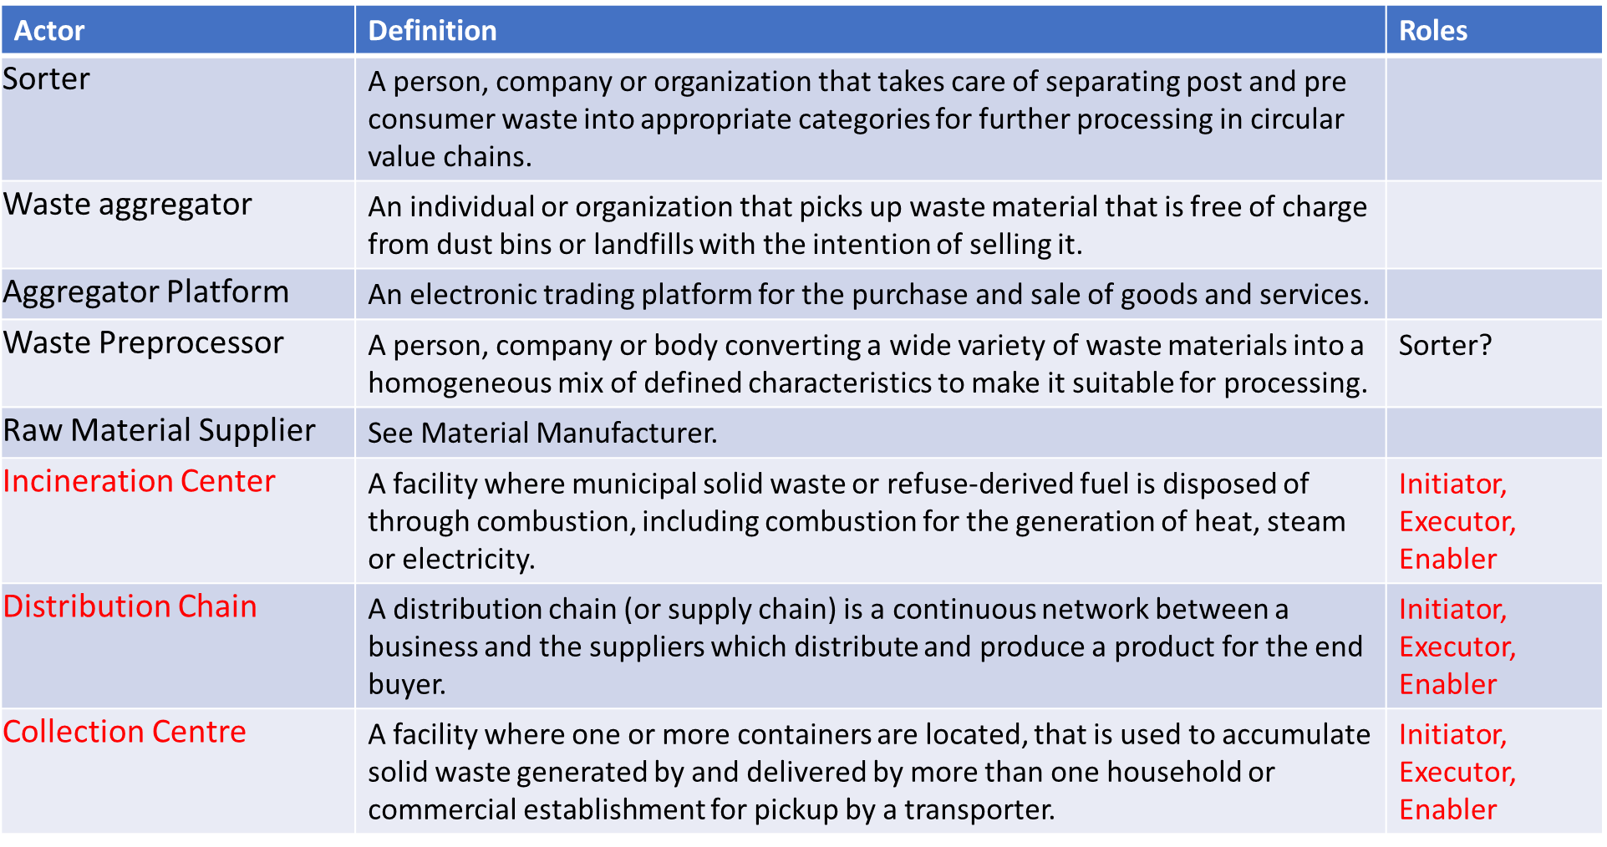
Circular Economy: Actors/Definitions/Roles
DRAFT

Slide 14
Product Circularity Data Project
3rd meeting
3 March 2023
ITEM 4: Presentation ON IDENTIFYING information DATA EXCHANGES
for process “Collection”
Jan Merckx, Leader Draft 2: Identifying Information Data Exchanges
Used sources:
Ecodesign for Sustainable Products Regulation - preliminary study on new product priorities EU
Sustainable Products Initiative EU

Slide 15
Information exchange; process “Collection”
To be done
 | Process: Collection
Actors | Actor A | Actor B | Actor C | Actor D | Actor E
A Municipal Collector | Empty collection bins | Deliver collected items | Activity/Action | Activity/Action | Activity/Action
 | X | Item Volume Item source/origin | What data | What data | What data
 | X | Reception of items Planning | Why | Why | Why
B Centre for Sorting / Triage |  | Sorting of items | Activity/Action | Activity/Action | Activity/Action
 |  | X | What data | What data | What data
 |  | X | Why | Why | Why
C Actor | Activity/Action | Activity/Action | Activity/Action | Activity/Action | Activity/Action
 | What data | What data | X | What data | What data
 | Why | Why | X | Why | Why
D Actor | Activity/Action | Activity/Action | Activity/Action | Activity/Action | Activity/Action
 | What data | What data | What data | X | What data
 | Activity | Why | Why | X | Why

Slide 16
Product Circularity Data Project
3rd meeting
3 March 2023
Item 5: Presentation on Harmonization drafts and existing initiatves
Gerhard Heemskerk, Leader Draft 3: Harmonization
Used sources: UN Core Component Library
UN Code Lists
Circularity ID
Circular Product Data Protocol
Product Circularity Data Sheet
CEN Presentation on material declaration
EU Circular economy: definition, importance and benefits

Slide 17
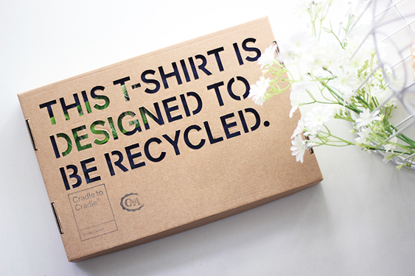
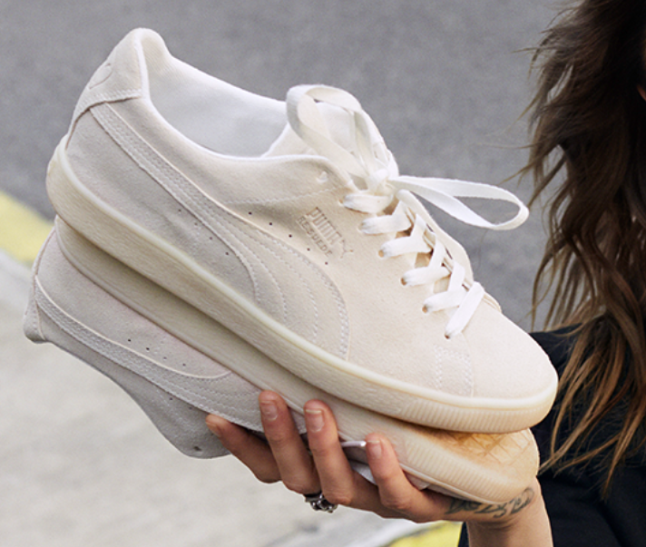
Harmonization existing initatives
DRAFT
Which data do they have in common and what are the differences.
Fields
Textile & Leather Circular Product Data
e.g. Product is Recyclable.
111
Circularity.ID V 3.0
C&A debuted the world’s first Cradle-to-Cradle Gold level certified t-shirt made entirely from organic cotton, including the thread and was treated with non-toxic dyes and chemicals allowing it to be recycled safely and efficiently.
Fields
Textile Circular Product Data
44
CPDP V1.0
e.g. Product is Biodegradable.
With the RE:SUEDE experiment, PUMA will test whether it can make a biodegradable version of its most iconic shoe, the SUEDE. The participants will wear the RE:SUEDE for half a year before returning their pairs to PUMA. The company will then send the worn RE:SUEDES to industrial composting experts Ortessa in the Netherlands.
Fields
Generic Circular Product Data
44
PCDS v3.2s Light

Slide 18
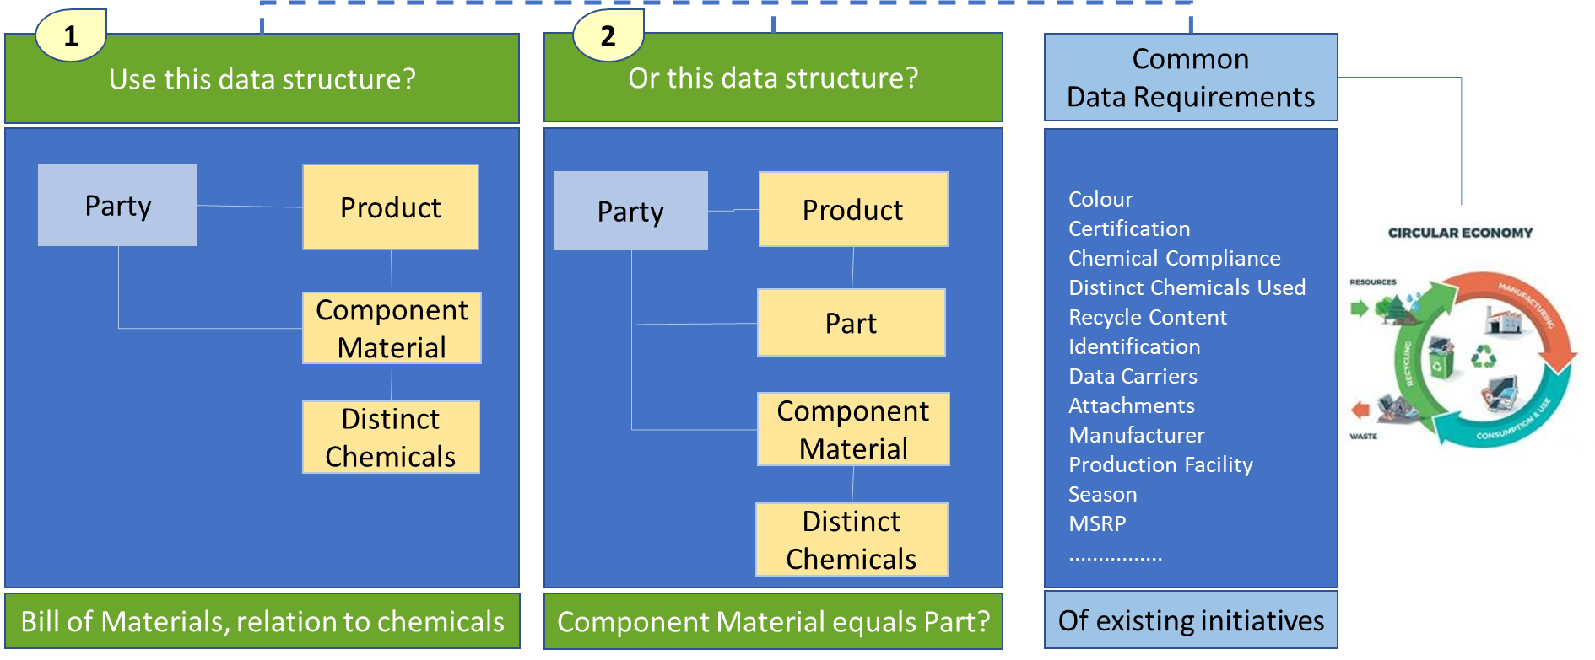
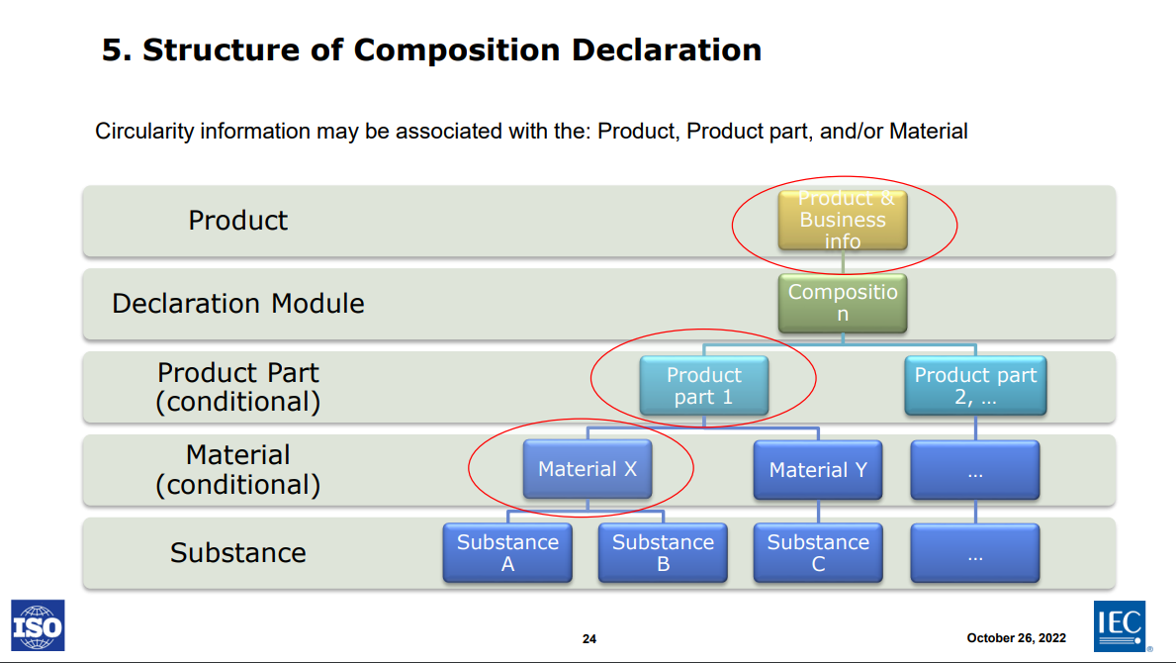
Component materials equals product part?
DRAFT
ISO/IEC: How material declaration of products can support circular economy and digital product passports

Slide 19
Few remarks on existing initiatives
DRAFT
Fields
Textile & Leather Circular Product Data
111
Circularity.ID V 3.0
Data is specific for the textile and/or leather industry.
Data is mainly targeted for resale, reuse, recycle.
Data is focussing on ESG certifications and transparency.
Fields
Textile Circular Product Data
Data can be mandatory, optional, coded (enumerations)
44
CPDP V1.0
Fields
Generic Circular Product Data
Data is generic. Predefined statements on circularity characteristics
A self-declaration on product, material and substances.
44
PCDS v3.2s Light
Not all data seems to be suitable for all type users (actors).
A product declaration which presents standardized and trustworthy information on the circularity aspects of a product which could be used partially or entirely by other stakeholders (e.g. databases, platforms or consultants) to enable circular evaluation of the product.

Slide 20
Overview circular product data found in initiatives
DRAFT
Product Data
Component Data
Sustainability Data
Party
ID,SKU, GTIN, Data Carrier
Name, Description/Brand name
Sub-Brandname
Images / Care label & symbols
Country Size Matrix
Colour incl Main & Category
GS1 Family/Brick/Classification
Season/Gender/Age/Segment
Price
Net Weight
Grade/Pattern/Thickn./Water p.
Country of Origin/ Species
Finishing/Printing details
Bill of Material ID
Type / Name
Presence (%.Min/Max/Wgt/Rng)
Used chemicals (%, wgt)
Colours (type, %, etc)
Certification Standard
Composition Disclosure y/n
Third Party Verified Composition
Circular Strategy
Certification Standard
Chemical Compliance
Used Chemicals
Recoverability
Reusability (incl. content)
Repairability
Refurbishability
Biodegradability
Diassemability
Renewable Content
Recycled Content
CE Marking
Parent Organization
Manufacturer details
Production Facility Details
Traceability Data Provider
Production Process Steps

Slide 21
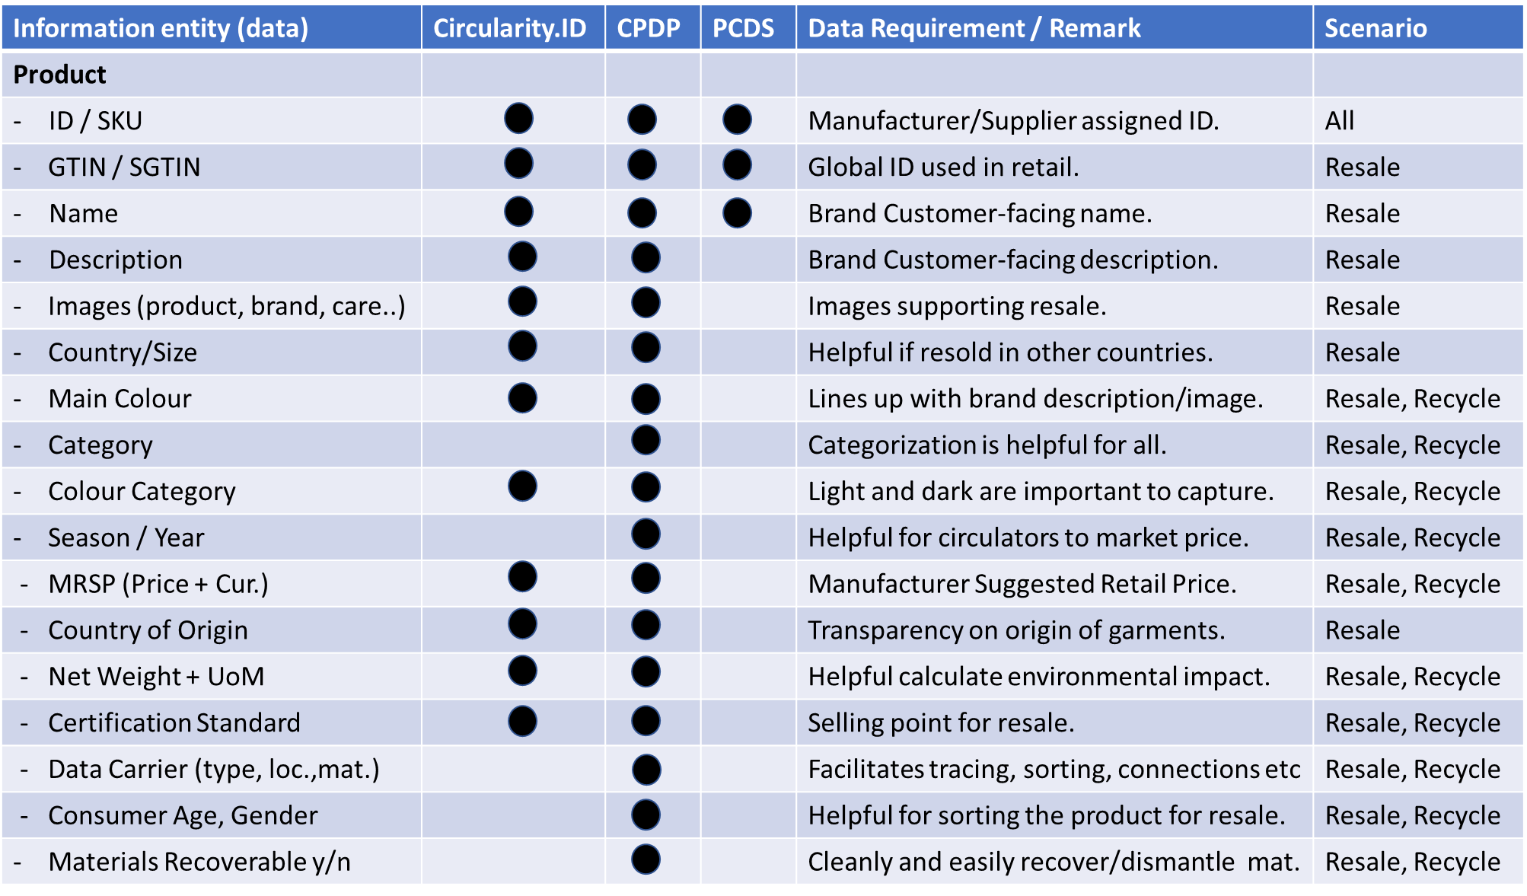
Product
Circularity
Data
DRAFT

Slide 22
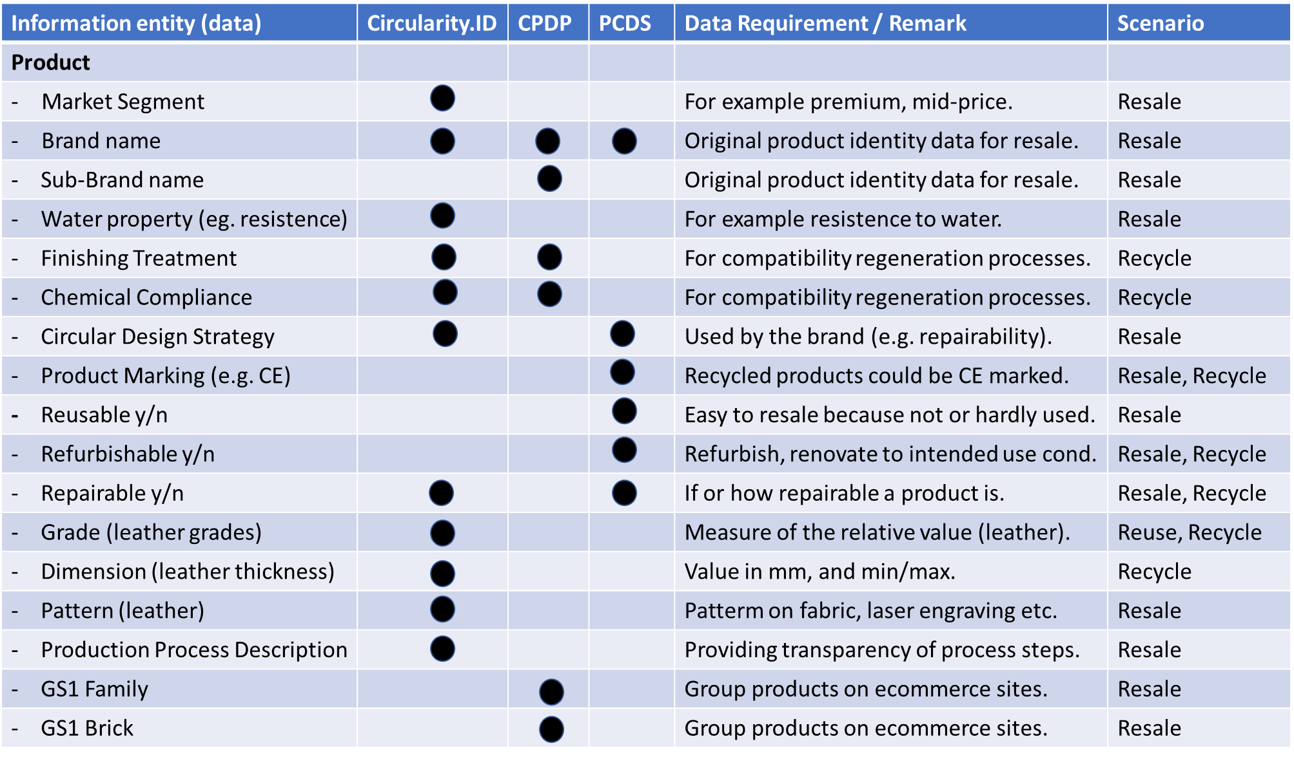
Product
Circularity
Data
DRAFT

Slide 23
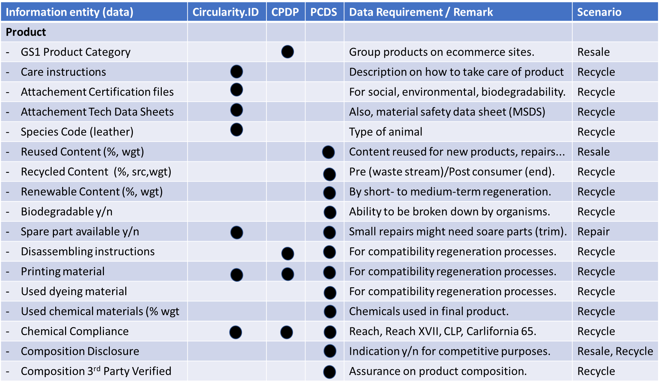
Product
Circularity
Data
DRAFT

Slide 24
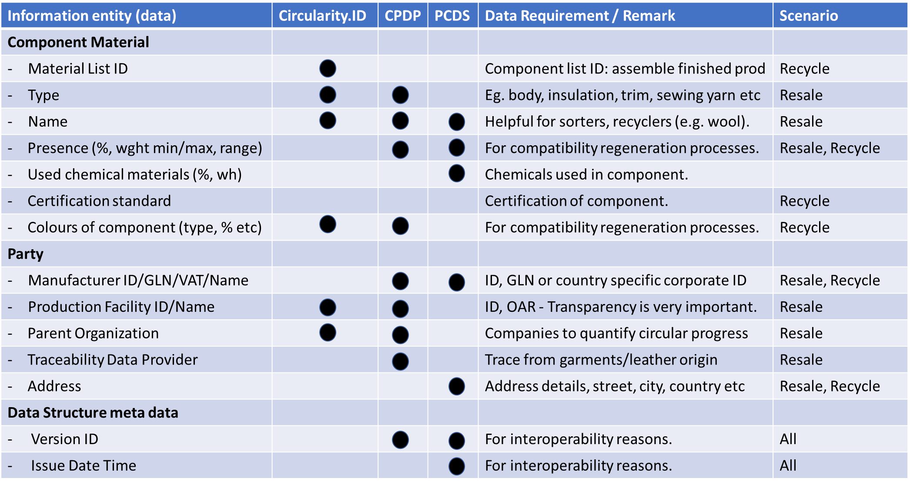
Product
Circularity
Data
DRAFT

Slide 25
Next Step: Evaluate importance of data in existing initiatives
DRAFT
Data element should be marked as
  “mandatory”; must be in.
  “optional”; could be in.
  “dismissed”; keep out.
  “coded”; a list of predfined values.
  “not clear”; explanation needed.
  “scenario” for circularity strategy is incorrect or incomplete.
Following data elements should be in scope (are missing):
  ..........................

Slide 26
Harmonization: UN library expected missing data
DRAFT
Presention file (content type text/code)
Main Colour
Colour Category
Data Carrier
Water Properties (e.g. water resistent)
Chemical Compliance
Circular Design Strategy
CE marking Y/N
Grade
Refurbisable Y/N
Repairable Y/N
Biodegradable Y/N
Reusable Y/N
Reusable Content (%, weight)
Recycled Content (%, weight)
16. Pattern
17. Refurbishable Y/N
18. Technical Data Sheet (file)
19. Composition Disclosure Y/N
20. Composition 3rd Party Verified Y/N
21. Chemical compliance per material type
22. Component Material Colour
23. Components List ID
24. Recycled Content Pre/Post Consumer & Input
25. Renewable Content (%, weight)
26. Spare parts availability Y/N
27. Disassembly instructions
28. Traceability Data Provider
29. Materials Recoverability

Slide 27
Annex: Abbreviations
UN/CEFACT United Nations Centre for Electronic Business
ISO International Standards Organisation
IEC International Electrotechnical Commission
SKU Stock Keeping Unit
GTIN Global Trade Item Number
SGTIN Serialized Global Trade Item Number (Serial no)
GLN Global Location Number
GS1 Global Standards 1
MRSP Manufacturer Suggested Retail Price
Water p. Water properties (eg. Water resistence)
Wgt Weight
Rng Range
CE Marking Conformité Européenne (European Conformity)
Cur. Currency
Loc. Location
Src Source of recycled material
CLP Substance defined in the CLP regulation (EC) n° 1272/2008
Carlifornia 65 A warning under California Proposition 65.
REACH Registration, Evaluation, Authorisation and Restriction of Chemicals
VATnr Value Added Tax number

Slide 28
Product Circularity Data Project
3rd meeting
3 March 2023
ITEM 6: Any other business and next meeting
Virginia Martos-Cram, UN/CEFACT Project Lead

Slide 29
Product Circularity Data Project
3rd meeting
3 March 2023
Looking forward to your contributions and presentations at our next meeting!
4th Working meeting
- 17 March 2023 15.00-17.00

