Slide 1
ISO/TC 307
Blockchain and distributed ledger technologies

Slide 2
What is ISO/tc 307?
New ISO Technical Committee (from which projects will come)
  Proposal from Australia: ISO/TS/P 258 April 2016
    Standardisation of blockchains and distributed ledger technologies to support interoperability and data interchange among users, applications and systems.
    Very broad in scope; maturity and readiness for standards questioned
  ISO/TC 307 established September 2016
    https://www.iso.org/committee/6266604.html
  Mirror committees began to prepare
  First meeting in Sydney, April 2017
  Next plenary meeting in Chiyoda City (Tokyo), November 2017

Slide 3
What will it do?
Answer 1: TBD
Answer 2: Whatever the participants agree it should do, under the rules defined by ISO
Technical committees are established by the ISO/Technical Management Board (TMB) on a provisional basis. Within 18 months, provisionally established technical committees are required to prepare a strategic business plan for review by the ISO/TMB . The committees are formally established by the ISO/TMB at the time of acceptance of the business plan. This does not preclude the initiation of standardization projects during this 18 month period.

Slide 4
Who is Involved?
Participating Members (19)
France (AFNOR)
United States (ANSI)
Austria (ASI)
United Kingdom (BSI)
Germany (DIN)
Denmark (DS)
Malaysia (DSM)
Russian Federation (GOST R)
Croatia (HZN)
Japan (JISC)
Korea, Republic of (KATS)
Netherlands (NEN)
Ireland (NSAI)
Australia (SA)
China (SAC)
Canada (SCC)
Finland (SFS)
Spain (UNE)
Italy (UNI)
Observing Members (16)
Indonesia (BSN)
Luxembourg (ILNAS)
Argentina (IRAM)
Iran, Islamic Republic of (ISIRI)
Hong Kong (ITCHKSAR)
Belgium (NBN)
New Zealand (NZSO)
South Africa (SABS)
Israel (SII)
Sweden (SIS)
Norway (SN)
Switzerland (SNV)
Slovakia (SOSMT)
Singapore (SPRING SG)
Thailand (TISI)
Czech Republic (UNMZ)
P countries provide experts, actively participate, vote

Slide 5
Attendees
1st plenary meeting In Sydney
Australia
Canada
China
France
Germany
Japan
Malaysia
Republic of Korea
Russia
SWIFT
United Kingdom
United States
European Commission
Most countries shared points of view, especially of areas on which to move forward.

Slide 6
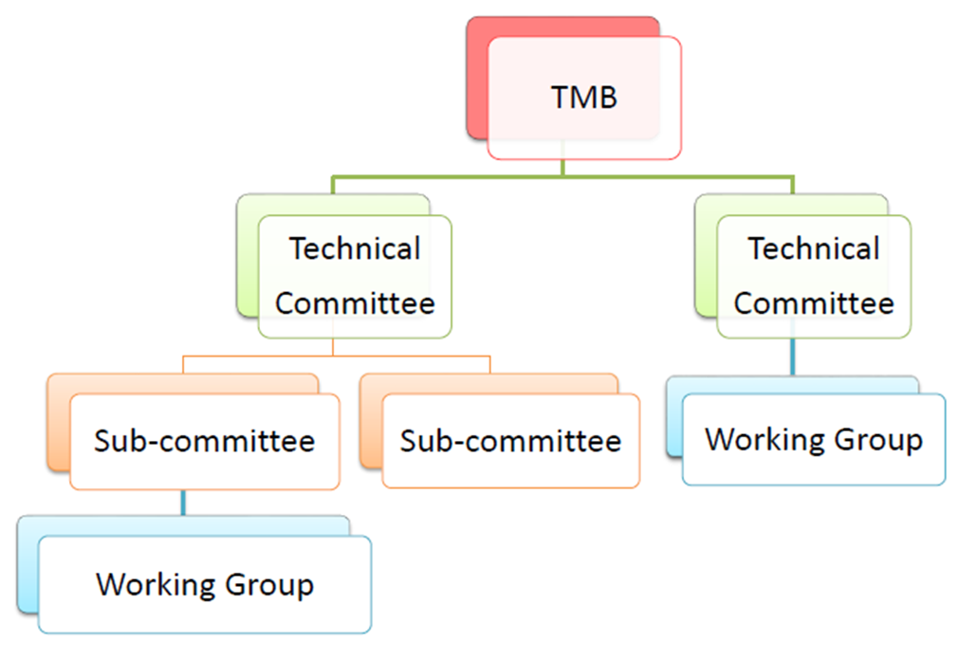
Near term Activities
Most common was the expressed need for agreement on terminology
Group | Name
New Work Item Proposal (NWIP) Working Group (WG) | Terminology
2. ISO/TC 307/Study Group 1 | Reference architecture, taxonomy and ontology
3. ISO/TC 307/SG 2 | Use cases
4. ISO/TC 307/SG 3 | Security and privacy
5. ISO/TC 307/SG 4 | Identity
6. ISO/TC 307/SG 5 | Smart contracts

Slide 7
Why Working groups and why Study groups?
Study Groups (SGs)
  Chartered to investigate the need and feasibility of additional standardization and/or guidance in a technical area
  Main objective: to understand the current activities in a particular area and make recommendations
  Not process time limited (e.g., standard 3 year cycle for deliverables)
Working Groups (WGs)
  Established to expedite development of one or more approved work items, and will exist as long as it has responsibility for approved work items

Slide 8
SG1: Reference architecture, taxonomy and ontology
This group will study material relevant to the creation of a blockchain and distributed ledger technology reference architecture, taxonomy and ontology, with the objective of creating a recommendation on how to proceed with this work
Examine contributions from countries
Report back to Plenary

Slide 9
SG2: Use cases
Consider the most common types of use cases
Consider the potential implications of the existing use cases and applications
Examine contributions from countries
Report back to Plenary

Slide 10
SG3: SECURITY AND PRIVACY
Review existing standards in this area and explore relationships in this area with other work;
Assess whether there are requirements for security and privacy in relation to blockchain and distributed ledger technologies that go beyond those in other areas;
Ensure that their review does not confine itself to any use case, but rather considers what the “superset” of requirements may be
Examine contributions from countries
Report back to Plenary

Slide 11
SG4: Identity
  Take into account existing identity related standards, particularly in ISO/IEC JTC 1/SC 27 WG5; and
  Take into account existing business use cases and functional use cases.
  Identify the types of identities and entity types needed for data and functionality within blockchains;
  Identify the identity management requirements needed outside a blockchain, upon which the operation of the blockchain depends, such as for data integrity and for access control;
  Review existing identity-related standards and identify which existing standards, and standards under development, could be relevant for ISO/TC 307;
  Identify any regulations that could impact the creation, use and management of identities in relation to blockchains; Identify any other relevant material or activities;
  Assess where work with other ISO/TC 307 bodies, particularly the Security and Privacy Study Group, and Liaisons with other bodies would be helpful in pursuing potential projects;
  Assess how to work with ISO/IEC JTC 1/SC27 WG5 and to advise on the feasibility of establishing a Joint Working Group
Examine contributions from countries
Report back to Plenary

Slide 12
SG5: Smart Contracts
The scope of this study group is to provide an analysis in the form of a report of the current understanding of smart contracts within the remit of ISO/TC 307 from both a technical as well as appropriate legal perspective.
The study group will consider interoperability with the law, including but not limited to the verification, enforcement, and life cycle of smart contracts.
Examine contributions from countries
Report back to Plenary

Slide 13
LIAISONS
Many ISO groups
SWIFT
EC
And others in process

