Slide 1
The Use of Code Lists within UN/EDIFACT and UN/XML Schemas
Initial contribution from SCRDM team

Slide 2
Identified issues
Version compatibility
The ability to use the latest possible version of a code list in association with any version of a message, i.e. decoupling the versioning of code lists from the business message versions
2. Extending code lists
Evaluate if permanent extensions are possible and desirable
3. Restricting code lists
Provide rules and methodology for restricting code lists for use within specific context. Users of the UN/CEFACT libraries may identify any subset they wish from a specific code list for their own community requirements.
4. Code list validation rules
Provide rules and methodology for how to validate instance documents against an XML Schema or UN/EDIFACT message type in respect to code lists
5. Temporary codes
Provide rules and methodology for the inclusion of temporary codes that will be replaced by a permanent code at the next UN/CEFACT standardised release.
6. Externally maintained code lists
Define rules and procedures for referencing code lists maintained by organisations external to UN/CEFACT, e.g. ISO, ICC, W3C.
7. Publication format of code list

Slide 3
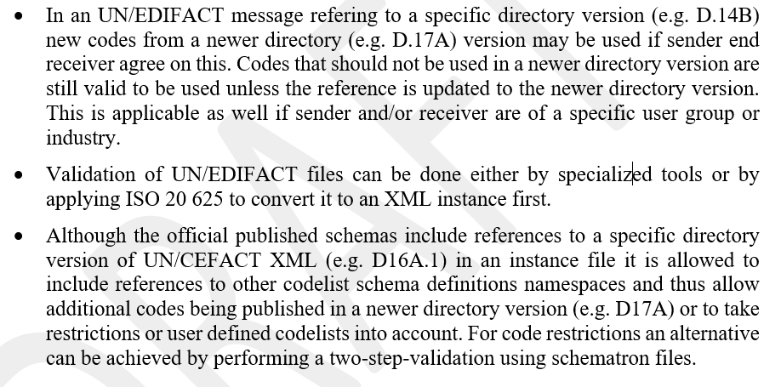
1. Version compatibility
The ability to use the latest possible version of a code list in association with any version of a message, i.e. decoupling the versioning of code lists from the business message versions

Slide 4
Example: versioning
Syntax
Mapping
Inhouse
file
Code Values
EDIFACT
UNB+UNOA:3+16121+2132112+101013:1043+4711'
UNH+000001+DESADV:D:96A:UN:LOCALID'
Traditional
Application
e.g.ISO 20625
Validation
Transform
XML
UN/XML
Message
Code Validation
UN/XML
Code Lists
Message schema
XML
<xsd:import ....... schemaLocation="QualifiedDataType_20p0.xsd"/>
UNECE_DocumentNameCode_D16A
UNECE_PackageTypeCode_2006.xsd

Slide 5
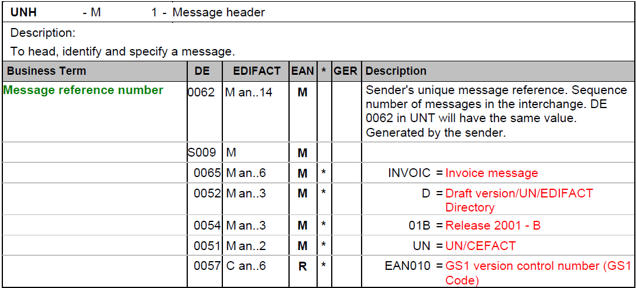
Example: GS1 UN/EDIFACT
new codes from a newer directory (e.g. D.17A) version may be used if sender end receiver agree on this.

Slide 6
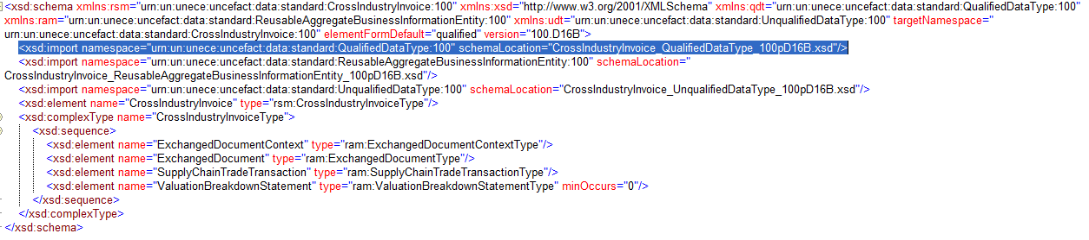
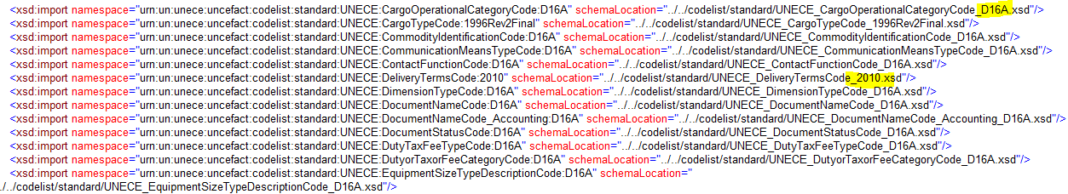
Example: UN/CEFACT SCRDM Cross Industry Invoice
Coupled Code lIsts
(p.s. if decoupled no import statements)

Slide 7
2. Extending code lists
Evaluate if permanent extensions are possible and desirable
UNCEFACT
User Groups
UN/EDIFACT
UN/XML
Create your own qualfied
Code list as Extended and
Coupled this one
Mark Codes
As Extended in
Message Implementation
Guideline (MIG)
Causes:
Different timelines between new codes published and time of implementation.
Industry specific codes needed
UNECE
UNECE
extend
+ code lists
+ codes
+ code lists
+ codes
Alternative:
Code list with the old and new values AND associated revised version information.
DMR
permanent

Slide 8
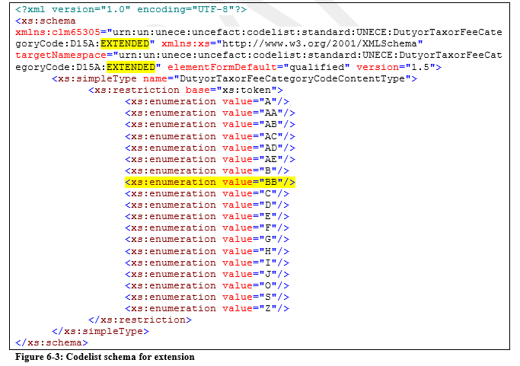
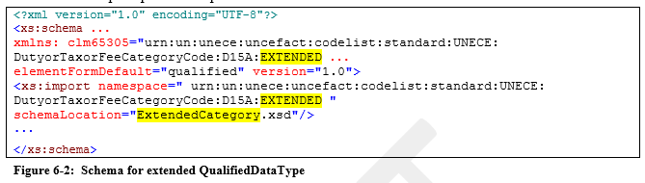
Example: extending code list
In this example the schema is saved as ExtendedCategory.xsd.

Slide 9

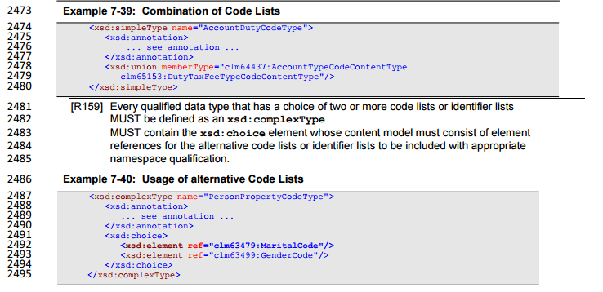
Example: union & choice code lists
From UN/CEFACT NDR Rules 2.1

Slide 10
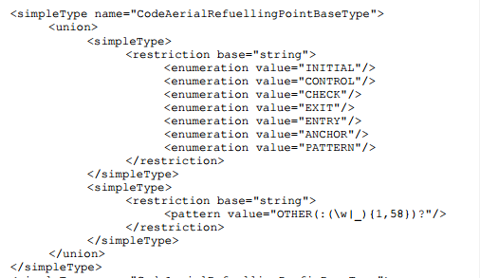
Example : other union
Example other standards organization
1
2

Slide 11
3. Restricting code lists
Subset of the managing agency’s list.
UNCEFACT
User Groups
UN/EDIFACT
UN/XML
UNECE
UNECE
Restrict
(only XML)
Mark Code List
As Restricted in
Message
Implementation
Guideline (MIG)
Restricted because:
Business rules only allow limited number of codes
Subsets for different contexts
Interoperability when chosing for subsets
Restricted list of code lists when different code lists are available
Create your own qualfied
Code list as Restricted and
couple this one
Restrict
(only XML)
+
restrict
- codes
- code lists
- Need to restrict to their context
- e.g. double qualified code lists
- code lists
- codes
Alternative:
A restricted code list is a shorter version of the full-list, but the shorter file has unique code list metadata reflecting the subset of values (it should have different metadata). This ensures multiple restricted lists of the same full list can be uniquely identified and managed by their respective distinguished metadata

Slide 12
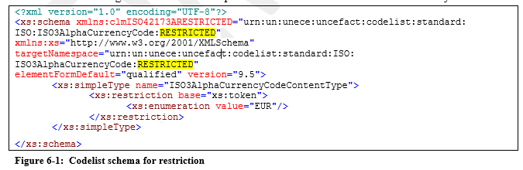
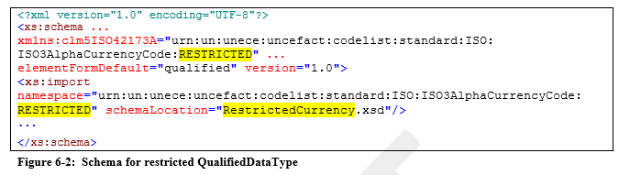
Example: restricting
In this example the schema is saved as RestricedCurrency.xsd.

Slide 13
4. Code List Validation Rules
Provide rules and methodology for how to validate instance documents against an XML Schema or UN/EDIFACT message type in respect to code lists
INPUT UN/EDIFACT
INPUT UN/XML
UNECE
One-step-validation process (coupled)
Codes are validated against the codes listed in code list specified in the imported code list schema module.
- Against UNCEFACT Code List Codes
- Against amended UNCEFACT Code List Codes
- Against own Code List Codes
e.g. UN/EDIFACT syntax process
Handling of EDIFACT syntax by directly mapping each data element to an inhouse file. Validation of codes will be done by the inhouse application.
e.g. ISO 20625
A standardized methodology to convert an EDIFACT instance to a XML instance. By applying this transformation standard validation tools for XML validation can be applied.
Two-step-validation process (uncoupled)
The advantage of this approach is that the original schemas can stay unmodified.
e.g. Schematron
- ISO-standard Schematron (ISO/IEC 19757-3)
e.g. XSLT
- W3C
Extensible Stylesheet Language Transformations, a language for transforming XML documents into other XML documents or other formats. The <xsl:if> element is used to put a conditional test against the content of the XML file.

Slide 14
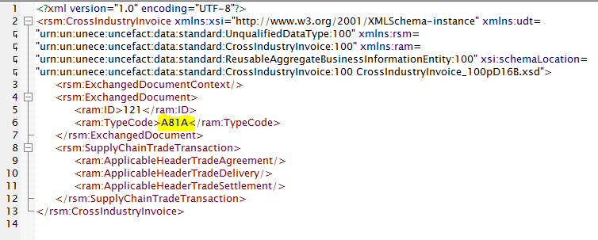
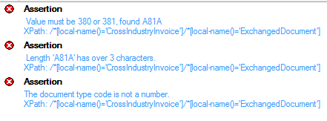
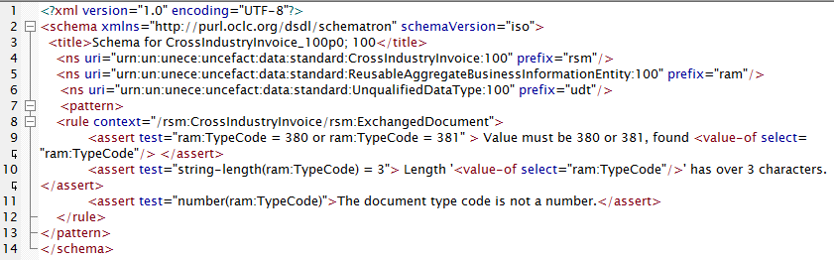
Example: schematron
XML Instance
Schematron

Slide 15
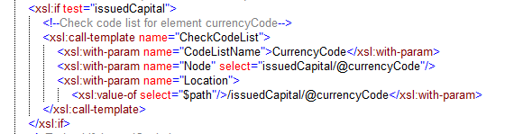
Example: XSLT
<!--Rule 141: The value of element gln should be tested against a maximum length.-->
<xsl:if test="gln and string-length(gln) &gt; 13">
<xsl:call-template name="ErrorMessage">
<xsl:with-param name="Message">Rule 141: The value for element gln (<xsl:value-of select="gln"/>) is too large. Maximum
amount of allowed charachters is 13</xsl:with-param>
<xsl:with-param name="Location">
<xsl:value-of select="$path"/>/administrativeUnit/gln</xsl:with-param>
<xsl:with-param name="Node" select="gln"/>
</xsl:call-template>
</xsl:if>

Slide 16
5. Temporary codes
Provide rules and methodology for the inclusion of temporary codes that will be replaced by a permanent code at the next UN/CEFACT standardised release.
- A user group code list has been extended because UNECE did not have a code available.
- The use group assigns a temporary code value that will be added in the UNECE data base once the code is approved as a formal addition to the original code list.
- Users should be aware that the code value will change over time.
- The user group may decide not to submit the added code or UNECE can decide to not approve it. It stays a permanent user group code.
UNCEFACT
User Groups
UNECE
UNECE
extend
extend
+ codes
+ code lists
+ codes
+ code lists
Alternative:
The new temporary codes would be expressed in a dedicated file. This dedicated file would have its own identity separate from the published base list. In real time, the union of the published base list with the temporary codes list. When the published list is revised, the new temporary values are incorporated as in (extending a code list.
DMR
permanent

Slide 17

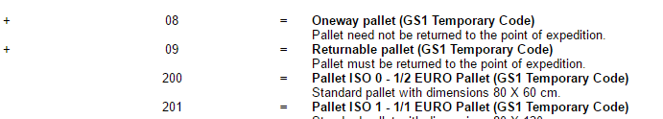
Example: GS1 Temporary Codes

Slide 18
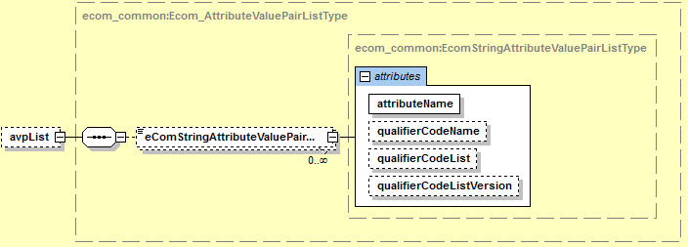
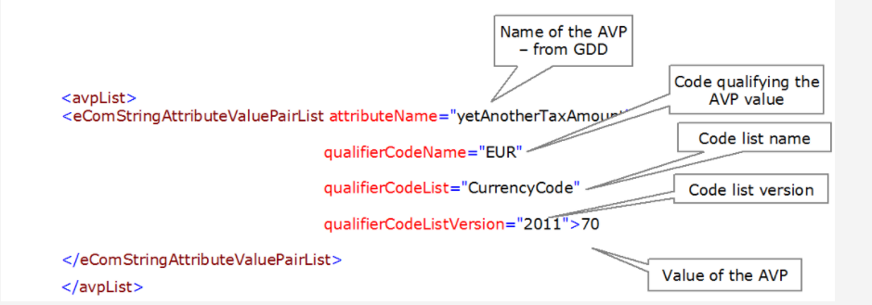
Example: Attribute Value Pairs (GS1 XML 3.2)
GS1 XML: Starting from release 3.2 of GS1 XML GS1 EDI standard, every message contains placeholders for temporary message components, called Attribute Value Pair – AVP. The actual attributes and values allowed are stored in the Global Data Dictionary. The AVPs are defined outside of the schema, therefore their values cannot be validated. The data types of the attribute values are not specified in the schema, so they cannot be checked either.
In this example, the attribute value must be qualified by a code value taken from the code list, here – CurrencyCode list. It may also be needed to specify the code list version – here it is the ISO list 2011.

Slide 19
6. Externally maintained code lists
Define rules and procedures for referencing code lists maintained by organisations external to UN/CEFACT, e.g. ISO, ICC, W3C.
NOW
EDIFACT Rules: Use 1131/3055
NDR Rules: Use Supplementary Components
UN/EDIFACT
UN/ EDIFACT
User Groups
UN/XML
UN/XML
User Groups
Section 4:
UN/EDIFACT DIRECTORY VERSION/RELEASE PROCEDURES
It is essential that messages should be capable of being identified in relation to the current version of the directory from which they are derived, (i.e. the code lists, data elements, composite data elements and segments).
Some are using data elements 1131 (Code list identification code) and 3055 (Code list responsible agency code).
- Code List. Identifier
Can be used to identify the URL of a source that defines the set of currently approved permitted values
- Code List. Agency. Identifier
Defaults to the UN/EDIFACT data element 3055 code list.
- Code List. Version. Identifier
Identifies the Version of the UN/EDIFACT data element 3055 code list.
- Code List. Uniform Resource. Identifier
The Uniform Resource Identifier that identifies where the code list is located.
Examples
Most code lists values are stored outside of the XML schemas (decoupled, the values can be added between schema releases)
Bilaterally defined code lists
are mutually agreed between trading partners,
Code list values are enumerated in the schema if
- values are “Intrinsic”
- code lists are immutable
- manageable size < 50 values
Bilaterally defined code lists
Mutually agreed between trading partners,

Slide 20
Example: External code lists and linkage
e.g. Element 4405 = XSD Status_ Code. Type
Syntax 3
UN/EDIFACT
ALL
Syntax 4
Restricted
e.g. element 8248 = XSD Transport Equipment Movement Status_ Code. Type
EDIFICAS-EU
UNCEFACT
UN/XML
ALL
e.g. XSD Accounting Contact_ Code. Type
UNCEFACT
UNCEFACT Rec
XML Code List
ISO
External Codes
ALL
e.g. element 6345 = XSD Currency_ Code. Type
ICC
e.g. element 4053 = XSD Delivery Terms_ Code. Type
Etc.
User Codes
‘Mutually defined’
CODE ‘ZZZ’
e.g. Element 7357 = XSD Cargo Commodity Category_ Code. Type
Restricted
(Double
Qualified)
UNCEFACT
Restricted
Code Lists
Qualified XML
Code List
Restricted
e.g. element 4405 = XSD Accounting Debit Credit_ Status_ Code. Type
Date Time
Codes for
Date Time. Format.
ALL
e.g. element 2379 = XSD Formatted_ Date Time. Type

Slide 21
Linkage between UN/EDIFACT & UN/CCL Code list
UNECE Recommendation
Code Linkage Example
UN/EDIFACT DE 7065 Package Type Description Code
TDED DE 7065 Package. Type. Code
CCL BCC Package. Type. Code/TDED Link 7065
UNECE Recommendation 21 Package Type Code List

Slide 22
Example: issue Country codes
Version: “it is from 2006”. This is an issue:
- there are new countries since 2006.
- one of the codes is from a country that came into being after 2006.
Since 2006, Kosovo declared independence from Serbia (2010, XK - not present) and South Sudan gained independence from Sudan (SS, 2011, somehow present). Montenegro (ME, 2006) is present.

Slide 23
7. Publication format of code list
- One machine readable format, to be decided

Slide 24
Conclusion
Code List Modules : Coupled, uncoupled or both is up to the users.
Easy & understandable way of extending and restricting XSD (by creating own ones)
Use supplementary elements to refer to external code lists
For validation purposes users can choose to use Schematron or XSLT or any other tool
Publication format has to be decided yet
We have to create guidance material to solve issues users have, apart from the technical specifications
Schematron is an ISO/IEC 19757-3 standard

