Slide 1
Agenda Topic 1:
Clarification “version compatibility”
1. Decoupling the versioning of code lists
OR
2. Decoupling code lists module schemas from the business message versions”
Example today: As done for SCRDM Cross Industry Invoice

Slide 2
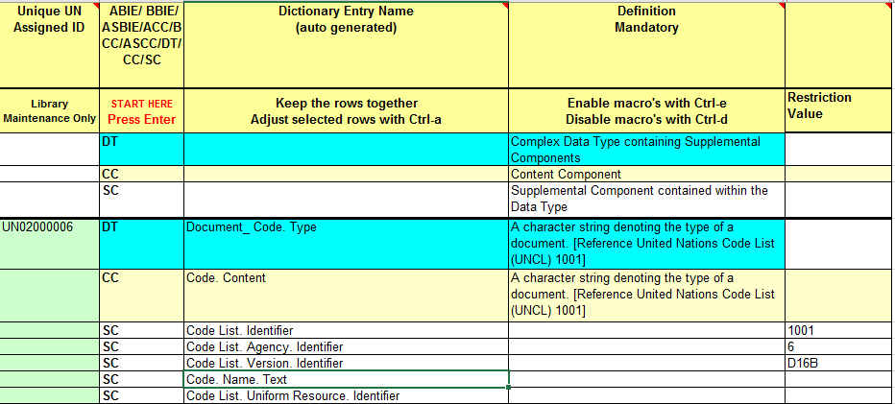
Example: CCL qDT Document_ Code Type
Next slide: example based on SCRDM CII (coupled/uncoupled)

Slide 3


Decoupling only in qDT schema (‘specifies’ code lists)
Coupled version
Uncoupled version (only qDT schema changed, see next slide)

Slide 4
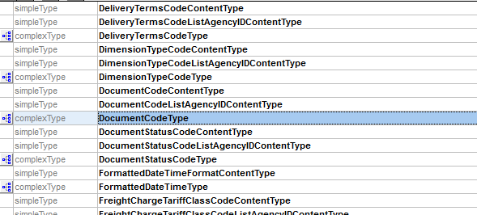
Fragment of qDT specified code lists

Slide 5
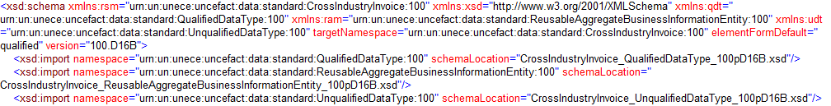
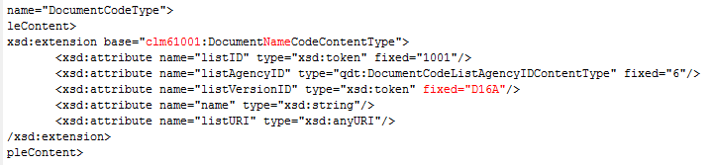
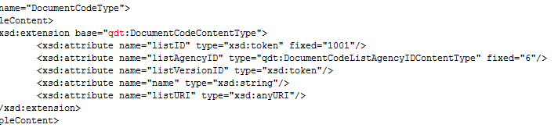
Message.xsd
Always qDT coupled
Qualified Data Type
Schema
Coupled
<xsd:import namespace="urn:un:unece:uncefact:codelist:standard:UNECE:DocumentNameCode:D16A" schemaLocation="../../codelist/standard/UNECE_DocumentNameCode_D16A.xsd"/>
Coupling of code list schema modules:
‘IMPORTS’ ENUMERATIONS of CODE LIST
No import IMPORT declaration in schema
Qualified Data Type
Schema
Uncoupled
clm
(code list module)
No VERSION

Slide 6
Example XML Instances
Coupled
VERSION
Coupled
ENUMERATION
Uncoupled
VERSION
Uncoupled
ENUMERATION

Slide 7




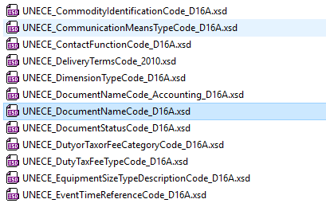
Codelist standards published in both cases including version in schema file name

