Slide 1
SCRDM Project meeting
Agenda Forum Tuesday PM2
Milestones
Status
Planning

Slide 2
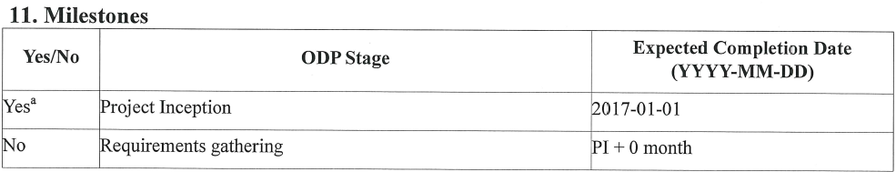
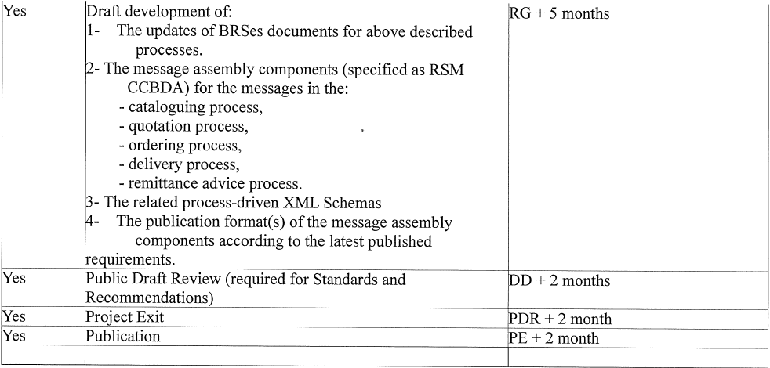
1. Milestones

Slide 3
2. Status
  a. Update BRS
  Wednesday PM1
  Some challanges (mismatches)
  b. RSMs
  Wednesday PM2
  Draft MAs build
  Checks to be done
  c. Schemas
  Thursday AM1
  Automated process (few hours)
  Checks to be done

Slide 4
3. Planning
a. Challenges BRSs might cause delay
b. Checking consistencies takes more time

