Slide 1
  Anticipating and Following Technological Trends
  in eBusiness Data Exchanges
Rolf Wessel SCRDM Project Lead
Ian Watt SCRDM Editor
Sue Probert MMT Lead Editor
Gerhard Heemskerk SCRDM Lead Editor

Slide 2
Mini Conference Background
This Mini Conference will provide participants with information on:
  Reference Data Models (RDMs) for the Supply Chain and the Transport & Logistics domains.
Participants will also get information on:
  Projects
  Concepts
  Deliverables
  Maintenance
Mini Conference, Geneva, 27 March 2017

Slide 3
Agenda
PM1
0. Opening
Projects (Rolf Wessel)
Concept of Reference Data Models (Ian Watt)
Coffee break/Networking
PM2
Reference Data Model High level focus (Sue Probert)
Maintenance of Reference Data Models (Sue Probert)
Reference Data Model (technical details) (Gerhard Heemskerk)
Mini Conference, Geneva, 27 March 2017

Slide 4
  Anticipating and Following Technological Trends in eBusiness Data Exchanges
Reference Data Models are based on UN/CEFACT principles of:
Harmonization
Standardization
Simplification
Reference Data Models - Key Aspects:
Reducing dependency on traditional documents
Reducing redundancy
Process driven collaborative workflows & shared artefacts
Mini Conference, Geneva, 27 March 2017

Slide 5
Key Benefits
Reduction of administrative burden
A trusted Reference Data Model
Enhanced interoperability of data
Standardized & aligned business data exchange structures
Supports Document & Process driven collaborations
Integrated international code lists
A future proof semantic model (data exchange syntax neutral)
Mini Conference, Geneva, 27 March 2017

Slide 6
Section 1: Projects
SCRDM
&
MMT
Publication
Messages
Mini Conference, Geneva, 27 March 2017

Slide 7
RDM Projects and related projects
Inception:
1. Supply Chain Reference Data Model Project (SCRDM)
NOV-2015
2. Multi Modal Transport (MMT)
SEP-2014
3. Extension of Cross Industry Invoice technical artefacts
MAY-2016
4. Extension of Cross Industry Cataloguing, Quotation,
Ordering, Delivering and Remittance Advice technical
artefacts
JAN-2017
5. Procedures for Reference Data Model & associated artefacts
publication
MAY-2016
Mini Conference, Geneva, 27 March 2017

Slide 8
Project details
Project Teams
Project Purposes
Project Deliverables
Mini Conference, Geneva, 27 March 2017

Slide 9
SCRDM & Extension Technical Artefacts Cross Industry messages
Project Leadership
Team
Project Leader: Mr Rolf Wessel
Lead Editor : Mr Gerhard Heemskerk
Editing team:
- Andreas Pelekies
- Colin Laughlan
- Hisanao Sugamata
- Ian Watt
- Karina Duvinger
- Mary Kay Blantz
- Natascha Rossner
- Sue Probert
- Ulrike Linde
Mini Conference, Geneva, 27 March 2017

Slide 10
MMT Project Leadership
Team
Project Leader: Mrs Sandretto & Mr David Hesketh
Lead Editor : Mrs Sue Probert
Editing team:
- Henk Van Maaren
- Marielle Stumm
- Rudi Bauer
- Yoshi Kito
- Dominique Vankemmel
Mini Conference, Geneva, 27 March 2017

Slide 11
Publication Procedures
Project Leadership
Team
Project Leader: Mr Ulrike Linde
Editing team:
- Colin Laughlan
- Gerhard Heemskerk
- Karina Duvinger
- Ian Watt
- Mary Kay Blantz
- Sue Probert
- Ulrike Linde
Mini Conference, Geneva, 27 March 2017

Slide 12
Project Purpose: SCRDM & MMT
Purpose
Development of semantic models (Reference Data Models)
for the Supply Chain and the Transport & Logistics domains
Easy to use and maintainable semantic framework
for the Supply Chain and the Transport & Logistics domains
Based on the UN/CEFACT Core Component Library (CCL)
Semantic links between:
- UN Layout Key documents via TDED references
- UN/EDIFACT message implementation structures
- Core Component Library
Guidelines for using Reference Data Models
Mini Conference, Geneva, 27 March 2017

Slide 13
Project Purpose: Extension Technical Artefacts Cross Industry messages
Purpose
Based on UN/CEFACT Supply Chain Reference Data Model (SCRDM)
Process Driven XML schemas, based on existing artefacts of:
- Cataloguing
- Quotation
- Ordering
- Delivering
- Remittance advice
The new SCRDM Process driven XML schemas will become modern alternatives to the previously published Document driven XML schemas
Business requirement consistency will be ensured because the new SCRDM XML schemas will be based on the currently published Business Requirement Specifications (BRSs)
Mini Conference, Geneva, 27 March 2017

Slide 14
Project Purpose: Publication Procedures
Purpose
Define the procedures for the creation and publication of CCL-based Reference Data Models and associated artefacts.
The process for the publication of Reference Data Models takes account of the following aspects:
- Relationship with the underlying CCL
- Validation rules for publication formats
- Production of the publication bundle
- Maintenance of Reference Data Models
Mini Conference, Geneva, 27 March 2017

Slide 15
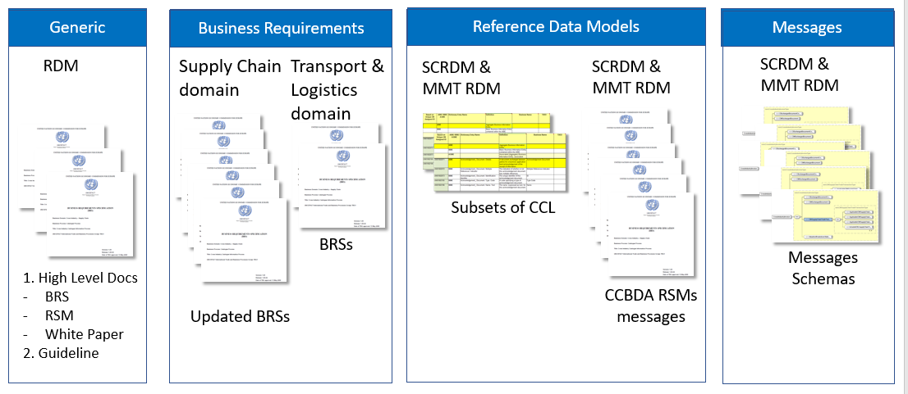
Project Deliverables: SCRDM, MMT,
Extension Technical Artefacts Cross Industry
Messages
Deliverables
Mini Conference, Geneva, 27 March 2017

Slide 16
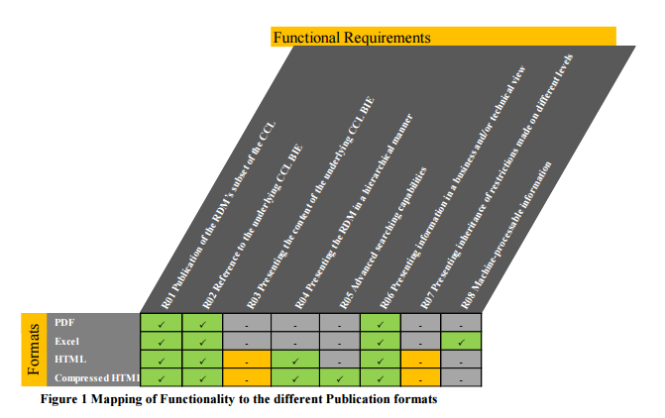
Project Deliverables: Procedures Publication
Deliverables
Definition of the publication bundle
- 8 Requirements
- 4 Publication Formats
Public Review comments
(if any) discussed during forum
Mini Conference, Geneva, 27 March 2017

Slide 17
Project Status
Open Development
Process stage
1. Supply Chain Reference Data Model Project (SCRDM)
Publication
2. Multi Modal Transport (MMT)
Draft
3. Extension of Cross Industry Invoice technical artefacts
Publication
4. Extension of Cross Industry Cataloguing, Quotation, Ordering,
Delivering and Remittance Advice technical artefacts
Draft
5. Procedures for Reference Data Model & associated artefacts
publication
Public Review
Mini Conference, Geneva, 27 March 2017

Slide 18
The path forward
Transition period
- Further Process Driven XML messages will be derived from the RDMs
(e.g. Scheduling)
- New RDM Process driven XML schemas will become modern
alternatives to any previously published Document driven XML schemas
Mini Conference, Geneva, 27 March 2017

Slide 19
Work for the coming months
You are welcome to join our team
Internal and Public Review of Message Assemblies (RSMs)
and updated Business Requirement Specifications (BRSs) for:
- Cataloguing
- Quotation
- Ordering
- Delivering
- Remittance Advice
Preparing publication of updated Business Requirement Specifications (BRSs), Requirement Specification Mappings (RSMs) for Public Review
Processing the Public Review comments
Preparing publication of deliverables including the Process Driven XML schemas
Mini Conference, Geneva, 27 March 2017

Slide 20
Questions on
“The projects” ?
End section 1:
Mini Conference, Geneva, 27 March 2017

Slide 21
Section 2: Concept of RDMs
Reference
Data
Models
Data Pipelines
Single
Window
Mini Conference, Geneva, 27 March 2017

Slide 22
Reference Data Model – WHY?
“The average international transaction involves 27 to 30 different parties,
40 documents, 200 data elements (30 of which are repeated at least 30 times) and the re-keying of 60-70% of data at least once”.
– United Nations Conference on Trade and Development –
“The average cost of invoicing is USD$5 per paper invoice, versus $2 for an electronic invoice”
– UN/CEFACT (UN Centre for Trade Facilitation and Electronic Business) –
“The prevalence of mistakes is evidenced by the Auditor General in Canada who reports that ‘30-50% of all Customs Entries are misclassified’ and by the US Customs Service who report that 62% of customs submissions are considered to have “Major Transactional Discrepancies”.
– Auditor General in Canada –
Mini Conference, Geneva, 27 March 2017

Slide 23

Something had to change...
we did not try to fix the 400 year old road infrastructure in our cities
we created super highways to support physical movement
- similarly we have now developed Reference Data Models for defining
required Process Driven information flows to be exchanged along super
highways for information
Mini Conference, Geneva, 27 March 2017

Slide 24
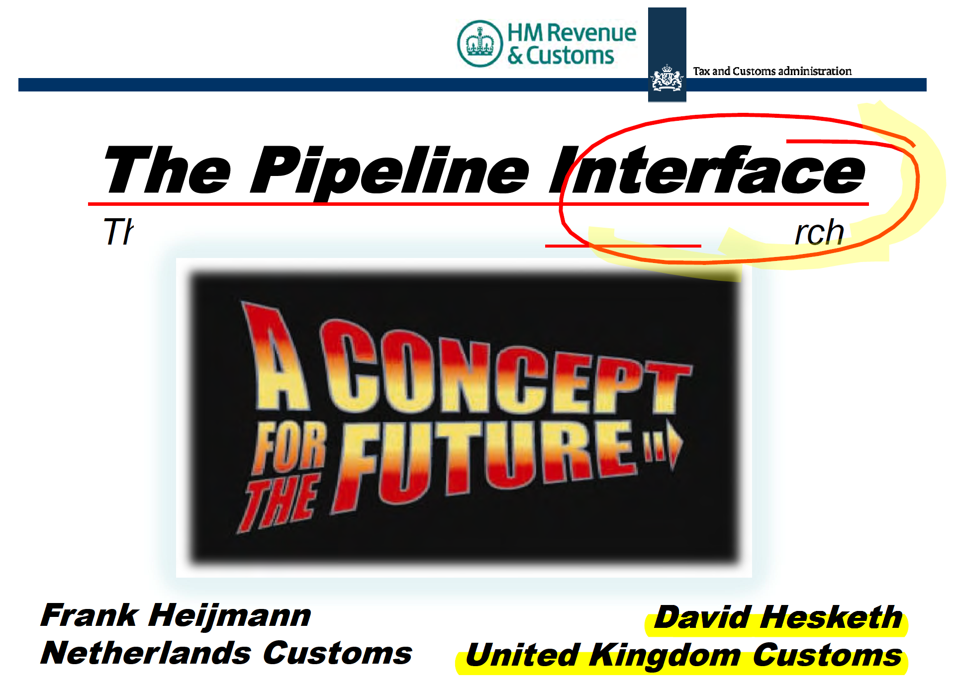
Reference Data Models & Data Pipelines fit together
Data Pipeline:
Information travels from origin to destination and can be accessed by appropriately authorized private and public sector parties to the specific trade transaction.
Mini Conference, Geneva, 27 March 2017

Slide 25
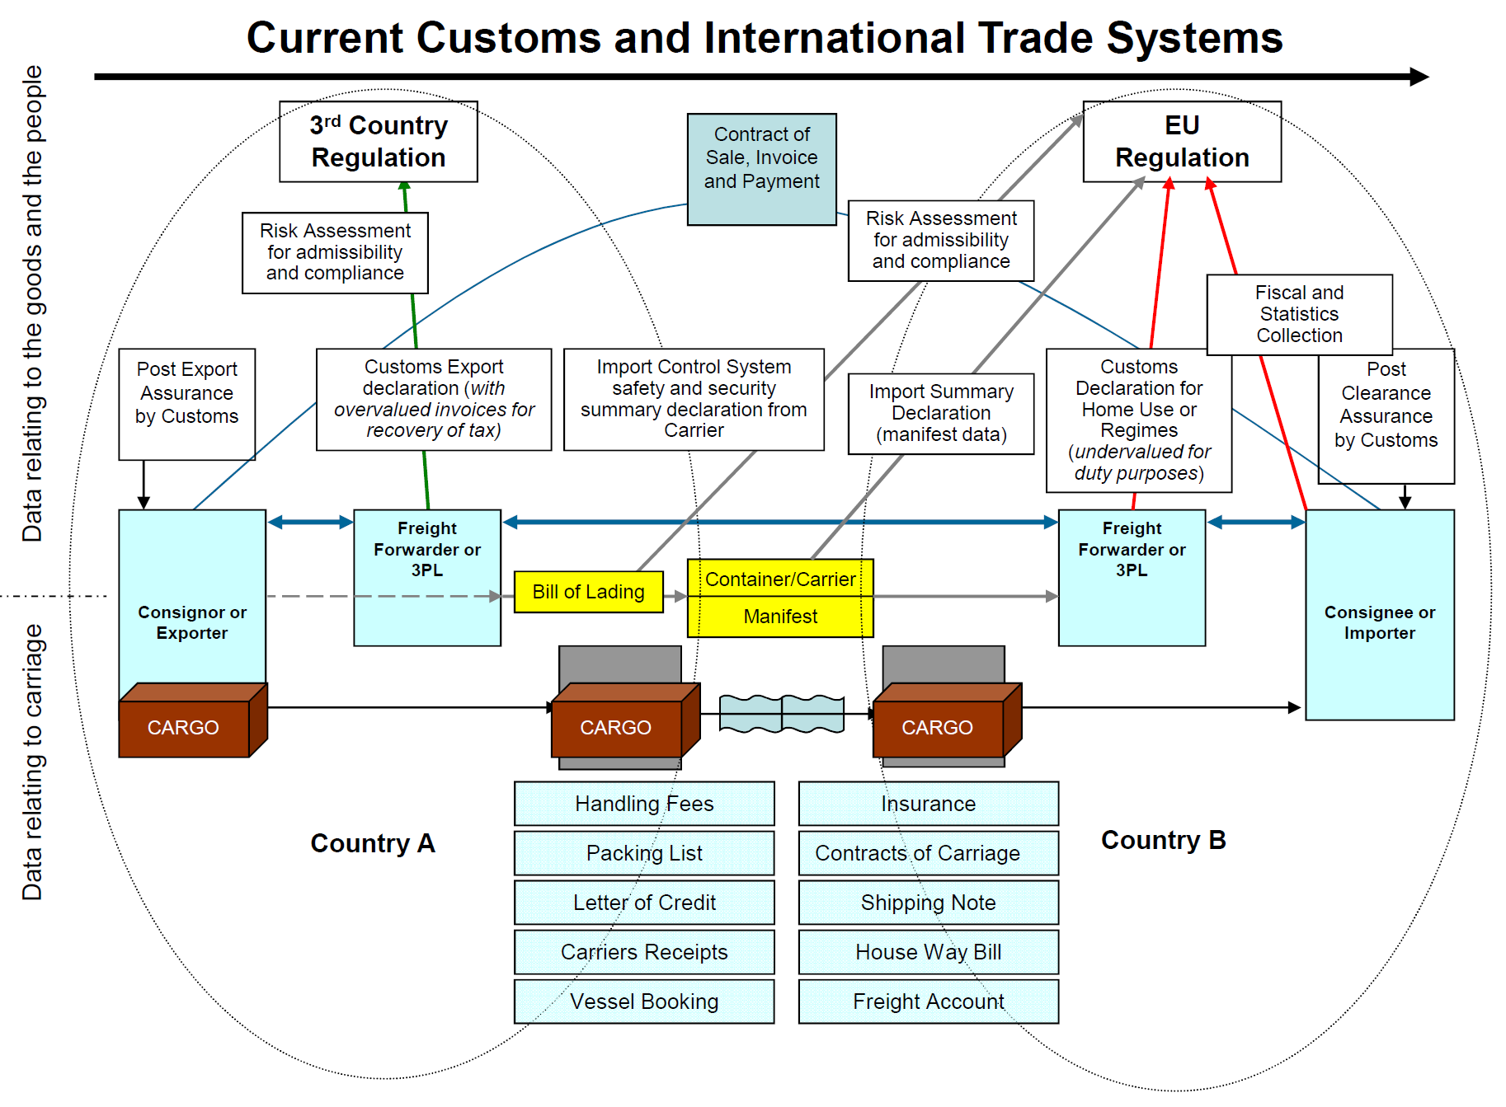
Integrated Data Pipelines … As-Is
Hesketh, Heijmann 2011
Mini Conference, Geneva, 27 March 2017

Slide 26
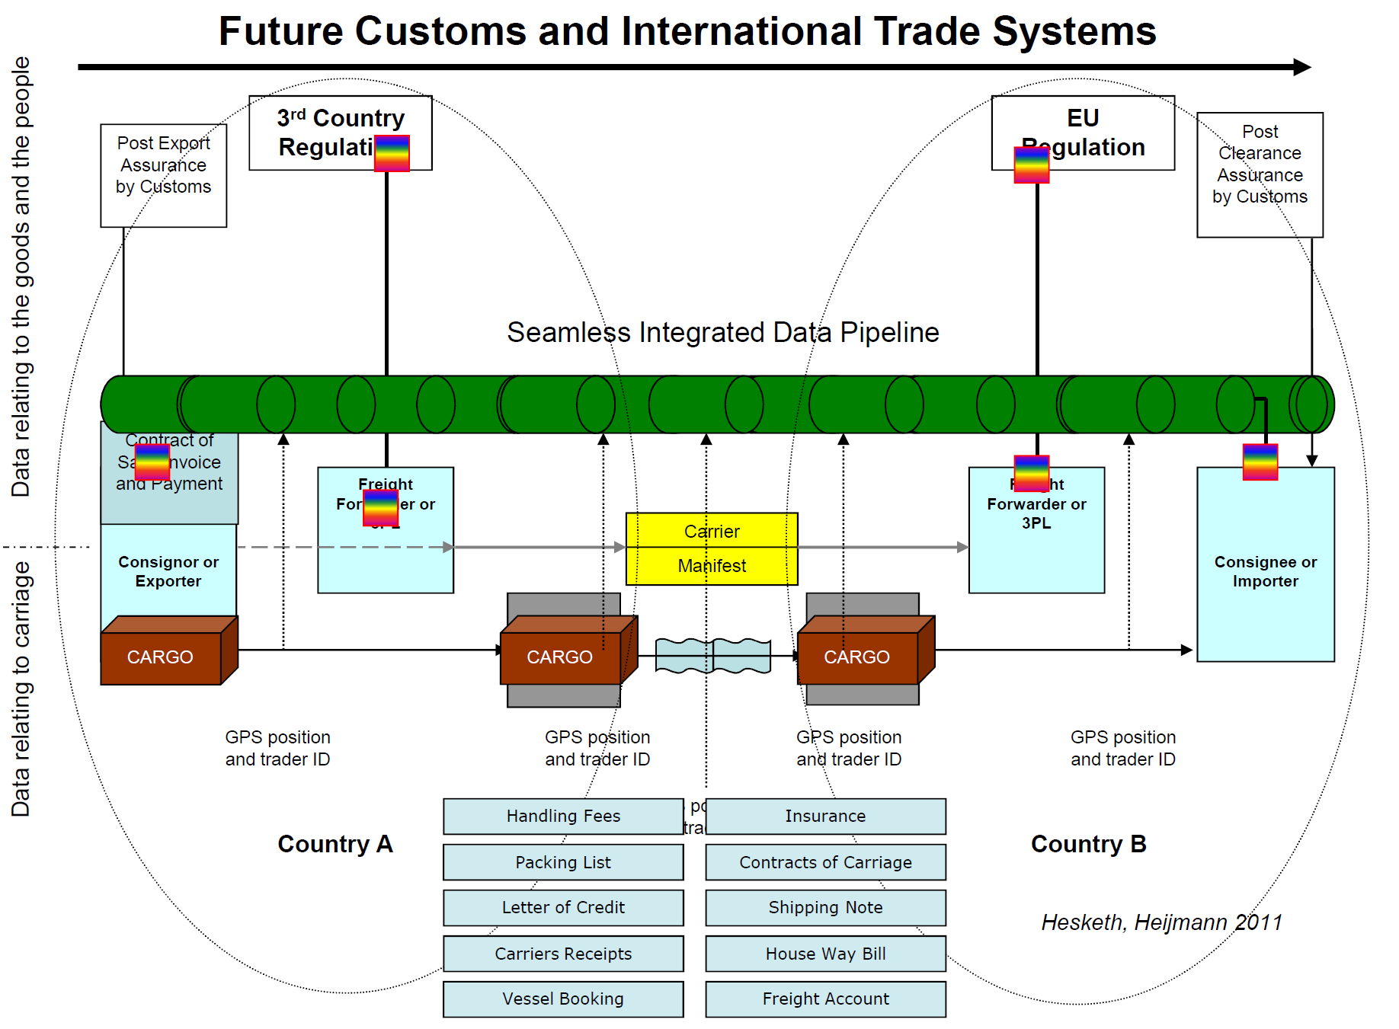
Integrated Data Pipelines … To-Be
Mini Conference, Geneva, 27 March 2017

Slide 27
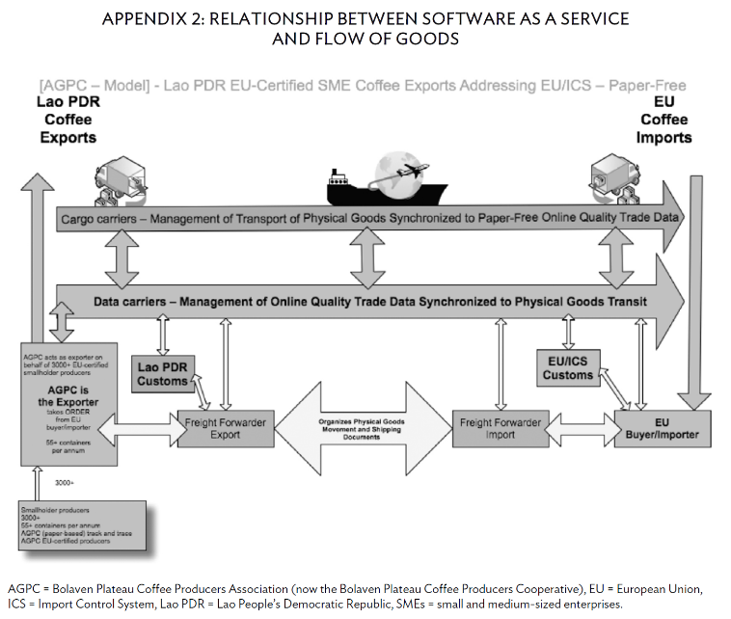
Example: Lao Coffee Project (2011)
Shipping Lao Coffee to the EU
Trial ‘paper-less’ transactions,
partly funded by the Asia Development Bank
Savings per shipment
(1 or more containers)
- $200–$240*
* incl. $80 removal document courier costs
Paper-Free Trade for Smallholder Farmers
‘A pilot study of a Coffee Association in the LAO People’s Democratic Republic’
(ADB South East Asia Working Paper Series No.10 February 2015)
Mini Conference, Geneva, 27 March 2017

Slide 28
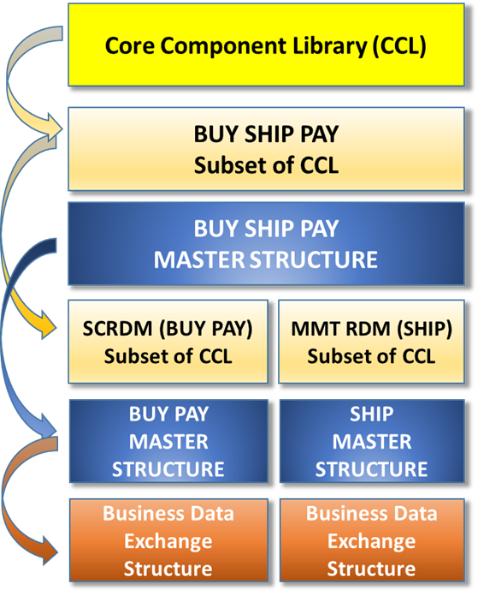
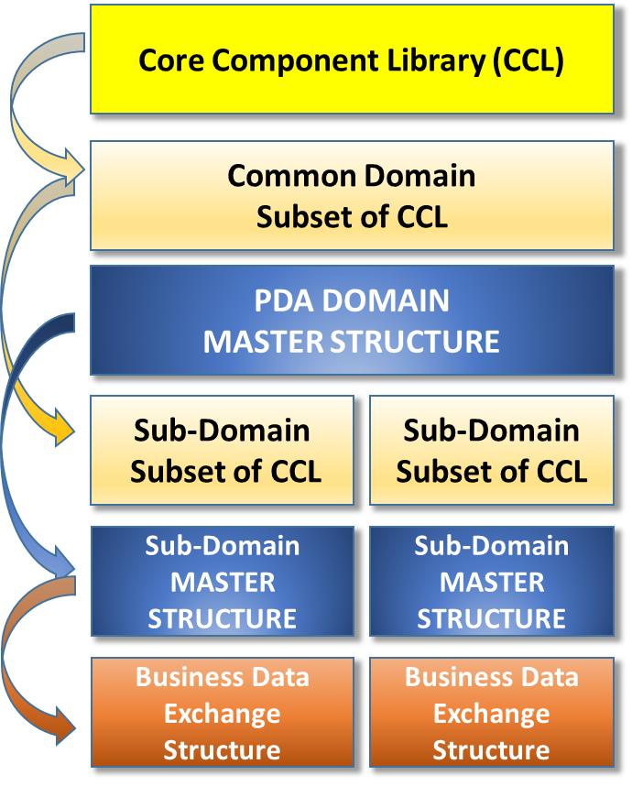
Reference Data Model - HOW
The Supply Chain and The
Transport & Logistics Domains
Other Domain(s)
Data
pipeline
Mini Conference, Geneva, 27 March 2017

Slide 29
RDMs Support Process & Document Driven
Data Exchanges
RDM
REFERENCE
BIEs
Suitable for all processes
within the RDM scope
RDM
Supports Process
& Document Driven
Data Exchanges
Collaborative Workflows (Data Pipelines)
CCBDA (Applied to the RDM Master Structure)
Snippet
Snippet
Snippet
Snippet
Snippet
Snippet
Snippet
Complete Document
e.g. order
Complete Document
e.g. invoice
Mini Conference, Geneva, 27 March 2017

Slide 30
UN/CEFACT Reference Data Models
Reference Data Model (e.g. SCRDM, MMT RDM)
  a subset of the UN/CEFACT Core Component Library (CCL)
  a rich collection of business artefacts contextualized for a domain
  (e.g. Supply Chain)
  from which standard business data exchange structures can be created
The evolution:
  creation of standard business data exchange structure (e.g. documents, snippets of documents) from a ‘Master Structure’
  contextual message restrictions are applied to the subset artefacts, the ‘Master Structures’ and/or the standard ‘Business Data Exchange Structure’
Mini Conference, Geneva, 27 March 2017

Slide 31
Our first delivery: Cross Industry Invoice
Subset
of CCL
SCRDM
Scope SCRDM
Project
BUY PAY
Master Structure
Business Data Exchange Structure
CII SCRDM
From semantic model to syntax
Process Driven
Schema
CII SCRDM
Schema
Scope of CI Invoice
Technical artefact
Project
Mini Conference, Geneva, 27 March 2017

Slide 32
Benefits: for Decision Makers
The support of information sharing, e.g. enabled by data pipelines, with the timely capture of quality data from data sources ensuring supply chain visibility
The provision of global semantics covering all data requirements internationally accepted
Reduction of administrative burden by efficient reuse of data shared within the BUY SHIP PAY model
Trusted semantic model, based on internationally accepted standardized & harmonized library
Enhanced interoperability of data with BUY SHIP PAY domain
Standardized data exchange structures, based on common ‘Master’ data exchange structure
Integrated international code lists, using commonly used UNECE Recommended code lists, UN/EDIFACT code lists, ISO code lists..
Future proof semantic model, a data exchange syntax neutral semantic model
Mini Conference, Geneva, 27 March 2017

Slide 33
Benefits: for implementers of UN/CEFACT Reference Data Models
The use of a syntax neutral semantic model for defining business data exchanges
Enhanced interoperability of data across Supply Chain and Transport & Logistic business processes
Easy message specific restriction of artefacts, no need to create new artefacts (document specific ones).
Restrictions can be applied at process, master or message level
Simple creation of new data exchange structures from the “Master”
Available artefacts easy to find, by searching in the subset of the CCL
Newcomers easily guided to the available, appropriate artefacts (“the right spot”)
Mini Conference, Geneva, 27 March 2017

Slide 34
Benefits: Government and Private sector
Facilitation of government & private sector interfaces by supporting Data Pipeline & Single Window concepts
Reduction of administrative burden, efficient reuse of data
Trusted semantic model, based on internationally accepted standardized & harmonized library
Providing global cross-syntax Reference Data Models through the principles enshrined in:
  the United Nations Layout Key (UNLK),
  the United Nations Trade Data Element Directory (UNTDED)
  United Nations Electronic Data Interchange for Administration, Commerce and Transport (UN/EDIFACT);
Integrated international code lists, using commonly used UNECE Recommended code lists, UN/EDIFACT code lists, ISO code lists.
Mini Conference, Geneva, 27 March 2017

Slide 35
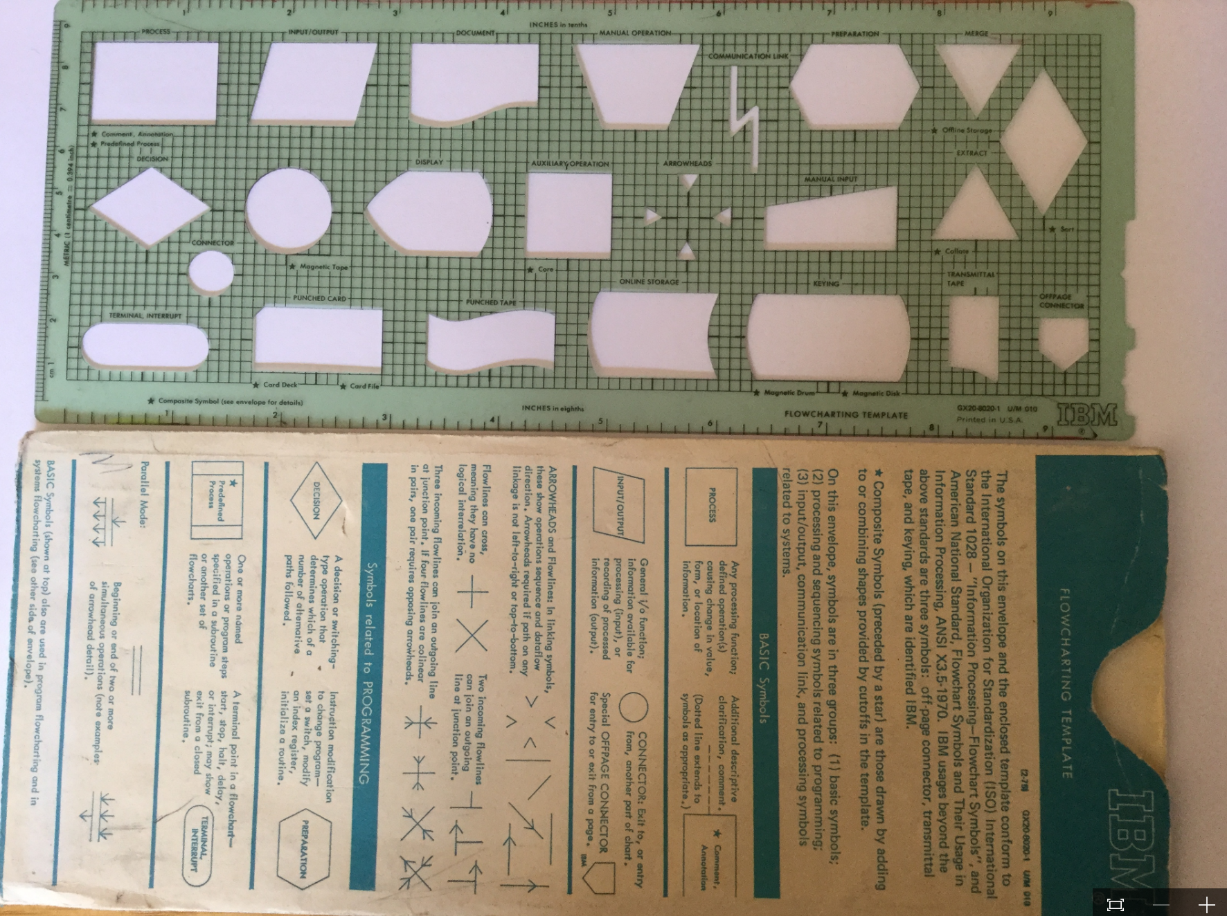
Leveraging UN/CEFACT Assets
UMM: ISCRM: Processes
&
CCTS: CCL: Data
Mini Conference, Geneva, 27 March 2017

Slide 36
Reference Data Models & Single Windows fit together
“in practice, it is more common to see several systems performing various regulatory processes sometimes behind a single trader view, other times not”
Single Window concept relies on globally harmonized data for supporting interoperability
Exchanges between national Single Windows rely on common structures, internationally harmonized data
Streamlined business processes are essential to reduce duplicated reporting of trade information
Web Services require data exchange structures that just send information needed (snippets of documents)
Centralized Server Models rely on incremental data, needed for a particular process at a particular moment
Mini Conference, Geneva, 27 March 2017

Slide 37
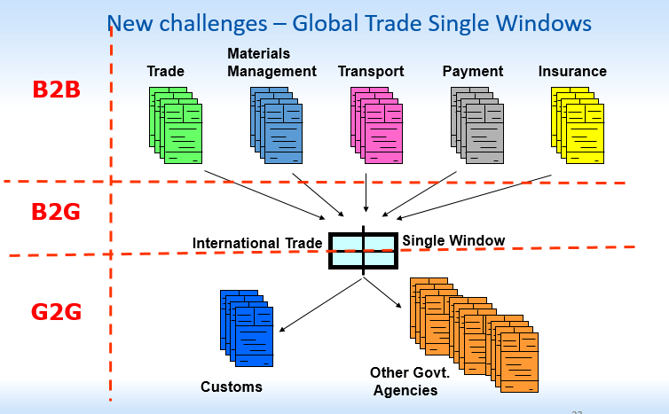
Facilitating regulatory functions by standardized data exchange structures
Mini Conference, Geneva, 27 March 2017

Slide 38
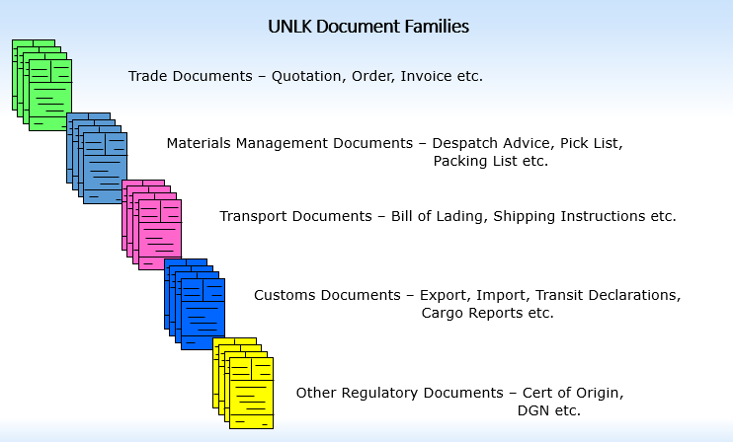
United Nations Layout Key Document Families
Mini Conference, Geneva, 27 March 2017

Slide 39
Questions on
“The Concept of RDMs”?
End section 2:
Mini Conference, Geneva, 27 March 2017

Slide 40
Section 3: High level focus
White Paper
on RDM
High Level
BRS
High Level RSM
Mini Conference, Geneva, 27 March 2017

Slide 41
Available high level documents
High-Level White Paper on Reference Data Models
  Executive summary for the Reference Data Model
High level BRS (Business Requirements Specification)
  Processes in the Supply Chain domain
  Processes in the Transport, Finance, Government domain
  The actors and scenarios
High level RSM (Requirements Specification Mapping)
  Mapping of common party roles
  Mapping of common locations
  Mapping of common business entities
Mini Conference, Geneva, 27 March 2017

Slide 42
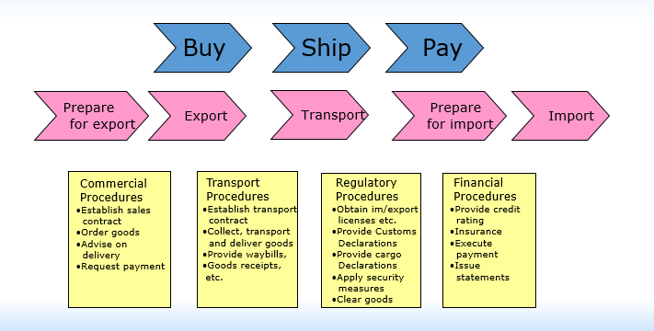
High level BRS (processes)
Mini Conference, Geneva, 27 March 2017

Slide 43
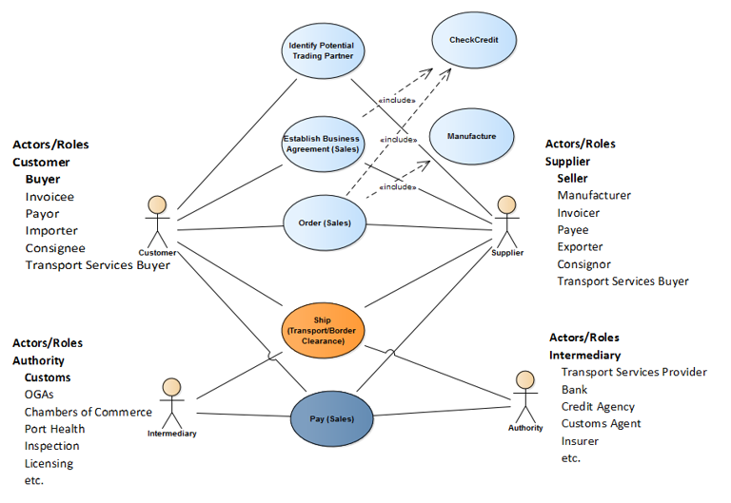
The actors
Mini Conference, Geneva, 27 March 2017

Slide 44
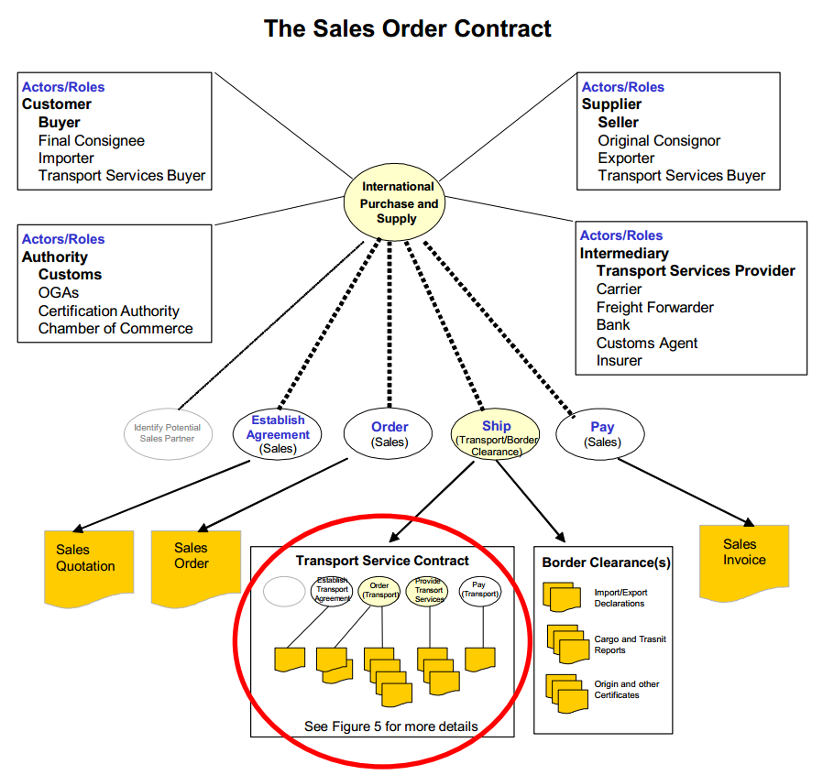
The Sales Contract
Mini Conference, Geneva, 27 March 2017
44

Slide 45
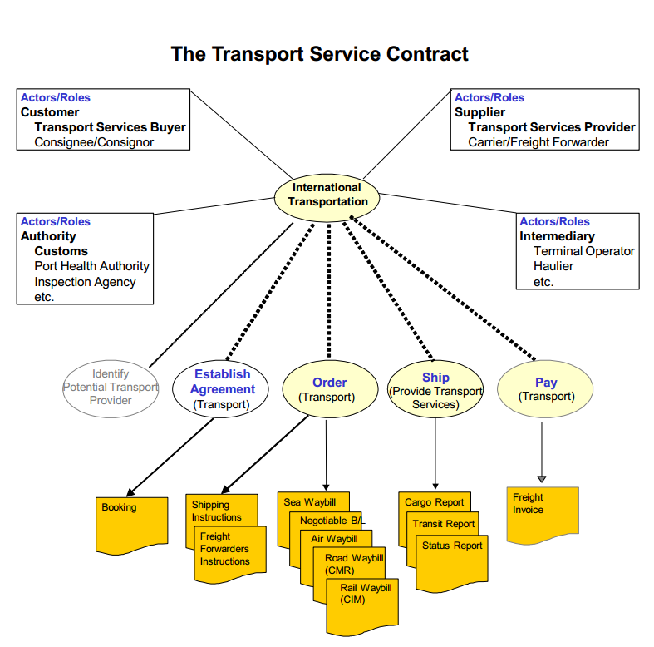
The Transport Contract
Mini Conference, Geneva, 27 March 2017
45

Slide 46
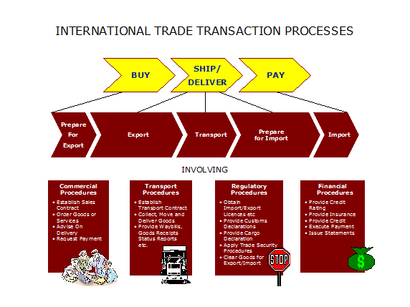
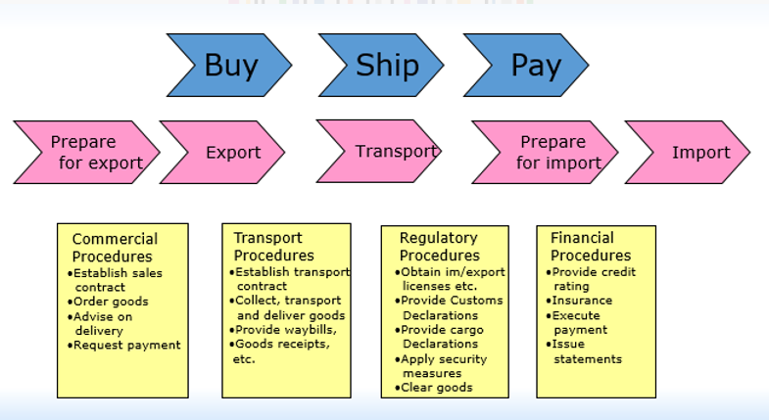
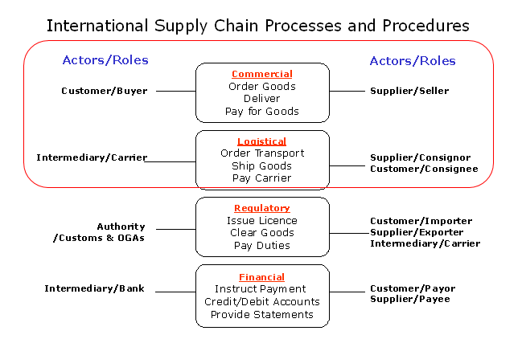
Commercial & Logistic processes
Relationship
Mini Conference, Geneva, 27 March 2017
46

Slide 47
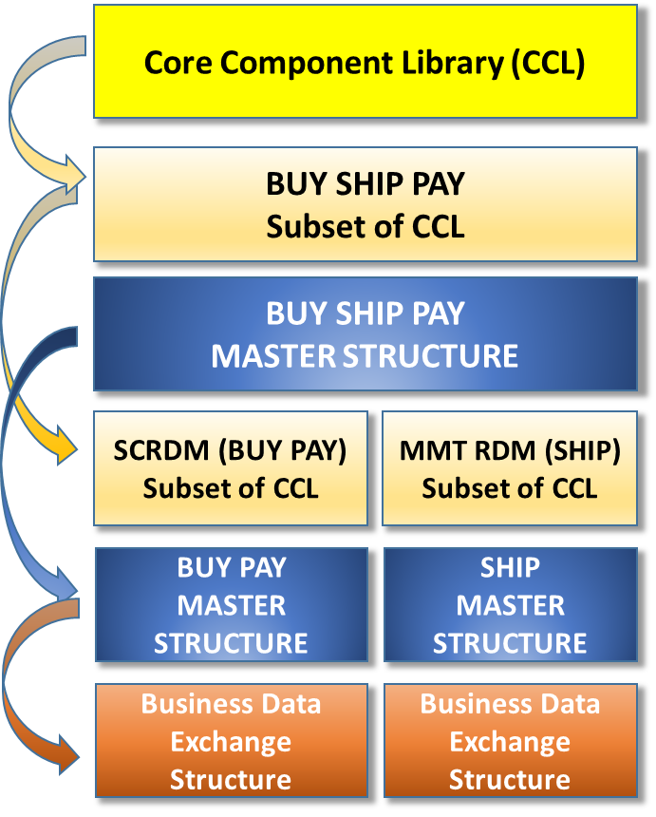
High level RSM (data)
The Supply Chain and the
Transport & Logistics Domains
Subsetting / Restrictions
Data
pipeline
Mini Conference, Geneva, 27 March 2017

Slide 48
SCRDM and MMT subsets of CCL
UN/CEFACT Core Component Library (CCL)
Joint project copy of the Buy-Ship-Pay subset of the UN/CEFACT CCL as the base for modelling restrictions, extensions which may be future CRs.
Based on
Generic specializations of Project Library, commen terms, code restrictions, business rules etc. that apply consistently for all projects specializations should be set at this level.
Generic specializations of Project Library, common terms, code restrictions, business rules etc. that apply consistently for all projects specializations should be set at this level.
SCRDM (BUY PAY)
Subset of CCL
Based on
BUY SHIP PAY
Subset of CCL
Based on
MMT (SHIP)
Subset of CCL
Based on
Based on
Based on
BUY SHIP PAY MASTER
(Base information package)
Project Specialization e.g. Invoice
Project Specialization e.g. Order
Project Specialization e.g. Quotation
Based on
Project Specialization e.g.Bill of Lading
Project Specialization e.g. Booking
Project Specialization e.g. BayPlan
Based on
Based on
Based on
Based on
Based on
BUY PAY Master
(Base information package)
SHIP Master (1)
(Base information package)
SHIP Master (2)
(Base information package)
Mini Conference, Geneva, 27 March 2017

Slide 49
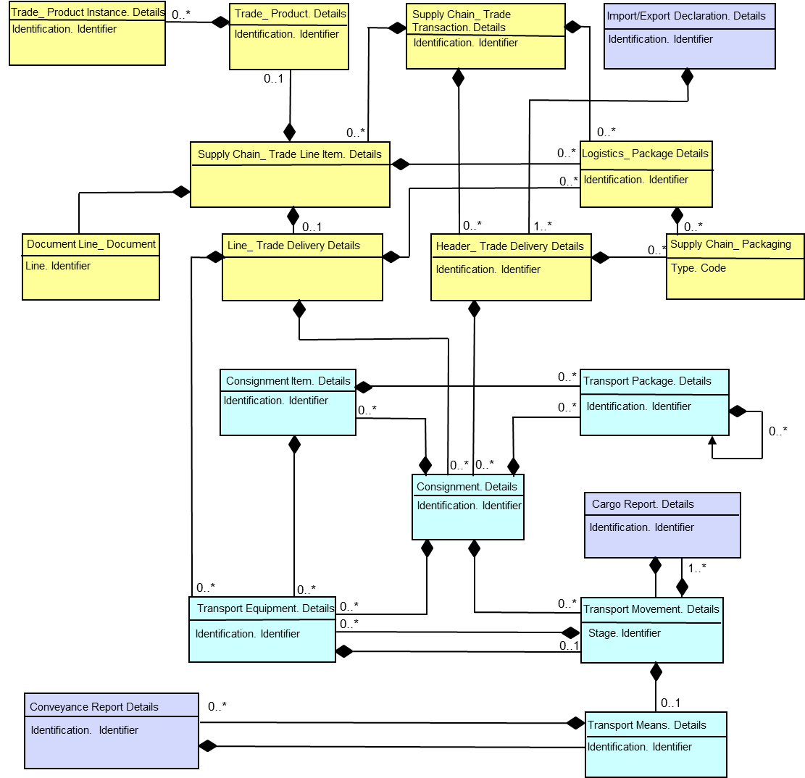
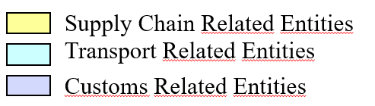
Sharing Business artefacts e.g. consignment
Mini Conference, Geneva, 27 March 2017

Slide 50
Questions on
High level focus?
End of section 3:
Mini Conference, Geneva, 27 March 2017

Slide 51
Section 4:
Maintenance of Reference Data Models
Maintenance
Subset of CCL
CCL
Mini Conference, Geneva, 27 March 2017

Slide 52
RDM Parts subject to maintenance
BUY SHIP PAY Master Structure
BUY PAY and SHIP Structure
BUY PAY (SCRDM) and SHIP (MMT) Subset of the CCL
Message Assemblies
Mini Conference, Geneva, 27 March 2017

Slide 53
Relation between CCL, Structures, Subsets
Updates
Mini Conference, Geneva, 27 March 2017

Slide 54
Maintaining Structures
Updates in ‘BUY SHIP PAY’ Master Structure
    Examples:
    A new ASMA (association in message assembly)
    Additions in ABIEs used by ASMAs
    Updates in ABIEs used by ASMAs
Updates in ‘SCRDM’ or ‘MMT’ Master Structures
    Examples:
    Updates in ASMA usage in the underlying’BUY SHIP PAY’ master
    Updates in BIEs usage in the underlying subset of the CCL
  << structural updates will be rare>>
Mini Conference, Geneva, 27 March 2017

Slide 55
Maintaining Subsets of the CCL
Updates in ‘SCRDM subset of the CCL’
    Example:
    Updates in BIEs usage in the underlying subset of the CCL
Updates in ‘MMT subset of the CCL’
    Example:
    Updates in BIEs usage in the underlying subset of the CCL
Mini Conference, Geneva, 27 March 2017

Slide 56
Maintaining Message Assemblies (MAs)
Updates in messages:
    Examples:
    Updates in BIEs usage in the underlying subset of the CCL
    Updates in BIEs usage
Mini Conference, Geneva, 27 March 2017

Slide 57
Business Requirements may invoke...
  Update(s) in Master Structure(s)
  Update(s) in Subset(s)
  Updates(s) in Message(s)
  Submission for the underlying CCL
Mini Conference, Geneva, 27 March 2017

Slide 58
How to organize maintenance on RDMs
Maintaining Reference Data Models means:
  Collaboration between ‘BUY PAY’ and ‘SHIP’ domains
  Validating
    Need for updates in subset of the CCL?
    Need for new artefacts?
  Coordination
  Procedures
Mini Conference, Geneva, 27 March 2017

Slide 59
RDM Maintenance Procedures
Library Maintenance Focal Point:
  Currently responsible for CCL maintenance
  For discussion/recommendation
  RDM maintenance should be the responsibility of Library Maintenance Focal Point
  RDMs are subsets of the CCL
  Library Maintenance editors are CCL experts
  CCL updates may impact one or more RDMs
  RDM maintenance requires:
  Individual experts be assigned from the RDM project team?
  OR
  Individual experts be assigned from appropriate domain?
  Assigned expert responsibility
  Update of RDM that has no CCL impact
  Participation in Library Maintenance calls/meetings
Mini Conference, Geneva, 27 March 2017

Slide 60
Questions on
Maintenance of RDMs?
End of section 4:
Mini Conference, Geneva, 27 March 2017

Slide 61
Section 5
Reference Data Models (technical details)
Messages
Structure
CCL subset
Mini Conference, Geneva, 27 March 2017

Slide 62
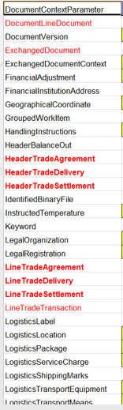
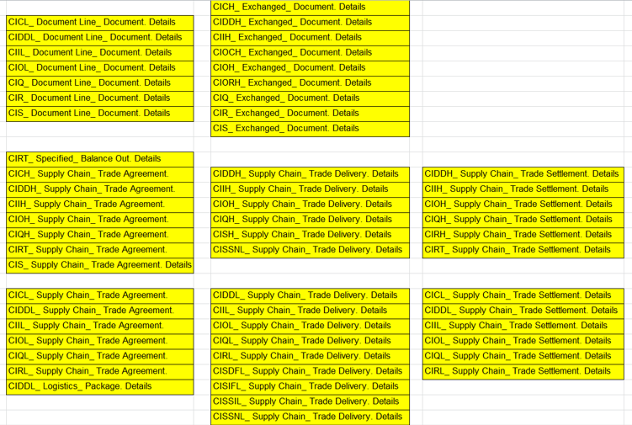
SCRDM Rationalization example
ABIES : 200
ABIES : 123
Document specific
Process driven
-77
Mini Conference, Geneva, 27 March 2017

Slide 63
Rationalization results...
40% fewer business information artefacts needed to build the same number of messages.
- 17 new artefacts (ABIEs), 1% of CCL
- SCRDM CCL subset: 1,400 artefacts out of 11,500
- Easily maintainable
- Easier to implement
Mini Conference, Geneva, 27 March 2017

Slide 64
SCRDM contextualized Reference BIE example
RDM Reference BIE
e.g. Header Trade Agreement
Processes
Cataloguing
Quotation
Ordering
Delivery
Invoicing
Remittance
Scheduling
CCBDA (Core Component Business Document Assembly)
Data Exchange Structures e.g. complete documents or snippets
Mini Conference, Geneva, 27 March 2017

Slide 65
Structure, Context, Publication and Usage
Structures
‘BUY SHIP PAY’ Master Structure of a Reference Data Model
‘SCRDM’ Master Structure of a Reference Data Model
‘MMT RDM’ Master Structure of a Reference Data Model
Contexualizations
Subsets for SCRDM and MMT RDM
Message level restrictions
Publication of RDMs
Formats
Usage
Creating, Using, Updating of a Reference Data Model (guideline)
Mini Conference, Geneva, 27 March 2017

Slide 66
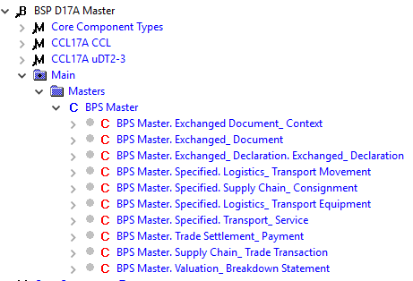
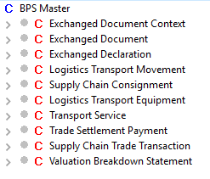
Main Structure: BUY SHIP PAY Master
BSP (BUY SHIP PAY)
Master Structure
CCL
Buy Ship Pay Master
Mini Conference, Geneva, 27 March 2017

Slide 67
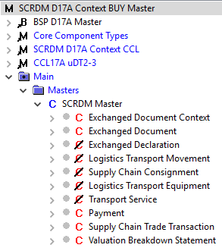
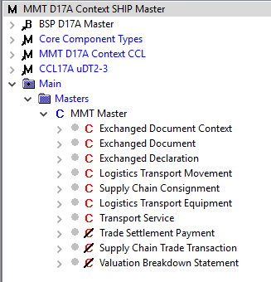
Contextualized structures for domains
SCRDM
BUY PAY
Master Structure
MMT RDM
SHIP
Master Structure
BUY PAY Master
SCRDM
Subset of CCL
MMT
Subset of CCL
BUY PAY Master
SHIP Master
Mini Conference, Geneva, 27 March 2017

Slide 68
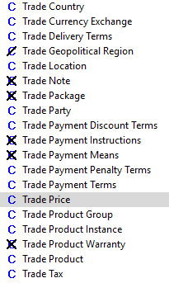
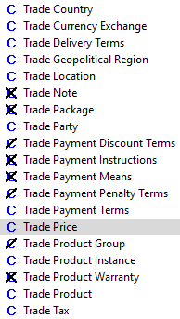
Contextualized Restrictions (Subset level)
SCRDM
Subset of CCL
MMT RDM
Subset of CCL
Mini Conference, Geneva, 27 March 2017

Slide 69
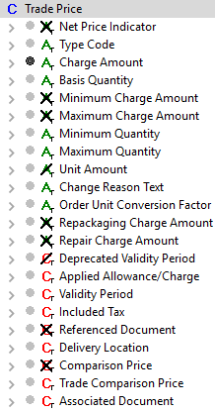
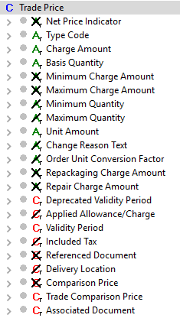
Contextualized Restrictions (ABIE Level)
SCRDM
Subset of ABIE
Trade Price
MMT RDM
Subset of ABIE
Trade Price
Mini Conference, Geneva, 27 March 2017

Slide 70
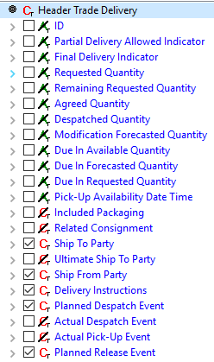
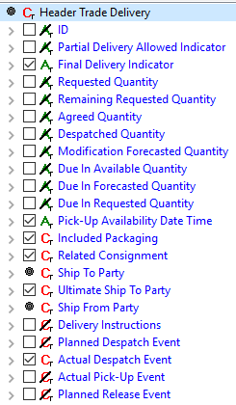
Contextualized Restictions (Message level)
SCRDM
Order Message
SCRDM
Despatch Advice Message
Mini Conference, Geneva, 27 March 2017

Slide 71
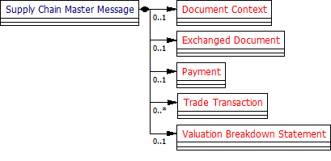
Principle is applicable for all messages
1:1
1:1
Quotation
1:1
Order
1:1
1:1
1:1
1:1
1:1
1:1
Invoice
1:1
Remittance Advice
1:1
1:1
1:1
1:1
1:1
1:1
1:1
0:1
Mini Conference, Geneva, 27 March 2017

Slide 72
Schema production improvement (1)
- RDM approach
Coupled/uncoupled codes lists
Since version D16B: two SCRDM Invoice schema variants:
Uncoupled (new)
Coupled
Why?
- Maximum flexibility without changing the standard UN/CEFACT schemas.
- Still compliant to the standard UN/CEFACT published schema.
- You can extend or restrict the codes in the code list so that the
corresponding type refers to the modified code list schema
Mini Conference, Geneva, 27 March 2017

Slide 73
Schema with coupled code lists
All trading partners have to validate against the same codes, this enhances interoperability.
UN/CEFACT code lists are standardized and widely used, also used by other standards.
A validation of codes in a schema instance in 1 step.
Mini Conference, Geneva, 27 March 2017

Slide 74
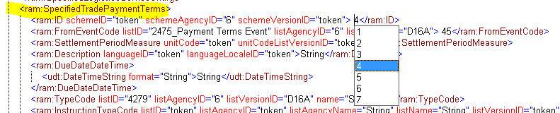
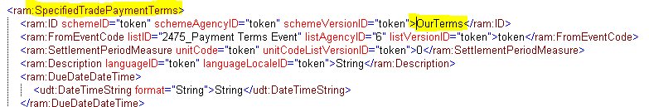
Schema instance coupled/uncoupled
1. Coupled Code List schema Modules
2. Uncoupled Code List schema Modules
Mini Conference, Geneva, 27 March 2017

Slide 75
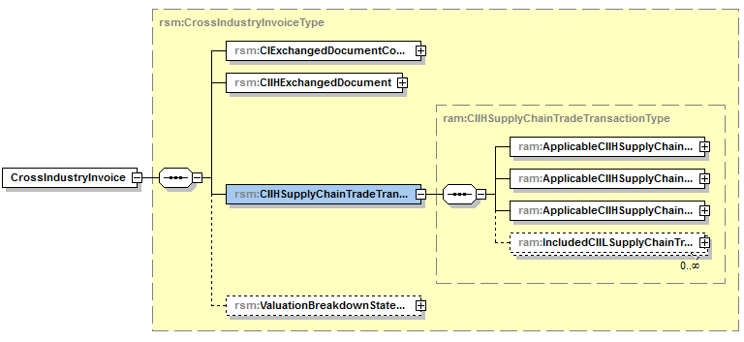
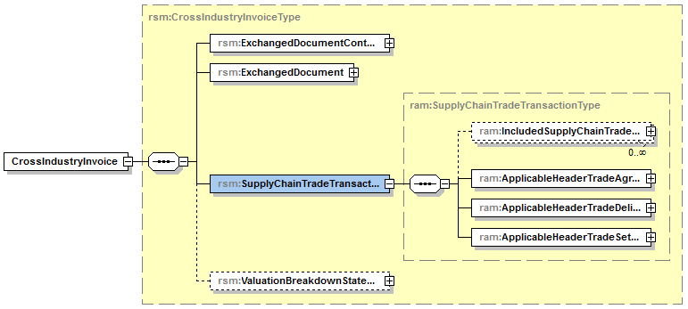

Schema Production improvement (2)
- RDM approach
Invoice: As Is
Invoice: To Be
Mini Conference, Geneva, 27 March 2017

Slide 76
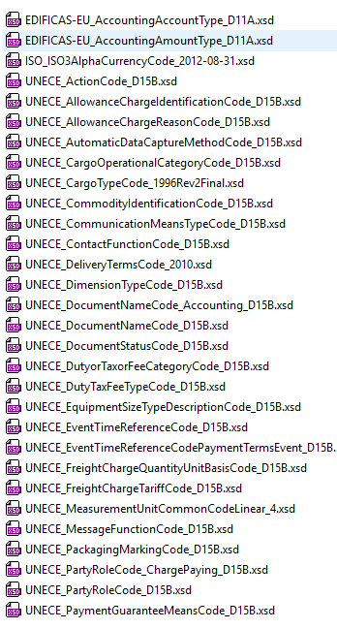
Schema publication (message):
- code lists
Code Lists : As Is
Invoice: As Is
imported schema modules
128
Invoice: To Be
Imported schema modules
50
Mini Conference, Geneva, 27 March 2017

Slide 77




Publication of Reference Data Models
Business Artefacts
Formats
Mini Conference, Geneva, 27 March 2017
77

Slide 78
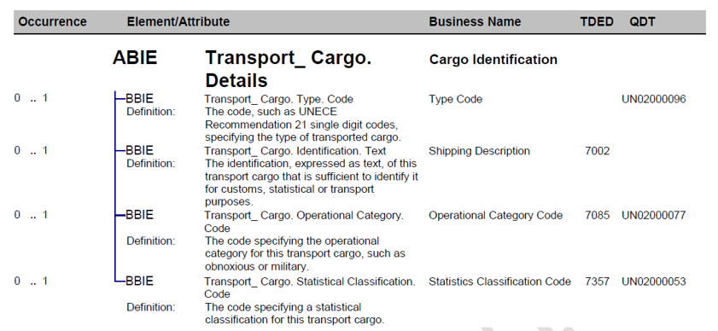
PDF Publication Format
Semantic Links
Common Term
Mini Conference, Geneva, 27 March 2017
78

Slide 79
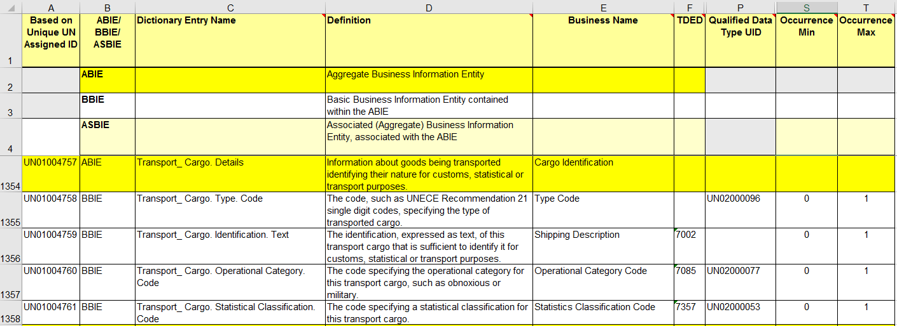
Excel Publication Format
Semantic Links
Common Term
Mini Conference, Geneva, 27 March 2017

Slide 80
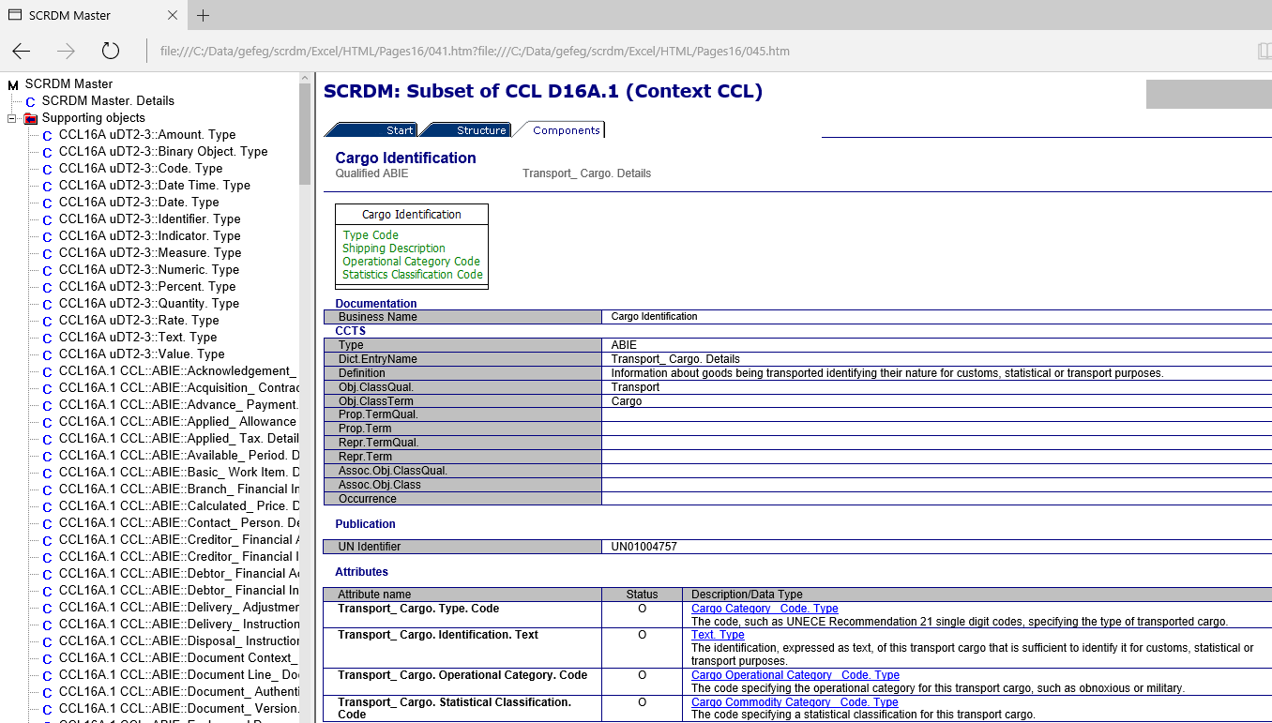
HTML Publication Format
Demo
Common Term
Mini Conference, Geneva, 27 March 2017

Slide 81
Compressed HTML Publication Format
Demo
Common Term
Mini Conference, Geneva, 27 March 2017

Slide 82

Guideline on Reference Data Models
Steps for using
Steps for updating
Steps for creating
Mini Conference, Geneva, 27 March 2017

Slide 83
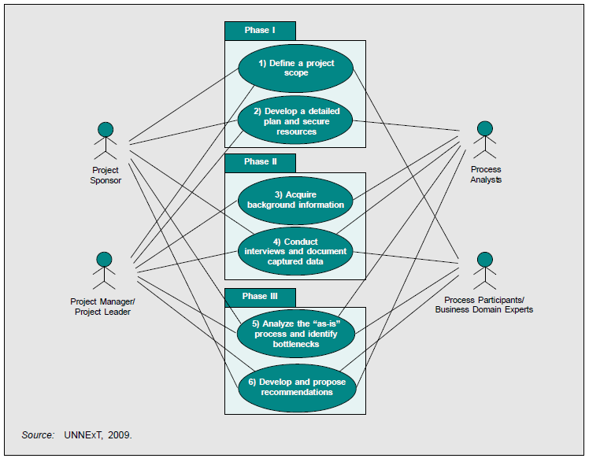
Business Process Analysis
Mini Conference, Geneva, 27 March 2017

Slide 84
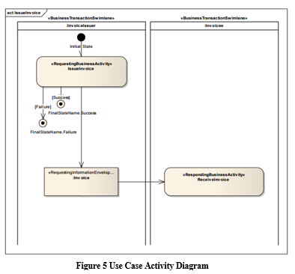
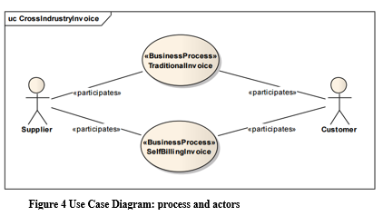
Use Business Process diagrams
Mini Conference, Geneva, 27 March 2017

Slide 85
Identifying needed data exchange structures (e.g. documents)
Catalogue
Catalogue Request
Subscription Request
Application Response
Response to Receive Line
Quotation Request
Quotation Request Response
Quotation Proposal
Quotation Proposal Response
Order
Order Response
Order Change
Despatch Advice
Invoice
Remittance Advice........
Mini Conference, Geneva, 27 March 2017

Slide 86
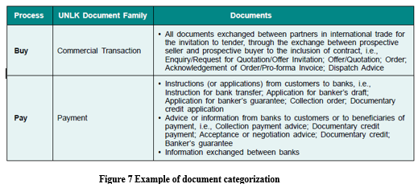
Categorize processes
Mini Conference, Geneva, 27 March 2017

Slide 87
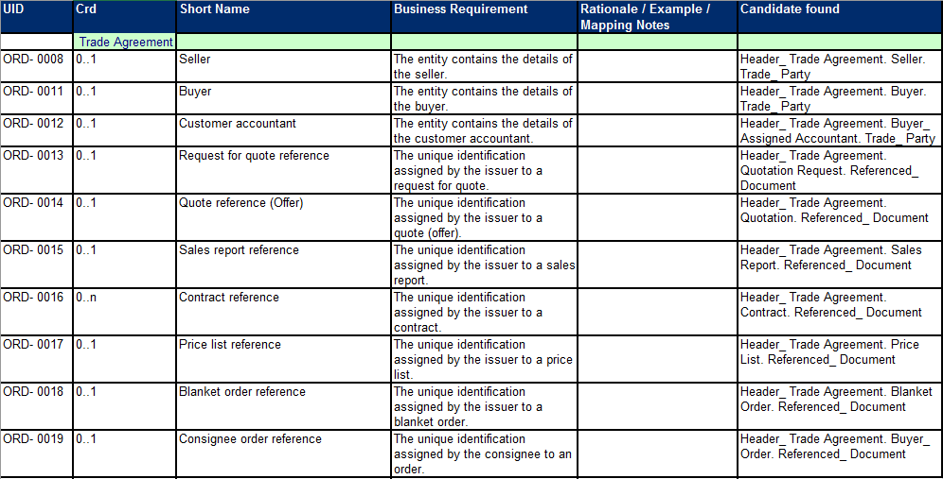
Map Business Requirements
Mini Conference, Geneva, 27 March 2017

Slide 88
Create high level BRS/RSM
Processes
Data
Mini Conference, Geneva, 27 March 2017

Slide 89
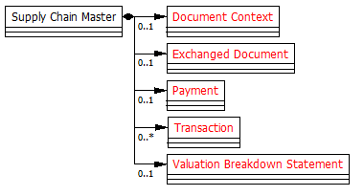
Create, update or use existing
Master Message Structure
BUY PAY Master
Mini Conference, Geneva, 27 March 2017

Slide 90
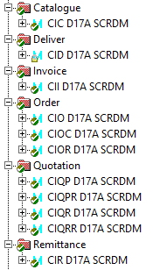
Build the messages
Profiles
1. Catalogue
2. Despatch Advice
3. Invoice
4. Order
5. Order Change
6. Order Response
7. Quotation Proposal
8. Quotation Proposal Request
9. Quotation Request
10. Quotation Request Response
11. Remittance Advice
Mini Conference, Geneva, 27 March 2017

Slide 91
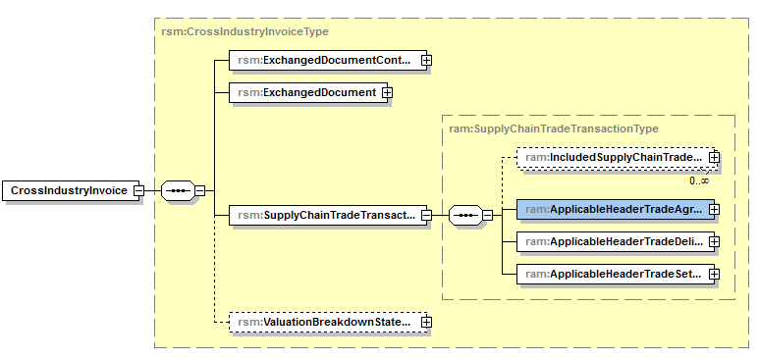
Generate the schemas
Mini Conference, Geneva, 27 March 2017

Slide 92
Questions on
Reference Data Models technical details?
End of section 5:
Mini Conference, Geneva, 27 March 2017

Slide 93
Thank you for your attention!
For further information on:
Supply Chain Management Reference Data Model (SCRDM)
- Project Lead : Rolf Wessel
: email: r.wessel@seeburger.de
- Lead Editor : Gerhard Heemskerk
email: gerhard.heemskerk@kpnmail.nl
Multimodal Transport Data Reference Model (MMT RDM)
- Lead Editor : Sue Probert
email : sue.probert@dial.pipex.com
Mini Conference, Geneva, 27 March 2017

Slide 94
The end
Mini Conference, Geneva, 27 March 2017

