Slide 1
  Anticipating and Following Technological Trends
  in eBusiness Data Exchanges

Slide 2
Mini Conference Background
This Mini Conference will provide participants with information on:
  Reference Data Models for the Supply Chain and Transport & Logistics domain.
Participants will also get information on:
  The projects
  The concepts
  The deliverables
  The maintenance
Mini Conference, Geneva, 27 March 2017

Slide 3
Agenda
PM1
Opening
The Projects
The Concept of a Reference Data Model
Coffee break
PM2
Reference Data Model High level focus
Reference Data Model Details
Maintenance of Reference Data Models
Mini Conference, Geneva, 27 March 2017

Slide 4
  Anticipating and Following Technological Trends in eBusiness Data Exchanges
Reference Data Models are based on UN/CEFACT principles of:
Harmonization
Standardization
Simplification
Reference Data Models key aspects:
Reduding dependency on traditional documents
Reducing redundancy
Process-driven collaborative workflows & shared artefacts
Mini Conference, Geneva, 27 March 2017

Slide 5
Benefits (short list)
Reduction of administrative burden
A trusted Reference Data Model
Enhanced interoperability of data
Standardized business data exchange structures
Integrated international code lists
A future proof semantic model (syntax neutral)
Mini Conference, Geneva, 27 March 2017

Slide 6

Section 1:
The Projects
Mini Conference, Geneva, 27 March 2017

Slide 7
The Reference Data Model projects and related projects
Submitted:
1. Supply Chain Reference Data Model Project (SCRDM)
2015-05-05
2. Extension of Cross Industry Invoice technical artefacts
2016-05-16
3. Extension of Cross Industry Cataloguing, Quotation,
Ordering, Delivering and Remittance Advice technical
artefacts
2016-11-15
4. Multi Modal Transport (MMT)
2013-09-13
5. Procedures for Reference Data Model & associated artefacts
publication
2016-05-01
Mini Conference, Geneva, 27 March 2017

Slide 8
SCRDM Project Leadership
Project Leader Mr Rolf Wessel
Lead Editor Mr Gerhard Heemskerk
Editing team:
Andreas Pelekies
Hisanao Sugamata
Ian Watt
Karina Duvinger
Mary Kay Blantz
Natascha Rossner
Sue Probert
Ulrike Linde
Mini Conference, Geneva, 27 March 2017

Slide 9
MMT Project Leadership
Project Leader Mrs Sandretto & Mr David Hesketh
Lead Editor Mrs Sue Probert
Editing team:
Henk Van Maaren
Marielle Stumm
Rudi Bauer
Yoshi Kito
Dominique Vankemmel
Mini Conference, Geneva, 27 March 2017

Slide 10
Project Purpose: SCRDM & MMT
Development of a semantic model (Reference Data Model) aimed at the Supply Chain
Easy to use and maintainable semantic framework for the Supply Chain
Semantic links between UN Layout Key documents, UN/EDIFACT message implementation structures and the Core Component Library
Guidelines for using Reference Data Models
Mini Conference, Geneva, 27 March 2017

Slide 11
Project Deliverables SCRDM & MMT
A structured Reference Data Model based on the latest release of CCL (CCTS 2.01)
Semantics links UN/EDIFACT, TDED…. to support increased interoperability between data exchange structures and standard mappings
Guidelines on how to use Reference Data Models and produce XML messages.
Mini Conference, Geneva, 27 March 2017

Slide 12
Project Purpose: Extension CI messages
Process driven XML schemas, based on existing artefacts of cataloguing, quotation, ordering, delivering and remittance advice.
New process driven XML schemas are intended to replace the published (document-centric) XML schemas.
During the transition period, business requirements consistency will be ensured as all the XML schemas will be based on the same but updated BRSes
Mini Conference, Geneva, 27 March 2017

Slide 13
Projects Deliverables: Extension CI messages
Updated BRSes for cataloguing, quotation, ordering, delivering and remittance advice.
Message assembly components for above mentioned processes specified in RSMs
Process driven XML Schemas for above mentioned processes
Message assembly components in the format(s) as described in the “Procedures for Reference Data Model & Associated Artefacts Publication Project”.
Mini Conference, Geneva, 27 March 2017

Slide 14
Project Purpose: Procedures Publication
Define the procedures for the creation and publication of CCL-based Reference Data Models and associated artefacts.
The process for the publication of Reference Data Models takes account of the following aspects:
- Relationship with the underlying CCL
- Validation rules for publication formats
Production of the publication bundle
Maintenance of RDM
Mini Conference, Geneva, 27 March 2017

Slide 15
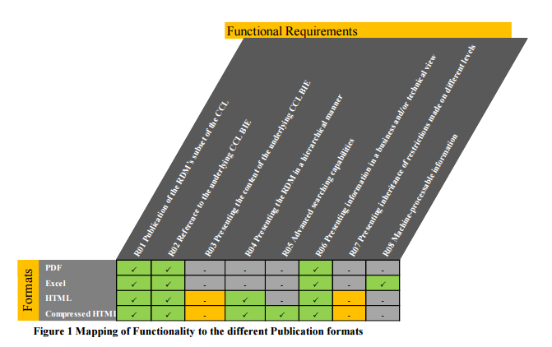
Projects Deliverables: Procedures Publication
Definition of the publication bundle
Mini Conference, Geneva, 27 March 2017

Slide 16
Project Status
ODP stage:
1. Supply Chain Reference Data Model Project (SCRDM)
ODP 5 Exit
2. Extension of Cross Industry Invoice technical artefacts
ODP 5 Exit
3. Extension of Cross Industry Cataloguing, Quotation,
Ordering, Delivering and Remittance Advice technical
artefacts
ODP 3 Draft
4. Multi Modal Transport (MMT)
ODP 3 Draft
5. Procedures for Reference Data Model & associated artefacts
publication
ODP 4 Review
Mini Conference, Geneva, 27 March 2017

Slide 17
Work for the coming months
Review Message Assemblies (RSMs) of Cataloguing, Quotation, Ordering, Delivering and Remittance Advice technical artefacts
Review updated BRSes of above mentiones processes
Preparing publication of updated BRSs, RSMs for public review of above mentioned processes
Process public review comments
Prepare publication of deliverables including XML schemas, all targeted for 17B.
Mini Conference, Geneva, 27 March 2017

Slide 18
Questions on
“The projects” ?
End section 1:
Mini Conference, Geneva, 27 March 2017

Slide 19
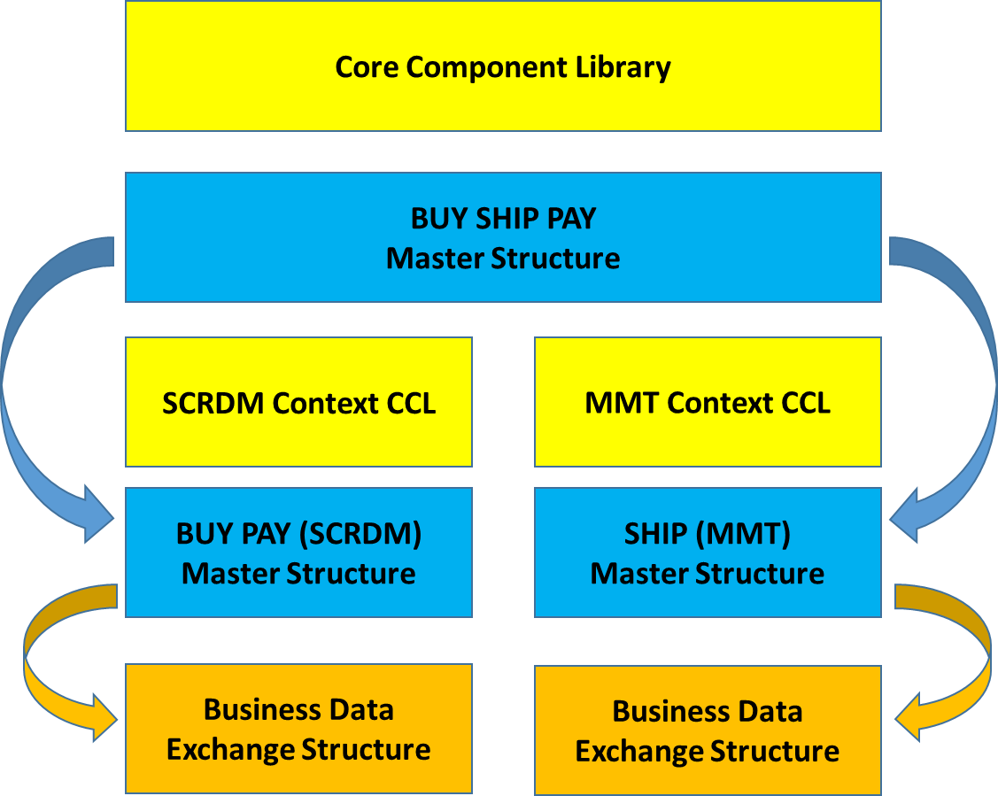
Section 2: The Concept
Reference Data Model
Mini Conference, Geneva, 27 March 2017

Slide 20
UN/CEFACT Reference Data Models
Reference Data Model (e.g. SCRDM)
  a subset of the UN/CEFACT Core Component Library
  a rich collection of business artefacts
  from which standard business documents can be created
The evolution:
  creation of standard business document subsets from ‘Master Structure’
  contextual message restrictions are applied to the subset artefacts, the Master Structure and/or the business document
Mini Conference, Geneva, 27 March 2017

Slide 21
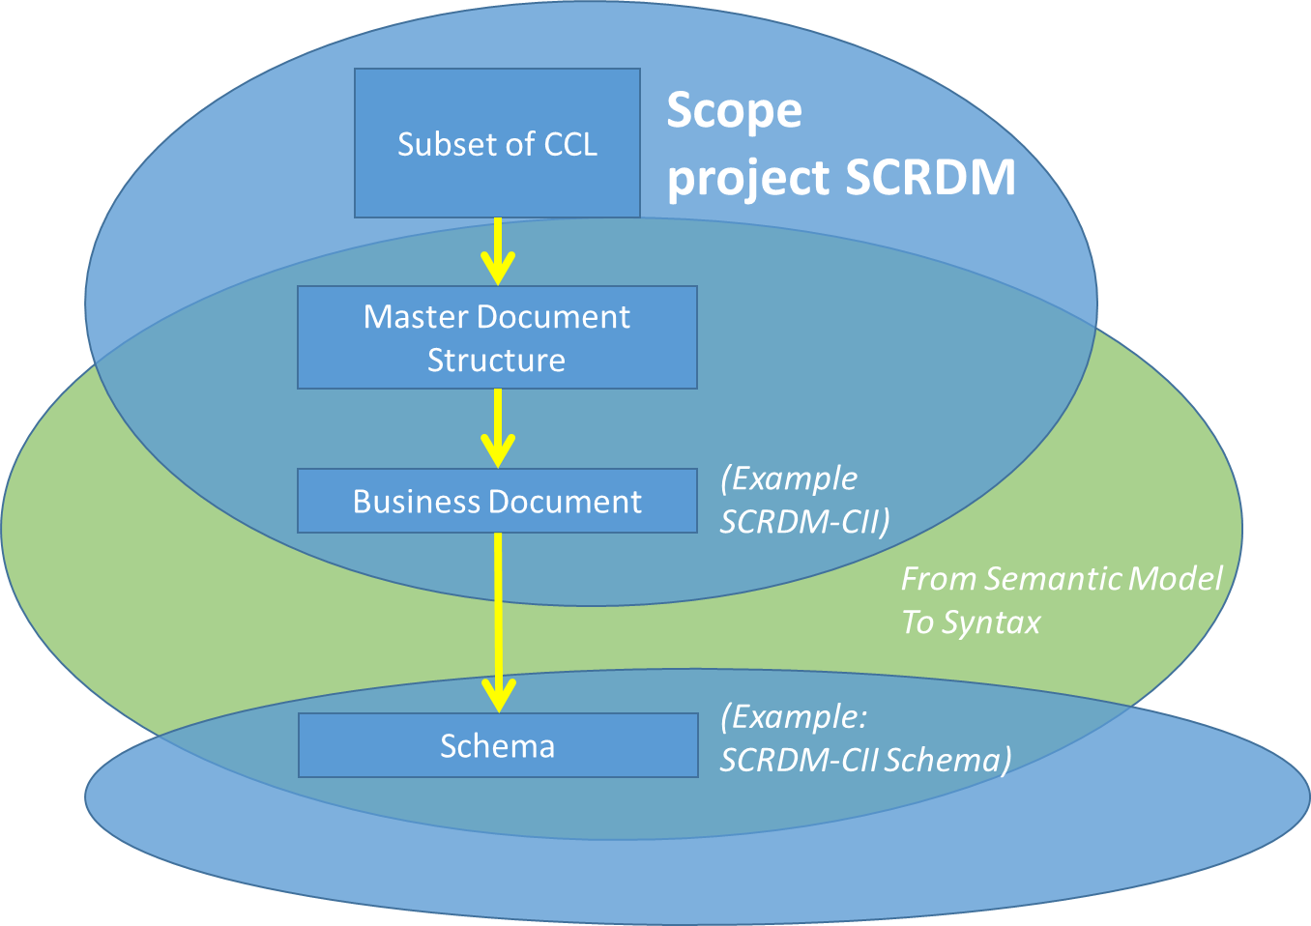
First delivery: Cross Industry Invoice
Mini Conference, Geneva, 27 March 2017

Slide 22
Benefits: for Decision Makers
The support of information sharing, e.g. enabled by data pipelines, with the timely capture of quality data from data sources ensuring supply chain visibility
The provision of global semantics covering all data requirements internationally accepted
Reduction of administrative burden by efficient reuse of data shared within the Buy Ship Pay model
Trusted semantic model, based on internationally accepted standardized & harmonized library
Enhanced interoperability of data with Buy Ship Pay domain
Standardized document structures, based on common ‘Master’ document structure
Integrated international code lists, using commonly used UNECE Recommended code lists, UN/EDIFACT code lists, ISO code lists..
Future proof semantic model, a syntax neutral semantic model
Mini Conference, Geneva, 27 March 2017

Slide 23
Benefits: for implementers of UN/CEFACT Reference Data Models
The use of a syntax neutral semantic model for defining business data exchanges
Enhanced interoperability of data across supply chain and transport & logistic business processes
Easy message specific restriction of artefacts, no need to create new artefacts (document specific ones).
Restrictions can be applied at process, master or message level
Simple creation of new data exchange structures from the “Master”
Available artefacts easy to find, by searching in context CCL
Newcomers easily guided to the available, appropriate artefacts (“the right spot”)
Mini Conference, Geneva, 27 March 2017

Slide 24
Benefits: Government and Private sector
Facilitation of government & private sector interfaces by supporting Data Pipeline & Single Window concepts
Reduction of administrative burden, efficient reuse of data
Trusted semantic model, based on internationally accepted standardized & harmonized library
Providing global cross-syntax Reference Data Models through the principles enshrined in:
  the United Nations Layout Key (UNLK),
  the United Nations Trade Data Element Directory (UNTDED)
  United Nations Electronic Data Interchange for Administration, Commerce and Transport (UN/EDIFACT);
Integrated international code lists, using commonly used UNECE Recommended code lists, UN/EDIFACT code lists, ISO code lists..
Mini Conference, Geneva, 27 March 2017

Slide 25
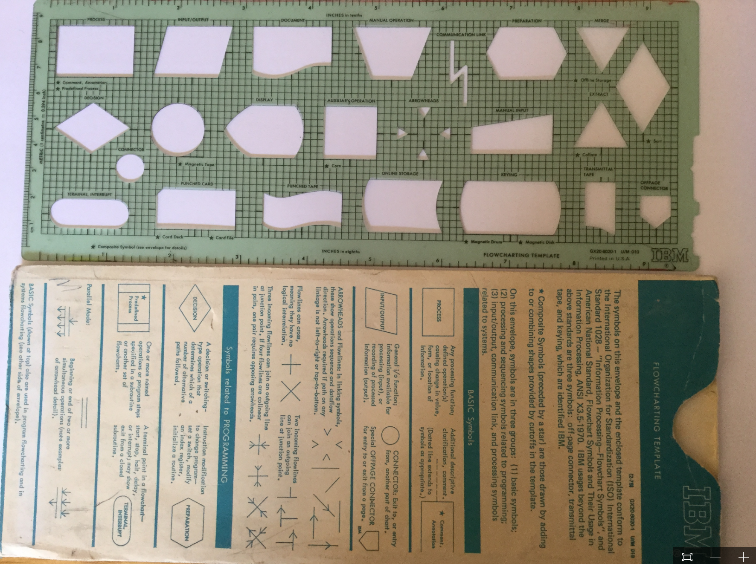
Understanding the process & the data
In the past we tended to ignore the connection between data exchanges and their underlying processes which resulted in the development of individual non-linked document structures…
Mini Conference, Geneva, 27 March 2017

Slide 26

Something had to change...
… we did not try to fix the 400 year old road infrastructure in our cities – we created super highways:
… similarly we have now developed Reference Data Models for defining document families to be exchanged along a process driven highway!
Mini Conference, Geneva, 27 March 2017

Slide 27
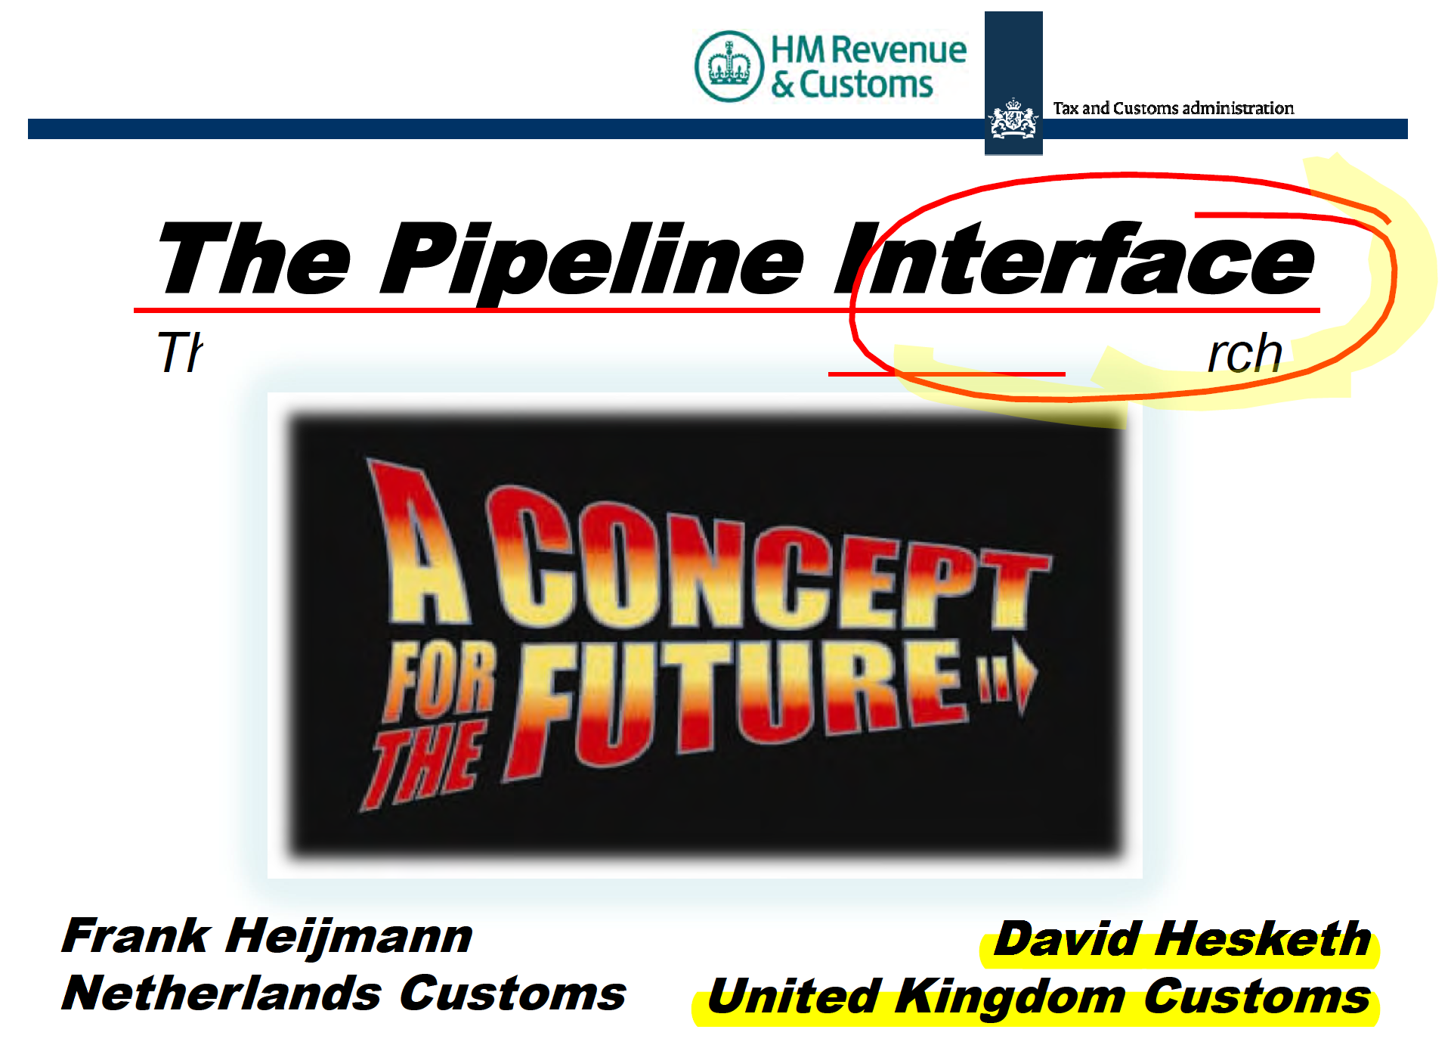
Reference Data Models & Data Pipelines fit together
Data Pipeline:
Information travels from origin to destination and can be accessed by appropriately authorised private and public sector parties to the specific trade transaction.
Mini Conference, Geneva, 27 March 2017

Slide 28
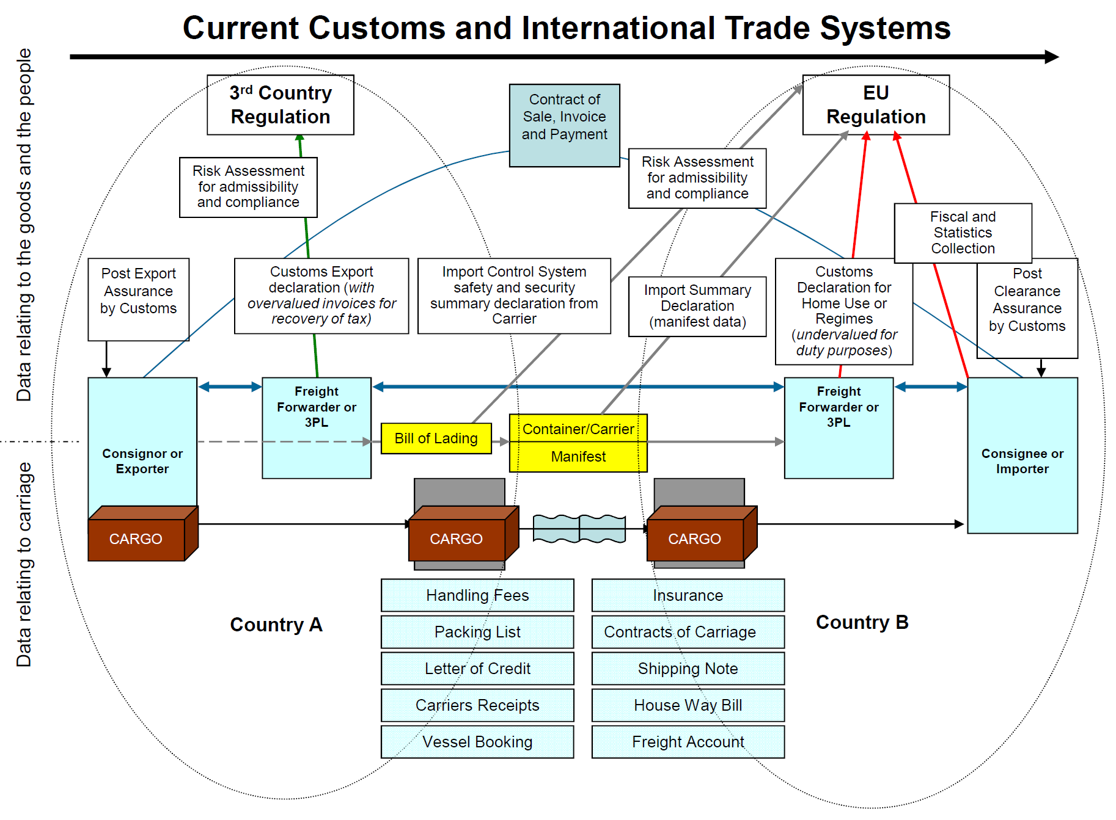
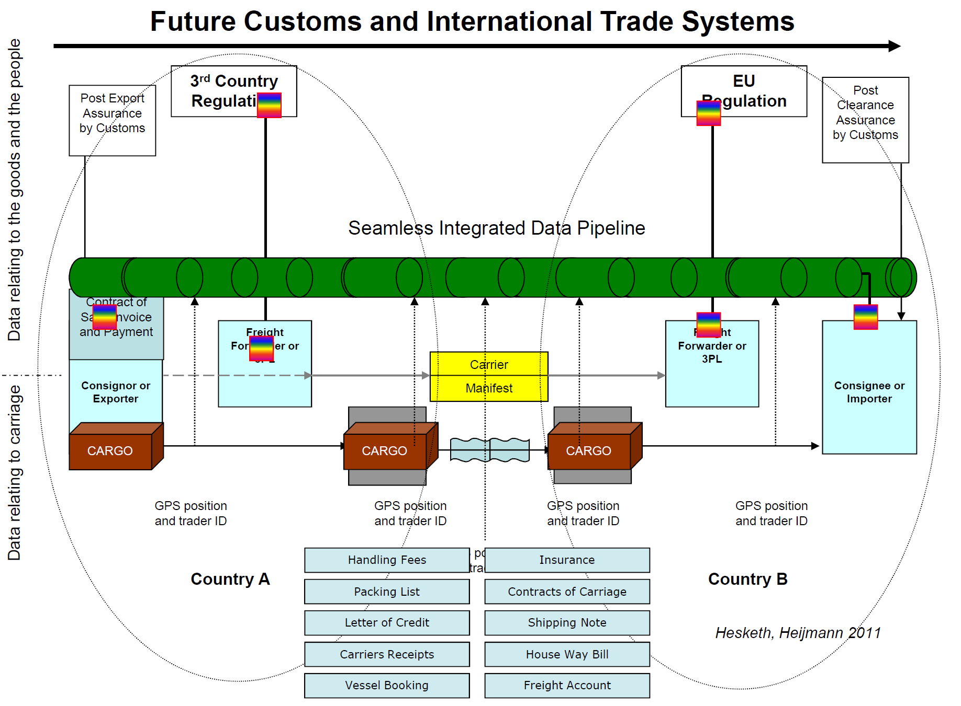
Integrated Data Pipelines
Mini Conference, Geneva, 27 March 2017

Slide 29
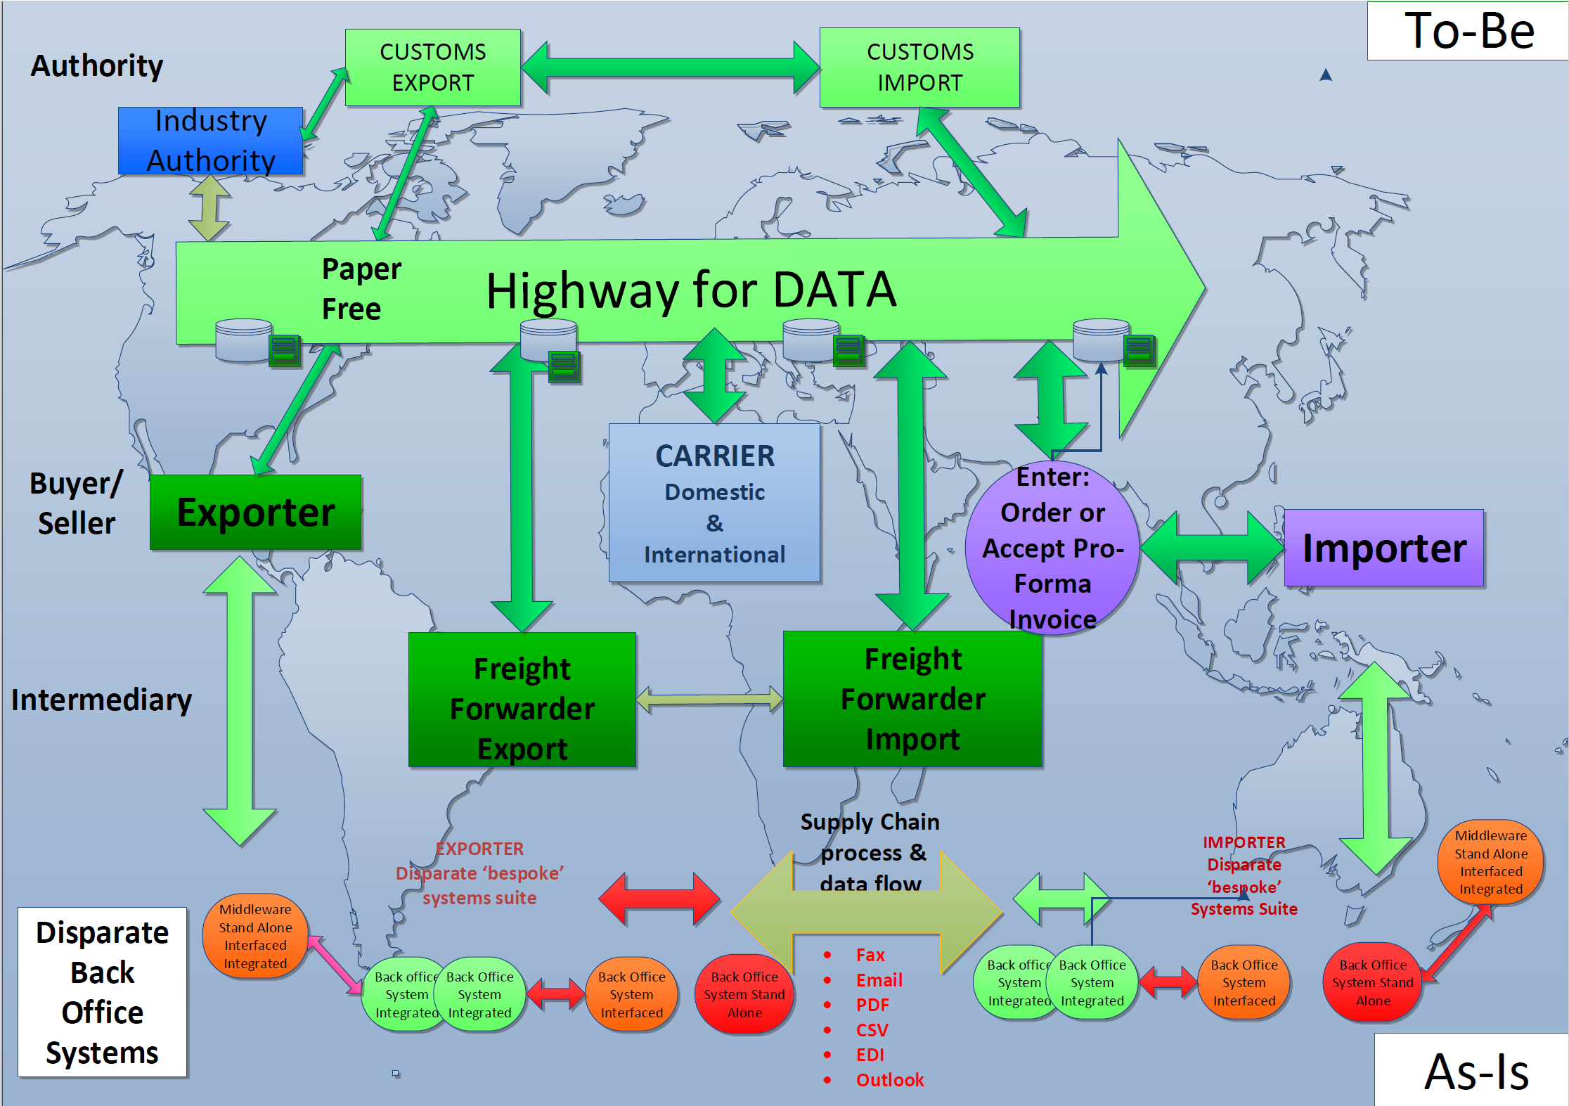
Moving from Document Driven to
Process Driven
Data – just what is needed
Web Services, Cloud
Complete documents
Paper &
many to many
e-connections
Mini Conference, Geneva, 27 March 2017

Slide 30
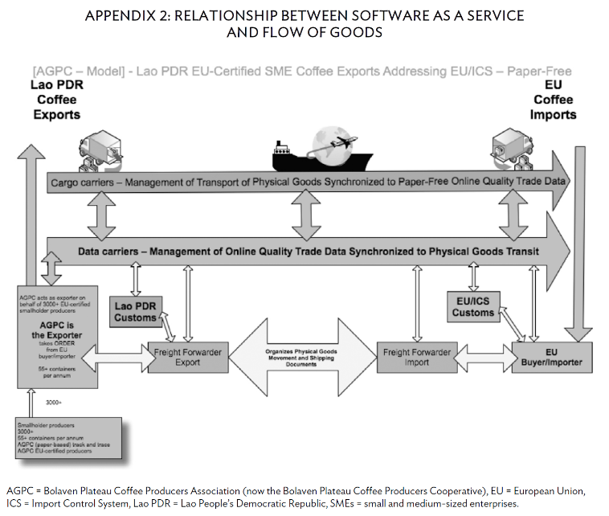
Example: Lao Coffee Project (2011)
Shipping Lao Coffee to the EU
Trial ‘paper-less’ transactions,
partly funded by the Asia Development Bank
Savings per shipment (1 or more containers)
- $200–$240*
*) incl. $80 removal document courier costs
Mini Conference, Geneva, 27 March 2017

Slide 31
Reference Data Models & Single Windows fit together
“in practice, it is more common to see several systems performing various regulatory processes sometimes behind a single trader view, other times not”
Single Window concept relies on globally harmonized data for supporting interoperability
Exchanges between national Single Windows rely on common structures, internationally harmonized data
Streamlined business processes are essential to reduce duplicated reporting of trade information
Web Services require documents structures that just send information needed (snippets of documents)
Centralized Server Models rely on incremental data, needed for a particular process at a particular moment
Mini Conference, Geneva, 27 March 2017

Slide 32
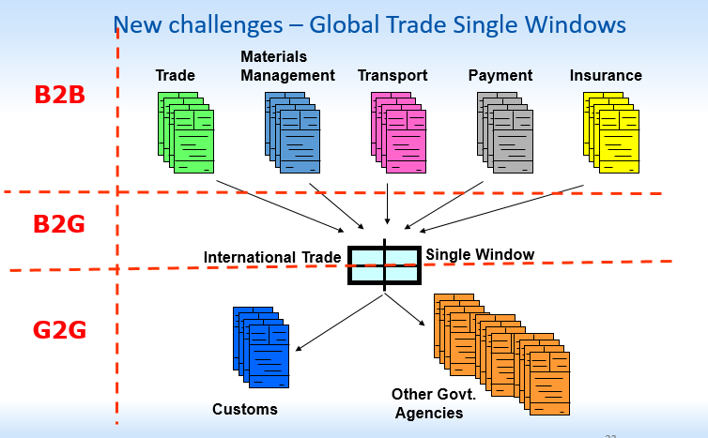
Facilitating regulatory functions by standardized document structures
Mini Conference, Geneva, 27 March 2017

Slide 33
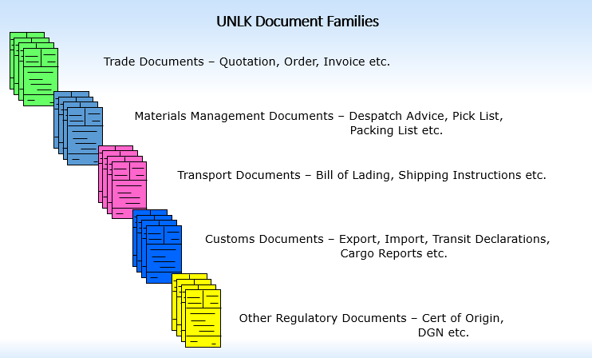
United Nations Layout Key Document Families
Mini Conference, Geneva, 27 March 2017

Slide 34
Questions on “the Concept”?
End section 2:
Mini Conference, Geneva, 27 March 2017

Slide 35
Section 3: High level focus
White Paper
High Level BRS
High level RSM
Mini Conference, Geneva, 27 March 2017

Slide 36
Available high level documents
High-Level White Paper on Reference Data Models
  Executive summary for the Reference Data Model
High level BRS (Business Requirements Specification)
  Processes in the Supply Chain domain
  Processes in the Transport, Finance, Government domain
  The actors and scenarios
High level RSM (Requirements Specification Mapping)
  Mapping of common party roles
  Mapping of common locations
  Mapping of common business entities
Mini Conference, Geneva, 27 March 2017

Slide 37
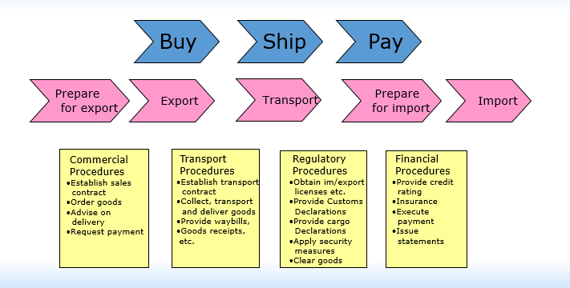
High level BRS (processes)
Mini Conference, Geneva, 27 March 2017

Slide 38
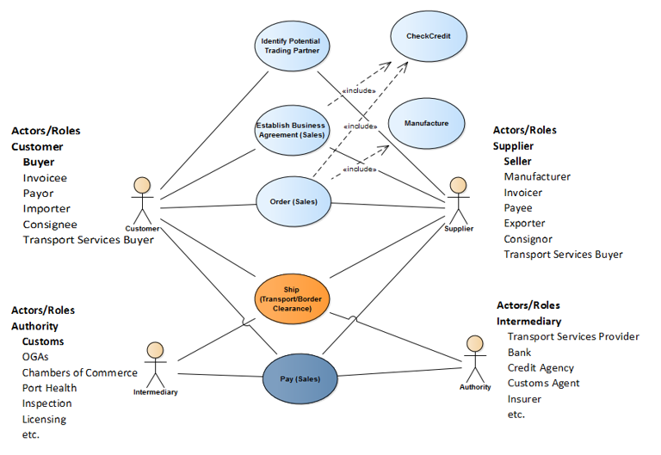
The actors
Mini Conference, Geneva, 27 March 2017

Slide 39
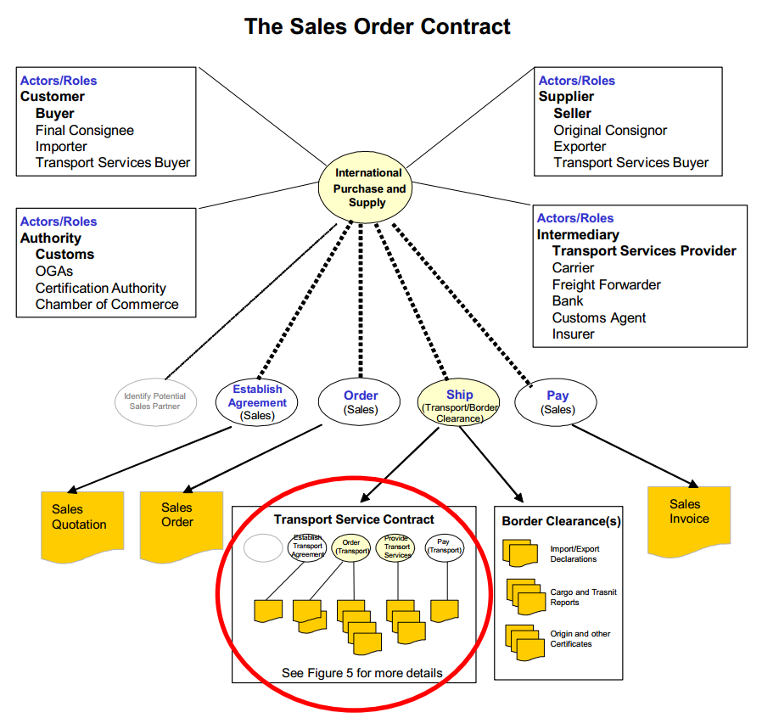
The Sales Contract
Mini Conference, Geneva, 27 March 2017
39

Slide 40
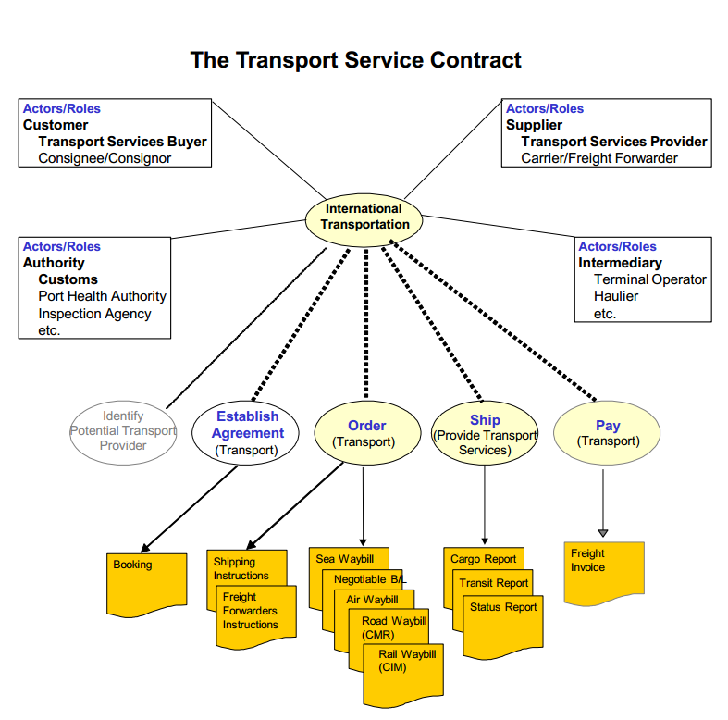
The Transport Contract
Mini Conference, Geneva, 27 March 2017
40

Slide 41
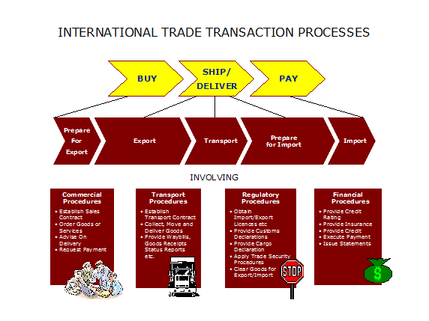
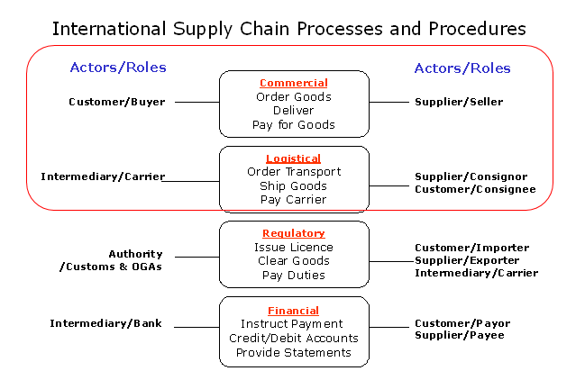
Commercial & Logistic processes
Relationship
Mini Conference, Geneva, 27 March 2017
41

Slide 42
High level RSM (data)
No Restrictions
Restrictions
Restrictions
Restrictions
Restrictions
Mini Conference, Geneva, 27 March 2017

Slide 43
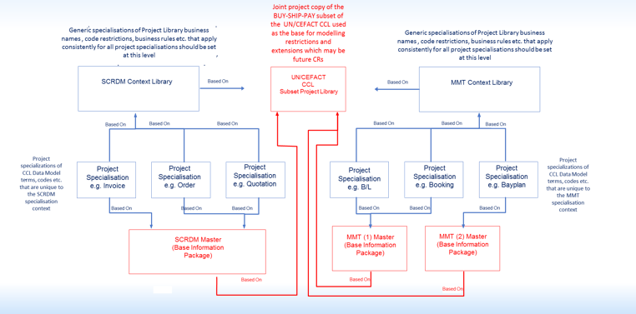
SCRDM and MMT subset of CCL
SCRDM
MMT
Mini Conference, Geneva, 27 March 2017
43

Slide 44
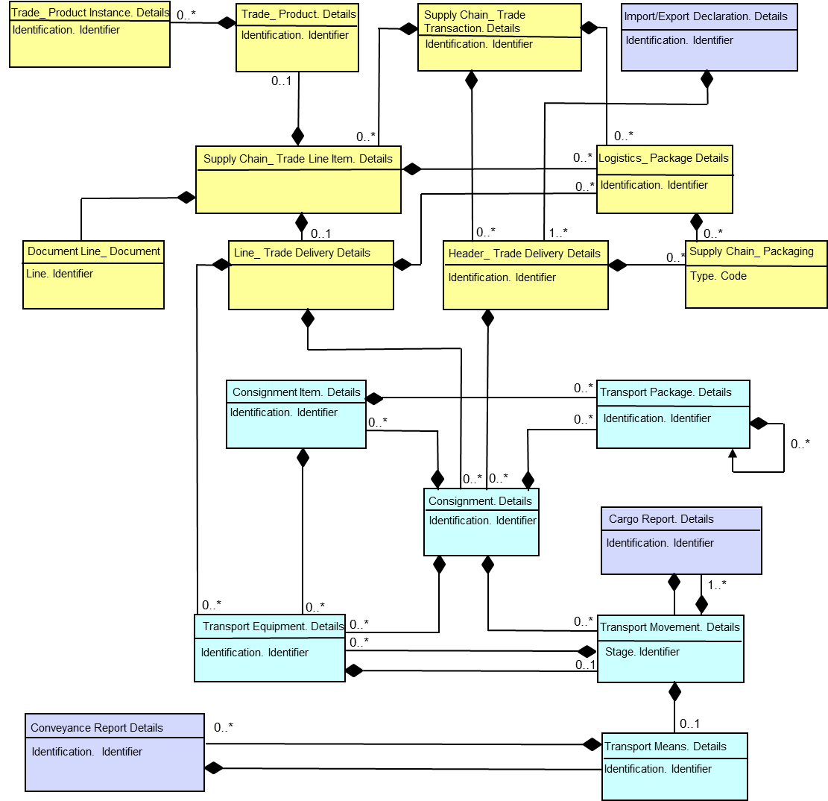
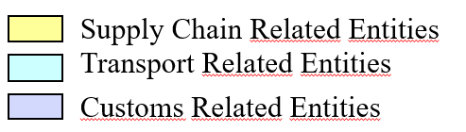
Sharing Busines artefacts e.g. consigment
Only
Mini Conference, Geneva, 27 March 2017

Slide 45
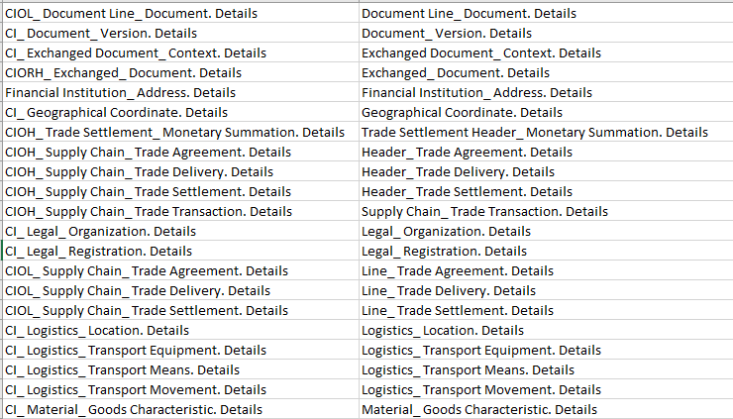
Process driven:
Artefact made re-usable for all processes
Rationalized
Mini Conference, Geneva, 27 March 2017

Slide 46
Process Driven
Artefeact
Trade Agreement
Processes
CCBDA
Catalogue
Quotation
Ordering
Deliver
Invoice
Remittance
Scheduling

Slide 47
Rationalization results...
40% less business information artefacts needed
Realized by just adding 17 new artefacts (ABIEs) to the Library (1%)
1400 artefacts to cover Supply Chain (out of 11,500)
Easily maintainable
Easier to implement
Mini Conference, Geneva, 27 March 2017

Slide 48
Questions on
High level focus on Reference Data Models?
End of section 3:
Mini Conference, Geneva, 27 March 2017

Slide 49
Section 4
Reference Data Models (details)
Messages
Structure
Context CCL
Mini Conference, Geneva, 27 March 2017

Slide 50
Structure – Publication - Use
How a Reference Data Model is structured
How it is published
How to use it (guideline)
Mini Conference, Geneva, 27 March 2017

Slide 51
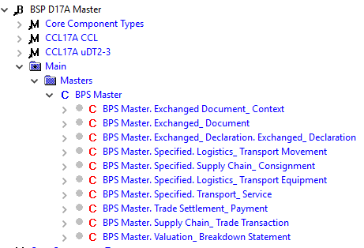
Belonging to the same model
‘Buy Ship Pay Master’
BPS Buy Pay Ship
Structure
CCL
Mini Conference, Geneva, 27 March 2017

Slide 52
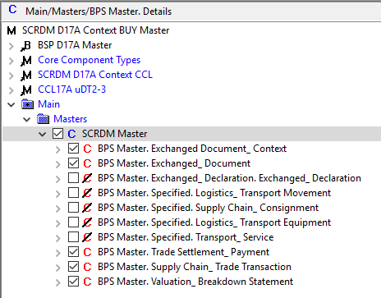
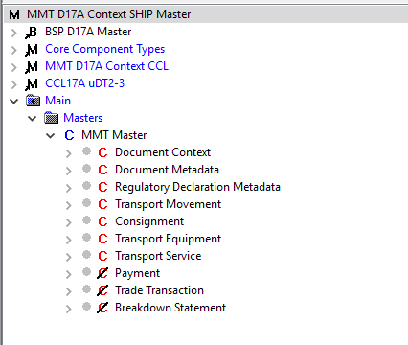
Having their own RDM masters
SCRDM Structure
MMT RDM Structure
SCRDM Context
CCL
MMT RDM Context
CCL
Mini Conference, Geneva, 27 March 2017

Slide 53
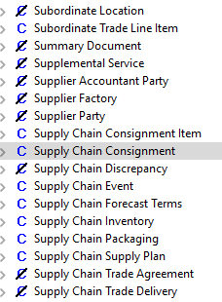
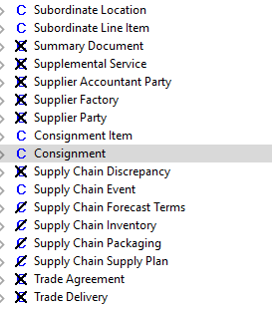


Having their own contextual CCL
X
X
Mini Conference, Geneva, 27 March 2017

Slide 54
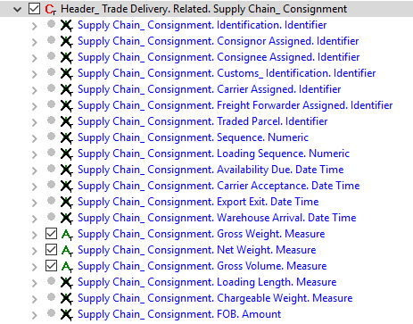
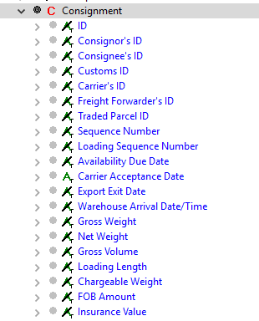
On message level futher restricted
Mini Conference, Geneva, 27 March 2017

Slide 55




Publication formats of RDMs
Business Artefacts
Formats
Mini Conference, Geneva, 27 March 2017
55

Slide 56
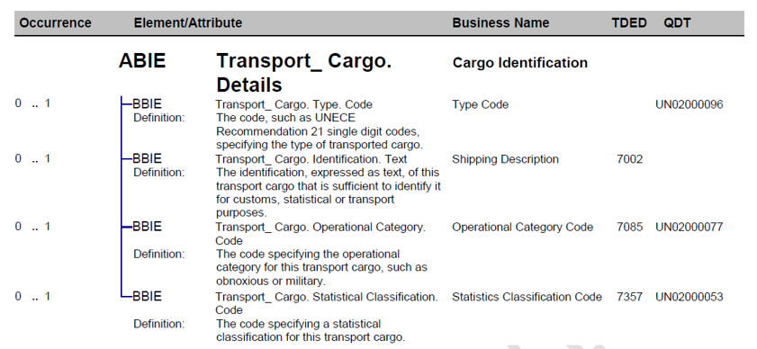
Supply Chain artefacts in PDF
Semantic Links
Mini Conference, Geneva, 27 March 2017
56

Slide 57
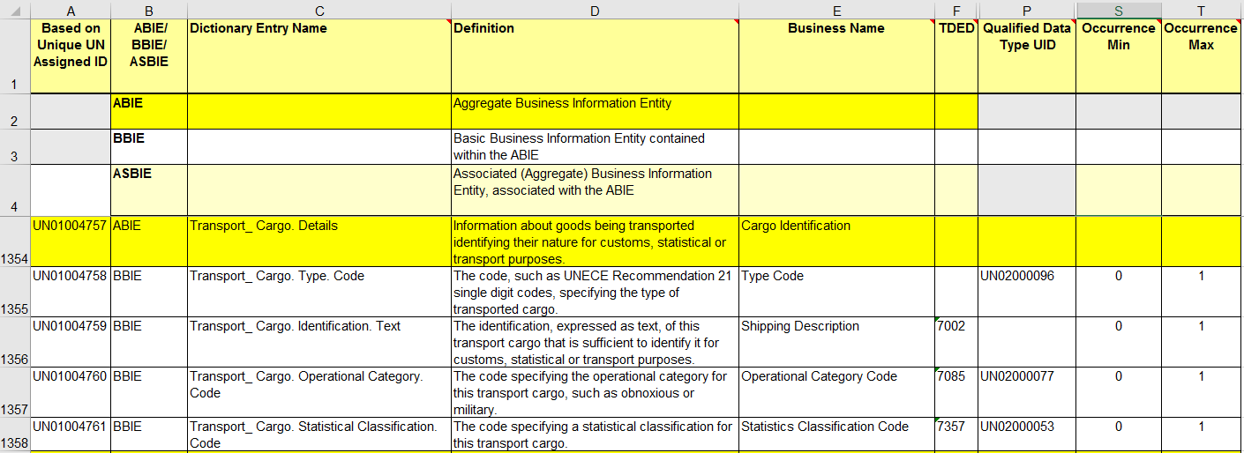
Supply Chain artefacts in Excel
Semantic Links
Mini Conference, Geneva, 27 March 2017

Slide 58
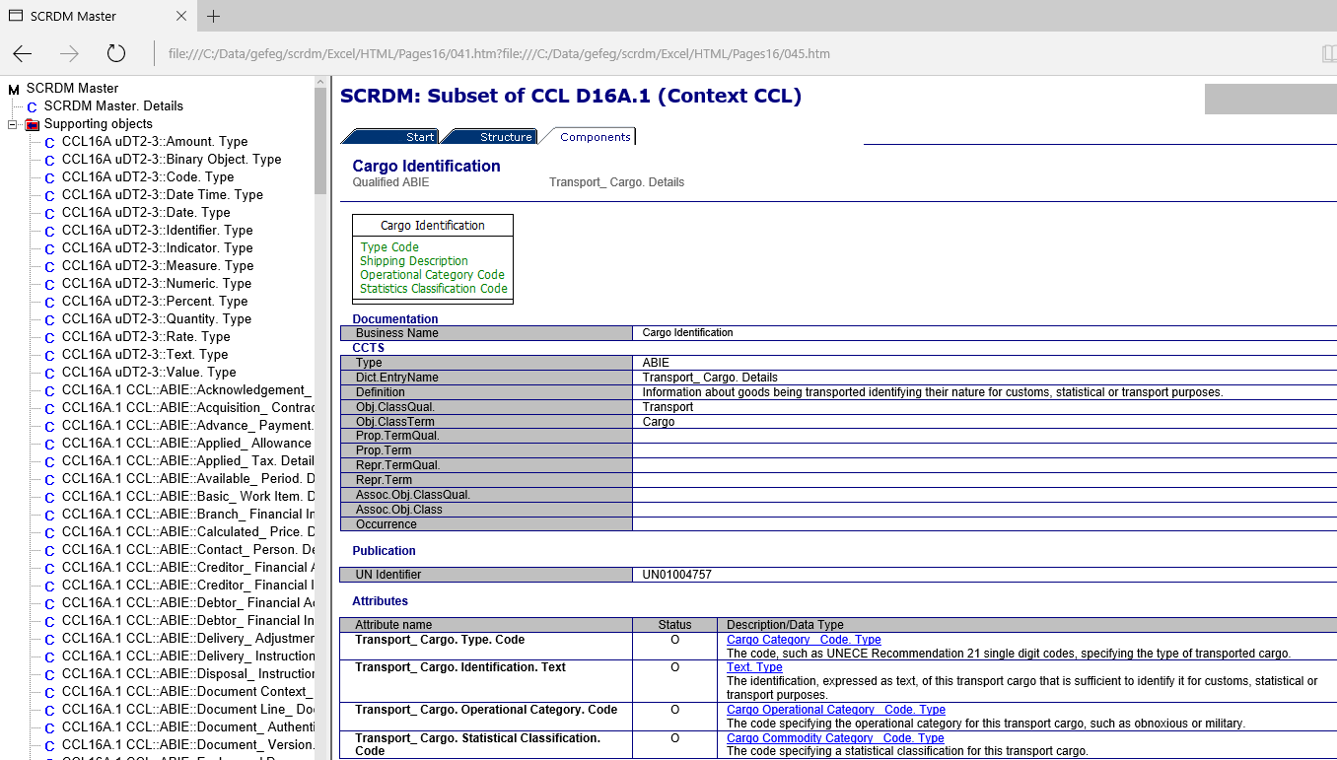
Supply Chain artefacts in HTML
Mini Conference, Geneva, 27 March 2017

Slide 59
Supply Chain artefacts in HTML
Mini Conference, Geneva, 27 March 2017

Slide 60
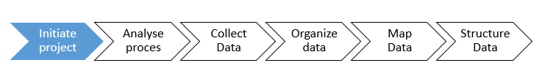
Guideline Reference Data Model
Steps for using
Steps for updating
Steps for creating
Mini Conference, Geneva, 27 March 2017

Slide 61
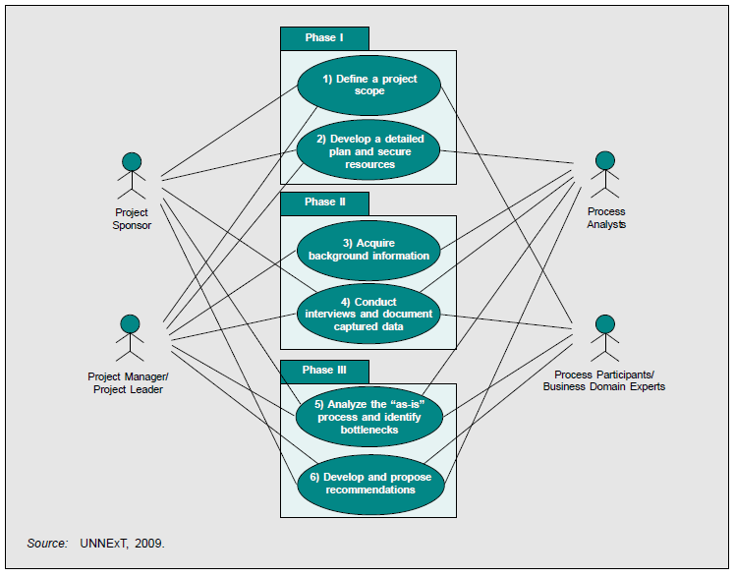
Business Process Analysis
Mini Conference, Geneva, 27 March 2017

Slide 62
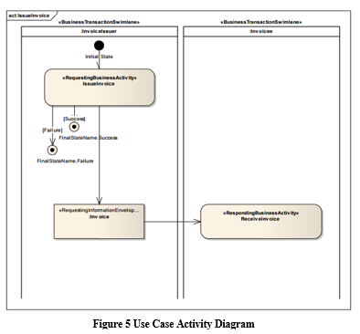
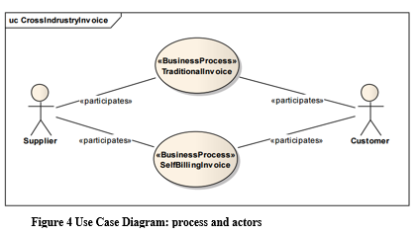
Methodology used: UMM/UML
Mini Conference, Geneva, 27 March 2017

Slide 63
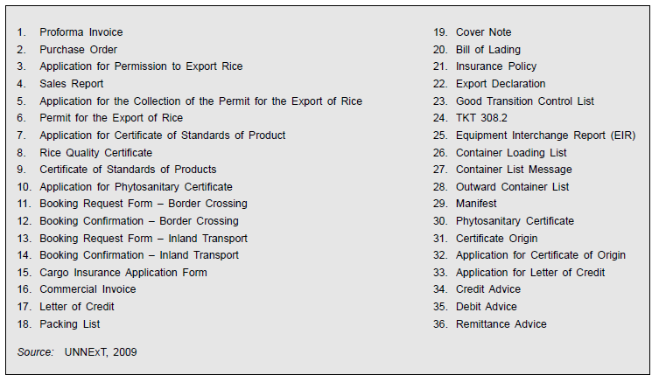
List of documents / data requirements
Mini Conference, Geneva, 27 March 2017

Slide 64
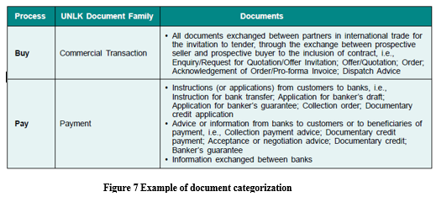
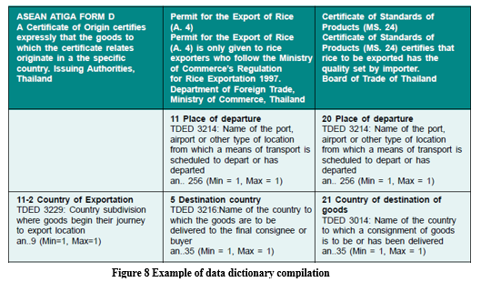
Categorize & compile data
Mini Conference, Geneva, 27 March 2017

Slide 65
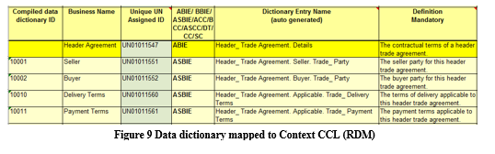
Mapping of requirements
Mini Conference, Geneva, 27 March 2017
65

Slide 66
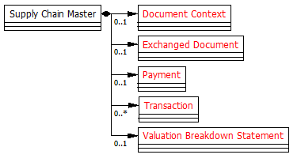
Analyse needed structure
Mini Conference, Geneva, 27 March 2017

Slide 67
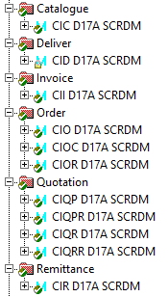
Built the messages
Mini Conference, Geneva, 27 March 2017

Slide 68
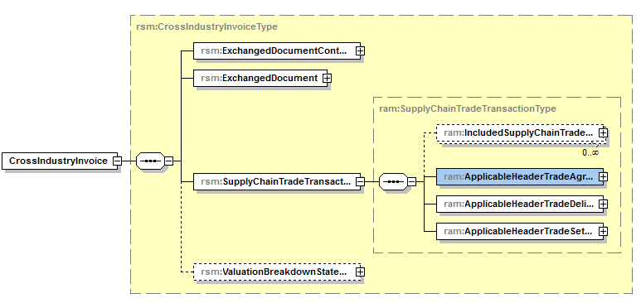
Produce the syntax
Mini Conference, Geneva, 27 March 2017

Slide 69
Questions on
Reference Data Models details?
End of section 4:
Mini Conference, Geneva, 27 March 2017

Slide 70
Section 5:
Maintenance of Reference Data Models
Maintenance
Structure
Context CCL
Mini Conference, Geneva, 27 March 2017

Slide 71
Parts subject to maintenance
Buy Ship Pay Master Structure
Buy Pay and Ship Structure
Buy Pay (SCRDM) and Ship (MMT) Context CCL
Message Assembly
Mini Conference, Geneva, 27 March 2017

Slide 72
Maintaining Structures
Changes in BSP structure
  May effect messages created for both domains
Changes in either BP or S structure
  May effect messages created by respective domain
  << changes on structure will be rare>>
Mini Conference, Geneva, 27 March 2017

Slide 73
Maintaining Context CCLs
Changes in Buy Pay (SCRDM) Context CCL
  May effect messages of the supply chain domain
Changes in Ship (MMT) Context CCL
  May effect messages of the Transport & Logistics domain
Mini Conference, Geneva, 27 March 2017

Slide 74
Maintaining Messages
Changes in message level:
  Will effect derived XML schemas
Mini Conference, Geneva, 27 March 2017

Slide 75
Business Requirements may invoke
  a change in the message structure
  a change on context CCL level
  a change on message level
  a change (submission) for the CCL
Mini Conference, Geneva, 27 March 2017

Slide 76
How to organize maintenance
Maintaining Reference Data Models means:
  Collaboration between Buy Pay and Ship domain
  Validating
    Need for new artefacts? (CCL submission)
    Need for changes in context? (Context CCL)
  Coordination
  Procedures
Mini Conference, Geneva, 27 March 2017

Slide 77
Present procedures: ODP
UN/CEFACT produces initial versions of publications by executing a process called “The Open Development Process” (ODP).
Open Development Process Steps
ODP1: Project Proposal and Team Formation;
ODP2: Requirements Gathering;
ODP3: Internal Draft Development;
ODP4: Internal Review;
ODP5: Public Review;
ODP6: Implementation Verification;
ODP7: Publication;
ODP8: Maintenance.

Slide 78
Publication Procedures
Reference Data Models
Library Maintenance Focal Point:
  Now responsible for updates in EDIFACT and CCL primairily
  Should maintenance of RDMs be the responsibility of Library Maintenance Focal Point?
  To be discussed this forum.

Slide 79
Questions on
Maintenance of Reference Data Models?
End of section 4:
Mini Conference, Geneva, 27 March 2017

Slide 80
Thank you for your attention!
For further information on:
Supply Chain Management Reference Data Model (SCRDM)
- Project Leader : Rolf Wessel
: email: r.wessel@seeburger.de
- Lead Editor : Gerhard Heemskerk
email: gerhard.heemskerk@kpnmail.nl
Multimodal Transport Data Reference Model (MMT RDM)
- Lead Editor : Sue Probert
email : sue.probert@dial.pipex.com
Mini Conference, Geneva, 27 March 2017

Slide 81
End of presentation
Mini Conference, Geneva, 27 March 2017

