Slide 1
UN/CEFACT Standards for
Air Cargo Transportation
Air Cargo Digitalization in COVID-19 Times:
Multimodal Interoperability
Domain Experts Meeting
17 June 2021
Steve Hill
UN/CEFACT Expert

Slide 2
Agenda
Welcome Experts! Introductions - All
Covid-19 Project Outline – Steve
UN/CEFACT Experts – Lance
COVID19-Phase 3 project briefing – Steve
Approach – Steve
Drilling into Data (detail) – Steve
Conclusion - All

Slide 3

  UN New York launched COVID-19 initiative encouraging exchange of digitised electronic data rather than paper documents in transport contract data exchanges
  United Nations Economic Commission for Europe (UNECE) &
  United Nations Centre for Trade Facilitation and Electronic Business (UN/CEFACT) joint contribution in two parts:
  International Forwarding and Transport (IFT) project – now completed and closed
  Modal Transport reusing the UN/CEFACT Multi-Modal Transport Reference Data Model (MMT RDM) to support digitised data exchanges between transport modes
  Supported by Heads of Delegation: Congo, Finland, Germany, Italy, Russian Federation, Spain, Turkey, Ukraine, United States of America and Vietnam
  For more: Home | UNTTC
Copyright UNECE

Slide 4

Team Air
Mario Apostolov: UNECE Project Officer/Regional Support
Lance Thompson: UNECE, Head UN/CEFACT Support Unit
Michael Dill: UN/CEFACT Project Lead
Sue Probert: UN/CEFACT Lead/Editor MMT RDM/CCL
Steve Hill: Air Domain Phase 3 Lead
Cortney Robinson: ICAO Air Transport Officer (Air Cargo)
and…
You: Domain Experts

Slide 5




Modal Specific MMT-based Customisations
Maritime
Road
Inland Waterway
Rail
Air (currently in flight!)
Copyright UNECE
Notes:
Explain that Maritime, road, rail, inland waterway are done – next is Air

Slide 6

Air
Project outline
Documents/dataset mappings to MMT RDM:
Air Waybill (AWB)
Consignment Security Declaration (CSD)
Dangerous Goods Declaration (DGD)
1. Standards:
Follows UN/CEFACT MMT RDM
Business Requirements Specifications (BRS)
Core Component Library (CCL) Structure
Dataset alignment with other ‘document’ objects
XLS guideline structure
XSD schema
UML diagrams
HTML index
JSON-LD schema
Plan:
Two phases
Develop the standards – July 2021
Pilot implementations – September 2021
Now:
Project team/experts
Data mapping & modelling
Models for review & refinement
2. Pilots:
In collaboration with ICAO
Identify/outreach to candidate countries/areas
Engage . Educate . Assist – with deployments
Copyright UNECE
Notes:
To complete the interoperability across all major modes of transport is Air
Three document or datasets are within the scope for this Phase 3 of the project comprising:
1. Air Waybill
2. Consignment Security Declaration
3. Dangerous Goods Declaration
The plan is to management the project in two parts
To develop the standards expected by mid July 2021
Run pilot implementations to use the standards we have developed
The project is to be split into two parts aligned with the previous modes of transport
Defining the framework of standards which follow the UN/CEFACT Multi-Modal Transport Reference Data Model, comprising:
the business domain specifications
Gudieline structures
UML model
Schema for XML and JSON
Piloting of the scheme will comprise candidate countries where we can apply the interoperable model between different
In this respect we highly appreciate our collaboration with ICAO to identify and reach out to countries and regions for piloting opportunities
Right now we are in the planning stage and looking to assemble a team of experts in their various fields
We encourage anyone who is interested in joining the landmark project to let us know.

Slide 7
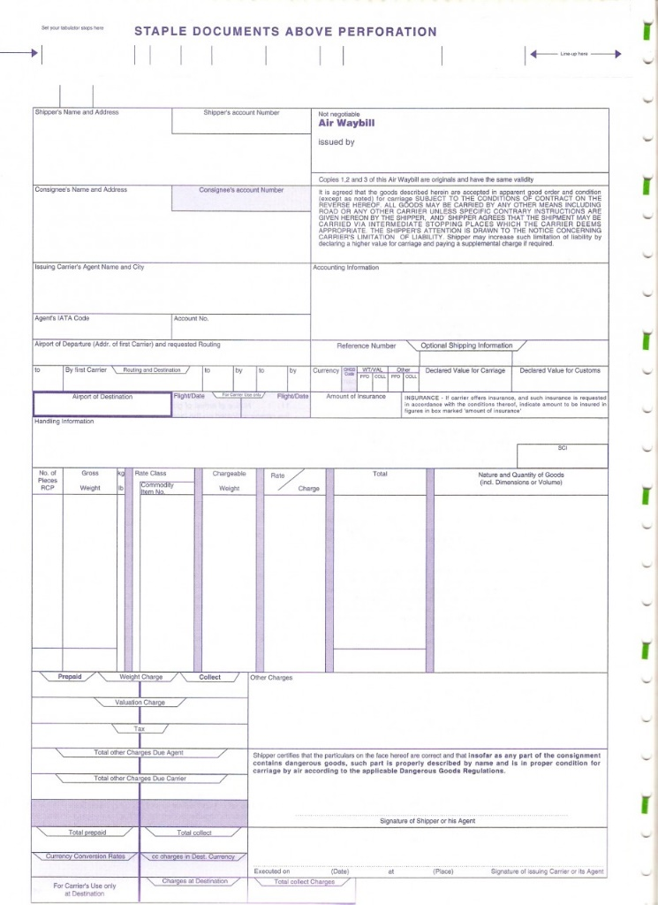
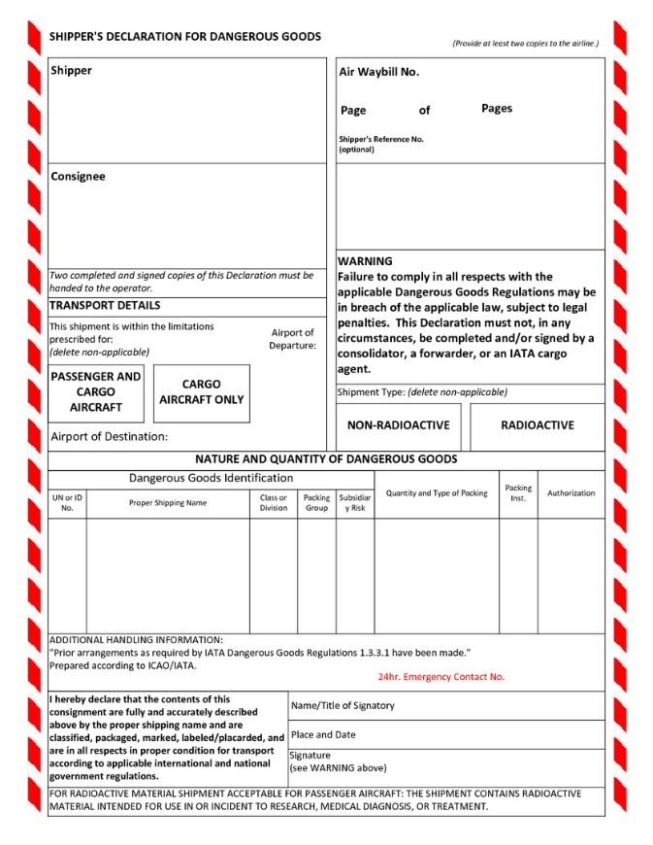
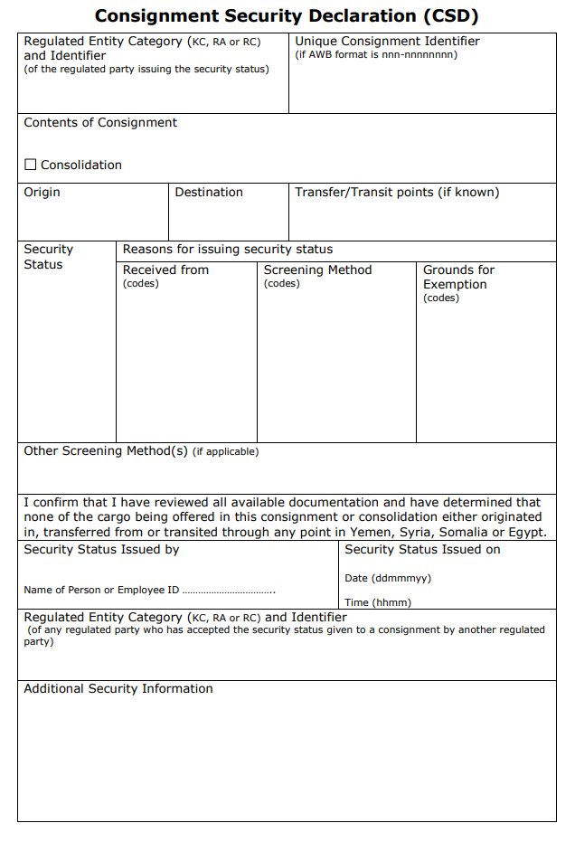
Air
Core Mappings
AWB
DGD
CSD
Common Data Elements
Copyright UNECE
Notes:
The scope of the air freight mappings comprises:
Air Waybill
Dangerous Goods Declaration
Consignment Security Declaration
While separate in the our right, there is some commonly shared data elements with the AWB, and electronically the eCSD comprises data which is captured and exchanged via the eAWB.

Slide 8
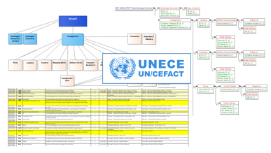
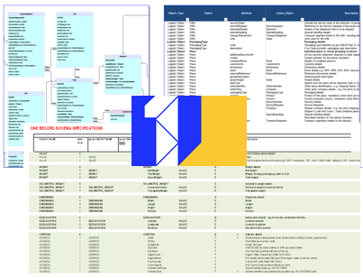
Air
Air Waybill Standards
Multiple IATA standards apply to Airfreight for
B2B & some B2G:
Cargo-IMP: legacy, bespoke EDI
Cargo-XML: current, UN/CEFACT aligned
ONE Record: piloting, JSON-LD backwardly compatible
UN/CEFACT Model
All modes of transport
MMT Bill of Lading (BoL) core
Air Waybill (AWB) baseline
Extends to House Waybill
Enhanced data model e.g. piece/item level
Copyright UNECE

Slide 9
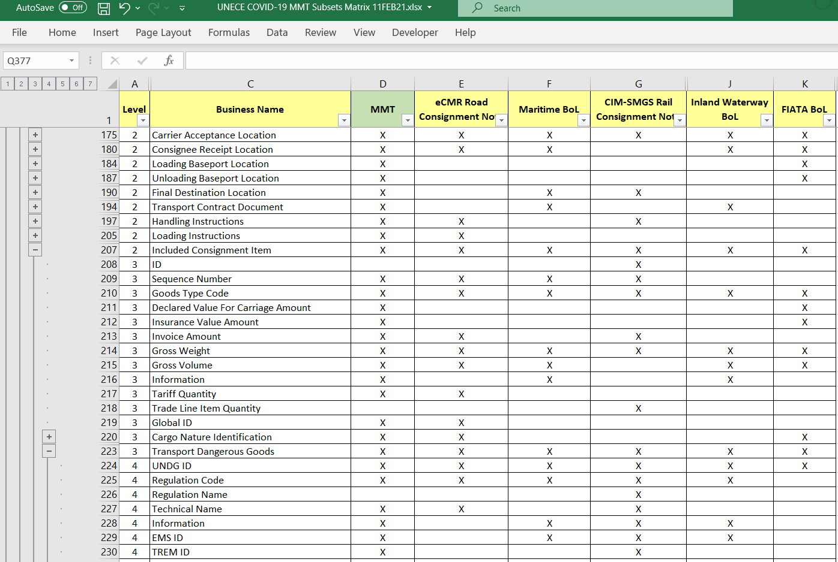
Results – March 2021
Air
AWB
CSD
DGD
X
X
X
X
X
X
X
X
X
X
X
X
X
X
X
X
X
X
X
X
X
X
X
X
X
X
Copyright UNECE
Notes:
From the completed phases of the project so far we already have a common matrix of data elements aligned with each transport document in scope comprising:
Road e-CMR
Maritime Bill of Lading
Rail Consignment Note
Inland Waterway Bill of Lading
FIATA Bill of Lading
And to complete the interoperability matrix will be the Air Waybill
And the other DGD/CSD as well to be evaluated

Slide 10
Clarifications!
Interoperability between modes of transport
Not replacing existing standards
Operational not commercial data meaning:
no rates/pricing/charges included

Slide 11
UN/CEFACT Experts
Overview from Lance Thompson
Domains
Role of Experts
Projects/Programme Participation
Further information:
https://unece.org/sites/default/files/2021-04/01-NewComer%27sSession.pdf
Contact:
lance.thompson@un.org

Slide 12
COVID19-Phase 3 Air
Looking at the detail
Two sets of artefacts distributed prior to meeting
  Matrix of modes with business objects / elements
  UML Data Model under construction
Key support data modelling using GEFEG.FX
UN/CEFACT Multi-Modal Reference Data Model (MMT RDM)
Core Component Library (CCL) objects
Sue can explain a little more

Slide 13
Approach [1]
Project in two major stages
Standards definition [planned July 2021]
  Producing artefacts
  Reference: https://unece.org/trade/uncefact/mainstandards
Pilot implementations [planned Sep 2021]
  ICAO assisting
  Prove the concept
  Contributions welcome

Slide 14
Approach [2]
Data model under construction [Sue & Steve]
AWB & DGD
  1st as ‘core’ – AWB comprises DG/CS data
  Reusable objects/elements from MMT RDM
CSD
  2nd as new to MMT
  Some challenge as not interoperable (yet) with other modes of transport

Slide 15
Approach [3]
Expert Focus Sessions
Review model & refine in each session for:
  AWB (HWB)
  DGD – links with other UN Transport DG Projects
  CSD – additional collateral / artefacts
Final confirmations as complete – for Air
Produce Artefacts
for sharing
Core Component Library (CCL) Structure
Modal Matrix - dataset alignment
XLS guideline structure
XSD schema
UML diagrams
HTML index
JSON-LD schema [may be developed]
GEFEG.FX

Slide 16
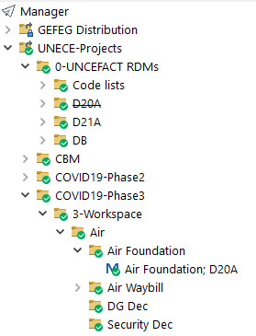
Air Project Structure
MMT RDM
D21A
COVID19-Phase 3
Air Foundation
1a
1b
2
Air Waybill
[AWB]
Dangerous Goods Declaration
[DGD]
Consignment Security Declaration [CSD]
Air Modelling Environment [AME]

Slide 17
Drilling into Data!
GEFEG.FX
Modal Matrix – WiP/Cross Check version

Slide 18
Conclusion
Q&A . AOB . DONM?

Slide 19
Рақмет сізге
Rhamat
Ďakujem
Mulțumesc
Hvala
ありがとうございました
Merci
Ta ck
Ευχαριστώ
Obrigado
Ačiū
Çox sağ ol
Dziękuję Ci
Dankon
Sagbol
მადლობთ
Баярлалаа
धन्यवाद
Хвала вам
Hatur nuhun
شكرا جزيلا
Спасибо
Diolch
감사합니다
Faleminderit
Thank you!
Paldies
Grazzi
ඔබට ස්තුතියි
Благодаря ти
Faafetai
Ačiū
Danke
Rahmat
Grazie
Շնորհակալություն
Takk skal du ha
Aitäh
谢谢
សូមអរគុណ
Köszönöm
Дзякуй
Gracias
Ви благодарам
Děkuji
Gràcies
Asante
תודה
Salamat
Tak skal du have
Рахмат сага
ধন্যবাদ
Go raibh maith agat
Mahalo
Kiitos
Teşekkür ederim
Dank je
Dankon
Þakka þér fyrir
Dankie

