Slide 1


Introduction to the project
REVISED
CROSS INDUSTRY DELIVERY
Project Lead
Project Lead Editor

Slide 2
PROJECT PURPOSE & Scope
PROJECT PURPOSE
- Receive Process – adding Cross Industry Receiving Advice
PROJECT SCOPE
- to exchange information concerning despatching & receiving of goods
missing part in UN/CEFACT
Cross Industry Supply Chain

Slide 3
PROJECT DELIVERABLES
1 - Revised Business Requirements Specification (BRS)
2 – CCBDA (SCRDM based) message for the despatch & receive process
3 - CCs & Reference BIEs needed, to be included in the CCL
4 - XML Schemas for the CCBDA message structures
SCRDM = Supply Chain Reference Data Model
CCBDA = core component business document assembly
CC = core components
BIE = business information entity
CCL = Core Component Library

Slide 4
EXIT CRITERIA
1 - Completed revised BRS Public review and logs
2 - Completed CCBDA message structures
3 - CCs & BIEs integrated into the CCL
4 - Completed XML Schemas
CCBDA = core component business document assembly
CC = core components
BIE = business information entities
CCL = Core Component Library

Slide 5
Initial Contributions
Process
• BRS Cross Industry Despatch and Receive Process 1.00.13, issued February 2009.
Data
• Harmonized BIEs of UN/CEFACT CCL.
• Published SCRDM, based on the latest CCL.
• Procedures for RDM & Associated Artefacts Publication, draft v1.0.0.9.
Structures
• RSM Cross Industry Delivery Process v2.00.00, issued September 2010.
• RSM CCBDA Cross Industry Delivery Process v3.0, issued June 2017.
• RSM Boost Aero Industries BAI v2.10 b CI Receipt Advice UN/CEFACT CCL09B
Schema
• Published document-centric Despatch XML schemas, based on the latest CCL.
RSM = Requirement Specification Mapping
RDM = Reference Data Model

Slide 6
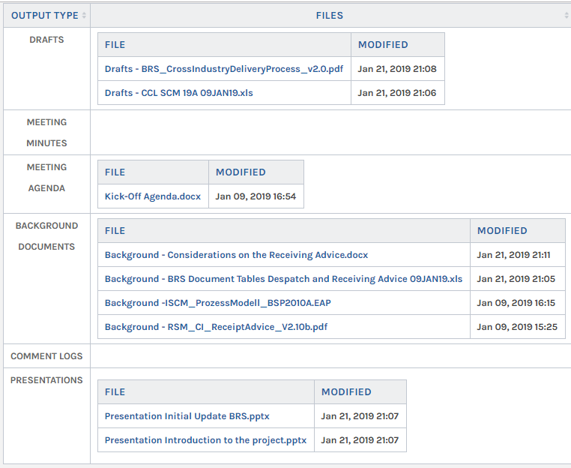
Preparations – initial update BRS Delivery Process

